Slide 1
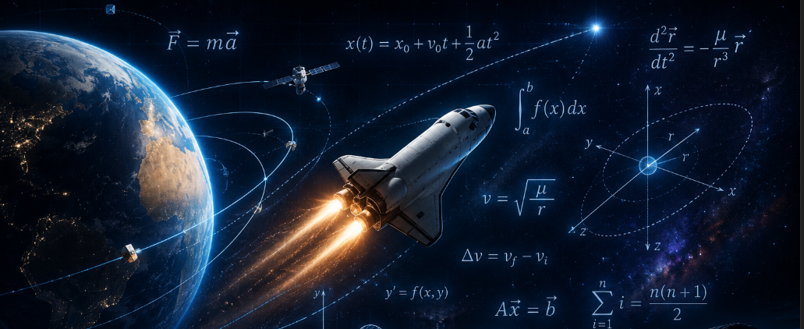
MATHEMATICS IN SPACE EXPLORATION
. Mathematics is the foundation of space exploration, as it enables the prediction of orbital motion, ensures precise trajectory and timing in missions, and powers the navigation and computational systems required to operate spacecraft effectively.

Slide 2
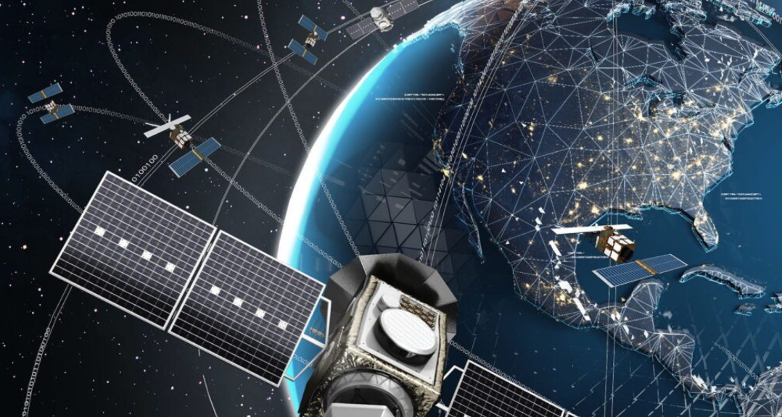
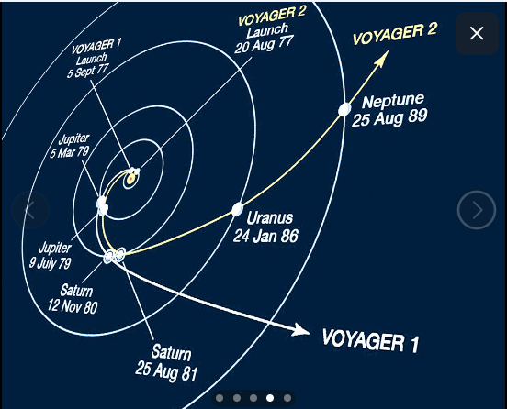
ORBITAL MECHANICS
Calculus
Algebra
Geometry

Slide 3
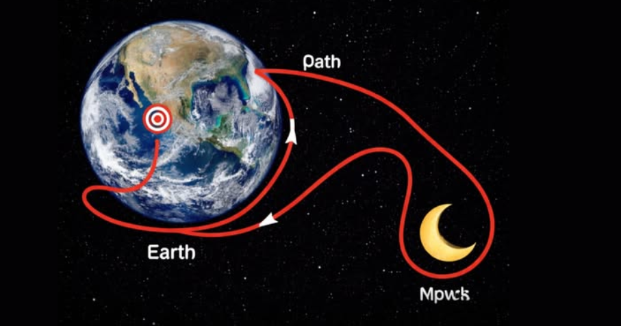
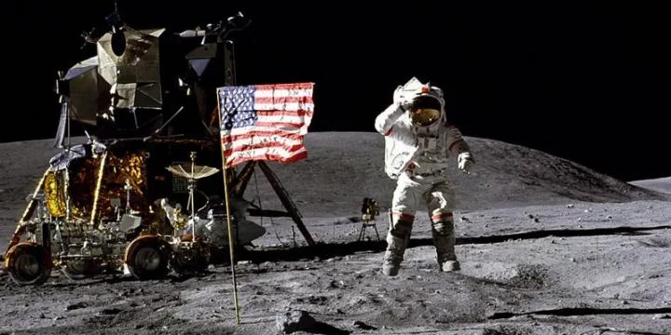
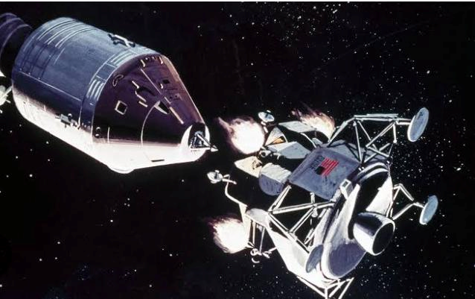
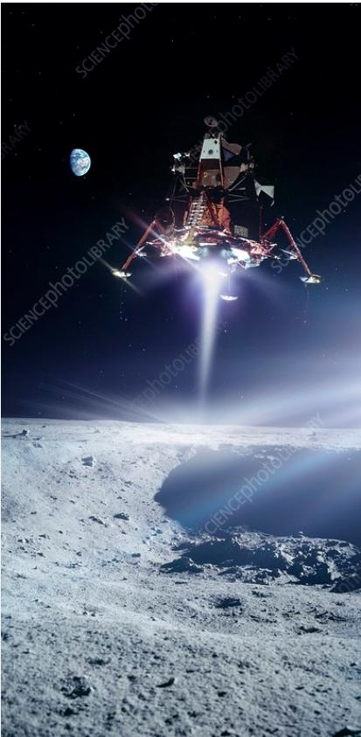
Trajectory Optimization

Slide 4
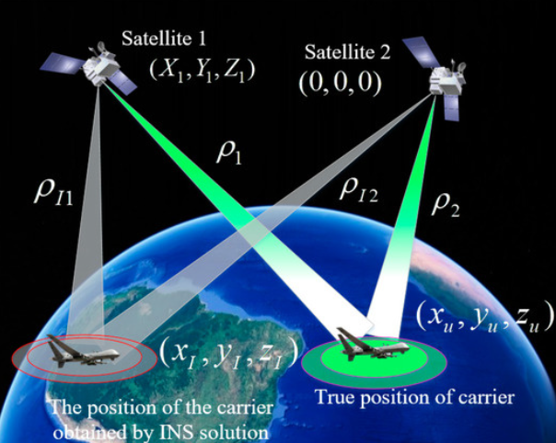
Spacecraft Navigation System

Slide 5
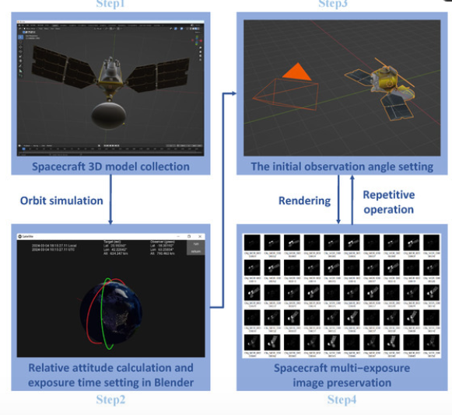
Mathematical Simulations

Slide 6
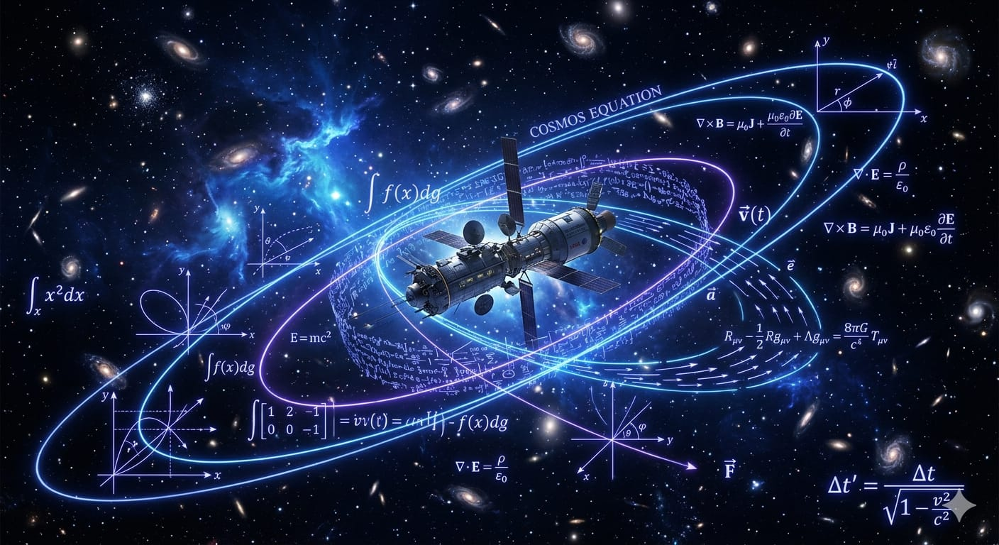
Mathematics is the foundation of all space exploration systems

Slide 7
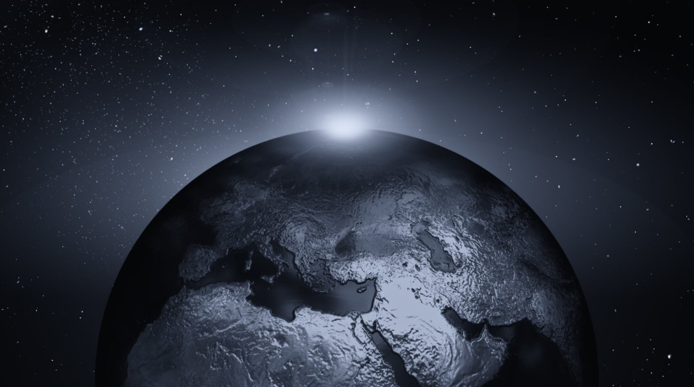
Conclusion
Without Mathematics, modern Space Exploration would not be possible.

