Slide 1
IBM University Engagement Project Submission
“Exploring the Power of Agentic AI with IBM Granite and IBM Bob”

Slide 2
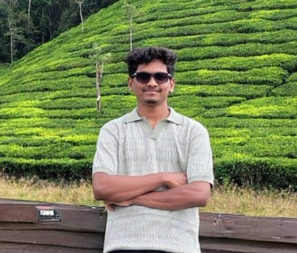
Domain of Project – Education
Project Tile – AI-Powered-College-Admission-Agent
Student Name | Recent Passport Photo | Email ID | Mobile number [WhatsApp]
MAHENDRA U |  | joshwamahendra@gmail.com | 7795266013
| College Admission Agent | 2

Slide 3
Problem Statement: College Admission Agent
THE CHALLENGE Students often struggle to find accurate and timely information about college admissions. Course details, eligibility, fees, required documents, deadlines and scholarships may be scattered across admission documents and notices. THE OBJECTIVE • Answer admission questions instantly • Retrieve relevant information from admission documents • Generate context-aware answers using IBM Granite • Reduce misinformation and hallucinations • Provide source information with responses • Offer a simple student-friendly chat interface
| College Admission Agent | 3

Slide 4
Proposed Solution: AI-Powered College Admission Agent
The proposed solution is a Retrieval-Augmented Generation (RAG) based College Admission Agent built using IBM Bob, IBM watsonx.ai and IBM Granite. FLOW Student Question → Flask API → RAG Retriever → Relevant Admission Context → IBM Granite → Answer + Sources The system uses an admission knowledge base so students can ask natural-language questions about courses, eligibility, fees, documents, deadlines and related admission information.
College Admission Agent | 4

Slide 5
Technology Used
• IBM Bob – AI-assisted development, organization and troubleshooting • IBM Granite – natural-language understanding, reasoning and response generation • IBM watsonx.ai – access to IBM Granite models and AI services • RAG – retrieves relevant admission information before generation • Python – backend implementation • Flask – REST API and application backend • HTML / CSS / JavaScript – student-facing web interface • TF-IDF-style similarity retrieval – lightweight document retrieval • Admission knowledge base – source of project information
College Admission Agent | 5

Slide 6
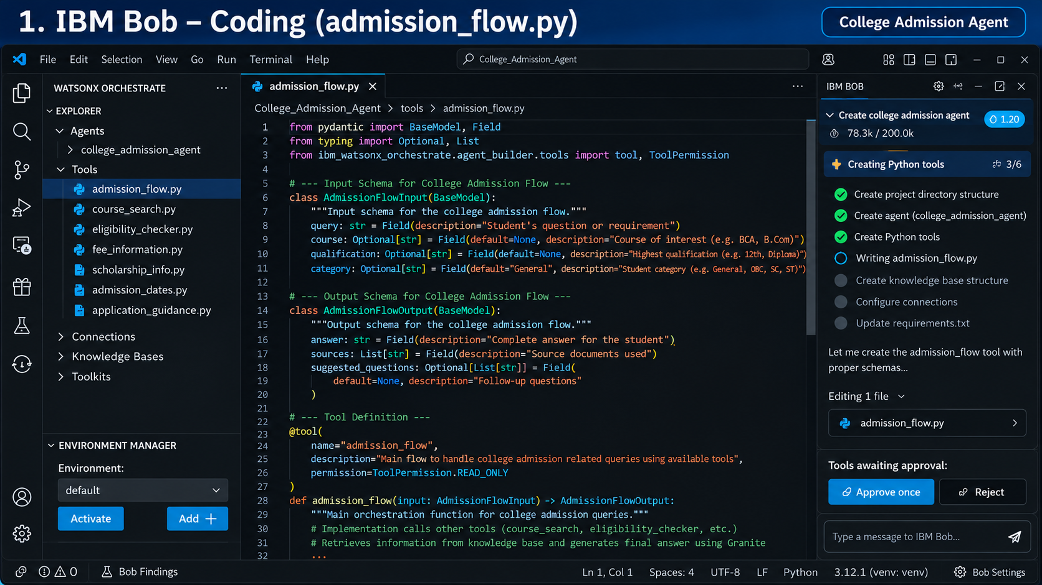
Required Files Created Using IBM Bob
College Admission Agent | 6
PROJECT STRUCTURE BACKEND • app.py • granite.py • rag.py • embeddings.py • document_loader.py • requirements.txt FRONTEND • index.html • style.css • script.js KNOWLEDGE BASE & DOCUMENTATION • admission_info.txt • README.md • .env.example • .gitignore

Slide 7
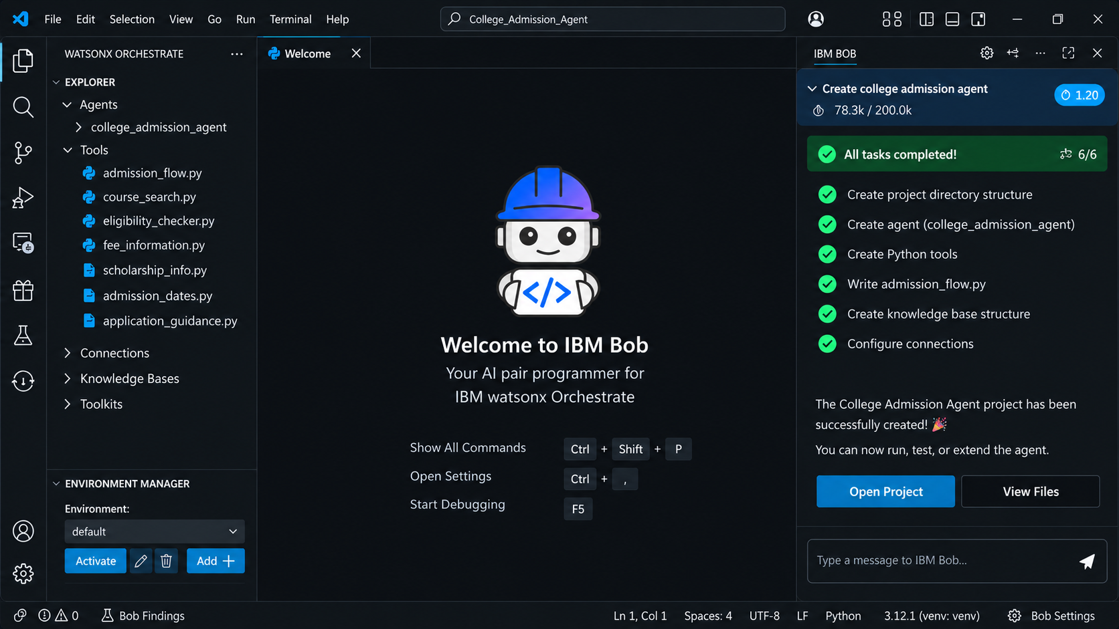
IBM Bob Screenshots
College Admission Agent | 7

Slide 8
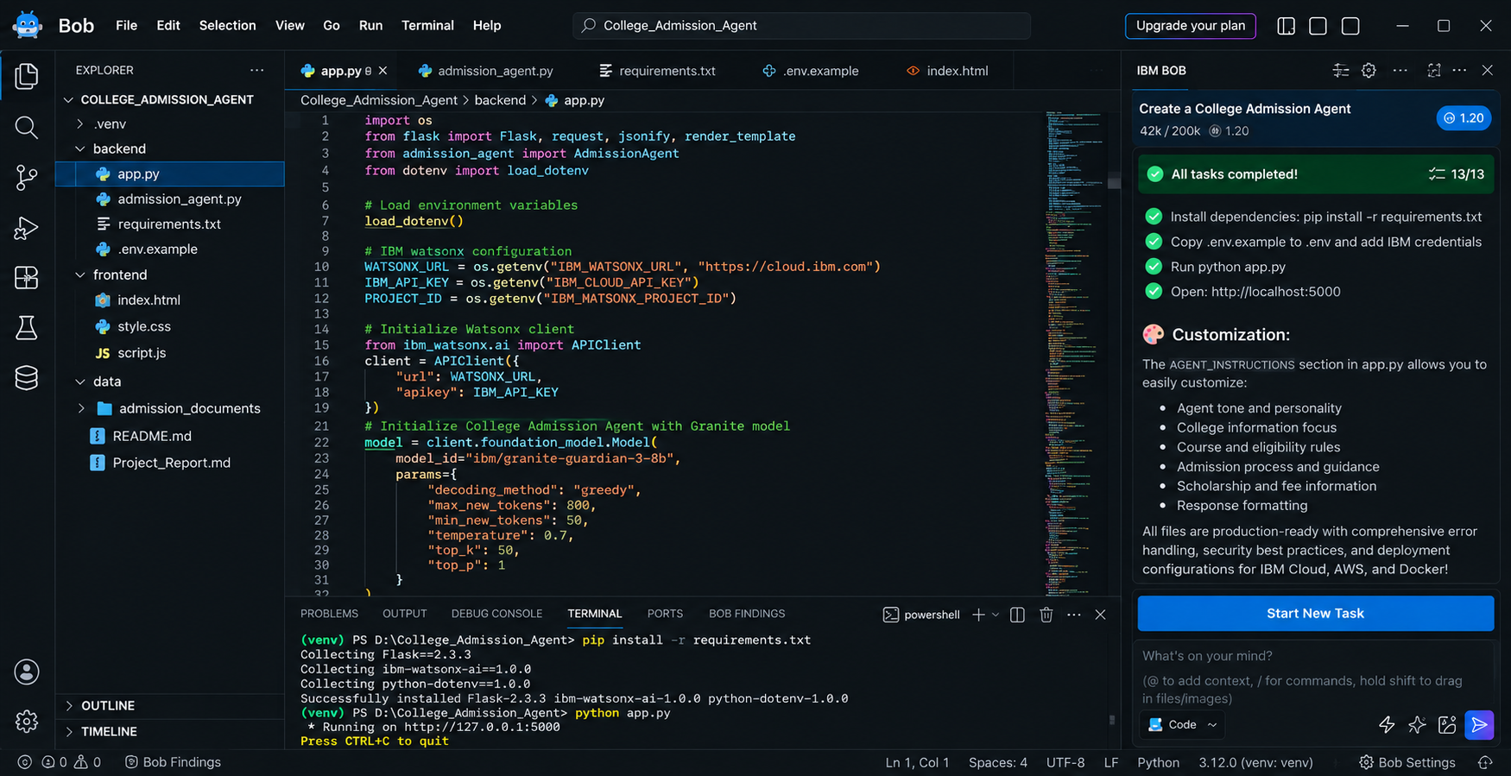
| College Admission Agent | 8

Slide 9
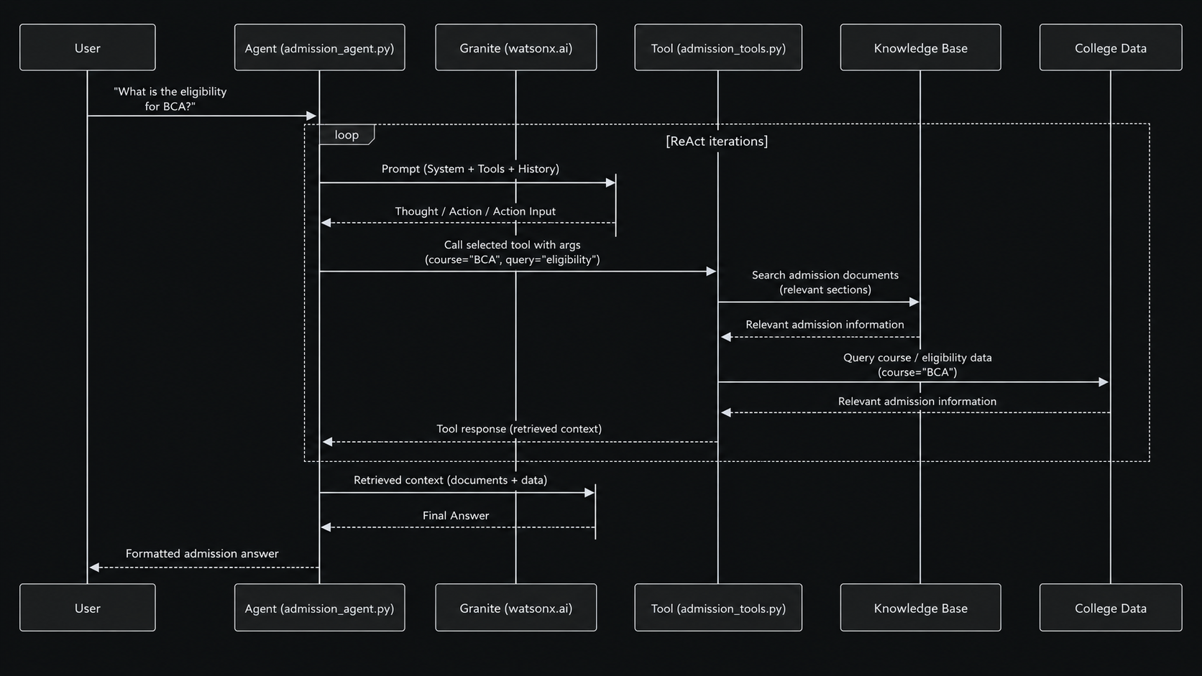
Architecture Blueprint
]College Admission Agent | 9

Slide 10

Role of Agentic AI in the Solution
Agentic AI enables the admission assistant to follow an intelligent workflow rather than acting as a simple static FAQ. • Understand – interprets the student's question • Retrieve – finds relevant admission information • Reason – processes retrieved context with IBM Granite • Generate – produces a student-friendly answer • Ground – keeps the answer tied to available context • Source – identifies the document used This makes the solution interactive, context-aware and goal-driven.
| College Admission Agent | 10

Slide 11
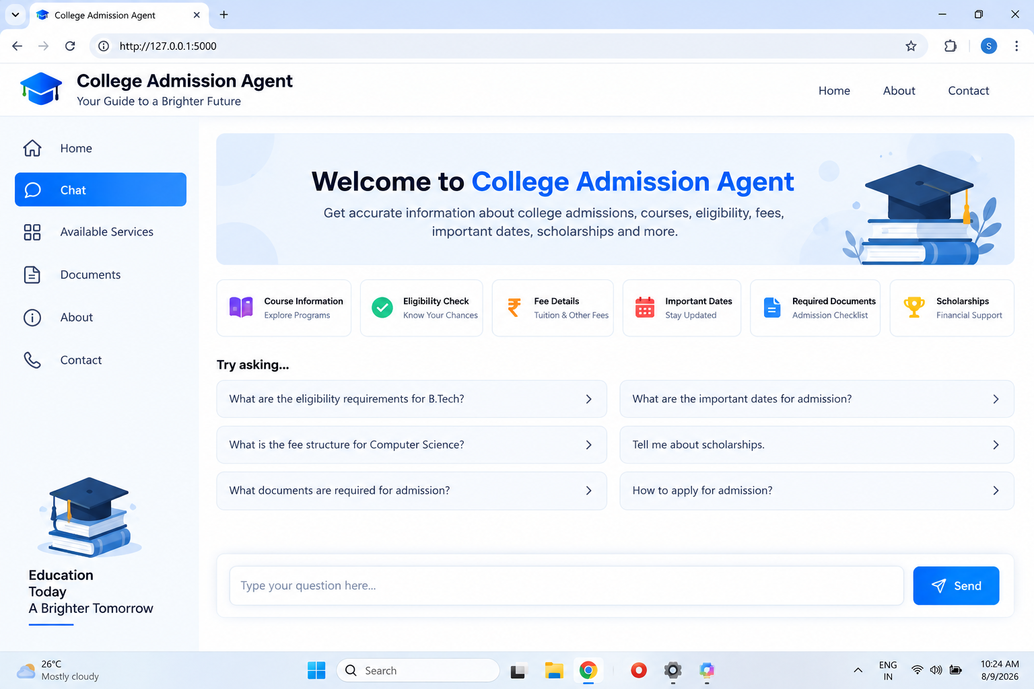
Project Output Screenshot – Home Page
·
·
College Admission Agent | 12

Slide 12
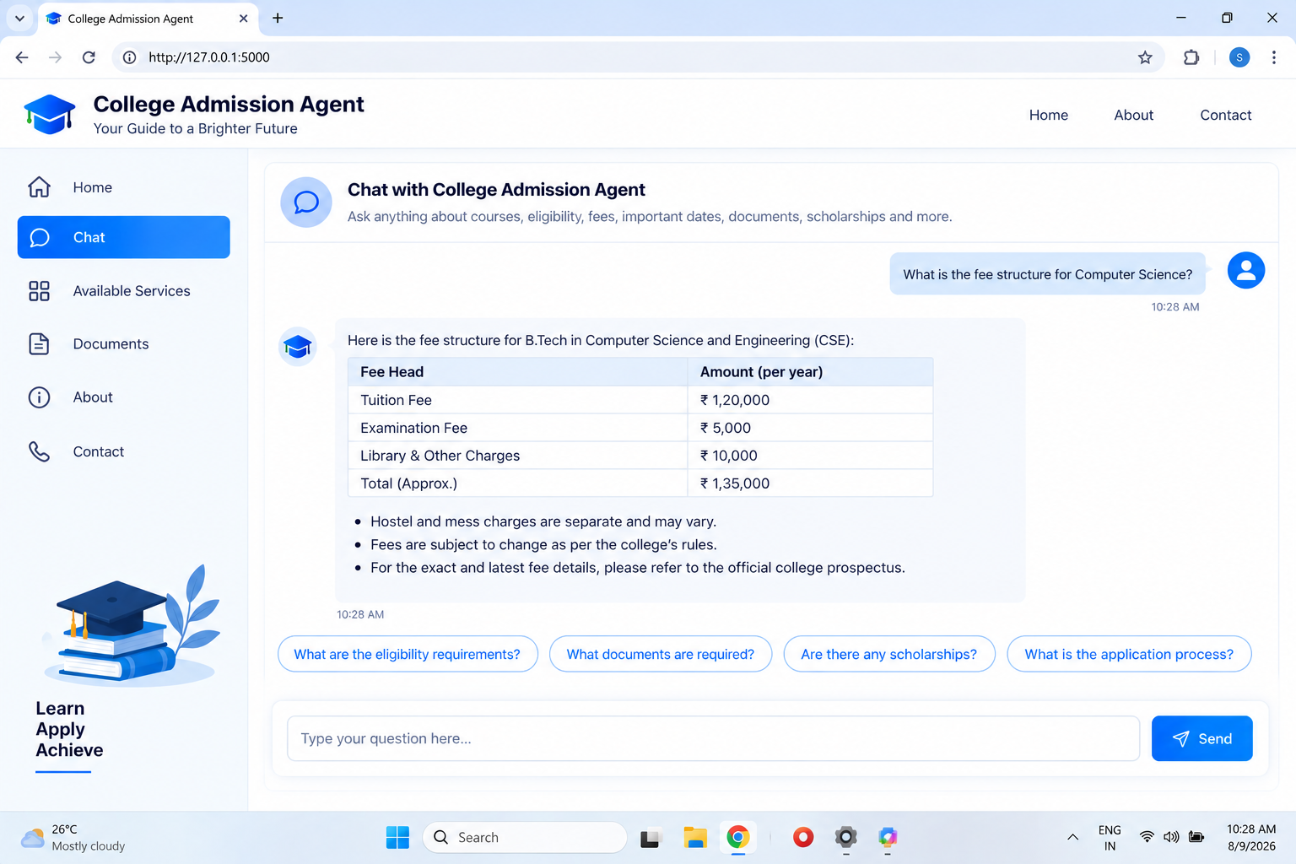
| College Admission Agent | 13

Slide 13
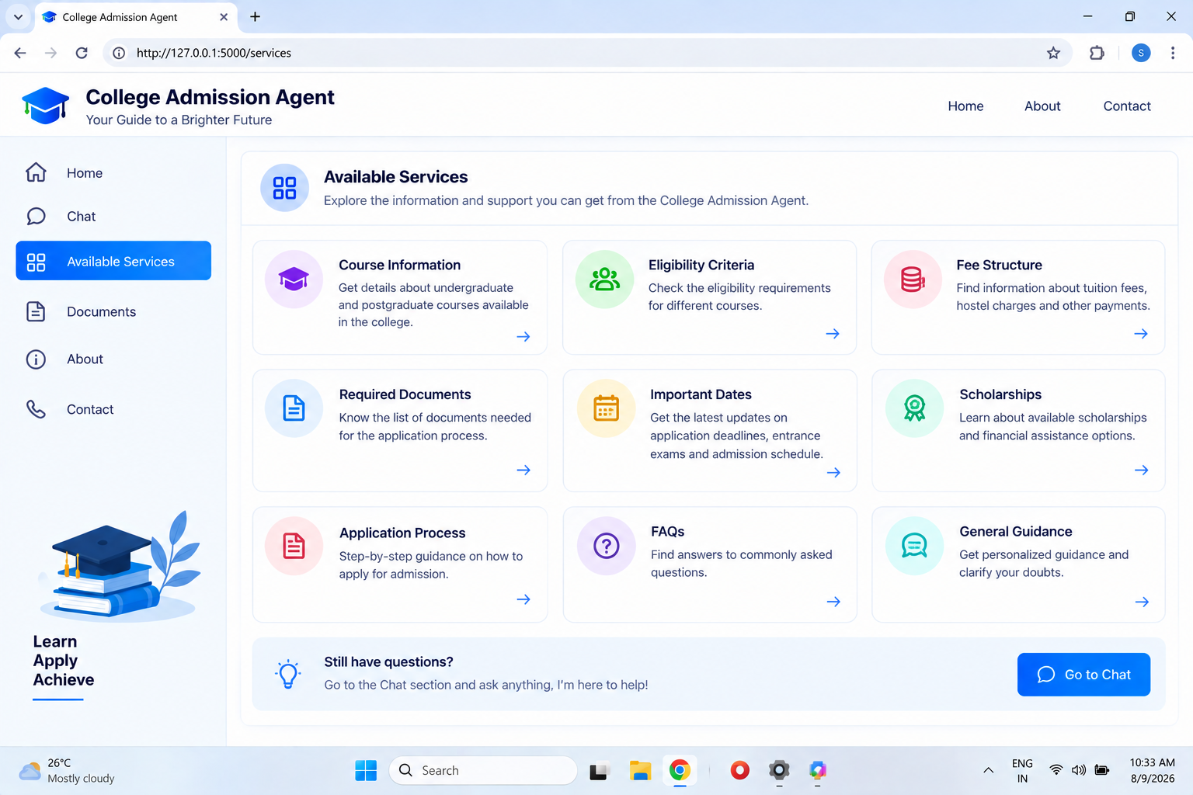
College Admission Agent | 14

Slide 14
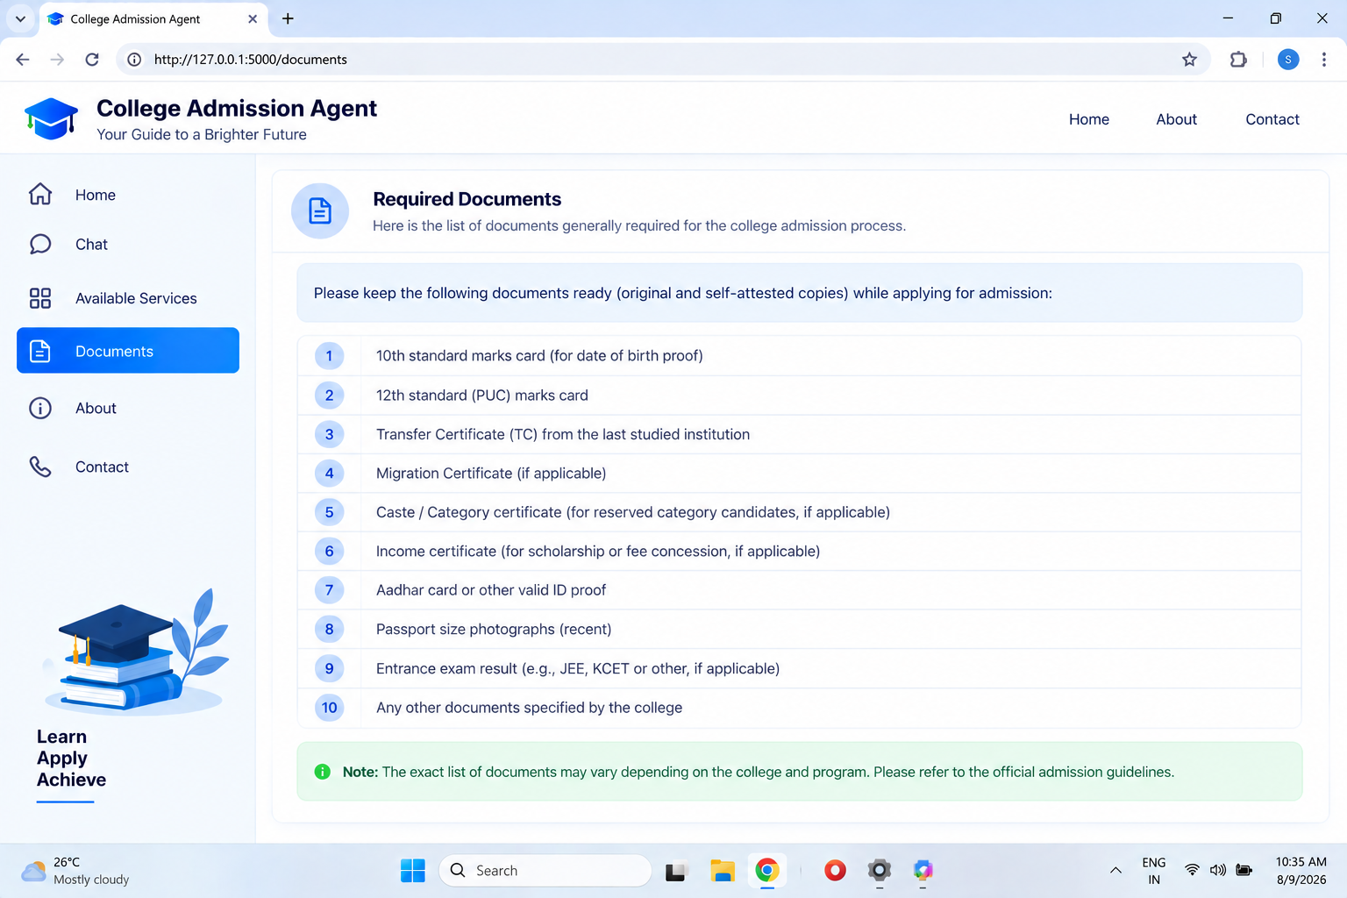

Slide 15
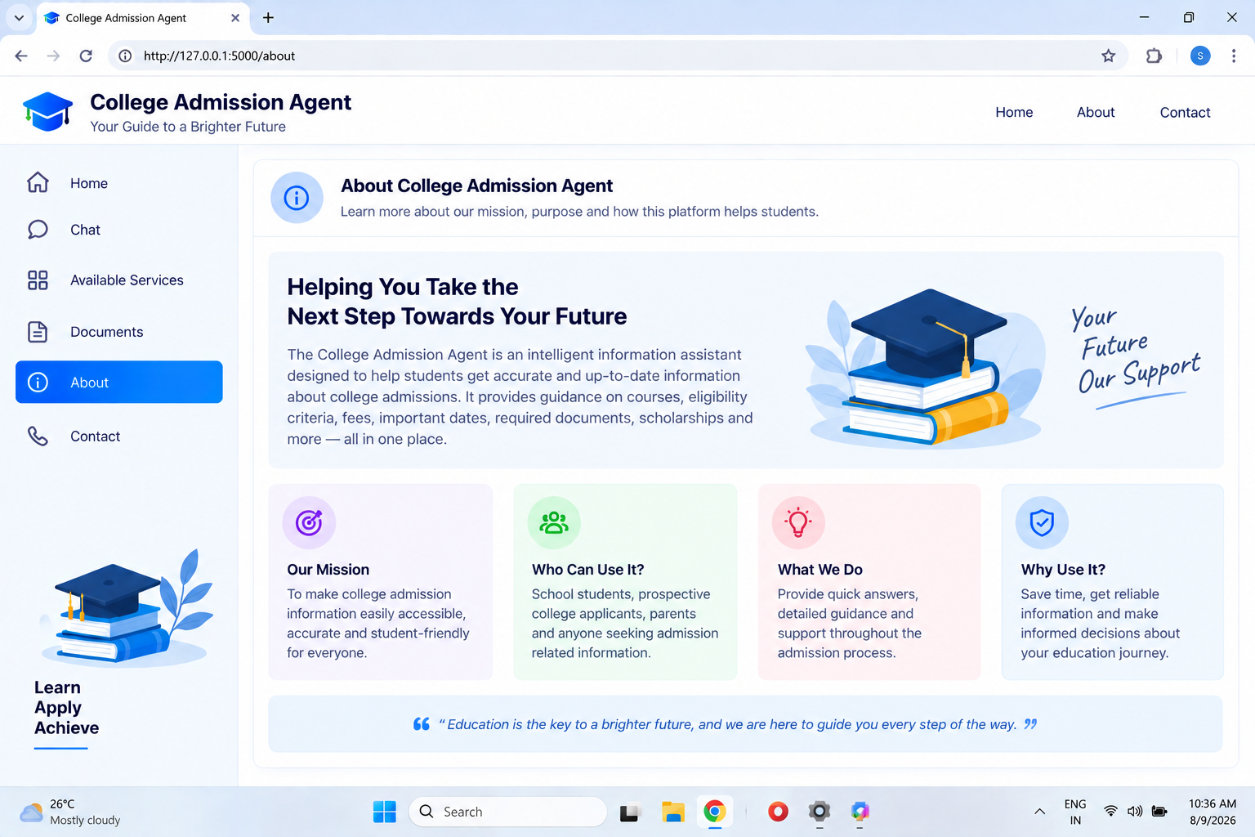

Slide 16
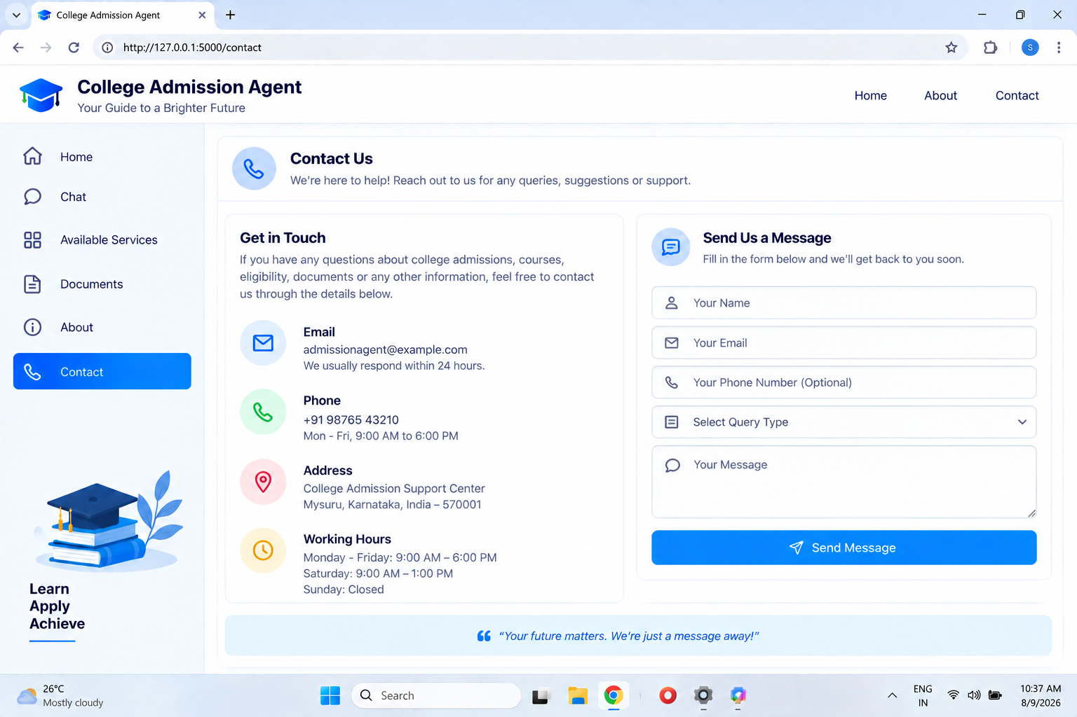

Slide 17
Novelty and Uniqueness
• RAG-Based Admission Assistant – retrieves relevant information before generation • Grounded Responses – answers are based on supplied admission context • Source-Aware Answers – source information is returned with responses • Natural-Language Queries – students can ask questions conversationally • Reduced Hallucination – can state when information is unavailable • Modular Architecture – retriever, document loader, Granite client and API are separated • Expandable Knowledge Base – additional admission documents can be added
·
·
·
College Admission Agent | 16

Slide 18
GitHub Link
PUBLIC GITHUB REPOSITORY Repository Name: AI-Powered-College-Admission-Agent
INCLUDE: 1. Project source files 2. Admission knowledge-base files 3. README.md 4. requirements.txt 5. Problem statement PDF 6. Project presentation PPTX 7. Supporting files GITHUB URL: https://github.com/mahendrajoshwa-eng/AI-Powered-College-Admission-Agent.git
·
·
·
College Admission Agent | 17

Slide 19
Future Scope
1. MULTI-COLLEGE KNOWLEDGE BASES – support admission information from multiple colleges and universities. 2. PDF DOCUMENT PROCESSING – automatically ingest prospectuses, brochures and notices. 3. ADVANCED VECTOR DATABASE – scale retrieval for larger document collections. 4. MULTILINGUAL SUPPORT – Kannada, Hindi, Tamil, Telugu, Malayalam and more. 5. VOICE ASSISTANT – allow students to ask questions using speech. 6. REAL-TIME UPDATES – connect with official portals for current deadlines and admission notices.
College Admission Agent | 18

Slide 20
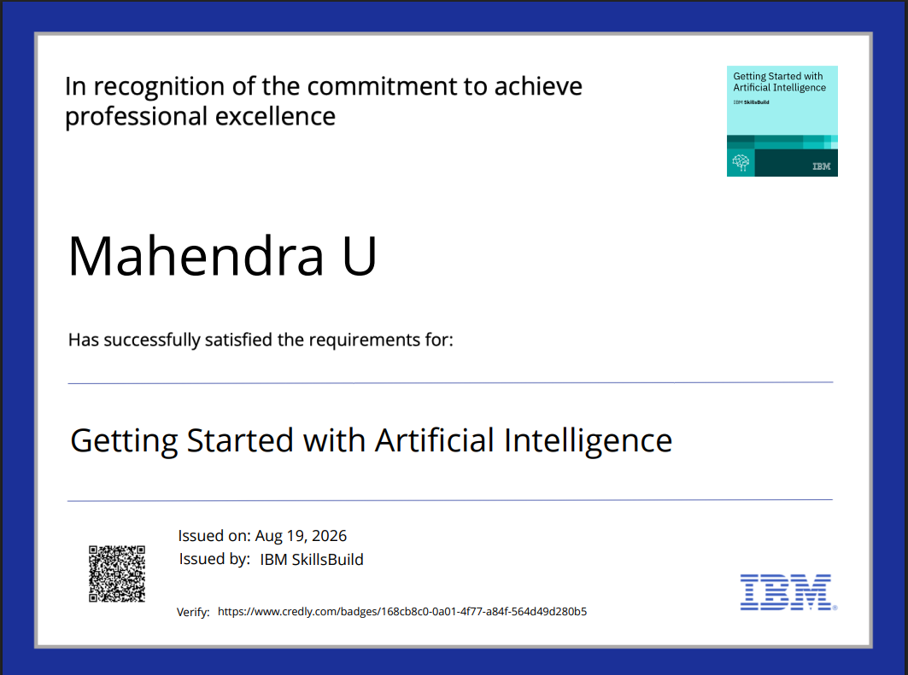
Certificates Earned
credly certificate(Getting Started with Artificial Intelligence)
| College Admission Agent | 19

Slide 21
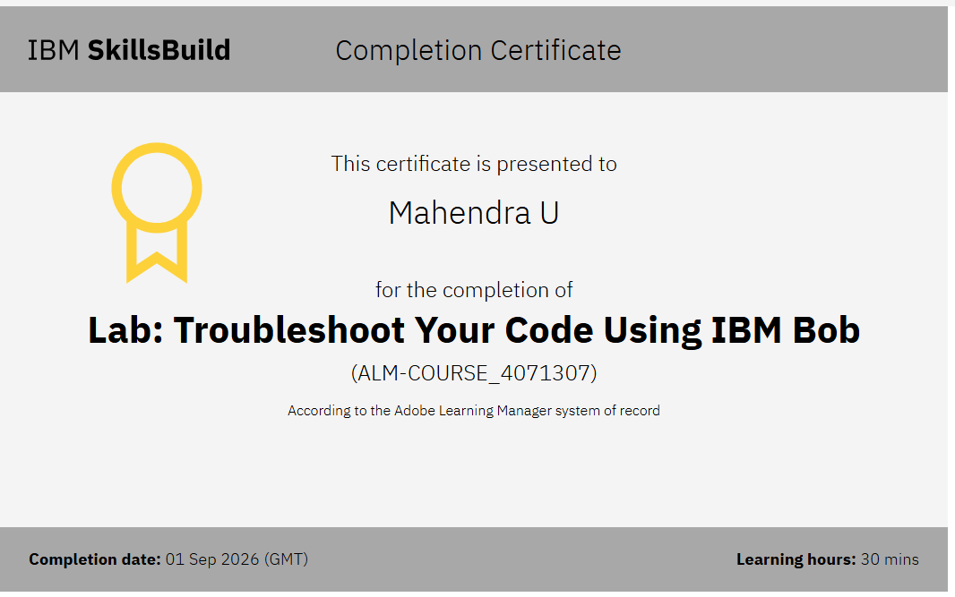
Certificates Earned:​
IBM BOB Certificate

Slide 22
THANK YOU!
AI-Powered College Admission Agent
Presented by MAHENDRA U

