Slide 1

Machine Learning
Lecture KNN
Dr. Muhammad Kamran Malik

Slide 2
KNN (Instance Based Learning)
Also known as lazy learner

Slide 3
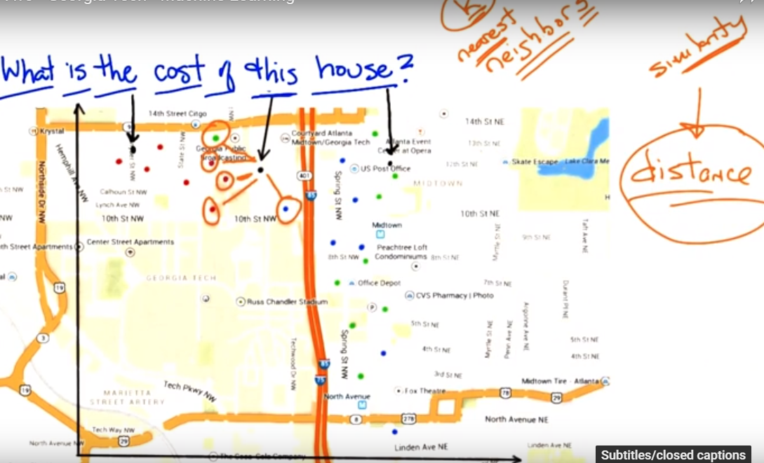

Slide 4
KNN - Classification
X1 | X2 | Actual Class
1 | 6 | 0
2 | 4 | 0
3 | 7 | 0
6 | 8 | 1
7 | 1 | 1
8 | 4 | 1
Input: 4,2
Measure used:
Manhattan distance = |a1 - a2| + |b1 – b2|
(Euclidean distance)^2 = |a1 - a2|^2 + |b1 – b2|^2

Slide 5
KNN - Regression
X1 | X2 | Actual Values
1 | 6 | 7
2 | 4 | 8
3 | 7 | 16
6 | 8 | 44
7 | 1 | 50
8 | 4 | 68
Input: 4,2
Measure used:
Manhattan distance = |a1 - a2| + |b1 – b2|
(Euclidean distance)^2 = |a1 - a2|^2 + |b1 – b2|^2

Slide 6
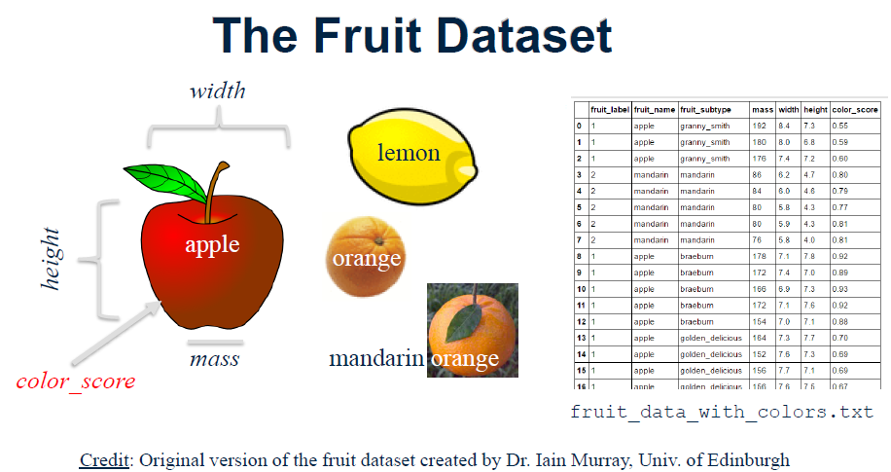
Example

Slide 7
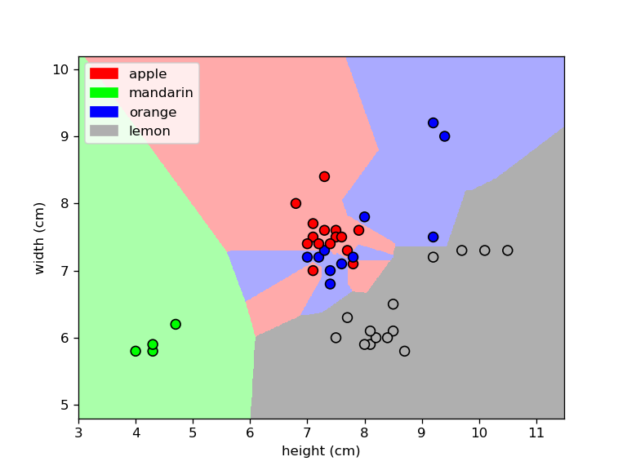
Decision Boundary K=1 (Classification)

Slide 8
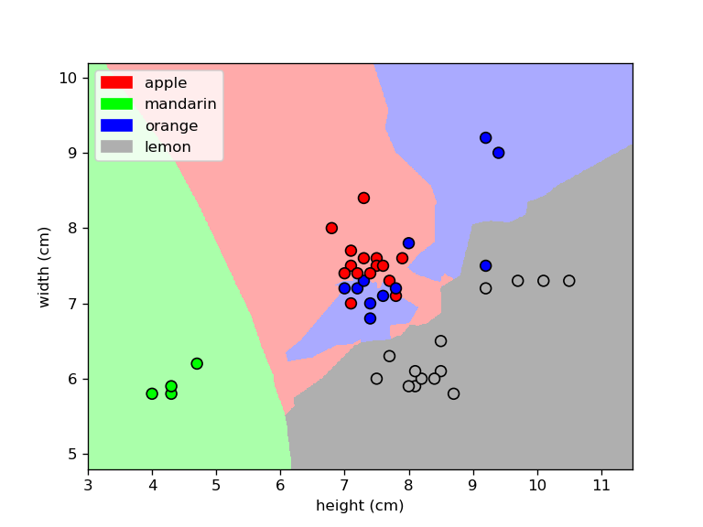
Decision Boundary K=3

Slide 9

Decision Boundary K=5

Slide 10
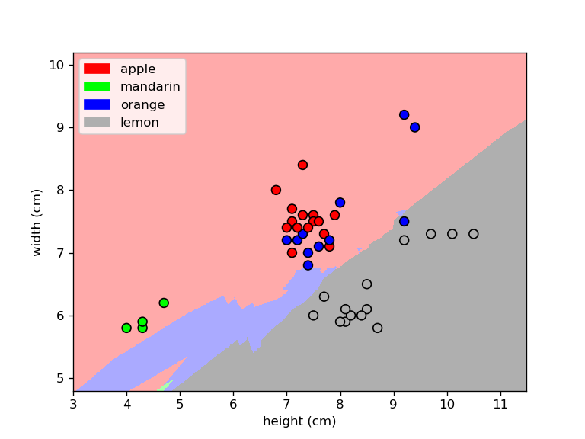
Decision Boundary K=15

Slide 11
KNN (Regression)
What people do naturally..
Real estate agent assesses value by finding sale of most similar house
$ = 850k $ = ???

Slide 12
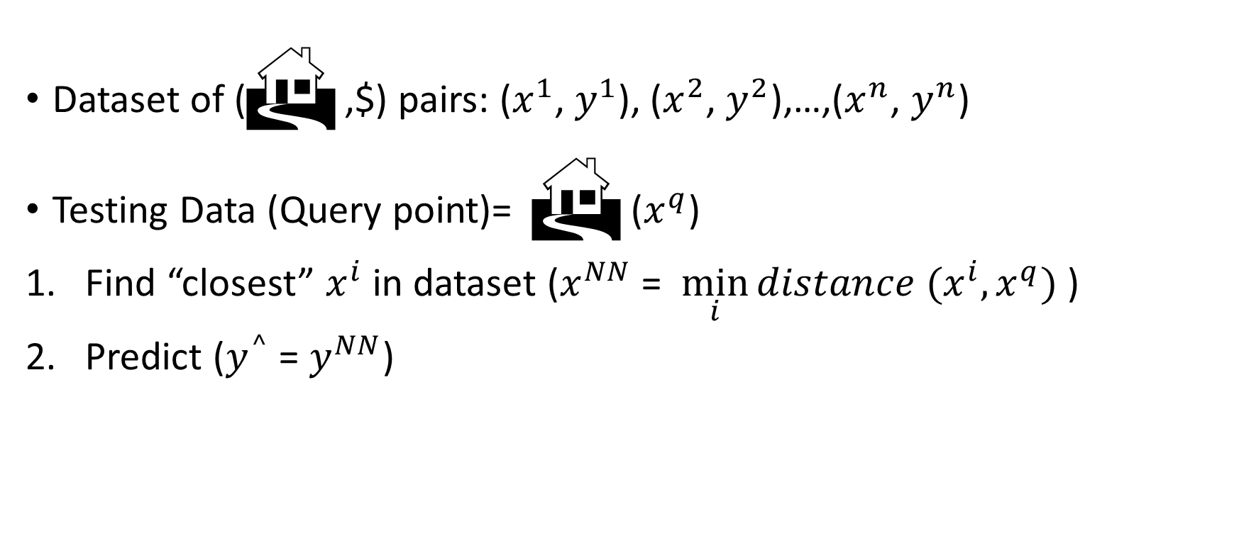
1-NN regression more formally
Dataset of ( ,$) pairs: ($x^{1}$, $y^{1}$), ($x^{2}$, $y^{2}$),…,($x^{n}$, $y^{n}$)
Testing Data (Query point)=  ($x^{q}$)
Find “closest” $x^{i}$ in dataset ($x^{NN}$ = $\min_{i}{distance (x^{i},x^{q})}$ )
Predict ($y^{^}$ = $y^{NN}$)

Slide 13
Decision Boundary K=1 (Regression)

Slide 14
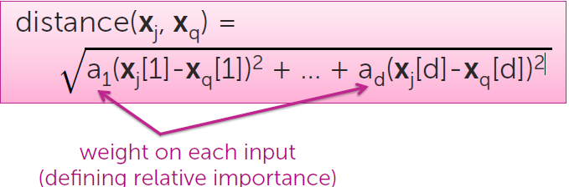
Distance metrics: Defining notion of “closest”
Manhattan distance
Euclidean distance
Mahalanobis distance
Rank-based
Correlation-based,
Cosine similarity
Hamming
In multiple dimensions:
can define many interesting distance functions
most straightforwardly, might want to weight different dimensions differently

Slide 15
Weighting housing inputs
Some inputs are more relevant than others
# bedrooms
# bathrooms
sq.ft. living
sq.ft. lot
floors
year built
year renovated
waterfront

Slide 16
Different distance metrics lead to different predictive surfaces
Euclidean distance Manhattan distance

Slide 17
Summary
Data attribute types: nominal, binary, ordinal, interval-scaled, ratio-scaled
Many types of data sets, e.g., numerical, text, graph, Web, image.
Gain insight into the data by:
Measure data similarity
Above steps are the beginning of data preprocessing.
Many methods have been developed but still an active area of research.

Slide 18
Q&A

