Slide 1
Front end Development
HTML 5
CSS 3
By Ashok Kumar naik

Slide 2
CSS3
1.Prelude
2.Getting Started with CSS3
3.Selectors
4.Cascading Order
5.Typography
6.Box Model
7.Transformations
8.Transitions
9.Responsive Web Design
10.Summary

Slide 3
CSS
Introduction to CSS
CSS syntax
Inline
Internal
External
Selectors
Element
ID
Class
Combinator
pseudo
CSS Box models
Padding
Border
Margin
Display Property
block
Inline
Flex
grid
CSS positioning:
Static
Relative
Absolute
Fixed
sticky

Slide 4
1.About CSS3
How to transform elements to create attractive web pages.
This course also explains about creating responsive web pages using media queries.

Slide 5
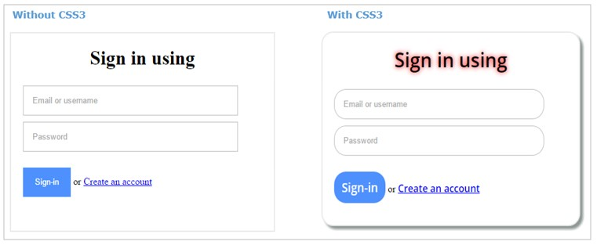
2.Getting Started with CSS3
CSS refers to Cascading Style Sheets. CSS helps in styling the HTML pages.

Slide 6
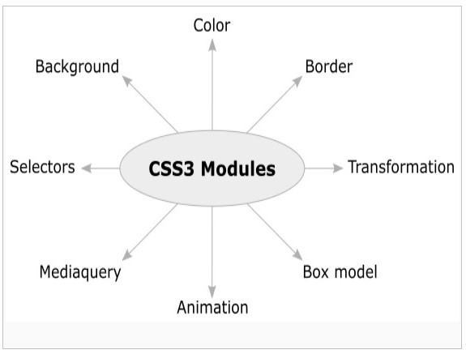
What is CSS3?
CSS3 is the latest version of CSS. CSS3 provides new styling elements using which we can style webpages without any additional tools.

Slide 7


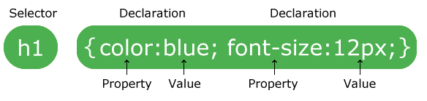
EDUCATION
A CSS rule-set consists of a selector and a declaration block:
EMPLOYABILITY
ENTREPRENEURSHIP
www.task.telangana.gov.in

Slide 8
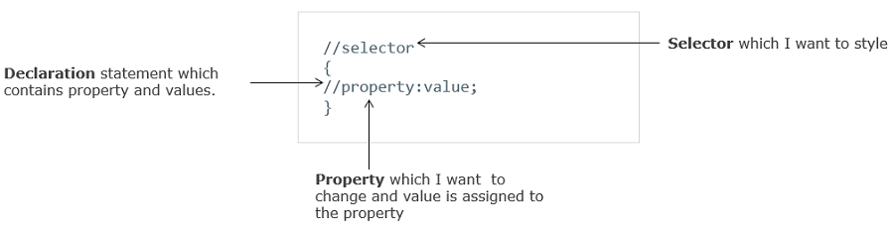
How to write CSS style rules?
CSS is a style sheet markup language. CSS styles are written as a property value pair.
Syntax:property: value
Example: color: green;
The style rules are applied to the HTML elements using selectors.

Slide 9
How to write CSS style rules?
Inline styling
Internal styling
External styling
Importing style sheet
<style
type="text/css"> @import url("http://www.xyz.com/style.css")
</style>

Slide 10
3.Selectors
Element selectors are used for styling elements
Id selectors are used for styling an element specifically.
Class selectors are used for providing the same styling for multiple elements.

Slide 11
How to use Selectors?
Element Selector
We can style the elements by selecting them using element selector as shown below
Id Selector
We can use the id selector as shown below
Class selectors
Class selectors can be used as shown below

Slide 12
Pseudo-classes
a:hover {
background-color: black;
color: white;
}
a::visited {
color: purple;
}

Slide 13
4.Cascading Order
What is Cascading Order?
Priority order/ Cascading order
Inline
Internal and/or import
External
Selector’s precedence
If there are multiple styles specified for the same HTML element then the priority is as below.
Id
Class
Element

Slide 14
!important Keyword
!important Keyword
color: limegreen !important;

Slide 15
5.Typography
Typography refers to the art of arranging type.
Typography refers to the technique of presenting the text of a website in a legitimate, readable, and appealing way
Elements of good typography included
Color: Background and text-color
Spacing: letter-spacing,line-height
Font: font-style and font-size
Alignment: text-align

Slide 16
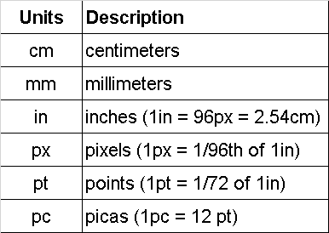
CSS Units
Absolute length units
The absolute length units that we specify for CSS properties will appear as exactly that size.

Slide 17
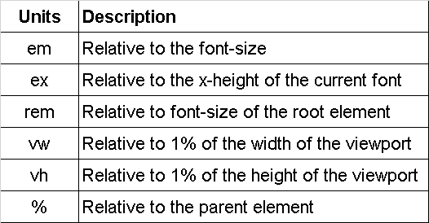
CSS Units
Relative length units
Relative units specified will be relative to another property

Slide 18
Font Properties
font-family: Specifies the font-family. Values can be web-safe fonts.
font-style: Specifies the style of the font. Values can be normal (default), italic, oblique
font-variant: Specifies the variant of the font. Values can be normal (default) and small-caps
font-size: Specifies the size of the font. Values can be x-small, small, medium, large, and can be a specific number with pixels unit.
font-weight: Specifies the weight of the font. Values can be normal, bold, bolder, light, x-large.
line-height: Specifies the height of the line

Slide 19

6.Box Model

Slide 20
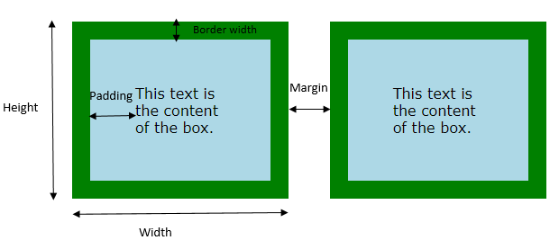
What is BOX Model
The CSS box model is a container, which wraps around every HTML element. It consists of margins, borders, padding along with the actual content.

Slide 21
7.Transformations
You might have observed an HTML element getting transformed such as the element gets rotated or scaled upon hover of the mouse.
These transformations were generally achieved through JavaScript or JavaScript frameworks.
CSS3 has introduced the transformations using which we can transform our HTML elements using the transform property of CSS3.
Transformations are applied to create dynamic web pages.

Slide 22

What are Transformations?
We can rotate and pop out a particular image in an image gallery on the hover of the mouse.

Slide 23
What are Transformations?
CSS3 supports the following transformations
Translate
Scale
Rotate
Skew

Slide 24
Translate
CSS3 translate() function is used to move an element from one position to another position.
An element can be moved to the right, left, top, bottom.
An element can be moved in only one direction i.e. horizontal/vertical using translateX and translateY functions.
Example:
translate(20px, 30px) -> moves the element to right by 20px and 30px down from the current position.
translate(-40px, 20px) -> moves the element to left by 40px and 20px down from the current position.
translate(-30px, -25px) -> moves the element to left by 30px and 25px up from the current position.

Slide 25
Scale
SS3 scale() function is used to change(increase/decrease) the size of any element.
Syntax: scale(x,y) -> scales the element width(x-value) & height(y value)
If only one value is supplied to the scale(value) function, then that value will be considered as both x & y parameters
Example:
scale(2,1) -> The width of the element will be doubled and height remains the same.
scale(0.5) -> will decrease the element size by half
scale(1)-> element size will remain same
scale(2)-> doubles the element size

Slide 26
Rotate
CSS3 rotate() function is used to rotate an element from its origin point up to a specified angle. The angle is specified in degrees.
Syntax: rotate(x) -> Rotates the element.
If the angle specified is a positive value then the element rotates clockwise. if the angle specified is a negative value then the element rotates anti-clockwise.
Example:
rotate(20deg) -> Rotates the element by 20 degrees in clockwise direction.
rotate(-50deg) -> Rotates the element by 50 degrees in anti-clockwise direction.

Slide 27
Skew
CSS3 skew() function is used to turn/skew any element to any angle.
The turning/skewing is dependent on the parameters specified for the vertical & horizontal axis.
Syntax: skew(x,y) -> skews the element from x degrees from the x-axis & y- degrees from the y-axis.
if the y-axis value is not specified then it has a zero value.
To skew an element across a single axis, we can use skewX() and skewY() functions.
Example:
skew(20deg) -> skew an element by 20 degrees across x-axis.
skew(30deg, 10deg) -> skews an element by 30 degrees across x-axis and 10 degrees across y-axis.
skewX(15deg) -> skews an element by 15 degrees across x-axis.
skewY(45deg) -> skews an element by 45 degrees across y-axis.

Slide 28
8. Transitions
If we have a requirement to show the gradual changes in the CSS properties of an element during an interval of time.
For example, you might want to show an element changing its size in an interval of 2 seconds upon hover of the mouse. We can use the CSS3 transition property.

Slide 29
The transition timing function is used to specify the pace/speed of transition.

Slide 30
9.Animation
Transition property can give a dynamic effect on web pages.
But there are a few disadvantages with transitions.
Transition starts only when some event like hover, focus occurs.
We can specify only the initial state and final state for transitions, but we cannot specify an intermediate state.
To overcome these disadvantages we use animations of CSS3.

Slide 31
What are Animations ?
Animations are the same as transitions, but we can specify intermediate states also and animations can start without events

Slide 32
What are Animations ?
Animation in CSS3 is done using keyframes. Within each keyframe, we define the start and end of a smooth transition.
We can specify when the change will happen using from & to keywords.
@keyframes anim
{
to {color: white;background:black;}
from {color: black;background:white;}
}
------------------------------------------------------------------------------
@keyframes anim
{
0% {color: white;background:black;}
100% {color: black;background:white;}
}

Slide 33
10.Responsive Web Design
We can make a web page's layout change according to the screen size using the below techniques
Fluid Layouts
Flexible Images
Media Queries

Slide 34
How to make web pages responsive?
Media queries
Media queries apply CSS styling based on the device form factors. Hence the layout can differ on a desktop, tablet, and mobile
@media screen and (max-width: 520px) {
.body {
background: none;
}
}

Slide 35
Summary
n this course you have learned how to :
Apply new features of CSS3 in web pages
Use CSS3 selectors in web pages
Apply CSS3 color models to HTML elements
Apply border-radius, box-shadow, text-shadow, and border-image effects
Apply 2D transformations, transitions, and animations
Use media queries in web pages

Slide 36
….Thank You….

