Slide 1

ECE-365 Workshop on Reconfigurable Computing Implementation of Vending Machine in Artix 7 Nexys 4 Board
Presented by,
S.Balakrishna [11809458]
Gantasala Sandeep [11808691]

Slide 2
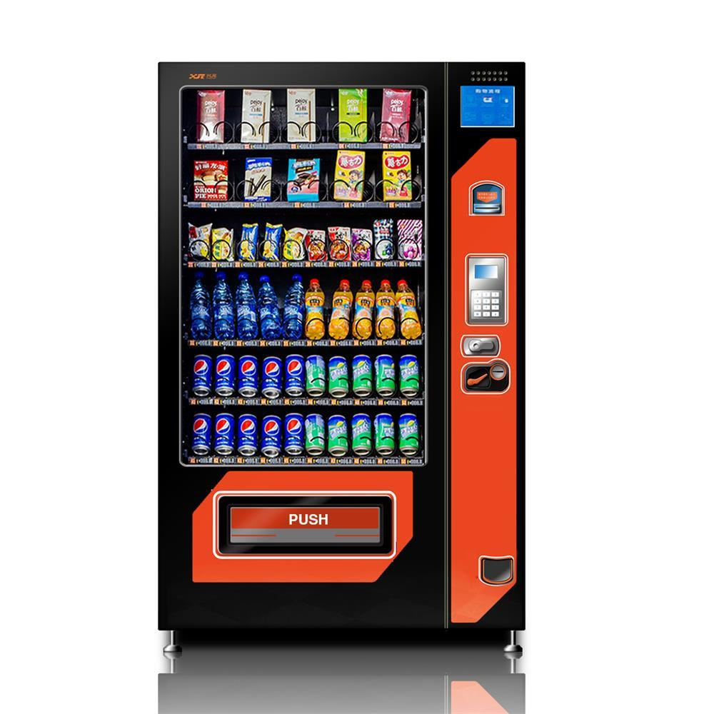
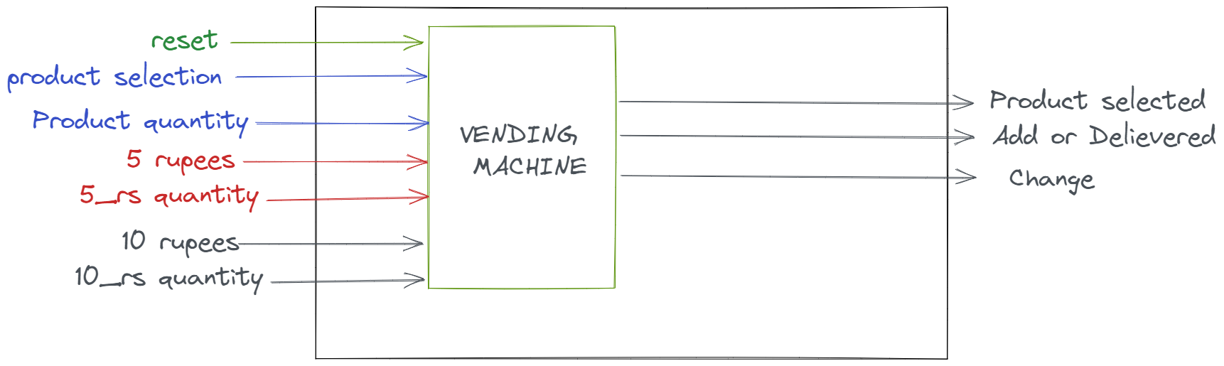
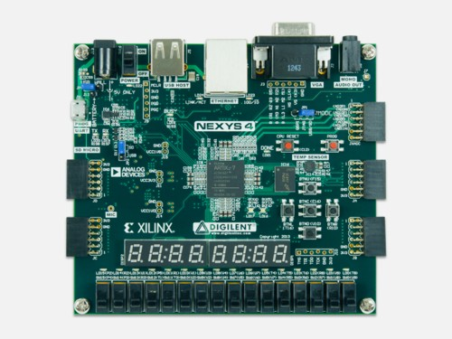
Content
Introduction
Vending Machine
Process
Insert Module
Select Module
Bin to BCD Module
Refresh Counter
Seven Segment Control
Complete

Slide 3

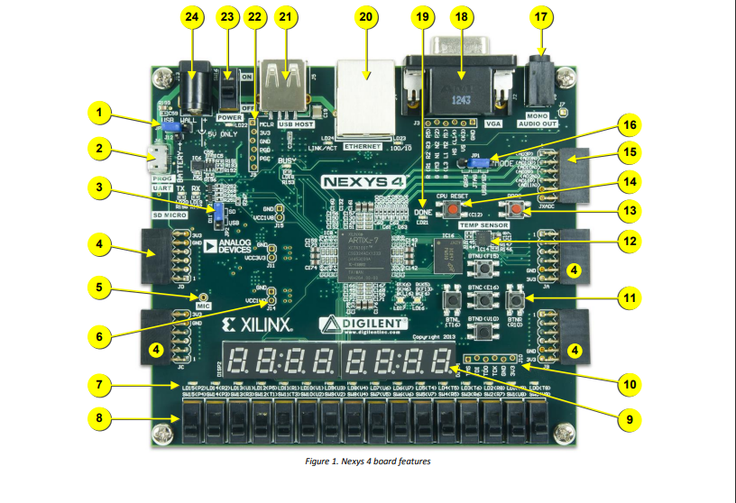

Introduction
Vending Machine is an automated machine which we generally use in airports, shopping malls, stores, etc… where the products like snakes, drinks, etc… are displayed in the machine we can select a particular product and it’s the quantity and finally insert the money to get the products delivered and also the change if more money is inserted.

Slide 4

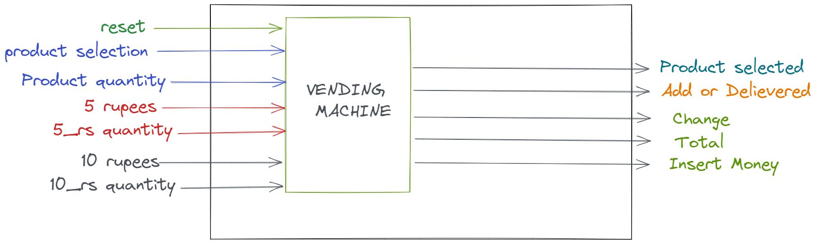
VENDING MACHINE

Slide 5
Process
Quantity
Product Selection and Quantity
of the Product
Count
The Count of the Money Inserted is done here.
Bin2BCD
The Change ,Total, Inserted Money which in Binary will be converted to BCD.
BCD2SevenSeg
Final
Display the Change, Total, Inserted money, Product Selected and Add money in the seven seg.
Change in form of BCD will send to the seven segment.

Slide 6
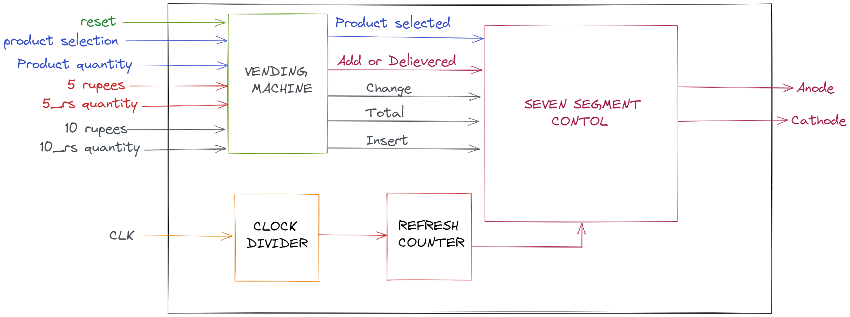
Complete Module

Slide 7
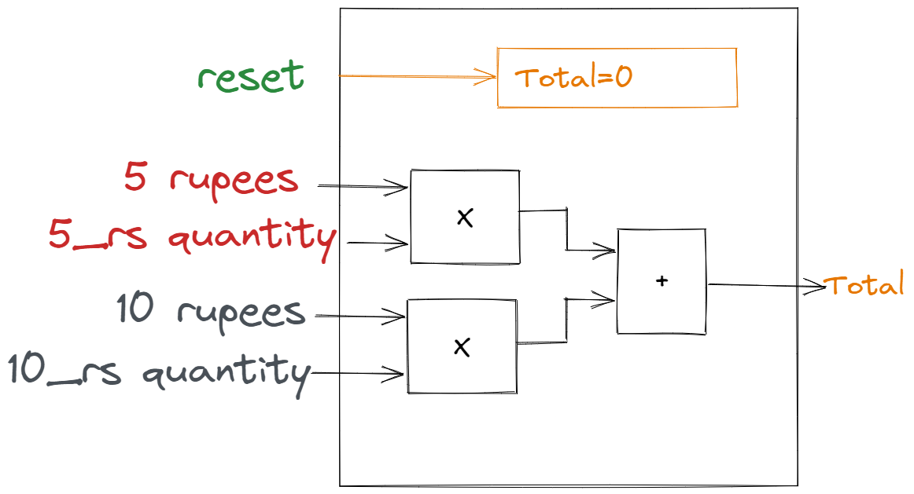
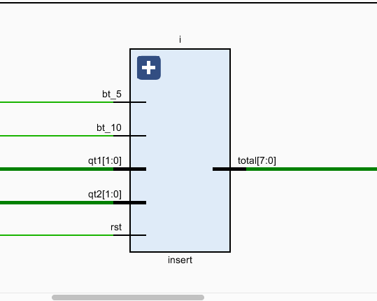
Insert Module
This is module is responsible for the Money inserted.

Slide 8
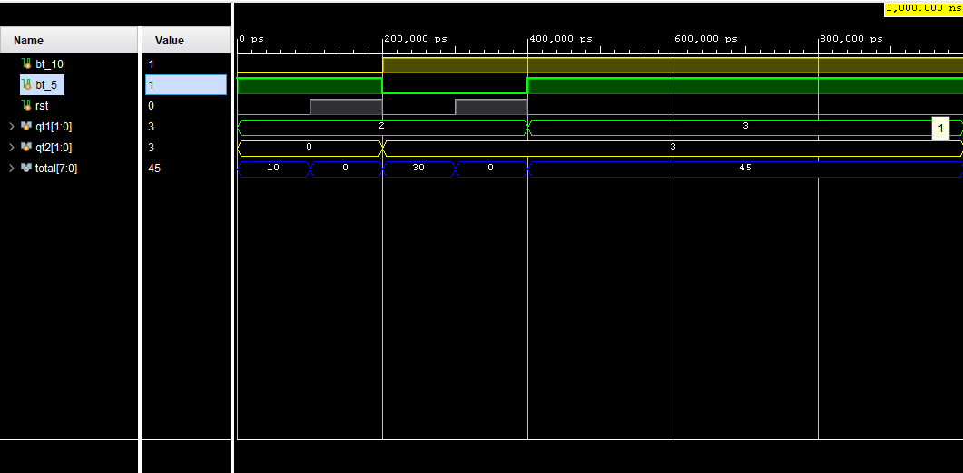
Insert Waveform

Slide 9
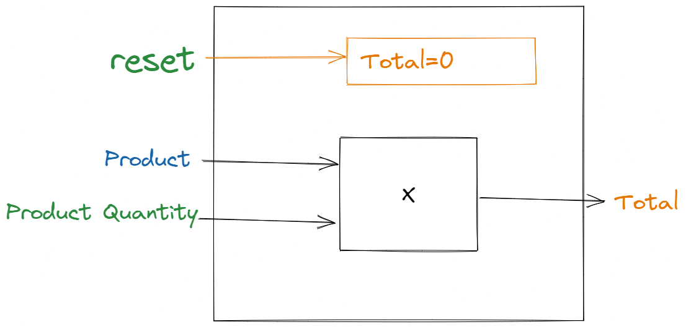
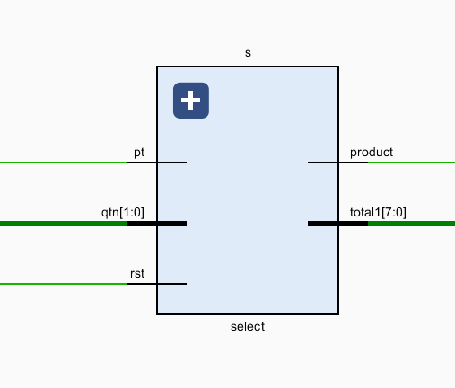
Select Module
This Module helps with the selection of the product we needed and we can even select the quantity of the selected product it finally provides the total money of the product we have selected along with its quantity in the form of 7-bit binary number and also the product selected.

Slide 10
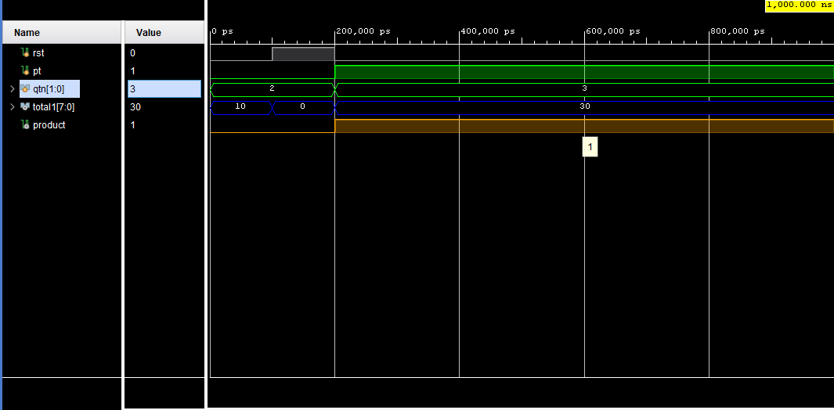
Select Waveform

Slide 11
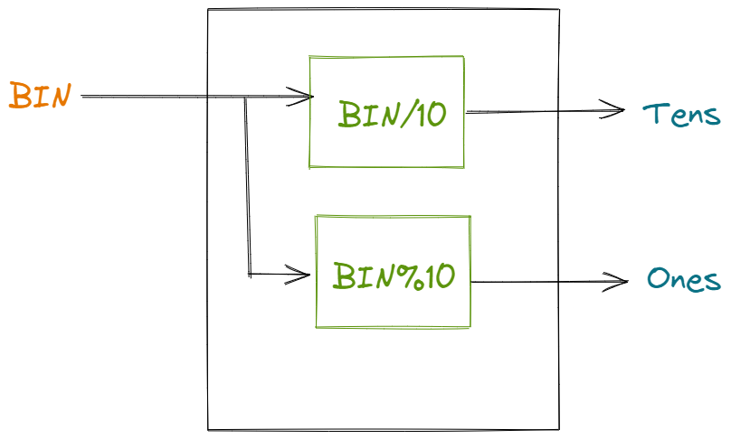
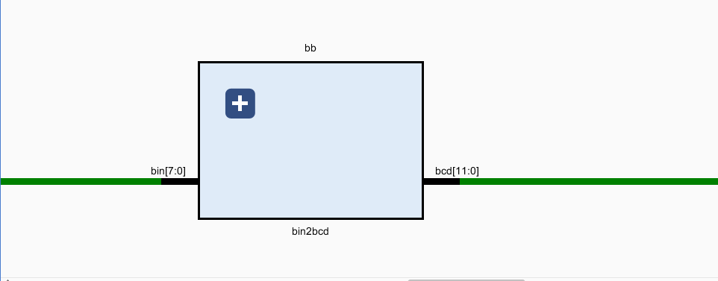
Bin2BCD
This Module helps with the conversion of the input binary number into tens and ones place numbers in terms of BCD format.

Slide 12
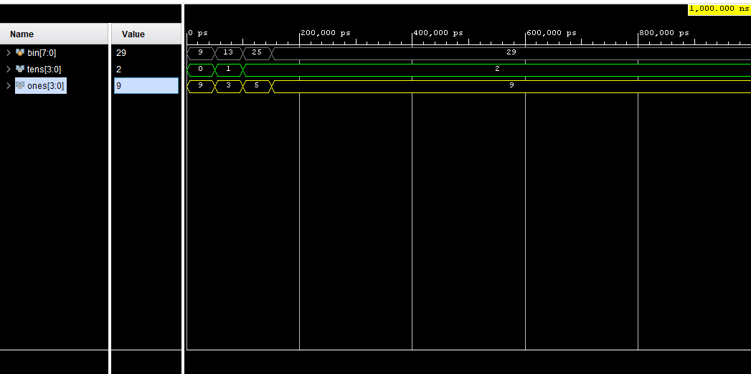
Binary to BCD Waveform

Slide 13
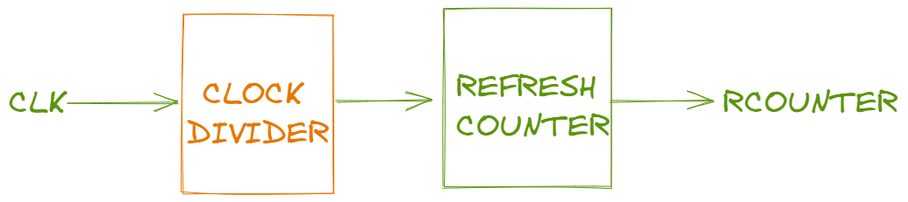
Refresh Counter
This Module helps with the Clock Signal division part where we can convert the high-frequency clock to the required frequency clock . This module is responsible for the display of different number in all the seven segments at the same time

Slide 14
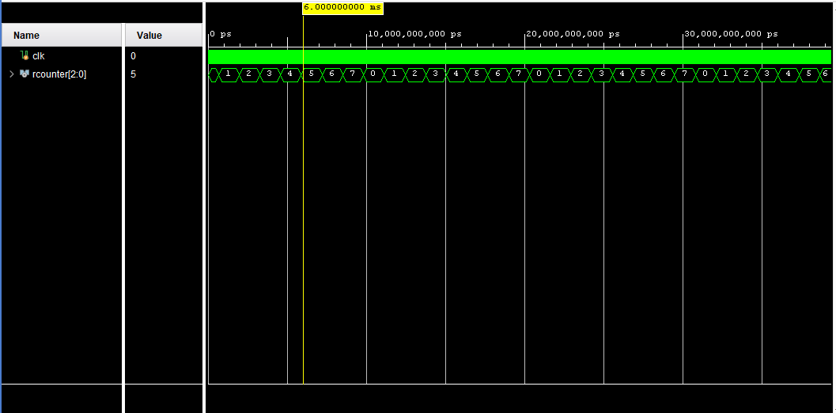
Refresh Counter Waveform

Slide 15
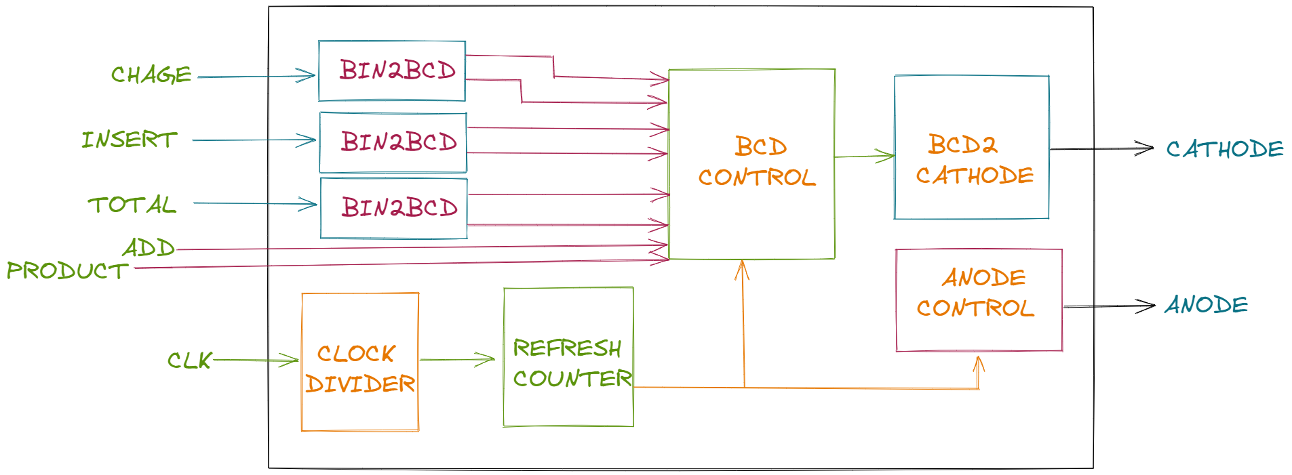
Seven Seg Control
Thursday, April 28, 2022

Slide 16
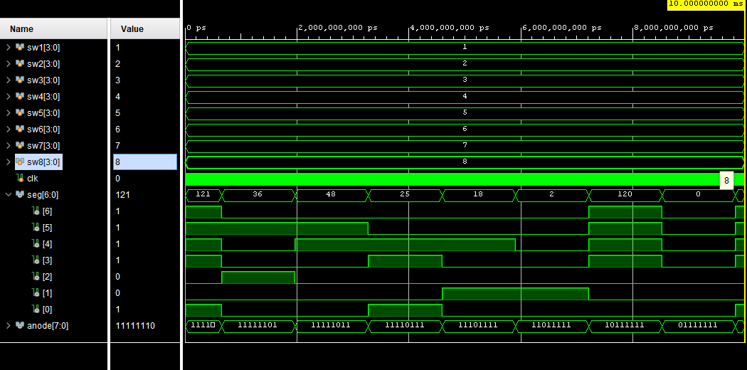
Seven Segment Control Waveform

Slide 17
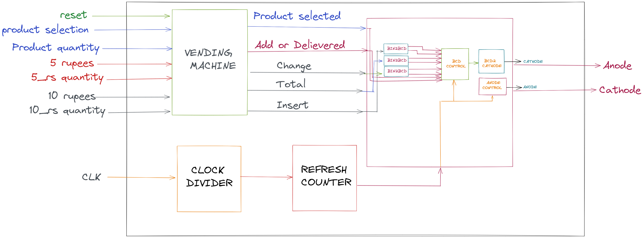
COMPLETE

Slide 18
Process
Quantity
Product Selection and Quantity
of the Product
Count
The Count of the Money Inserted is done here.
Bin2BCD
The Change ,Total, Inserted Money which in Binary will be converted to BCD.
BCD2SevenSeg
Final
Display the Change, Total, Inserted money, Product Selected and Add money in the seven seg.
Change in form of BCD will send to the seven segment.

Slide 19
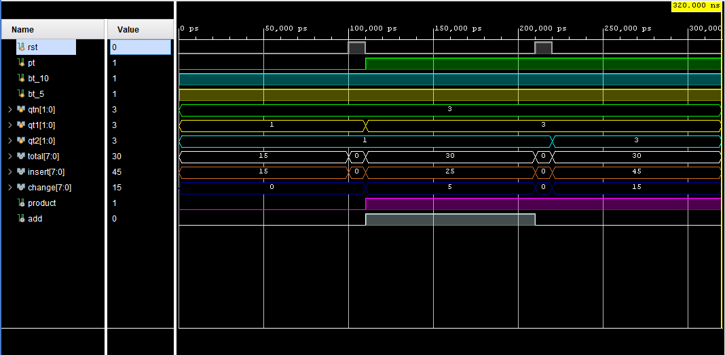
Complete Waveform

Slide 20
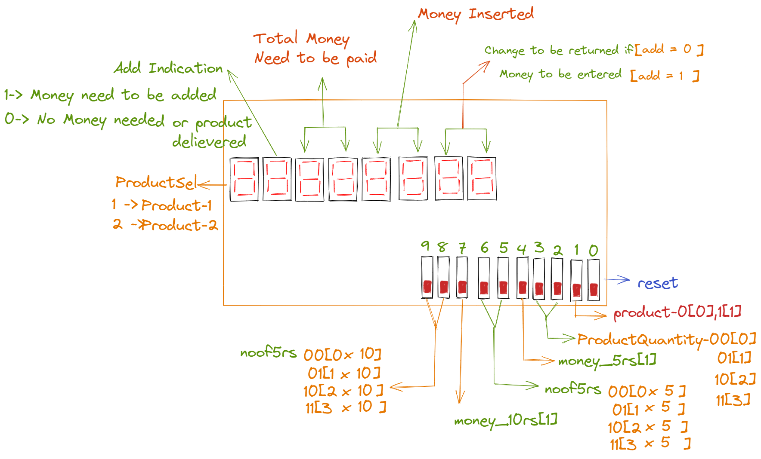
FPGA interface

Slide 21
Examples
Product | Total | Insert | Change | add
0[5rs] X 3 | 15rs | 15rs | 0rs | 0
0[10rs] X 3 | 30rs | 25rs | 5rs | 1
0[10rs] X 3 | 30rs | 45rs | 15rs | 0
Reset=1 | 0rs | 0rs | 0rs | 0

Slide 22

Thank You

