Slide 1

Home – school Partnerships
Dinah Aitken & Marie-Clare MacAskill
18 March 2023

Slide 2
Introduction
Mindroom – www.mindroom.org
What we mean when we talk about neurodiversity: what it is/is not.
Home-school partnerships: Involvement/engagement/partnership.

Slide 3
Home-school partnerships: Professionals and experts
The paid professionals in a school are the teaching, management and support staff, as well as the professionals who are engaged in supporting the students, such as social workers, allied health professionals, educational psychologists etc.
Parents and carers are the expert in their child – no-one knows them better.
The child or young person is expert in their own needs, but they may need help to understand or express those needs.

Slide 4
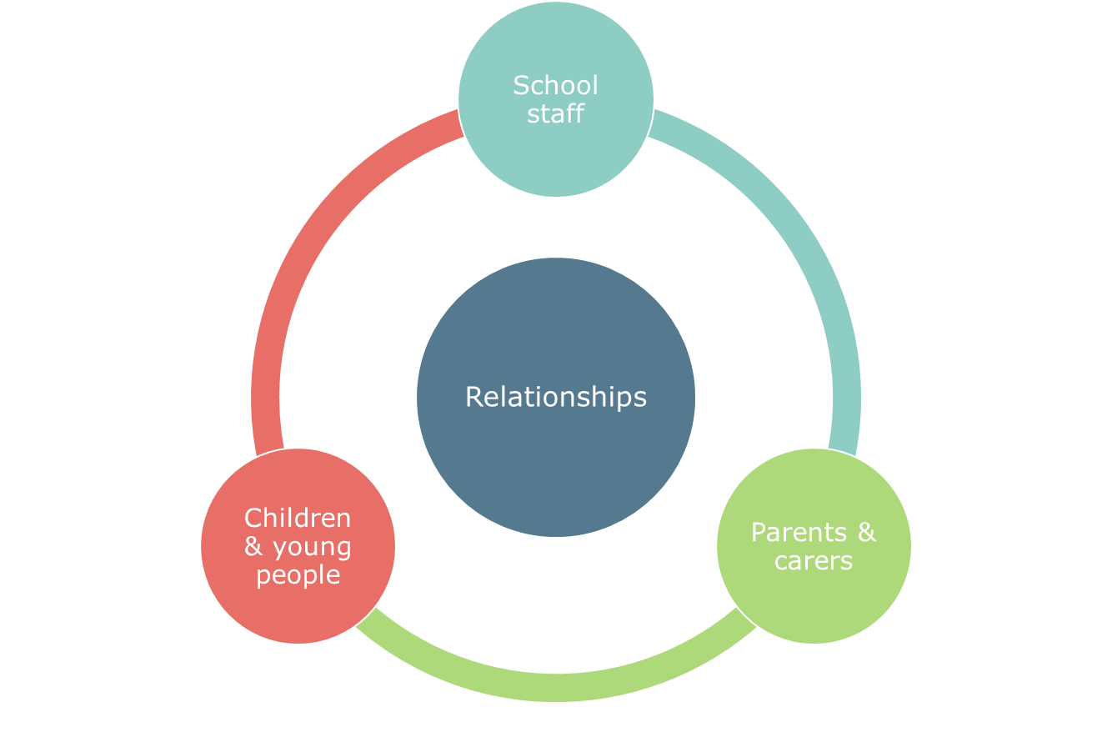

Slide 5
Key questions
What are the key things that strike you as the most difficult from the parent’s perspective?
The points in the story where you could hear that a different approach could have been taken – what else could have been done by the school to avoid the poor outcome?
Your thoughts on ways the parent could have approached the issue differently – how easy would that be for a parent at your school?

Slide 6

One family’s story: A home-school partnership gone wrong.
Audio of parent describing a poor relationship with school

Slide 7
DISCUSSION

Slide 8
Practical approaches.
Home school diaries, key contact and use of shared strategies.
Inclusive practices at home and at school and pre-planning for changes at school.
Child or young person advocacy.
Pupil passports.
Inclusive meetings.

Slide 9
Effective and inclusive meetings.
Practical
Meetings should be shared as far in advance as possible.
An agenda shared in advance.
All participants and their roles made known in advance.
Clear actions agreed, with timeframes.
Actions are followed up and communicated.
Emotional
Reduce conflict.
Recognise common ground.
Empathise with the impact of the actions or in-actions.

Slide 10

One family’s story: Home-school partnerships that work for everyone.
Audio of parent describing a good relationship with school

Slide 11
Discussion/Feedback
In that case study, two of the key supports to effective communication were:
Having a key contact at school.
Having a communication diary.
In the wider group, please share your thoughts and your experience of the following:
Is there always a key contact in your school for a parent of a child with ASN? And how well does this support communication?
If you have experience of communication diaries, how are they used in practice?
What are the advantages/disadvantages for schools of these supports?

Slide 12
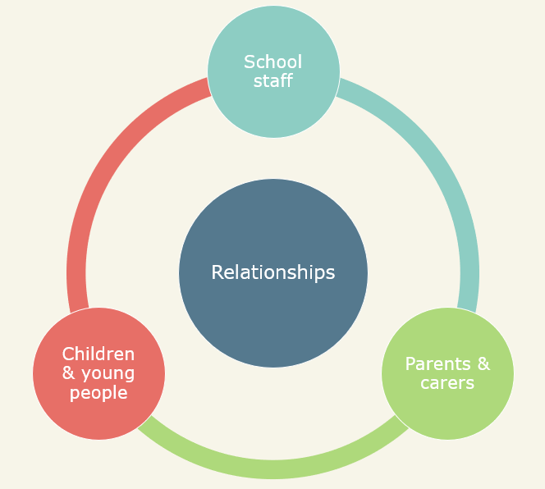
Home–school partnerships: key ingredients.
Mutual respect.
Voice of the child/young person.
Active listening.
Transparency.
Compromise.
Empathy.
Flexibility.
Accessible communication.

Slide 13
COMMENTS/QUESTIONS

Slide 14
Thank you
dinah@mindroom.org
marie-clare@mindroom.org
www.mindroom.org

