Slide 1
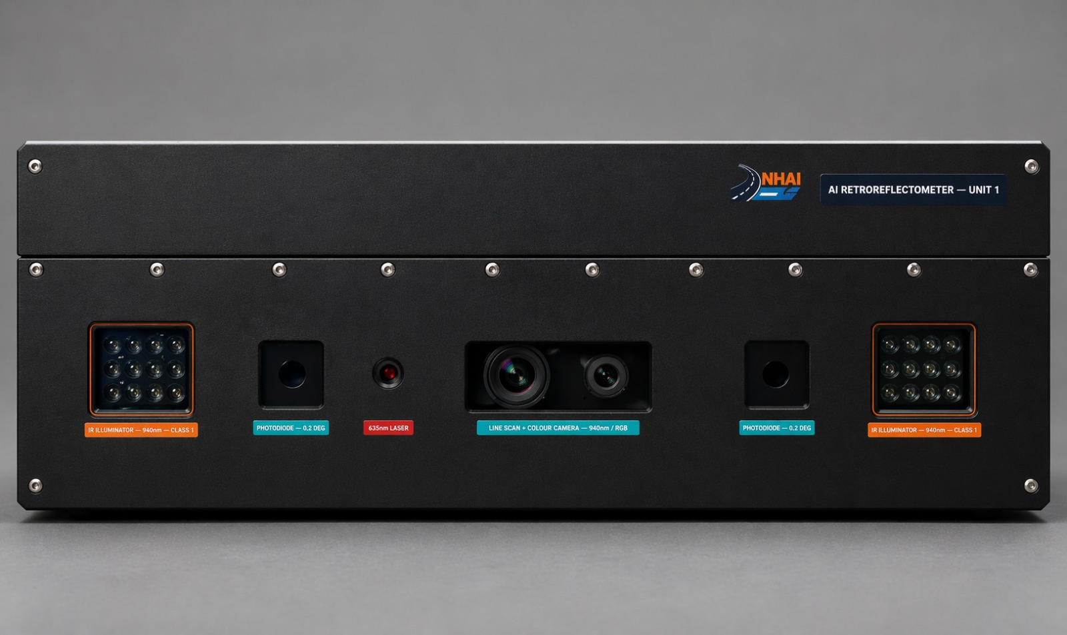
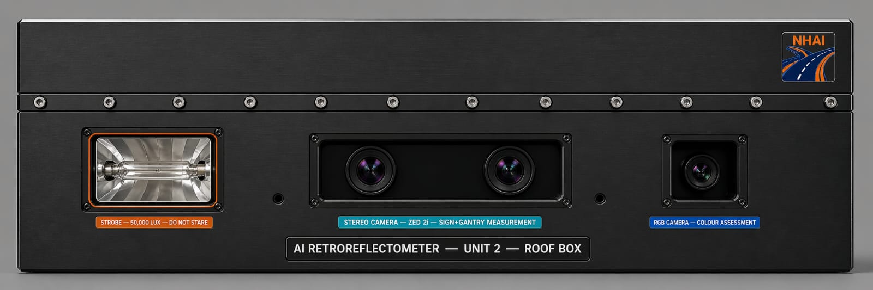
NHAI
6th Innovation Hackathon · Submission
UNIT 1
RASTRA
Front-Mounted
Reflectometer
📷
Front Unit Photo
Road Analysis & Safety Tracking
for Reflective Assessment
Team-Parrot
Team member-Sanidhya Somawar
Anshul Verma
Deepak Kashyap
Onkar Prasad
Deepika Kaiwart
UNIT 2
Roof-Mounted
Reflectometer
📷
Roof Unit Photo
AI-Powered Retroreflectivity Measurement System
Vehicle-Mounted · Highway Speed · Full Cross-Section · IRC 67:2012 / IRC 35:2015
Confidential — Hackathon Submission

Slide 2
The Problem
Why current retroreflectivity inspection is broken
⚠️
🐢
📉
Dangerous
Impossibly Slow
Silent Degradation
Workers stand on live highways — including 6-lane expressways — with handheld devices to measure one point at a time.
Manual point-by-point inspection cannot scale across NHAI's 50,000+ km network. Critical failures go undetected.
Markings, signs and studs lose retroreflectivity over time from UV, tyre wear and pollution — with no automatic monitoring.
150,000+
0.2°
IRC 67
IRC 35
km of NHAI Highways
Observation Angle (IRC)
Signs Standard
Markings Standard

Slide 3
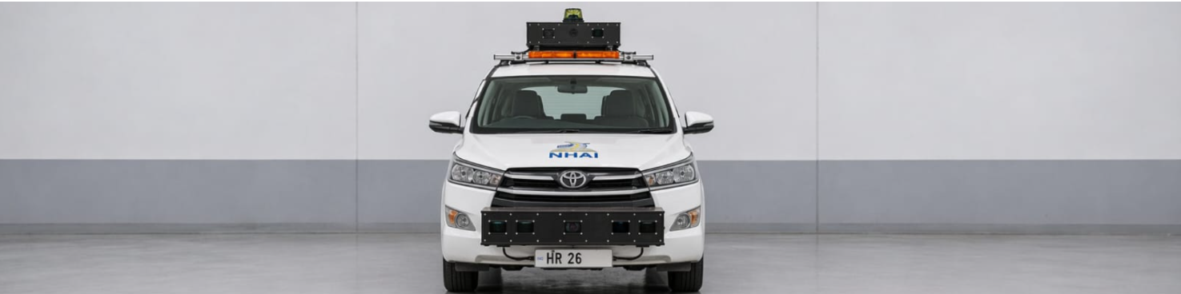
RASTRA — Complete Integrated System
One vehicle · One pass · All assets · Highway speed
UNIT 1 Sensors
UNIT 2 Sensors
🚗
▸ 940 nm IR LED Projectors (×2)
▸ White LED Flash Strobes (×2 + ×1 up)
▸ Silicon Photodiodes + 16-bit ADC
Survey Vehicle
▸ Stereolabs ZED 2i Stereo Camera
▸ Basler 8192-px Line Scan Camera
UNIT 1 · FRONT-MOUNTED
▸ Basler Near-IR Camera 850 nm
▸ Livox Mid-360 LiDAR
Road Markings (White & Yellow) Road Studs / RPMs (LiDAR confirmed) Measurement interval: 2.2 m continuous
▸ Ricoh Theta Z1 Fisheye (Gantry)
▸ 635 nm Colour Laser (White/Yellow)
▸ Livox Mid-360 LiDAR (Signs)
▸ FPGA Trigger Board — 1 µs sync
UNIT 2 · ROOF-MOUNTED
▸ Motorised Tilt Bracket (0°–25°)
Road Signs (Shoulder & Gantry) Flash measurement: 1 µs strobe at 15–20 m
RASTRA Software · BLE Connected · GPS Road-Tracked · IRC 67:2012 / IRC 35:2015 Compliance · PDF + CSV Export

Slide 4
Unit 1 — Front-Mounted Reflectometer
Road Markings & Road Studs · IRC 35:2015 · 0–120 km/h · IP67
📷 Front-Mounted Unit Photo
💡
Illumination
🔬
Photodiode
940 nm IR LED Array
Hamamatsu S1227
Pulsed 48W · invisible to human eye
10×10 mm · 16-bit ADC @ 1 MSPS
📸
Line Scan Camera
📡
LiDAR (Studs)
Front-Mounted Unit Photo
Basler 8192-px
Livox Mid-360
107 cm × 22 cm × 36 cm · ~20 kg
0.5 mm/px · hardware-triggered
200K pts/s · ±2 cm height detect
🎯
Coverage
📏
Interval
Full 2-lane Width
Every 2.2 m
[ Add Image Here ]
7.5 m at 12 m ahead · no boom
454 bundles/km · continuous
How it works: IR LED pulses illuminate road 12 m ahead. Retroreflected light is captured by photodiodes at 0.2° observation angle (IRC 35 geometry). 1 MHz sampling averages to one calibrated RL reading every 2.2 m. A 940 nm bandpass filter blocks all sunlight — accurate in full daylight at 120 km/h. LiDAR confirms stud physical height (15–20 mm) for definitive RPM detection.

Slide 5
Unit 1 — Key Technical Specifications
Front-Mounted Box · Markings & Studs · Full spec for evaluation
Parameter | Specification | Significance
Outer Dimensions | 107 cm × 22 cm × 36 cm · ~20 kg | Matches RetroTek-D form factor — front hitch mount
Measurement Speed | 0 – 120 km/h continuous | No slowing of survey vehicle required
Road Coverage | 7.5 m full 2-lane width at 12 m ahead | Simultaneous L + R lane measurement
Wavelength | 940 nm infrared (invisible) | Blocked by bandpass filter — works in daylight
LED Pulse Width | 5 – 50 microseconds (FPGA controlled) | Freeze motion at any speed; no blur
Photodiode | Hamamatsu S1227-1010BR (10×10 mm) | 0.2° observation angle per IRC 35
ADC Resolution | 16-bit @ 1 MSPS per channel | 0.03 mcd/lx·m² resolution in RL
Line Scan Camera | Basler raL8192-12gm · 8,192 pixels | 0.5 mm/pixel at 12 m — sub-mm detail
LiDAR (Studs) | Livox Mid-360 · 200,000 pts/sec | Physical stud height ±2 cm confirmation
Colour Laser | 635 nm red · 10 mW pulsed | White vs yellow marking discrimination
IP Rating | IP67 — fully sealed | Monsoon-season surveys without protection
Standards | IRC 35:2015 · IS 1580 | Complete Indian highway compliance

Slide 6
Unit 2 — Roof-Mounted Reflectometer
Road Signs & Gantry Signs · IRC 67:2012 · 15–20 m Flash Photometry · IP67
📷 Roof-Mounted Unit Photo
⚡
White LED Strobe
📷
Stereo Camera
2 × 250W Pulsed
ZED 2i · ±1% Depth
50,000 lux at 15 m · 1 µs flash
120 mm baseline · 2.2 MP per eye
🔭
IR Camera
🌐
Fisheye (Gantry)
Roof-Mounted Unit Photo
Basler + 850 nm Filter
Ricoh Theta Z1
80 cm × 30 cm × 20 cm · ~16 kg
Cross-validates RL independently
360°×180° · overhead panel capture
📡
LiDAR (Signs)
⚙️
Motor Tilt
Livox Mid-360
0° – 25° elevation
[ Add Image Here ]
Detects signs 40 m · gantry 100 m
Auto-tilt: roadside → gantry mode
How it works: LiDAR detects sign at 40 m. FPGA calculates exact timing to fire 1 µs white strobe when sign is 15–20 m away. ZED 2i measures distance ±1%. RL = Luminance ÷ Illuminance. IR camera cross-validates independently. For gantry: ZED 2i captures at oblique angle; fisheye captures from below when passing under — both measurements cross-checked.

Slide 7
Unit 2 — Key Technical Specifications
Roof-Mounted Box · Signs & Gantry · Full spec for evaluation
Parameter | Specification | Significance
Outer Dimensions | 80 cm × 30 cm × 20 cm · ~16 kg | Low-profile roof mount — minimal drag
Sign Measurement Range | 15 – 20 m from vehicle | Optimal flash geometry for RL accuracy
Strobe Output | 50,000 lux on sign face at 15 m | EN 12899-1 / IRC 67 minimum requirement
Flash Duration | 1 microsecond per flash | 0.022 mm vehicle motion — zero blur
Flash Energy | 4.5 Joules per flash (30V × 10,000 µF) | Capacitor bank — fully solid-state
Stereo Camera | ZED 2i · ±1% depth at 15 m | Distance accuracy critical for RL formula
RL Formula | RL = Luminance (L) ÷ Illuminance (E) | Standard IRC 67 photometric method
Colour Temperature | 6500 K · CRI > 90 | Matches D65 / IRC 67 white light spec
LiDAR Detection | Signs: 40 m · Gantry: 100 m | Pre-arms flash timing before sign zone
Gantry System | ZED 2i forward + Fisheye overhead | Two-angle cross-validation for prismatic sheeting
Tilt Range | 0° – 25° motorised elevation | Auto-switches sign ↔ gantry measurement mode
Standard | IRC 67:2012 · IS 15758 · MoRTH RSQM | Complete Indian road sign compliance

Slide 8
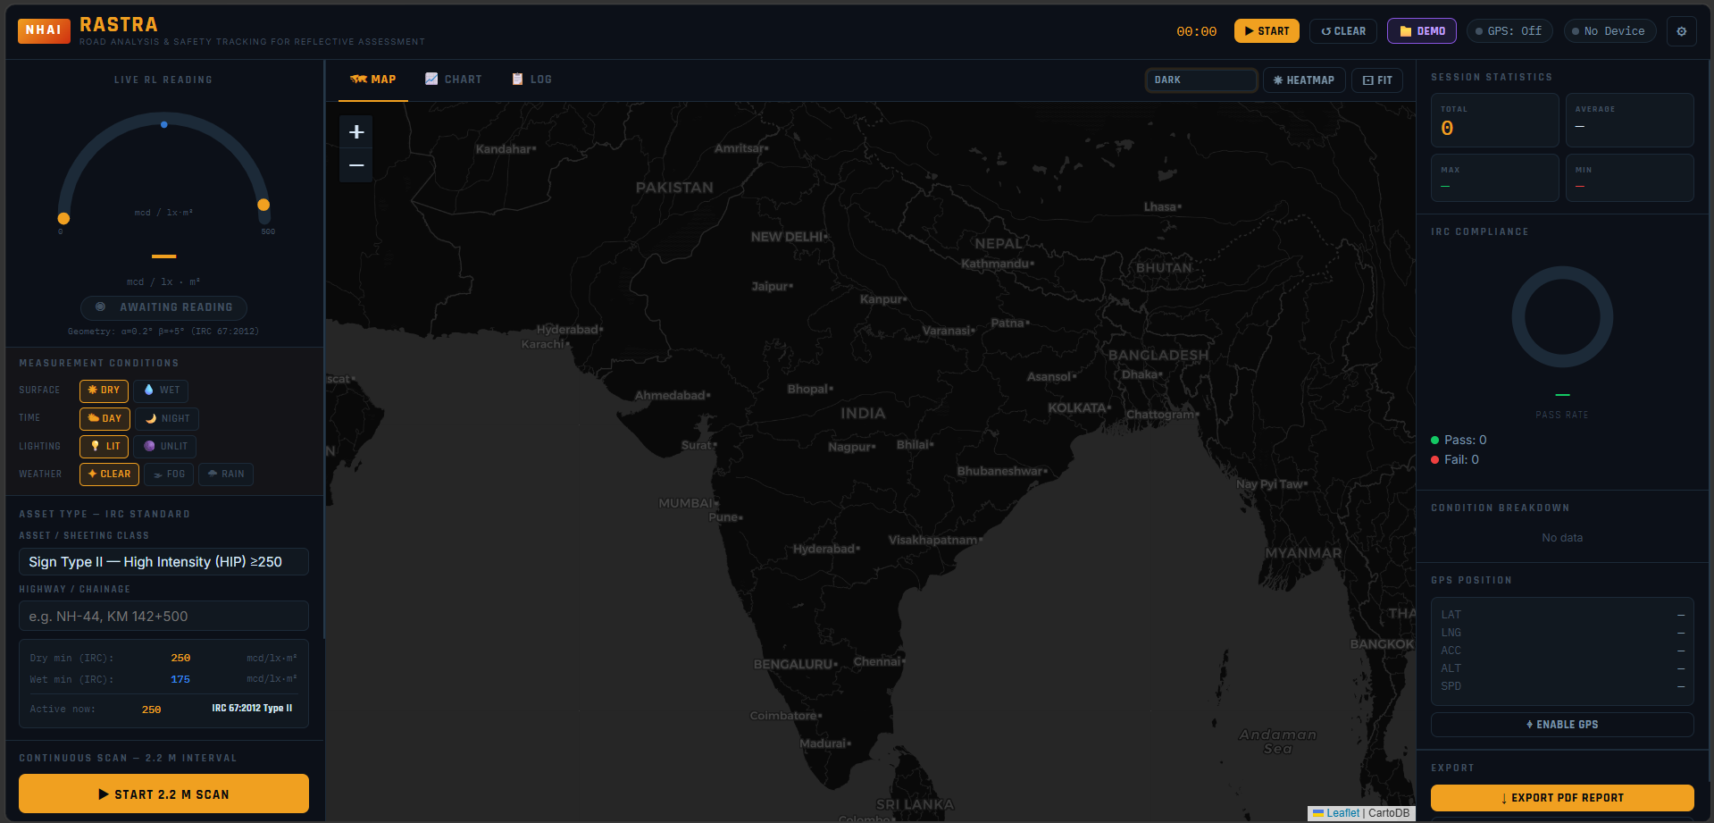
RASTRA Application — Software
BLE Connected · GPS Road-Tracked · IRC Compliant · Real-time Bundle Dashboard
📡
BLE Instrument Link
📷 RASTRA Dashboard Screenshot
Connects to reflectometer over Bluetooth. Each notification = one 2.2 m bundle.
🗺️
GPS + OSM Road Map
Readings placed on real highway centreline from OpenStreetMap — satellite + road overlay.
RASTRA Dashboard Screenshot
📦
Bundle System
Application running in Chrome browser
Every 2.2 m = simultaneous scan across all channels: markings, studs, signs, gantry.
📋
IRC Pass/Fail
Separate thresholds for dry/wet, IRC 67 for signs, IRC 35 for markings and studs.
[ Add Image Here ]
Export: PDF Inspection Report · CSV with GPS + Conditions + IRC Results · GIS-ready coordinates

Slide 9
The 2.2 m Bundle — Cross-Section Scan
Every 2.2 metres = simultaneous readings across full road width in one capture
Left
Sign
Left
Delin.
Left Edge
Marking
Left
Stud
Left Lane
Mark
Centre
Line
Right Lane
Mark
Right
Stud
Right Edge
Marking
Right
Delin.
Right
Sign
sgl
dl
el
sl
ll
cm
rl
sr
er
dr
sgr
← ← ← ← ← ← ← ← ← ← ← 2.2 m interval between bundles → → → → → → → → → → →
11
9
454
1 µs
Channels max
Active in demo
bundles/km
synchronised
per bundle
(configurable)
@ 2.2 m
trigger jitter

Slide 10
IRC Compliance — Standards Applied
Every reading evaluated against correct IRC clause for that asset and condition
IRC 67:2012 — Traffic Signs
IRC 35:2015 — Markings, Studs, Delineators
Type
Dry min
Wet ref
Geometry
Asset
Dry
Wet
Geom.
Type III (Diamond Grade)
380
266
α=0.2° β=+5°
White Marking — New
100
35
R2
Type II (High Intensity)
250
175
α=0.2° β=+5°
White Marking — In-Service
50
20
R2
Type I (Engineering Grade)
70
49
α=0.2° β=+5°
Yellow Marking — New
60
25
R2
mcd / lux / m² · IRC 67:2012 §6.3 Table 2 · White light measurement (6500 K D65)
Yellow Marking — In-Service
30
15
R2
Gantry / Overhead Signs
Road Stud / RPM Cat-B
300
300
Cat-B
Same Type III DG criteria · Min 50 cd/lux/m² per panel · MoRTH RSQM specification · Two-angle capture: ZED 2i + Fisheye cross-validated
Delineator / PRRP
150
150
IRC 35
Wet Measurement (Signs)
mcd / lx / m² · IRC 35:2015 §8 Table 1 · α=1.24° β=2.29° (R2 geometry) · Studs: same threshold wet/dry
IRC 67:2012 mandates dry-condition measurement. Wet reference values (70% of dry) shown for cross-validation only.
RASTRA automatically applies the correct IRC threshold for each channel based on asset type and surface condition (dry/wet). All pass/fail results are tagged with the specific IRC clause reference.

Slide 11
How a Survey Works
From equipment mounting to full NHAI-ready inspection report in one pass
1
2
3
4
5
Mount & Connect
Set Conditions
Start Scan
Real-Time Alert
Export Report
Unit 1 on front hitch
Unit 2 on roof rack
BLE link to RASTRA app
GPS activated · Road loaded from OSM
Surface: Dry / Wet
Time: Day / Night
Lighting & Weather
Active channels configured
Drive at highway speed
Every 2.2 m = full bundle
All channels captured simultaneously
Map updates live
Gauge shows worst RL
Bundle bar: ✓ / ✗ per channel
Map: green/red polyline on road
Non-compliant zones flagged instantly
PDF: summary + all readings
CSV: GPS + IRC + conditions
GIS-ready coordinates
Audit trail per IRC clause
▶
▶
▶
▶
Typical survey speed: 60–80 km/h · Output density: 454 bundles/km · Zero traffic disruption · One vehicle · Two operators

Slide 12
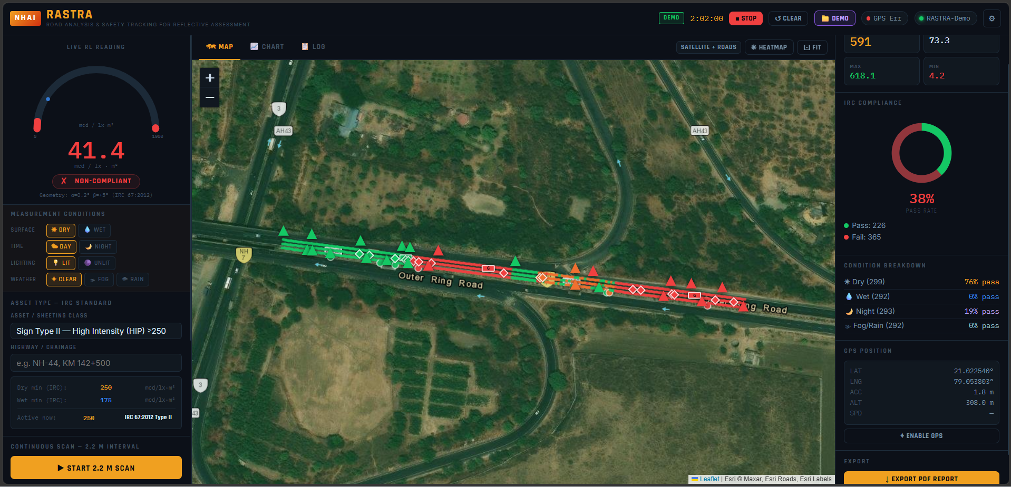
RASTRA Dashboard — Application Features
Real-time inspection interface running in Chrome browser on survey vehicle laptop
📷 RASTRA Application Dashboard — Full Screen Screenshot
RASTRA Application Dashboard — Full Screen Screenshot
Map · Chart · Log · Bundle Bar · Gauge · IRC Compliance Panel
[ Add Image Here ]
🗺️ Satellite + OSM Road Map
📦 2.2 m Bundle System
📊 Multi-Channel Live Chart
✅ IRC Pass/Fail per Channel
📄 PDF / CSV Export
☀️ Heatmap Overlay

Slide 13
Key Advantages Over Current Methods
RASTRA vs manual handheld measurement — the complete comparison
Aspect
Current Manual Method
RASTRA System
Safety
Workers on live highway — direct accident risk
Zero personnel on road — fully vehicle-mounted
Speed
~2–3 km/day manual measurement
60–80 km/h highway speed — 100× faster
Coverage
Selective spot-checking only
100% continuous — every 2.2 m, full cross-section
Channels
One reading per stop (one asset)
Up to 11 channels per bundle simultaneously
Signs
Cannot measure gantry signs safely at all
Microsecond flash photometry · ZED 2i + fisheye cross-check
Night Conditions
Separate night survey required
940 nm filter blocks daylight — works 24/7 without mode change
Data Quality
Manual log sheets — no GPS tagging, no audit trail
GPS road-tracked · IRC clause tagged · PDF/CSV/GIS export
Wet Condition
Wet measurement impractical — separate visit
Condition selector — IRC 35 wet thresholds applied in real time

Slide 14
NHAI
Road Safety
Started with
Visibility.
100×
Zero
100%
faster than manual
workers on road
continuous coverage
60–80 km/h vs 2 km/day
No traffic exposure risk
Every 2.2 m, full cross-section
IRC 67:2012 · IRC 35:2015 Certified Thresholds · Unit 1 + Unit 2 + RASTRA Software
Thank you · NHAI 6th Innovation Hackathon

