Slide 1
FINAL INTERNSHIP PROJECT
Enterprise HRMS
Live Delivery Checklist
Employee management, leave workflow, assets, reports, audit trail, and analytics in one full-stack React + Node.js application.
✓ GitHub Code
✓ Render Backend
✓ Vercel Frontend
✓ Cloud PostgreSQL
✓ PDF + PPT
Developer: Sanidhya Vijayvargiya
Enterprise HRMS | 1

Slide 2
PROJECT OVERVIEW
A real-world HRMS/ERP style system for internship delivery.
Secure login and protected dashboard using JWT authentication.
Employee CRUD, departments, skills, uploads, and joined listing data.
Leave approval workflow, asset allocation, audit logs, notifications, and reports.
Dashboard analytics with multiple charts for business presentation.
Enterprise HRMS | 2

Slide 3
ARCHITECTURE
React frontend talks to an Express API with deploy-ready environment variables.
Frontend: React + Vite + Recharts + Lucide icons.
Backend: Node.js + Express REST APIs with JWT middleware.
Database plan: PostgreSQL schema for users, employees, leaves, assets, audit logs.
Deployment plan: Render API, Vercel frontend, Neon PostgreSQL database.
Enterprise HRMS | 3

Slide 4
CORE MODULES
The application covers common HRMS workflows used in companies.
Employee profile management with departments, skills, attendance, and salary.
Leave management with manager approval, HR approval, and final status.
Asset tracking for laptop, monitor, ID card, access card, and return status.
Reports module with salary, TDS, PF, net salary, and CSV export.
Enterprise HRMS | 4

Slide 5
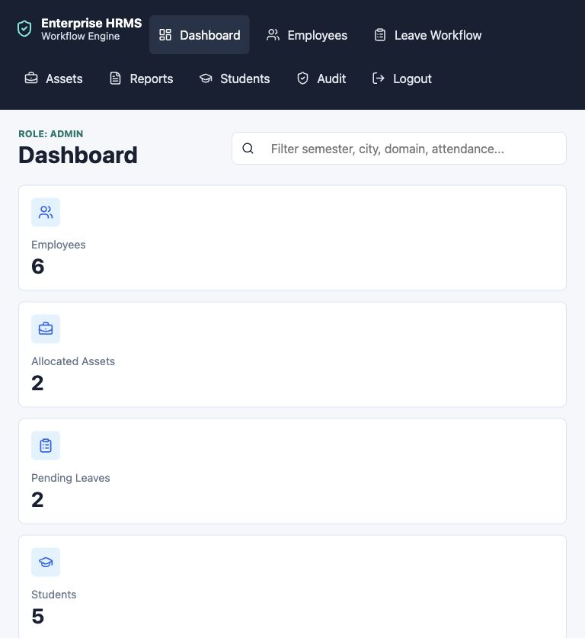
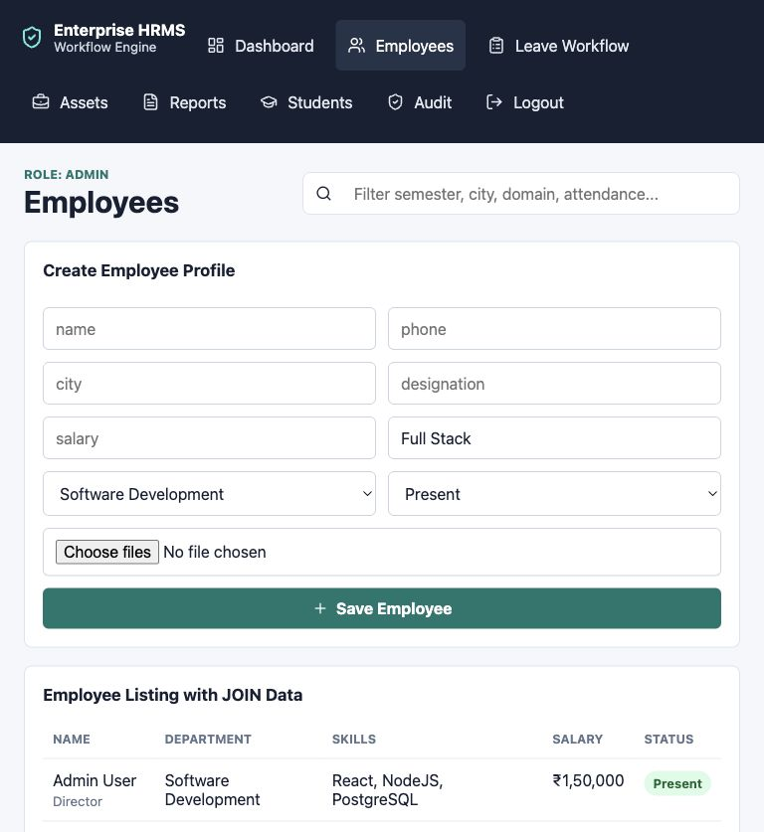
DASHBOARD
Analytics view for management and interview demo.
Includes department, salary, leave, asset, city, and online/offline/hybrid charts.
Enterprise HRMS | 5

Slide 6
DATABASE DESIGN
Normalized PostgreSQL schema supports relationships and reporting.
One-to-many: department to employees, employee to images, employee to leaves.
Many-to-many: employees and skills through employee_skills mapping table.
Audit table stores old/new JSONB data for enterprise tracking.
Views support employee summary reports and SQL JOIN demonstrations.
Enterprise HRMS | 6

Slide 7
DEPLOYMENT PLAN
Final delivery follows industry-style release steps.
Push source code to GitHub repository sanidhya254/sanidhya-demo.
Deploy backend service on Render using npm start and environment variables.
Deploy frontend on Vercel with VITE_API_URL pointing to the Render API.
Create Neon PostgreSQL database and run DATABASE_SCHEMA.sql.
Enterprise HRMS | 7

Slide 8
LEARNING OUTCOMES
This project demonstrates full-stack and production delivery skills.
REST APIs, protected routes, authentication, and role-based access concepts.
React forms, dashboard design, filters, charts, and CSV report export.
PostgreSQL schema design, JOINs, normalization, audit logs, and reports.
GitHub workflow, deployment documentation, and final project presentation.
Enterprise HRMS | 8

