Slide 1



RecPlay
Biometric Slot Booking System

Slide 2

INTRODUCTION
RecPlay is an innovative solution designed to revolutionize sports facility management at our college. The vision is to enhance the overall experience for students by introducing a modern, efficient, and user-friendly system.

Slide 3




Another idea, equally important
PROBLEM
Manual Entry
Unavaliability of Courts
Ineffective Scheduling
Students have to authenticate each time they want to play a sport
Unavailability of courts leads to overcrowding
Valuable academic time is spent waiting for sports facilities.

Slide 4

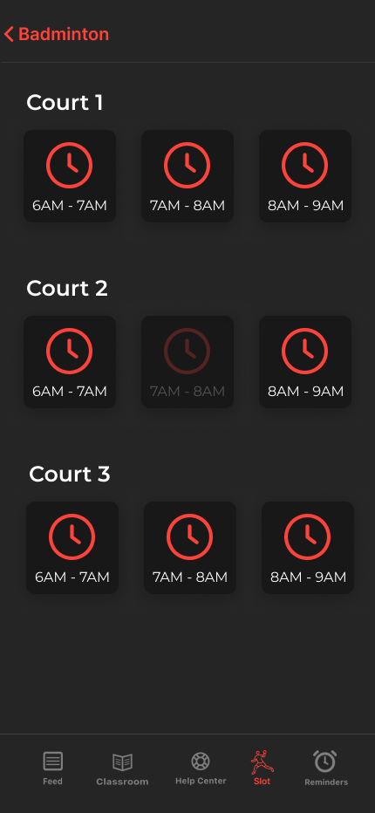
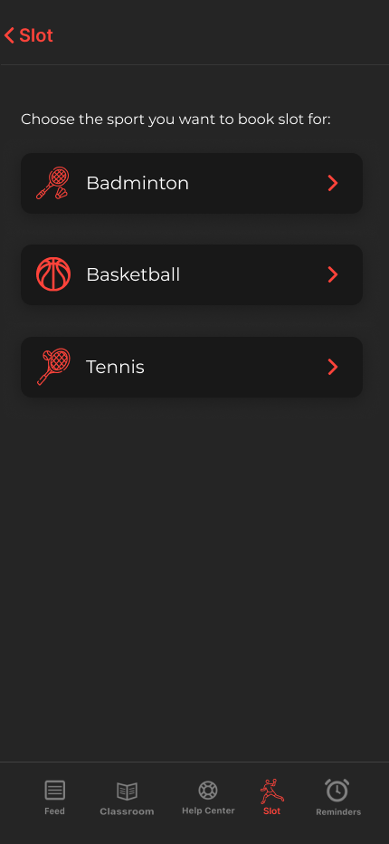
SOLUTION
RecPlay revolutionizes the way we experience sports facilities. No more scribbling in a register; our biometric entry system ensures you breeze through check-ins. Ever missed playing doubles with your friends? With RecPlay, just book your slot in advance, ensuring you get the court and time you want. Worried about losing study time? We've got you covered by eliminating the waiting game. To add an extra layer of convenience, we've seamlessly integrated with Collpoll, making RecPlay accessible to every student in the college. It's time to transform your sports experience – it's time for RecPlay! 🏸✨

Slide 5
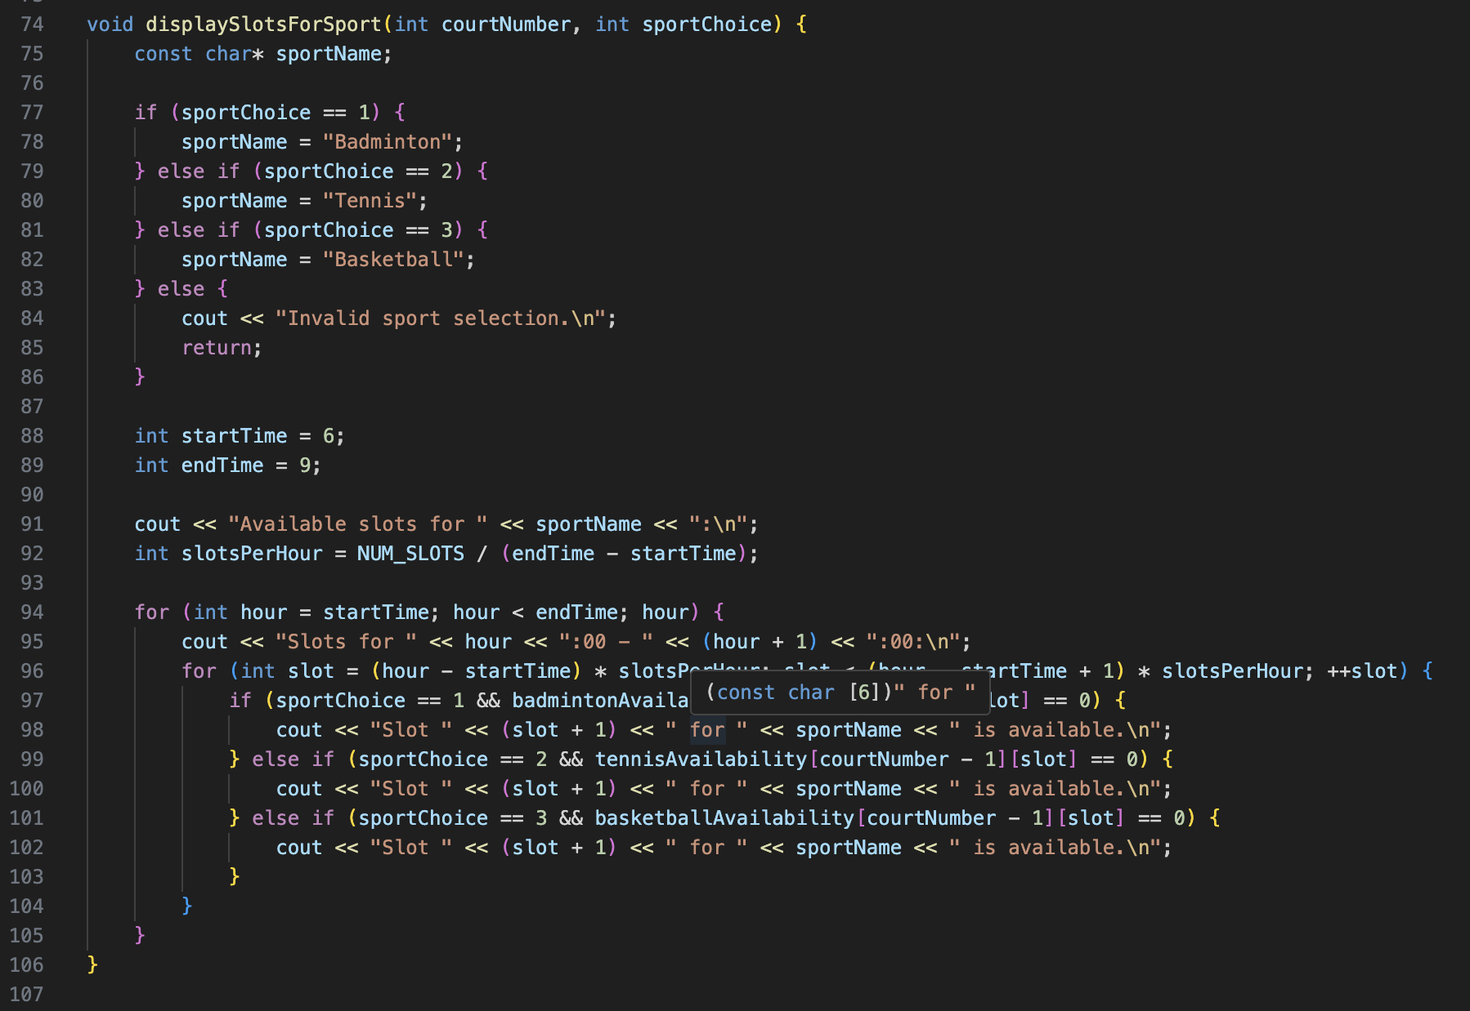

CODE SNIPPET

Slide 6

THANK YOU
Sanidhya Bhardwaj
E22CSEU1423

Slide 7



