Slide 1
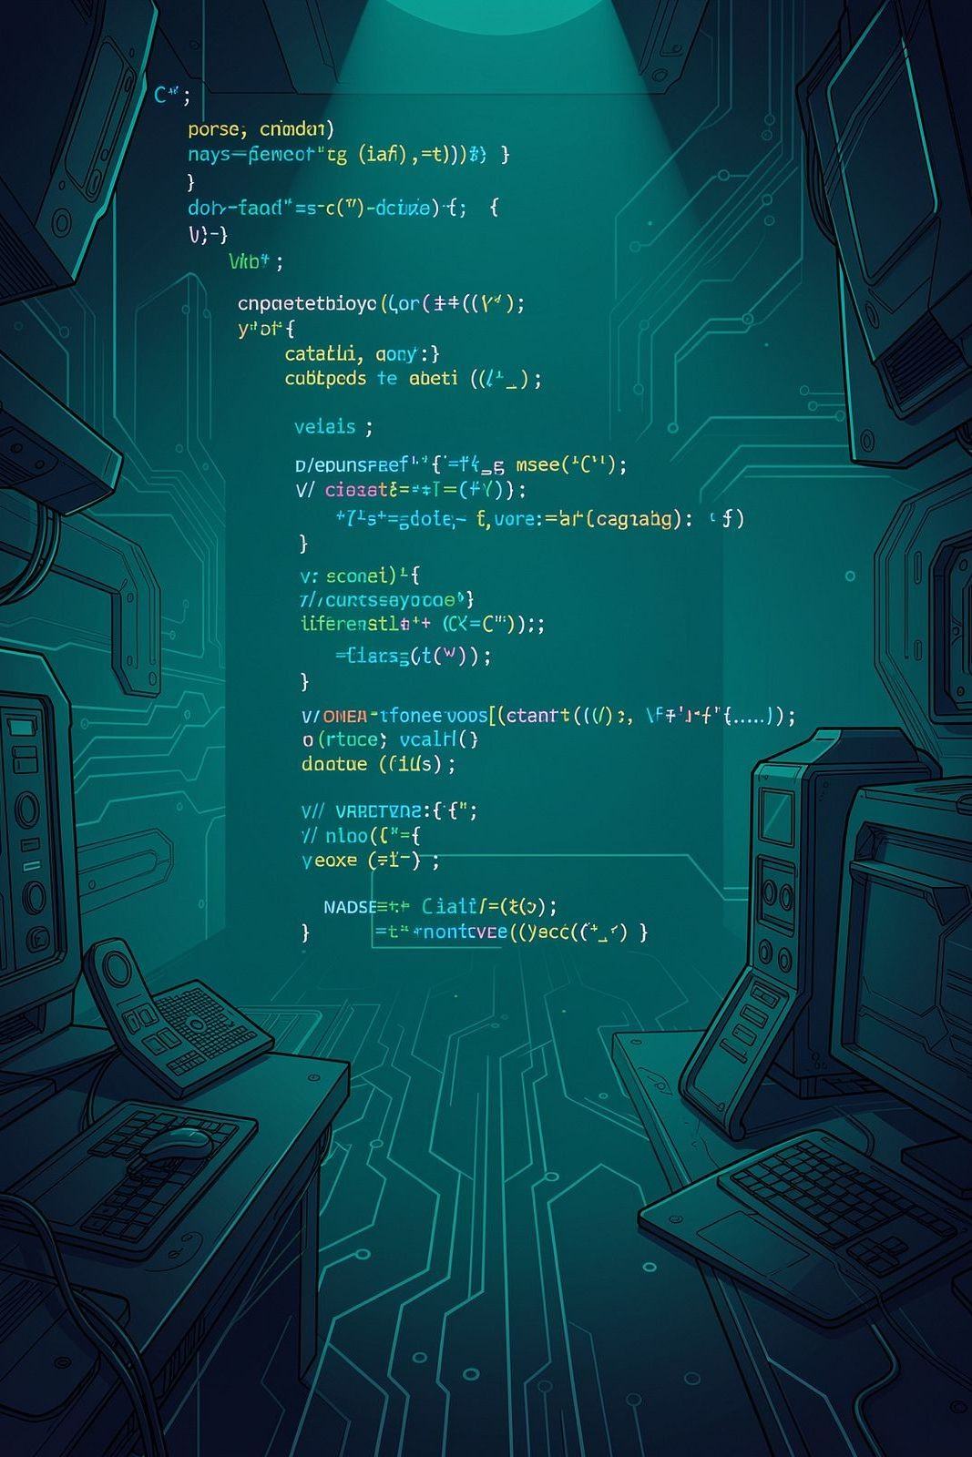
Internship Summit 202C
C++ Programming Internship at Thiranex
Sanidhya Singh — IILM University · Intern – C++ Programming

Slide 2
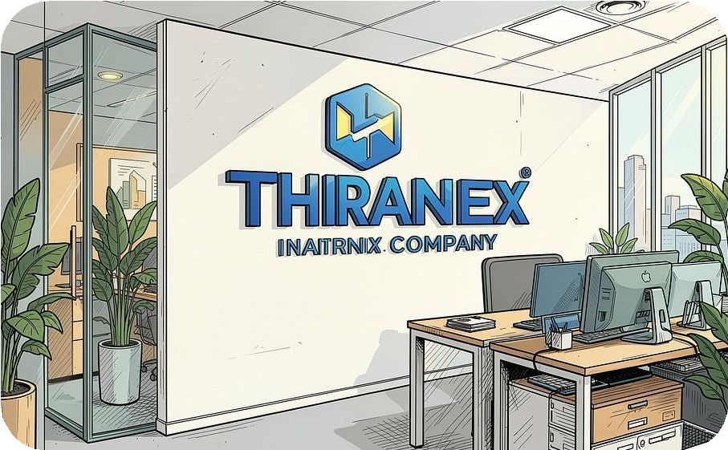
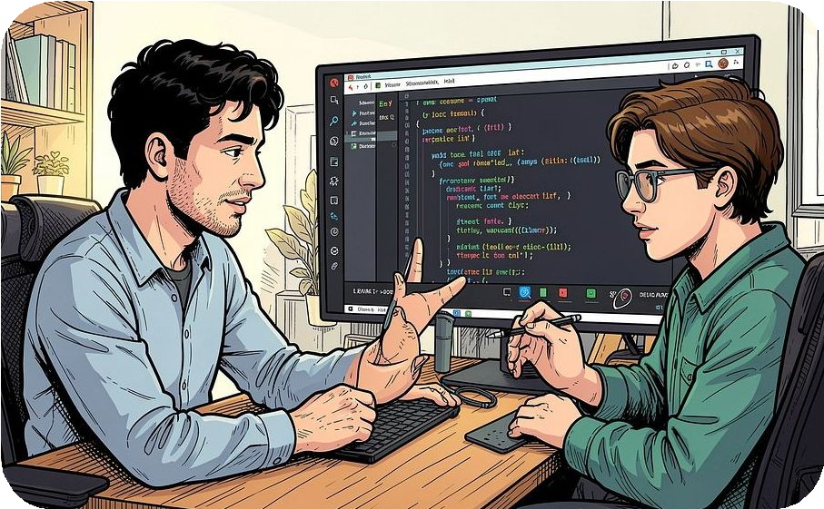

About the Internship
Organization
Thiranex — a software-focused team providing industry mentorship and project-driven learning.
Role & Approach
Intern – C++ Programming. Remote, project-based with hands-on software development and guided mentorship.
Objective
Improve programming fundamentals, problem solving, and practical application of C++ concepts.

Slide 3
Internship Objectives
Strengthen Fundamentals
Deepen core C++ concepts.
Apply Theory
Build real projects to reinforce learning.
Problem Solving
Improve logic, algorithms and debugging approach.
Software Workflow
Understand development lifecycle & versioning.
Code Quality
Write structured, maintainable programs.

Slide 4
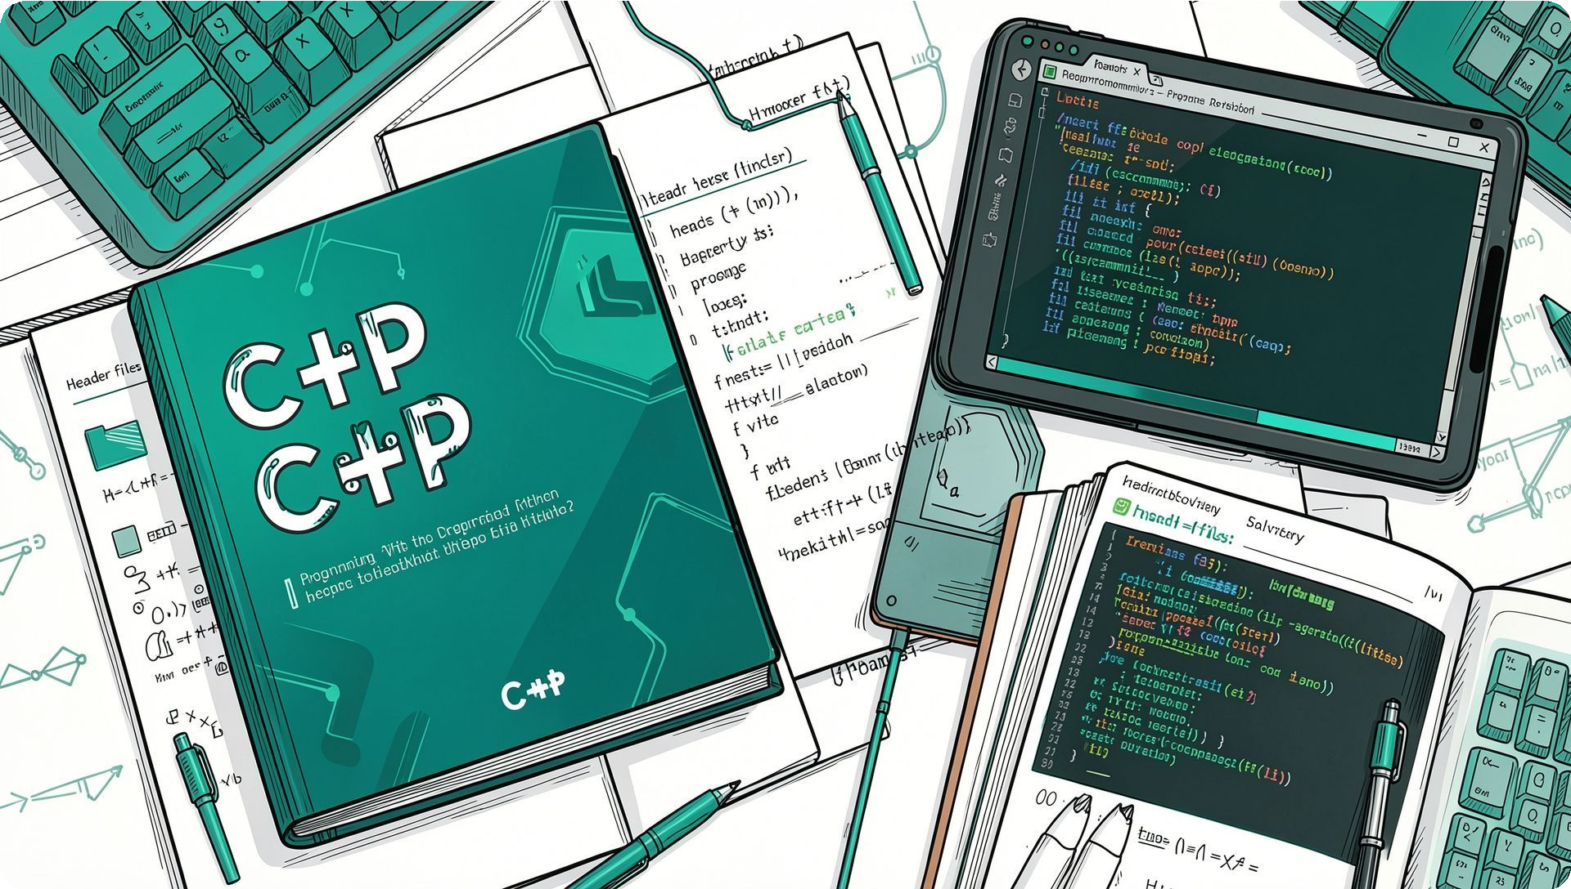
Technologies & Concepts Used
C++
Core language features and standard library.
OOP
Classes, inheritance, encapsulation
Functions
Modular code, parameter passing, recursion
Data Structures
Arrays, vectors, simple custom structures
File Handling
Persisting records to files
Debugging
Step-wise diagnosis and error handling
Problem Solving
Algorithmic thinking & test-driven fixes

Slide 5
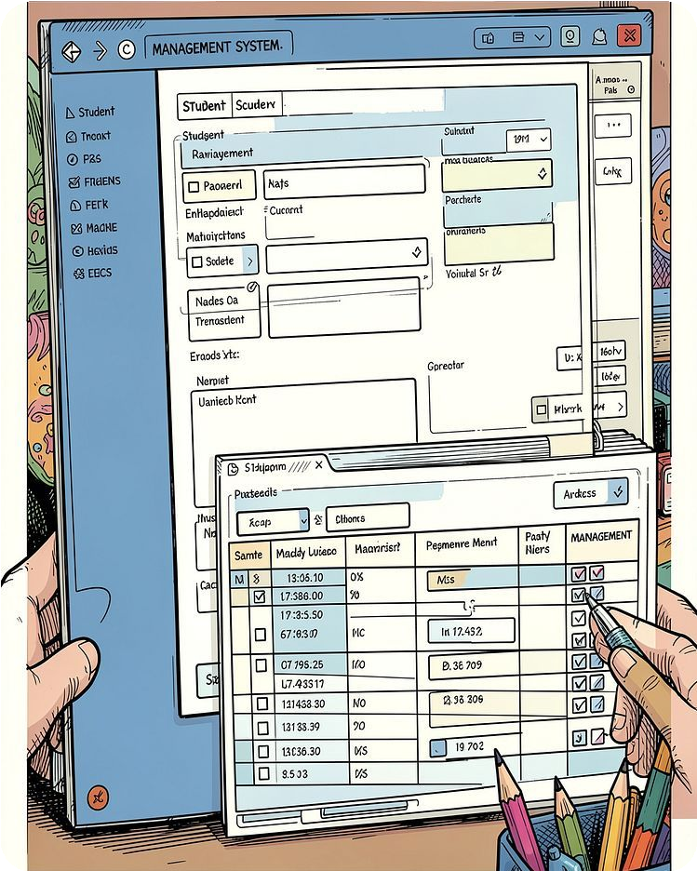
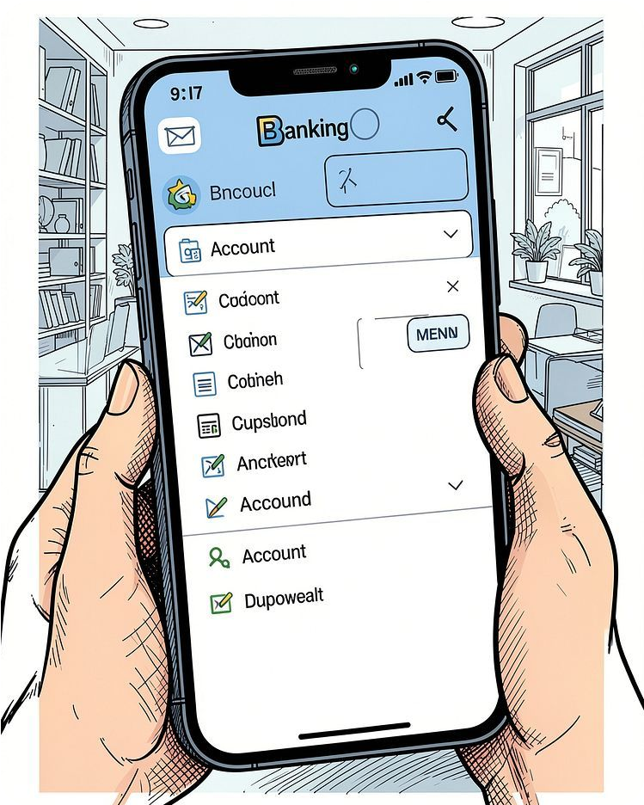
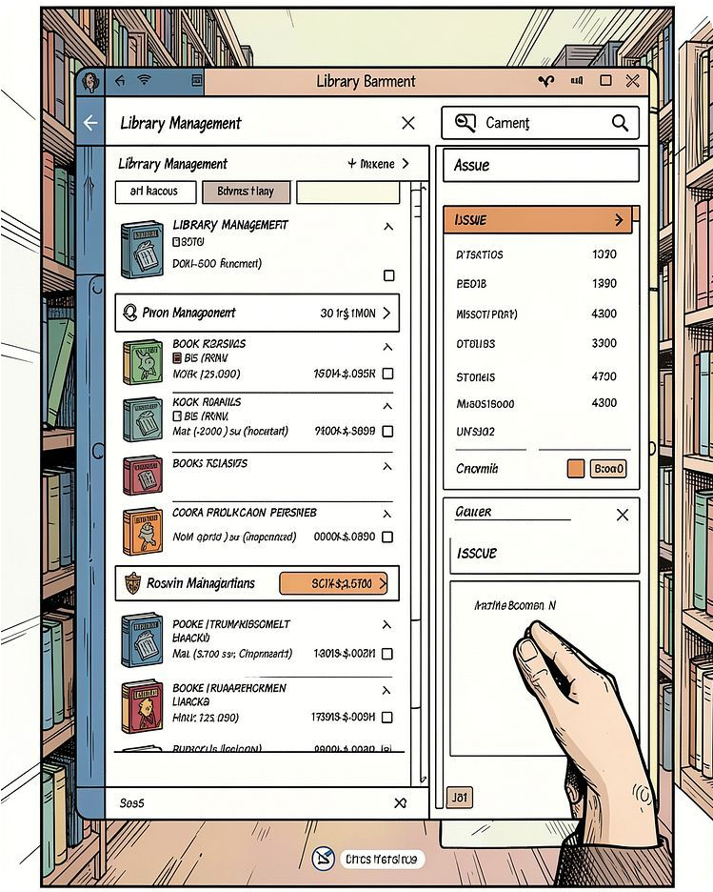
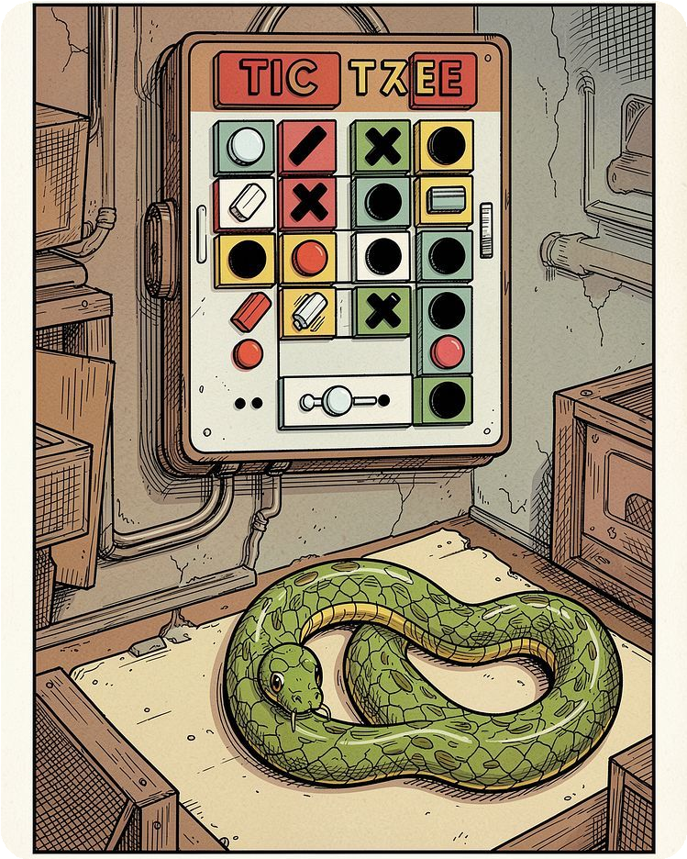
Projects Overview
Student Management System
Record management, search, update, and reports.
Bank Management Application
Account creation, deposit/withdrawal, transactions.
Library Management System
Book cataloging, issue/return workflows.
Mini Game Project
Tic Tac Toe & Snake — interactive logic and state management.

Slide 6
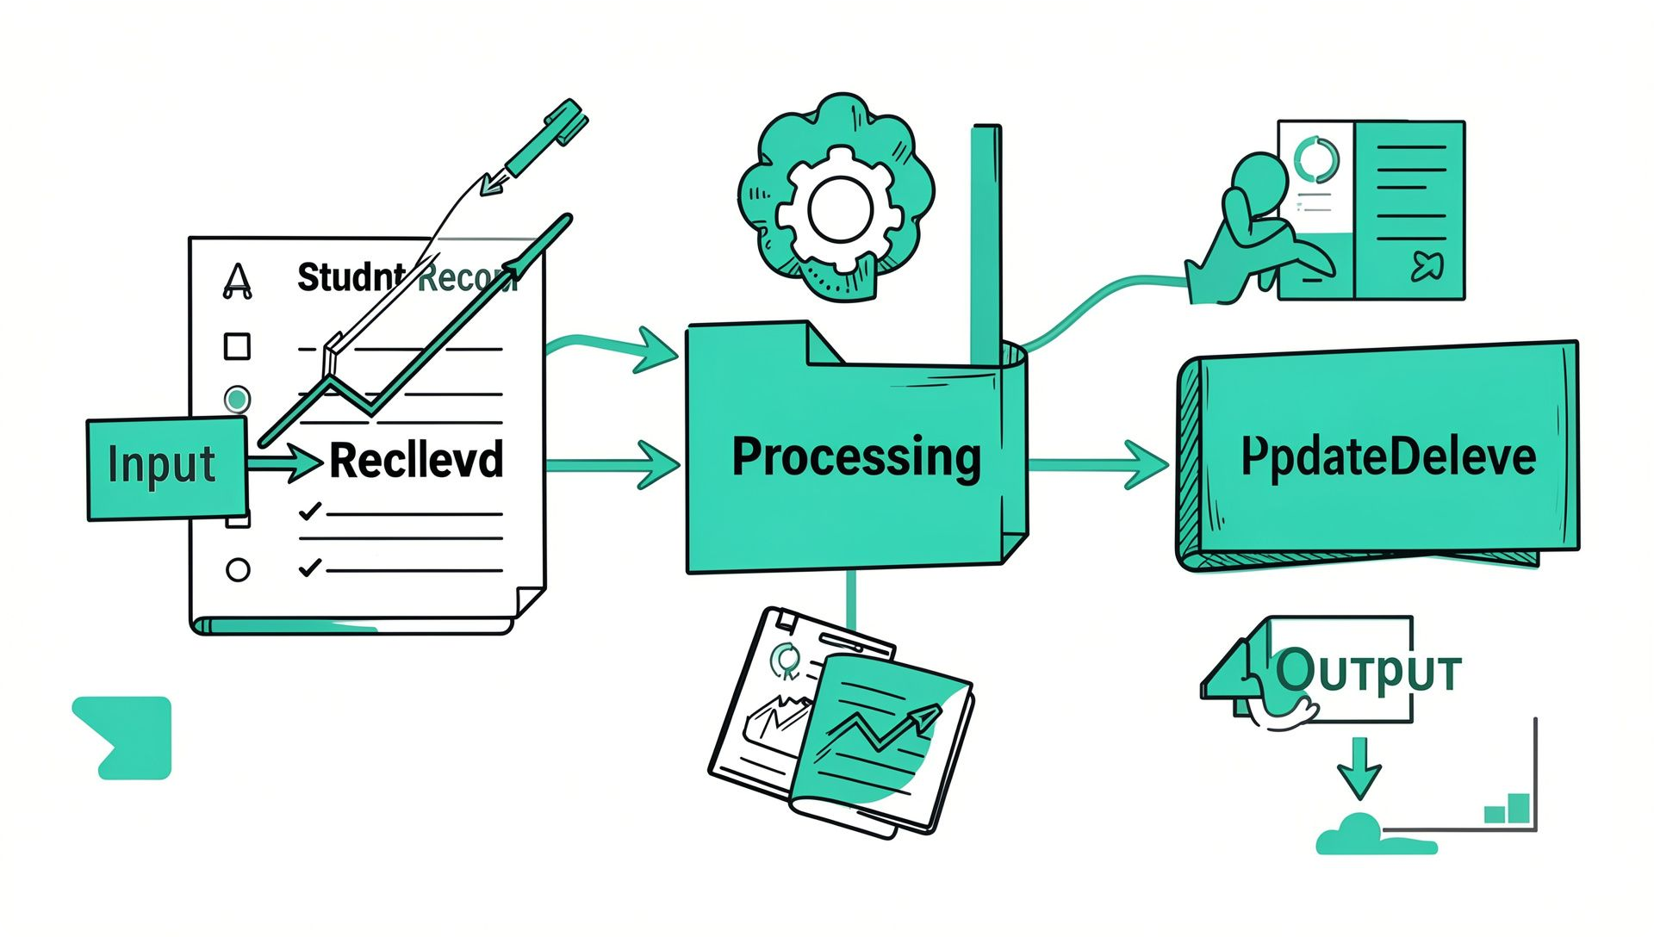

Project — Student Management System
Overview & Features
Add / View / Search student records Update & Delete records
File-based persistence and formatted output
Concepts Used
Classes & Objects
Functions, loops, conditional statements File handling and structured data storage
Placeholder: include screenshot of student_records.txt or console output.

Slide 7
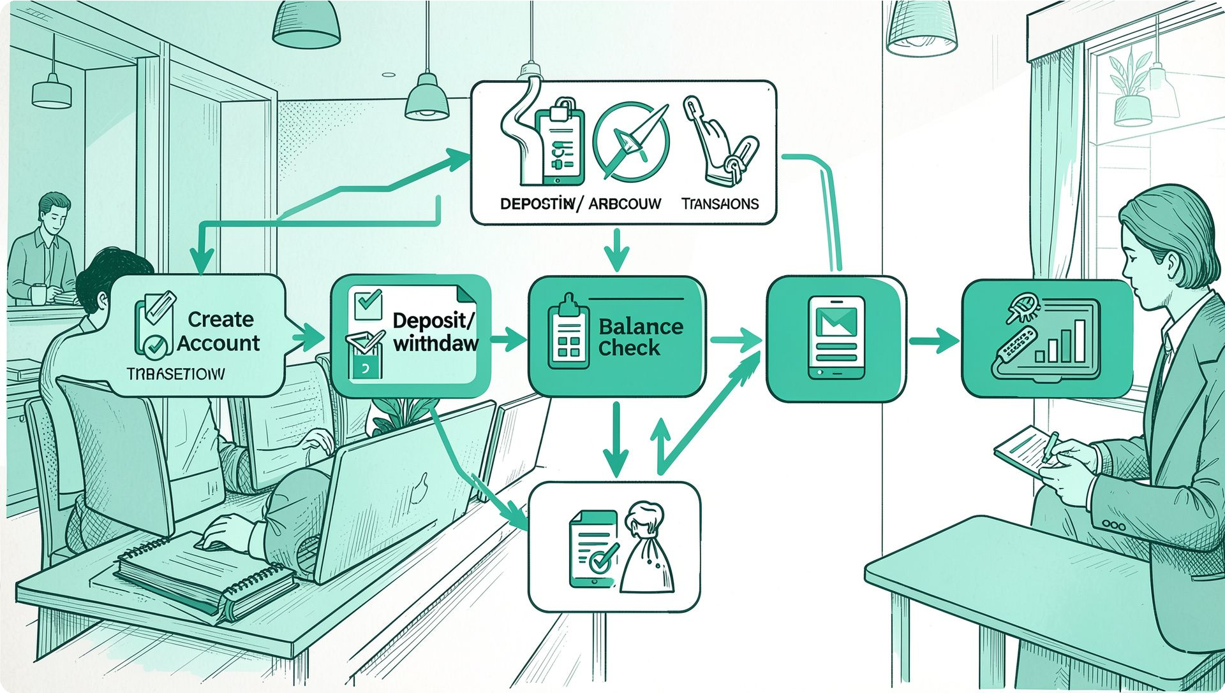
Project — Bank Management Application
Core Features
Create & manage accounts
Deposit, withdrawal, and balance inquiry Basic transaction history and validation
Programming Focus
Encapsulation with classes
Input validation and error handling Persistent storage using files
Placeholder for console demo or account_summary screenshot.

Slide 8
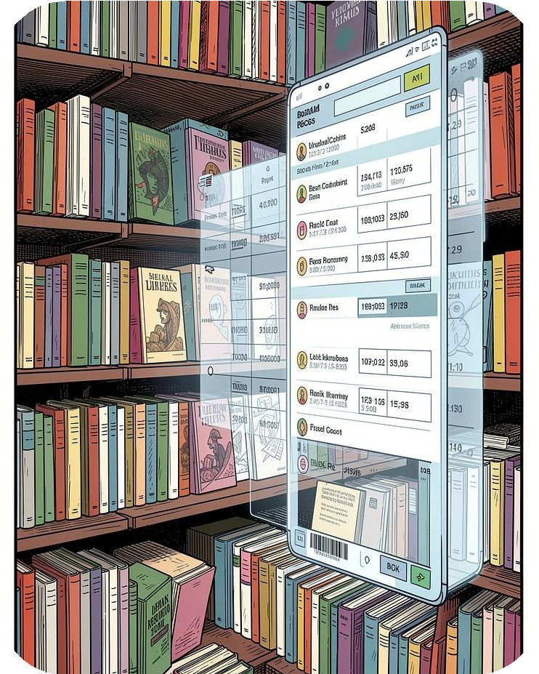
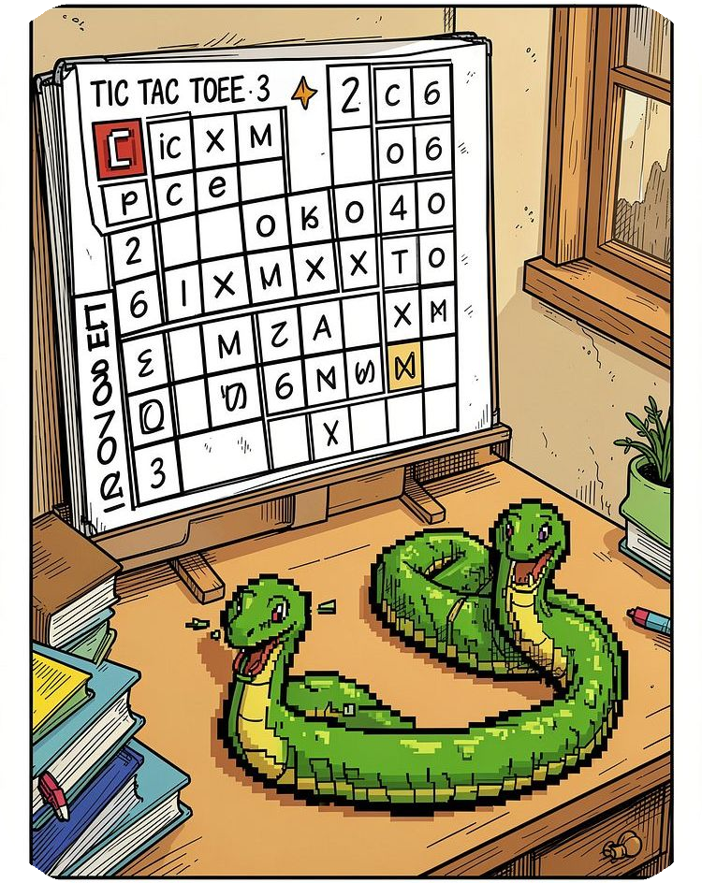
Project — Library Management & Mini Game
Library Manageme nt
Add / Display / Search / Issue / Return books; maintain inventory.
Mini Game Developme nt
Tic Tac Toe: board logic, win/draw checks. Snake: movement, food, collision, scoring.
Learning Highlights
Data modeling for records and inventories Real-time state updates for interactive games Testing edge cases and user inputs
Placeholders: code snippet screenshots and gameplay GIFs

Slide 9
Skills Developed
C++ Programming | OOP & Design Classes, encapsulation, | Debugging & Testing | Problem Solving
Syntax, STL basics, | modular design | Stepwise debugging and | Algorithmic thinking and
memory awareness |  | edge-case checks | optimization
Professional Skills
Time management, self-learning, communication

Slide 10
Challenges & Solutions
Challenges
Designing clear program logic Handling invalid or unexpected input Debugging multi-function flows Managing file-based persistence
Solutions & Practices
Modular design: break tasks into small functions Input validation & defensive coding
Use stepwise debugging and test cases Refactor for readability and reusability
Result: faster issue resolution and cleaner code structure.

