Slide 1

B.Tech(7th Semester) Project Presentation
of the project entitled “Retinopathy of Prematurity(R.O.P.) classification through Fundus images using Deep Learning Algorithms”
By Dhanu Das(Scholar ID- 2114089)
Sanidhya Sinha (Scholar ID- 2114019)
Under the supervision of
Dr. R. Murugan Sir
Assistant Professor
Department of Electronics and Communication Engineering
National Institute of Technology Silchar, Assam, India

Slide 2
OUTLINES
Introduction
Literature Review
Research Gap
Technical Novelty
Problem Statement
Methodology
Dataset
Future Work Plan
References

Slide 3
Introduction
What is Retinopathy of Prematurity?
Retinopathy of prematurity (ROP) is an eye disease that can happen in babies who are premature (born early) — or who weigh less than 3 pounds at birth. ROP happens when abnormal blood vessels grow in the retina (the light-sensitive layer of tissue in the back of your eye). Some babies with ROP have mild cases and get better without treatment. But some babies need treatment to protect their vision and prevent blindness.
What is Retinal Fundus Image?
A retinal fundus image is a specialized medical image that captures a detailed view of the
back of the eye, including the retina, optic disc, blood vessels, and surrounding structures.
Stages Of Retinopathy of Prematurity:
Stage 1 ROP: Demarcation of Line Stage 2 ROP: Visible ridge
Stage 3 ROP: Blood vessels in the ridge Stage 4 ROP: Sub-total retinal detachment
Stage 5 ROP: Total retinal detachment

Slide 4
Current Techniques for Detecting Retinopathy of Prematurity (ROP)
Fundus Examination: Indirect Ophthalmoscopy: Standard method using a specialized lens for wide-field retinal examination.
Wide-field Imaging:Digital Fundus Photography: Captures detailed images of the peripheral retina using wide-field imaging systems (e.g., RetCam).
Automated Screening System: Machine Learning Algorithms: Analyzes fundus images to assist in early ROP detection. Artificial Intelligence (AI): Enhances accuracy and speed of detection through image analysis.
Telemedicine: Remote Screening: Allows for digital imaging in NICUs, enabling transmission of images to specialists for evaluation.
Biomarkers and Genetic Testing: Genetic Testing: Investigates genetic markers to target screening in at-risk populations.
Biomarkers: Research into specific indicators in blood or retina that may suggest ROP risk.

Slide 5
Motivation for Using Retinal Fundus Images to Detect Retinopathy of Prematurity
Non-Invasive: The screening process is painless and non-invasive compared to traditional diagnostic methods for ROP.
Cost-Effective: Utilizes retinal imaging techniques, reducing reliance on more expensive diagnostics like MRIs and extensive hospital stays.
Early Detection: AI technology can identify early signs of ROP in retinal vessels before visible symptoms appear, allowing for timely intervention.
Widespread Availability: Retinal imaging devices are increasingly common and accessible in neonatal care units, facilitating broader screening efforts.
Speed & Automation: AI enhances the speed and accuracy of retinal image analysis, improving the efficiency of ROP diagnosis and follow-up care.

Slide 6
Literature Review
Name of the Paper | Name of the Journal | Year of Publication | Methodology | Limitation
1. Plus disease classification in Retinopathy of Prematurity using transform based features. | Multimedia Tools and Applications (2024) | 2024 | ANN trained using Wavelet and Curvelet features. | The dataset was small, and further improvements could be achieved by expanding the dataset and incorporating additional image features or deep learning methods.
2. Evaluation of a deep learning image assessment system for detecting severe retinopathy of prematurity | British Journal of Ophthalmology (2019) | 2019 | CNN trained on retinal images for vascular assessment. | The study faced variability in expert diagnoses and excluded poor-quality images, with limited detection of zone and stage features​
3. Automated Detection of Retinopathy of Prematurity Using Quantum Machine Learning and Deep Learning Techniques | IEEE Access. | 2023 | QSVM trained using SIFT and SURF features from SegNet-segmented retinal vessels. | The model's performance may be limited by the diversity of the dataset, affecting its generalizability to various populations.

Slide 7
Name of the Paper | Name of the Journal | Year of Publication | Methodology | Limitation
4. Development and Validation of a Deep Learning Model to Predict the Occurrence and Severity of Retinopathy of Prematurity | JAMA Network Open | 2022 | It used retrospective prognostic design | 1. Limited generalizability due to varying clinical characteristics across studies, requiring further validation with multi-center datasets. 2. The model only predicts occurrence and severity of ROP, lacking detailed predictions
5. Early Detection of Retinopathy of Prematurity stage using Deep Learning approach | AuthorInfo | 2024 | ROP using a convolutional neural network (CNN) | Its small dataset size and variability in image quality.

Slide 8
Research Gap
The existing studies on the classification of Retinopathy of Prematurity (ROP) using fundus images and deep learning algorithms often rely on relatively small datasets. This limitation hinders the accuracy and generalizability of the predictive models. Moreover, critical factors such as gestational age, birth weight, and oxygen exposure history, which are essential for ROP risk assessment, are frequently underrepresented or missing from these datasets. The absence of comprehensive patient data can significantly affect the performance of ROP classification models.
Additionally, many studies do not account for variations in clinical practices and diagnostic criteria across different healthcare settings, which may lead to inconsistencies in model applicability. There is also a lack of diverse datasets that reflect the various demographic and clinical characteristics of the population at risk for ROP. This raises concerns about the model's ability to generalize across different ethnic groups and healthcare environments.
To enhance the robustness of deep learning models for ROP classification, larger, diverse datasets with comprehensive clinical histories are needed for validation across various populations.

Slide 9
Technical Novelty
Early methods of detecting Retinopathy of Prematurity (ROP) include ophthalmoscopic examination, indirect ophthalmoscopy, and other retinal imaging techniques. We can enhance the early detection of ROP risk factors efficiently through this process—
Integration of Medical Imaging and AI : This project integrates medical imaging with advanced AI techniques to analyze retinal fundus images for the early detection and progression monitoring of Retinopathy of Prematurity.
Non-Invasive Early Detection : Retinal imaging provides a non-invasive and effective method to identify ROP at an early stage, enabling timely diagnosis and intervention to prevent severe vision impairment or blindness.
Deep Learning and CNN : Deep learning algorithms, especially Convolutional Neural Networks (CNNs), are applied to automatically extract complex features from fundus images, helping detect early-stage signs of ROP and facilitating more accurate diagnosis.
Multimodal Data Fusion : The project combines fundus images with clinical data of premature infants, such as gestational age, birth weight, and oxygen exposure, improving the precision of prediction models for ROP progression by considering various relevant factors.
8

Slide 10
Problem Statement
Retinopathy of Prematurity (ROP) is a leading cause of visual impairment in premature infants, necessitating early detection for effective intervention.
High-resolution fundus images provide critical insights into the retinal landscape, crucial for assessing ROP severity.
Manual analysis of these images is time-consuming and requires specialized expertise, highlighting the need for automation.
Deep learning algorithms can efficiently classify ROP stages, improving diagnostic accuracy and speed.
Image enhancement techniques and feature isolation, such as blood vessels and the optic disc, are essential for optimizing model performance.

Slide 11
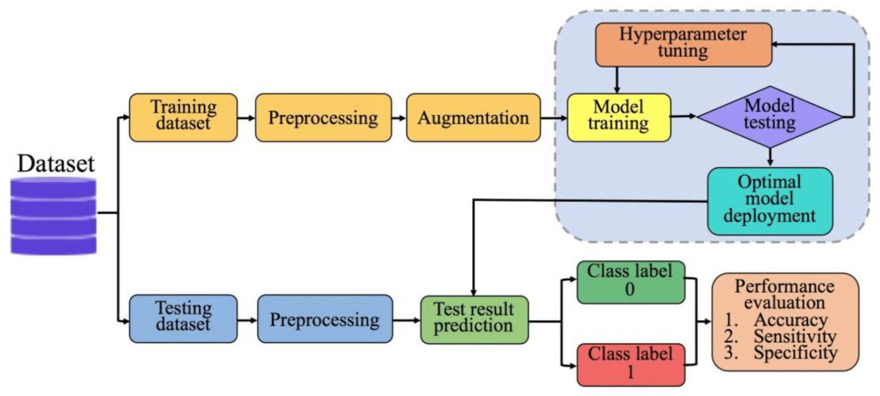
Methodology
Fig.1. Flow Diagram

Slide 12
Dataset:
Name of the Dataset | URL | No. of Images
1. HVDROPDB RetCam Neo Segmetation 2. Retinal Image Dataset of Infants and ROP | https://www.ncbi.nlm.nih.gov/pmc/articles/PMC10749257/ https://www.kaggle.com/datasets/e5ffd99802b928a3cbd7b93669599f0697c1842057b2c5641be7ecbb8b7da6a2 | 300 6004
About dataset:
HVDROPDB Dataset (ROP images): The dataset contains a total of 100 images of ROP stages 1, 2, and 3, captured from both posterior and temporal views using RetCam and Neo imaging systems. These images are specifically prepared for segmenting the demarcation line/ridge and other retinal structures related to ROP.
Contains 6,004 retinal images from 188 newborns, (sourced from the University Hospital Ostrava, Czech Republic), primarily premature infants, aimed at advancing research in retinopathy of prematurity (ROP).
11

Slide 13
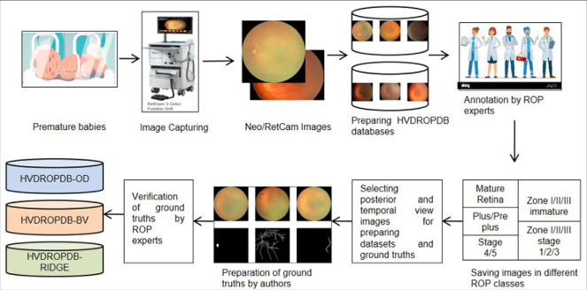
Preparation process of Data Set:
Fig.2. The dataset preparation process.

Slide 14
Future Work Plan
Model Development: Design deep learning architecture for ROP classification via fundus images.
Data Preprocessing: Implement image augmentation and preprocessing techniques.
Training & Optimization: Train the model, fine-tune hyperparameters, and optimize.
Performance Evaluation Metrics: Evaluate using accuracy, AUC, precision, and recall.
Baseline Comparison: Compare with existing ROP models.
Deployment: Plan clinical validation and real-world testing.
Bias & Generalization: Address biases and improve generalization.
Future Enhancements: Explore multimodal data integration and model fine-tuning.
Clinical Integration: Develop a user-friendly interface and ensure regulatory compliance.

Slide 15
References
1. Plus disease classification in Retinopathy of Prematurity using transform based features.
K. M. Jemshi1 ·G. Sreelekha1 · P.S. Sathidevi1 · Poornima Mohanachandran2 ·Anand Vinekar3
2. Evaluation of a deep learning image assessment system for detecting severe retinopathy of prematurity. Travis K Redd,1 John Peter Campbell,1 James M Brown,2 Sang Jin Kim,1,3 Susan Ostmo,1 Robison Vernon Paul Chan,4 Jennifer Dy,5 Deniz Erdogmus,5 Stratis Ioannidis,5 Jayashree Kalpathy-Cramer,2 Michael F Chiang,1,6 for the Imaging and Informatics in Retinopathy of Prematurity (i-ROP) Research Consortium
3. Automated Detection of Retinopathy of Prematurity Using Quantum Machine Learning and Deep Learning Techniques. V. M. RAJA SANKARI 1, U. SNEKHALATHA 1, (Member, IEEE), SULTAN ALASMARI 2, AND SHABNAM MOHAMED ASLAM 3, (Member, IEEE)
4. Development and Validation of a Deep Learning Model to Predict the Occurrence and Severity of Retinopathy of Prematurity Qiaowei Wu, MD^{1,2}; Yijun Hu, PhD¹; Zhenyao Mo, ME³; et al
5. Early Detection of Retinopathy of Prematurity stage using Deep Learning approach. Supriti Mulay, Healthcare Technology Innovation Centre, Chennai, India; Keerthi Ram, Dept. of Electrical Engg., IIT Madras, Chennai, India; Mohanasankar Sivaprakasam, Healthcare Technology Innovation Centre, Chennai, India, Dept. of Electrical Engg., IIT Madras, Chennai, India; Anand Vinekar, Narayana Nethralaya Postgraduate Institute of Ophthalmology, Bangalore, India.

Slide 16
Thank You!

