Slide 1
Waste Management System

Slide 2
DATASET
The dataset contains 20,000 rows and 7 columns, capturing sensor-based waste
classification data. It includes attributes like sensor_id, timestamp, waste_type, and sensor
readings for inductive_property, capacitive_property, moisture_property, and
infrared_property. There are no missing values, and data types include integers, floats, and
strings. The dataset is structured for analysis of waste types based on sensor properties, with
examples such as recyclable, non-recyclable, and organic waste categories.

Slide 3
INTRODUCTION
This project focuses on utilizing a sensor-based dataset for waste classification, containing
diverse features like inductive, capacitive, moisture, and infrared properties. The workflow
begins with visualizing the data to uncover patterns and insights, followed by preprocessing
steps to clean and normalize the data for analysis. Advanced classification algorithms are then
applied, with a particular emphasis on the Random Forest Classifier due to its robustness and
accuracy in handling multidimensional data. The goal is to accurately classify waste types such
as recyclable, non-recyclable, and organic, enabling smarter waste management solutions.

Slide 4
DATA PREPROCESSING
1] IMPORTED NECESSARY LIBRARIES
2]HANDLING MISSING VALUES
3]LABEL ENCODING FOR CATEGORICAL DATA
4[FEATURE SCALING USING STANDARDIZATION
4]OUTLIER DETECTION AND TREATMENT

Slide 5
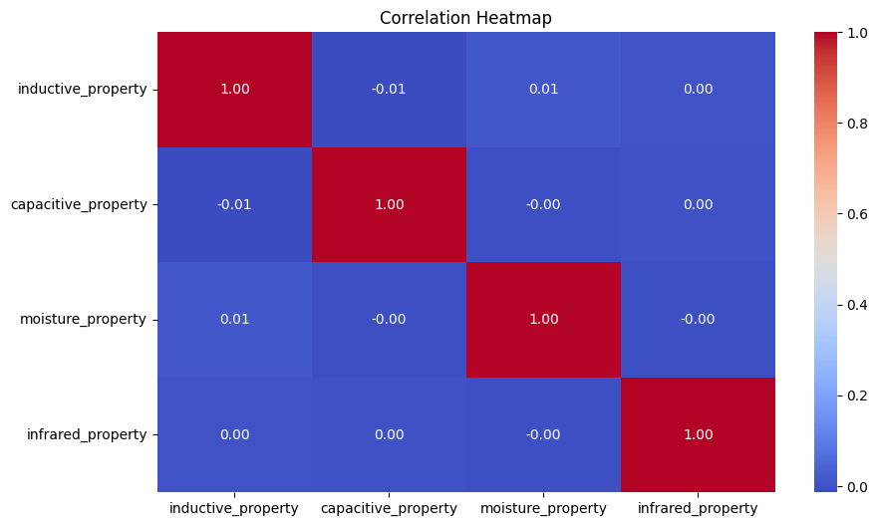
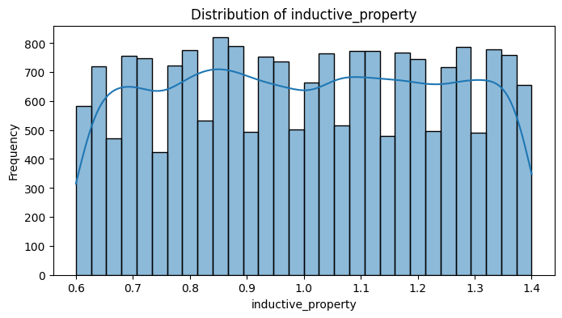
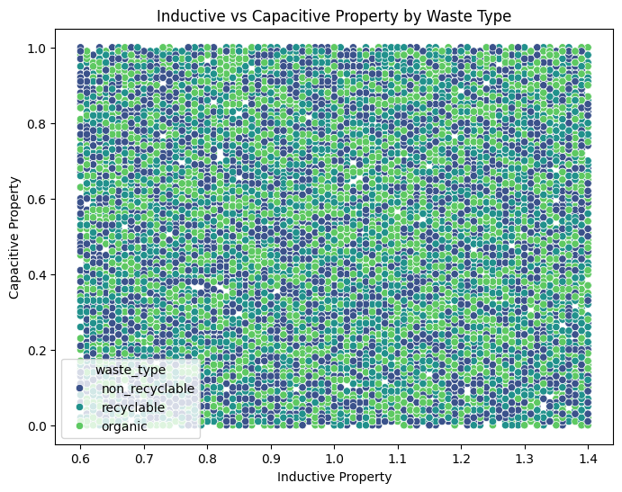
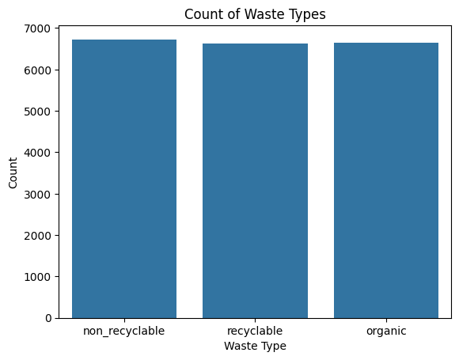
DATA VISUALIZATION

Slide 6
MODEL BUILDING
1]Training and testing dataset
2] Model Training
3]Metrics- Confusion matrix
4]Classification report, accuracy

Slide 7
RANDOM FOREST CLASSIFIER
A Random Forest classifier is an ensemble learning method that builds multiple
decision trees and combines their predictions to improve accuracy and prevent
overfitting. It works by randomly selecting subsets of features and training a
separate decision tree on each subset. During prediction, each tree makes a vote,
and the class with the majority vote is selected as the final output. Random Forest
is highly effective for classification tasks, handling both numerical and categorical
data well, and is robustto noise and overfitting compared to a single decision tree.

Slide 8
THANK YOU

