Slide 1

A Presentation on
“AI-Enhanced Real-Time OEE and Anomaly Dashboard
for a Smart Factory System”
By
Sanika Jamadar (Roll No. B291, Batch A2)
Under the Guidance of
Dr. Naziya Hussain
Department of AIML
MPSTME, Shirpur Campus
2026-27
Notes:
Introduce yourself and the project. One sentence: a software-only smart-factory monitor that shows OEE live and warns operators three different ways - rules, a machine-learning model and a trend projection - before a machine fails.

Slide 2
Introduction
Problem Statement
Objectives
Existing vs. Proposed System
System Architecture
Methodology
Modules
Technologies Used
Implementation / Screenshots
Results & Testing
Advantages & Applications
Future Scope
Conclusion
References
Notes:
Quick roadmap. The talk is about 10 minutes plus a live demo; screenshots are real captures of the running app.

Slide 3
Introduction & Problem Statement
Background
• Industry 4.0: machines are instrumented and connected
• OEE = Availability × Performance × Quality is the standard productivity KPI (ISO 22400)
• Fixed alarm limits fire late; predictive maintenance needs earlier warning
• Real plants are rarely available to students → a virtual factory makes everything demonstrable
Problem statement
Managers and engineers lack one live view that:
1. shows OEE per machine and plant-wide
2. flags hard faults instantly
3. detects subtle anomalies limits miss
4. predicts a breach early enough to act
SRS targets: updates ≤ 1 s · ML inference ≤ 200 ms · MQTT reconnect ≤ 5 s · 50 concurrent clients · 5 → 20 machines
Notes:
OEE is the standard productivity KPI: Availability x Performance x Quality. Today it is often computed after the shift, and alarms fire only at fixed limits. Operators need one live view that warns early. State the four needs on the right and the numeric targets from the SRS at the bottom.

Slide 4
Objectives
1. Simulate
5–20 virtual machines, 500 ms telemetry, injectable faults
2. Measure
Rolling 1 h / 8 h OEE per machine and plant
3. Detect
Rule (Red), ML Isolation Forest (Yellow), What-If trend (Orange)
4. Act
Acknowledge, assign, resolve, feedback, maintenance log
5. Report
7-day OEE trend, downtime per shift, ML accuracy
6. Run anywhere
One command; works with or without Docker and databases
Notes:
Read the six objectives; each maps to a requirement in the SRS (FR-01 to FR-12). Emphasise that everything is verified by tests, not just claimed.

Slide 5
Existing vs. Proposed System
 | Existing practice | Proposed system
OEE | Spreadsheets after the shift | Live 1 h / 8 h, A × P × Q shown separately
Fault detection | Fixed alarm limits only | Rules + Isolation Forest + What-If projection
Warning time | None – alarm at breach | Orange up to 60 s ahead with ETA
Operator workflow | Paper / chat | Ack, assign, resolve, feedback, maintenance log
Deployment | Vendor systems, hardware needed | Open software, one command, no hardware
Notes:
Contrast: today OEE is retrospective and alarms are fixed thresholds. Our system is live, layered and explainable, and it runs with no hardware.

Slide 6
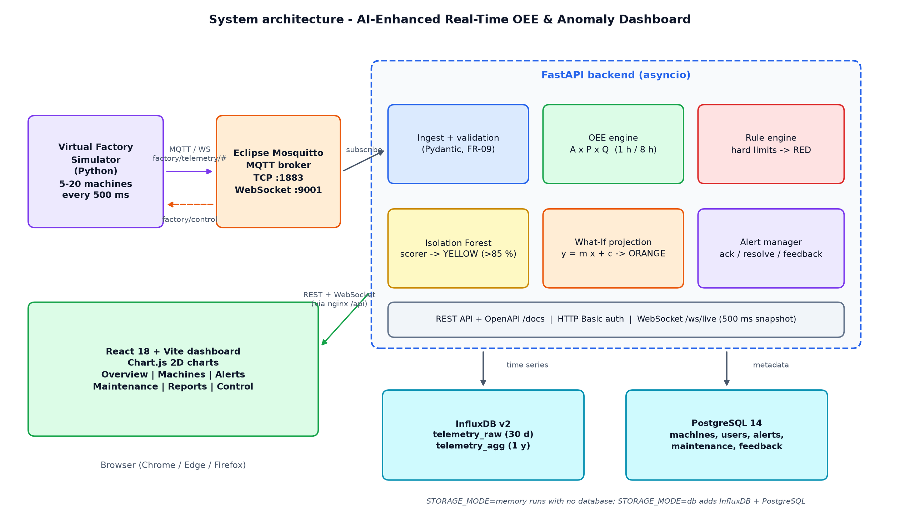
System Architecture
Notes:
Walk left to right: the simulator publishes JSON over MQTT (WebSockets) to Mosquitto; the FastAPI backend validates, computes OEE, runs the three detectors, stores data and pushes a snapshot every 500 ms to the React dashboard. Storage is a switch: memory by default, InfluxDB + PostgreSQL when configured.

Slide 7
Technology Stack
Simulator
Python 3 · paho-mqtt
Messaging
Eclipse Mosquitto · MQTT over WebSockets
Backend
FastAPI · Pydantic v2 · asyncio
Machine learning
scikit-learn Isolation Forest · NumPy
Time series
InfluxDB v2 (30 d raw / 1 y aggregated)
Relational
PostgreSQL 14 · SQLAlchemy
Frontend
React 18 · TypeScript · Vite · Chart.js
Deployment
Docker Compose · nginx
Quality
pytest · Vitest · Playwright
Notes:
Name the tools; each was chosen from the SRS. Highlight that the frontend and backend are fully typed and tested.

Slide 8
Alert Logic – Four Colours
GREEN ✓ Normal
Operating normally
No active condition
YELLOW ▲ ML caution
Isolation Forest anomaly score > 85 %
2 consecutive ticks; below every hard limit
ORANGE ↗ Projected fault
Line y = m·x + c through last 3 min
Crossing within 60 s → ETA countdown
RED ✕ Hard fault
Temperature or vibration > limit
or machine STOPPED – immediate
Priority: Red > Orange > Yellow > Green · open after 1–2 ticks · clear after 3–4 s · operator can acknowledge, assign, resolve, give feedback
Notes:
This is the heart of the system. Red is certain and immediate. Orange uses a regression line to predict a crossing within 60 seconds. Yellow comes from the Isolation Forest when the score passes 85 percent. Higher levels suppress lower ones. Every colour also has an icon and a label for accessibility.

Slide 9
OEE – Availability × Performance × Quality
Definition
Availability = run time ÷ planned time
Performance = (cycles × ideal cycle time) ÷ run time
Quality = good cycles ÷ total cycles
OEE = A × P × Q
Rolling 1 h and 8 h windows (5-second buckets, O(1) reads); plant OEE from summed components
Measured in the end-to-end test (1 h)
Availability 97.4 %
Performance 88.1 %
Quality 98.1 %
OEE 84.2 % (8 h window: 83.7 %)
5 machines · 7 days of simulated history back-fill
Dashboard shows the three rings next to the final figure so the cause of a loss is visible at a glance.
Notes:
Explain the three factors with the formula; then show the live plant numbers from the test run. Rolling windows are O(1) running sums so it scales to 20 machines.

Slide 10
ML Anomaly Scoring & What-If Projection
Isolation Forest (pre-trained)
• Trained on synthetic normal data (68 687 rows, 20 machine profiles); trimmed tail
• 6 normalised features: level, dynamics, joint magnitudes
• Score calibrated to 0–100 %; threshold 85 %
• Inference ≤ 36 ms (target 200 ms)
• Validation on injected faults: 6/6 detected, precision 100 %, 0 false alarms/h
• ML outage → last score held, Red rules keep working
What-If projection y = m·x + c
• Least-squares line through the last 3 min of temperature
• ETA = (limit − fit_now) ÷ m
• Orange when ETA ≤ 60 s (R² ≥ 0.6, slope ≥ 0.03 °C/s)
• Dashboard draws points, fitted line, limit and countdown
• Manual scenario: controlled 3-minute temperature rise (demo speed up to ×6)
• Measured: Orange raised with ETA 25 s, then Red at 85.1 °C
Notes:
Left: one Isolation Forest for all machines using per-machine normalised features, calibrated to a 0-100 percent score. We validated it on injected faults: six of six detected, 100 percent precision, no false alarms. Right: a least squares line over three minutes predicts when the limit will be hit.

Slide 11
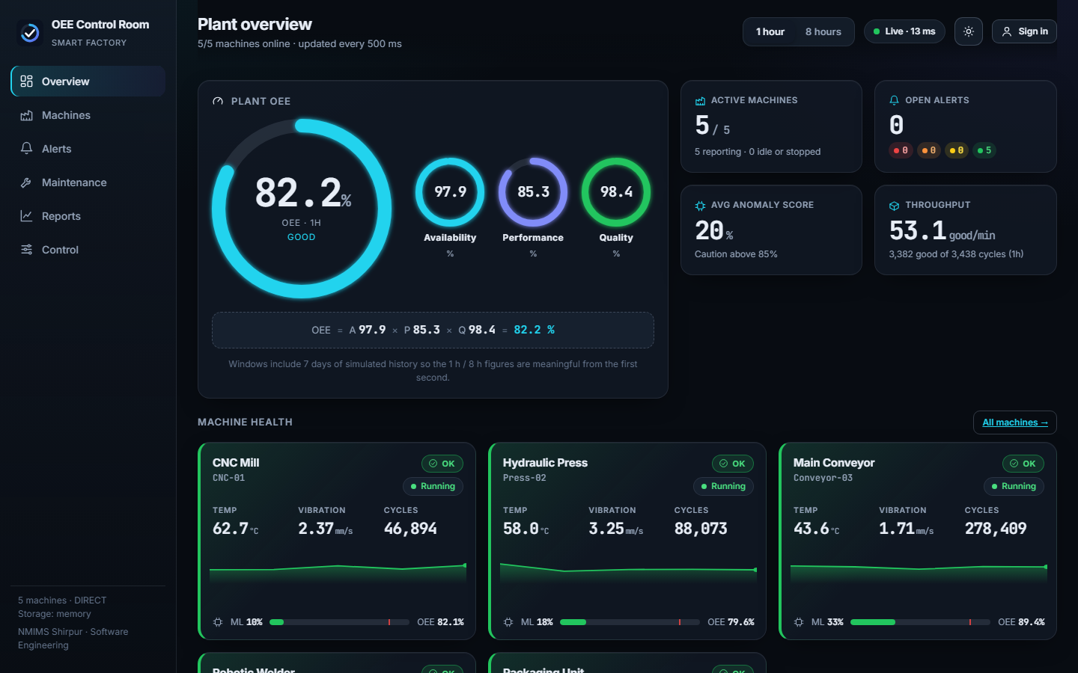
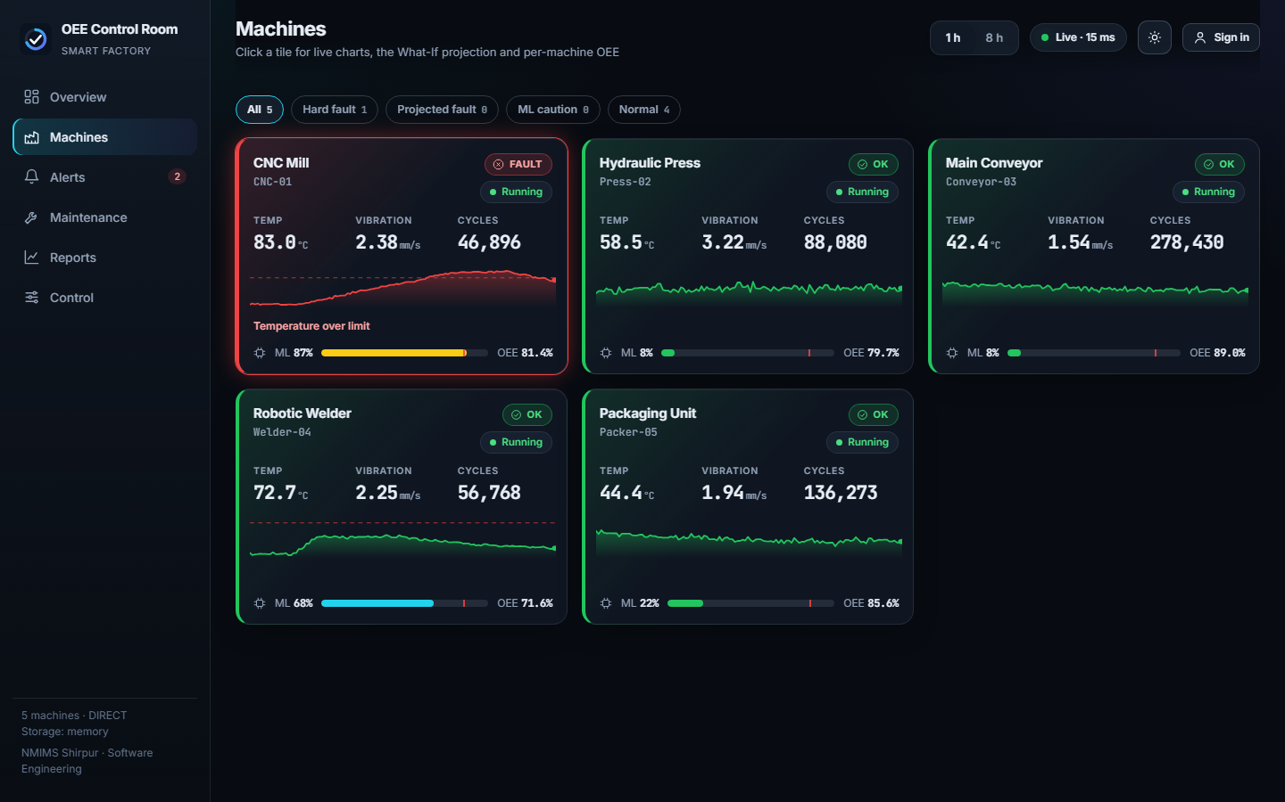
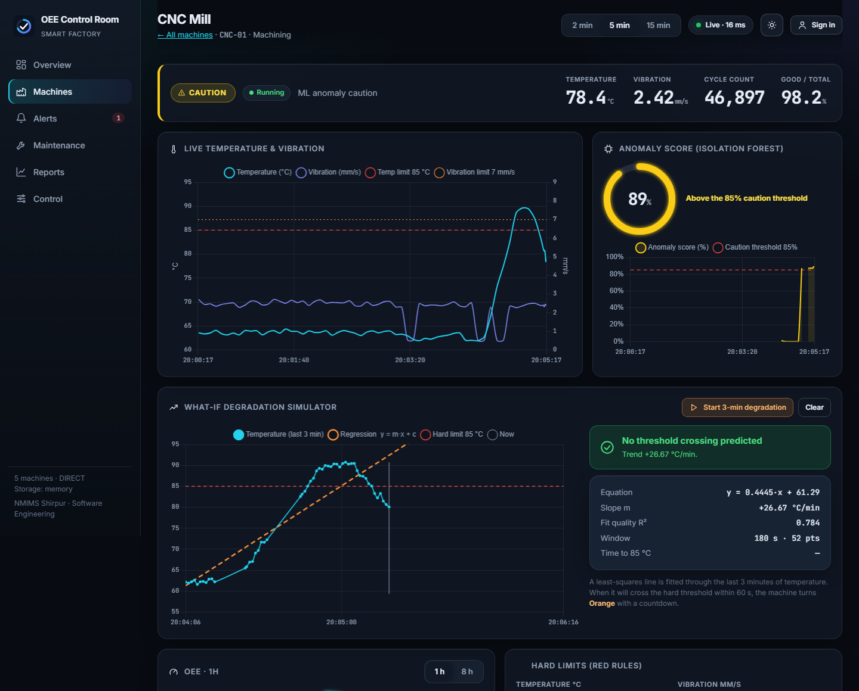
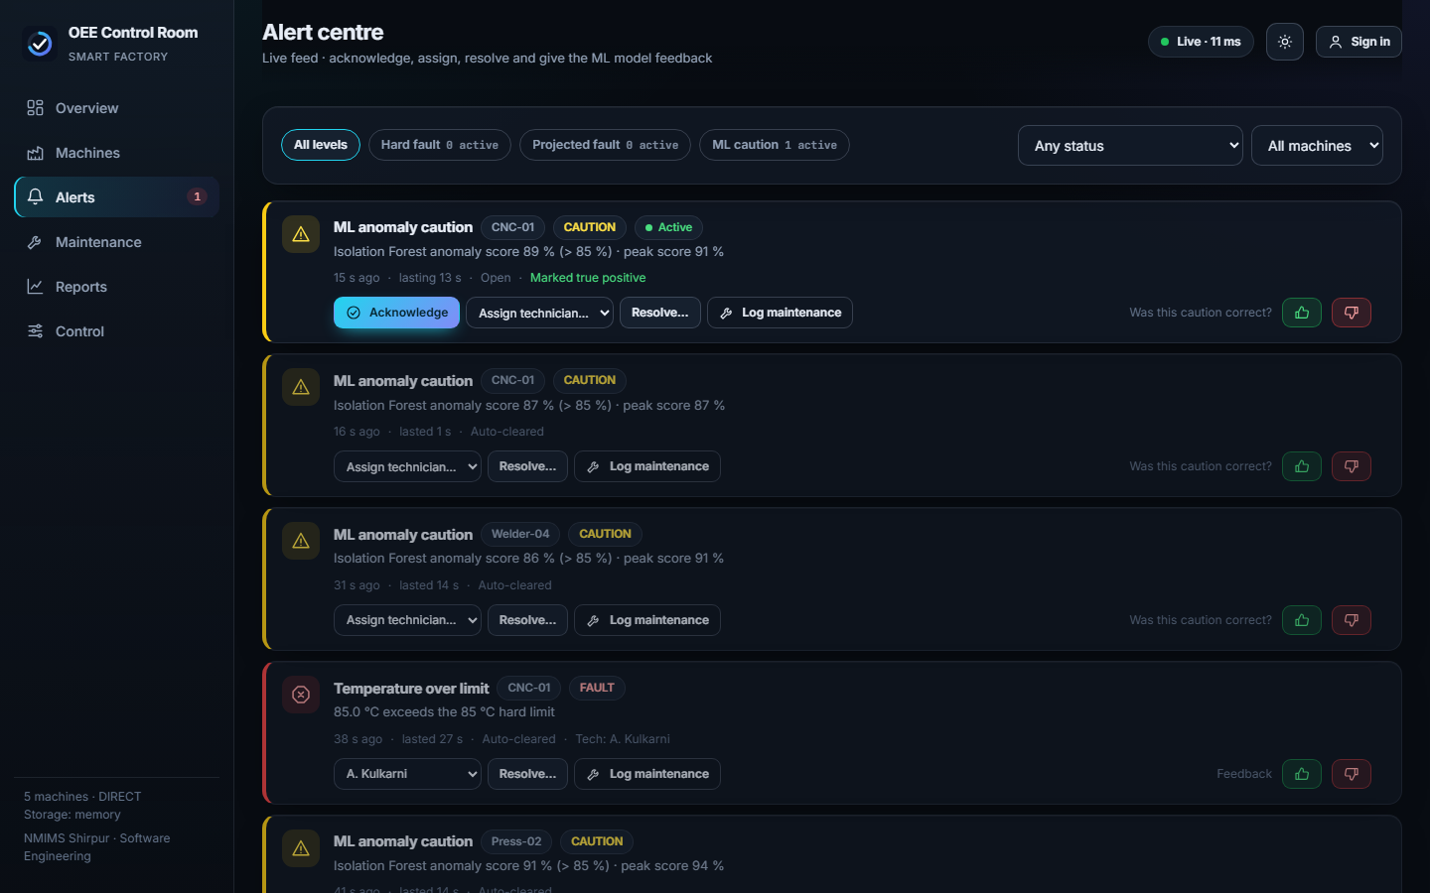
Implementation – Dashboard Screens
Plant overview: OEE gauge, A/P/Q, KPIs
Machine grid: Red · Orange (ETA) · Green
Machine detail + What-If regression
Alert centre: ack · assign · feedback
Notes:
Real screenshots from the running application at 1440 pixels. Top left overview, top right machine grid with red orange and green, bottom left the machine detail with the regression line, bottom right the alert centre after operator actions.

Slide 12
Live Demo
1
Open Control → sign in (manager)
2
ML anomaly on Welder-04 → tile turns Yellow
3
Demo speed ×6 → Temperature ramp on CNC-01 → Orange with ETA, then Red
4
Vibration spike on Press-02 → instant Red
5
Alerts: acknowledge · assign technician · resolve · 👍/👎 feedback
6
Maintenance log linked to the alert; Reports page
7
Simulate ML outage → scores held, rules still alert
Notes:
Switch to the browser. Follow the numbered steps; the whole demo takes three minutes. Before presenting: start with scripts/dev.ps1 or docker compose up, sign in as manager.

Slide 13
Testing & Results
28 + 7
13 / 13
0.5 s
automated tests passed
(pytest + Vitest)
end-to-end smoke checks
(5 machines, 50 WS clients)
dashboard update latency
(p95, target ≤ 1 s)
36 ms
2.3 s
6 / 6
worst-case ML inference
(target ≤ 200 ms)
MQTT recovery after broker
restart (target ≤ 5 s)
injected anomalies detected
0 false alarms on healthy
Orange alert raised with 25 s ETA before Red · Yellow score 97.7 % · fault injection returns HTTP 401 without login
Notes:
All numbers are from real runs of the final code. 28 backend tests, 7 frontend tests, a 13 check end to end smoke test and a MQTT broker kill test. Every performance target from the SRS was met. Be honest that the database layer was verified without live servers.

Slide 14
Advantages, Limitations & Applications
Advantages
• 3 detection layers
• Explainable alerts
• Works with no DB / Docker
• Operator workflow + audit
• Tested and documented API
Limitations
• Simulated telemetry
• Model trained once (C-04)
• Single-tenant Basic auth
• Linear What-If assumption
• 2D, desktop-responsive web app
Applications
• OEE & condition monitoring
• Industry 4.0 teaching lab
• Anomaly-model test bench
• Pilot for real PLC gateways
Notes:
Be balanced. Advantages: layered detection, explainable alerts, runs without infrastructure. Limitations: simulated data, one-off training, basic auth. Applications: monitoring, teaching, model test-bench.

Slide 15
Conclusion, Future Scope & References
Conclusion
Live OEE + Red / Orange / Yellow alerts in ≈ 0.5 s
All numeric targets met; ML validated on injected faults
Complete, reproducible, one-command platform
Future scope
• Real machines via OPC UA / Modbus → MQTT
• Retrain from operator feedback
• Roles, notifications, audit export
• Remaining-useful-life with non-linear models
• Multi-site deployment, Grafana
References
[1] Nakajima, Introduction to TPM (1988) [2] ISO 22400-2:2014 [3] Muchiri & Pintelon, IJPR 46(13), 2008
[4] Liu, Ting, Zhou, “Isolation Forest”, IEEE ICDM 2008 [5] Chandola et al., “Anomaly detection: a survey”, ACM CSUR 2009
[6] Pedregosa et al., scikit-learn, JMLR 2011 [7] OASIS MQTT 3.1.1 [8] Lee et al., Manufacturing Letters 3, 2015
Notes:
Conclusion: the system meets the SRS targets with measured evidence. Future: real equipment via OPC UA, use feedback to retrain, roles and notifications, non-linear RUL. References are in the report.

Slide 16
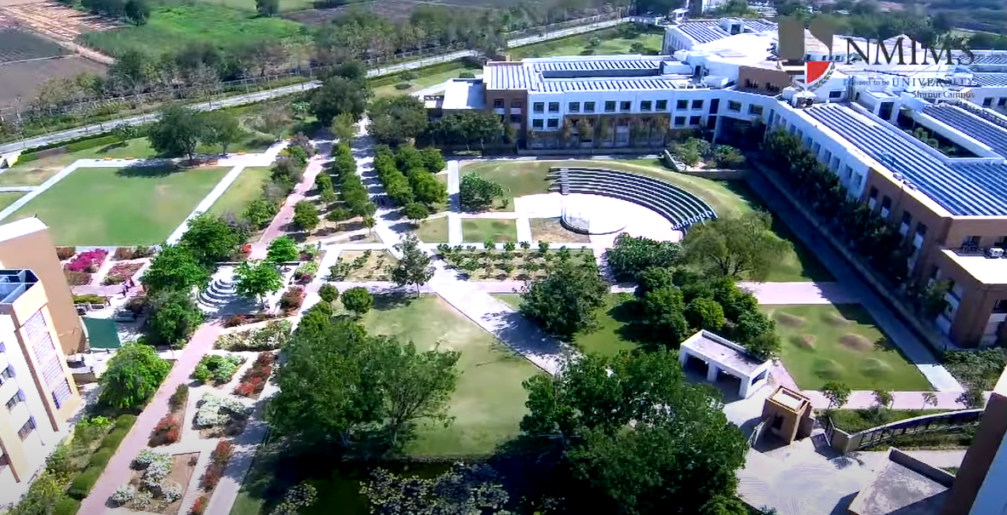
Thank You !!! Questions?
Notes:
Invite questions. Likely ones: Why Isolation Forest? (unsupervised, no fault labels, cheap inference). How is the 85 percent calibrated? (normal tail 70 percent, median anomaly 95 percent). What happens if the broker or ML fails? (auto-reconnect; last score held). What was not verified? (live InfluxDB/PostgreSQL and Docker were not available on the build machine).

