Slide 1

A
Presentation on
“REFWHISTLE: AN OFFLINE-FIRST TOURNAMENT SCHEDULING APP WITH LIVE DELAY HANDLING”
By
Sanika Jamadar (B291)
Sneha Bhavsar (B295)
Harsh Bharuka (B244)
Under the Guidance of
Dr. Atul Dusane
Department of CE
MPSTME, Shirpur Campus
2026-27
Notes:
RefWhistle is an Android app that builds sports tournament timetables automatically, keeps every organiser's phone consistent even without internet, and re-times the day when a match runs late.

Slide 2
Problem Statement and Objectives
Problem Statement
Tournaments are scheduled manually in spreadsheets and messaging apps. This leads to:
Double-booked venues, referees and players
Uneven referee workload; referees assigned to their own team
Manual, error-prone rescheduling when a match runs late
Conflicting edits from organisers working offline
Objectives
To develop an Android application that:
Generates a conflict-free timetable automatically, within all hard rules
Keeps every organiser's phone consistent without internet
Re-times only the affected matches when a match is delayed
Gives referees, teams and spectators role-specific views
Intended users: Admin (organiser) | Referee | Team or player | Spectator (web dashboard)
Notes:
Tournaments in colleges and schools are usually scheduled in spreadsheets and shared through messaging apps. This causes clashes, unfair referee workload, manual rescheduling and conflicting edits. The objectives on the right are the four things the app is built to guarantee.

Slide 3
System Design and Working
Stage | What happens | Who
1. Set up | Add teams, venues and referees (or load the demo tournament) | Admin
2. Generate | One tap builds the whole timetable within the rules | Admin
3. Match day | Kick-off, full time and score are entered on the phone | Referee
4. Changes | Late match or rain: the app proposes new times, the admin approves, teams are notified | Admin
5. Share and sync | Phones merge changes over Wi-Fi, file or cloud; standings go live on the web | Everyone
Architecture
Android application (Java)
Schedule, timeline, insights, map
SQLite change log
Single source of truth for the schedule
Synchronisation
Wi-Fi or hotspot, shared file, Firebase Firestore
Flutter web dashboard
Live standings for spectators
Referees and team members see only their own matches.
Technology: Java • Android Studio • SQLite • Firebase (Auth, Firestore) • Google Maps and Location • Flutter
Notes:
This is the journey of one tournament. The admin sets up and generates the timetable. On match day the referee records kick-off, full time and the score. If a match is late or it rains, the app proposes new times and the admin approves them. Everything is stored as an append-only change log in SQLite, and the schedule is always a replay of that log, which is why phones can be merged without losing a change.

Slide 4
Key Features, Contributions and Results
Core features
Constraint-based scheduler: hard rules never broken; referee fairness, short waits and no midday heat optimised.
Offline-first sync: append-only change log with a hybrid logical clock; phones merge and always agree.
Live delay propagation: a late match re-times only dependent matches, with preview and notifications.
Own contributions
Delay-resistant scheduling: plans spare time so one delay moves fewer matches (43% fewer at 12 teams).
Live match events: referee kick-off and full time trigger re-timing, reclaim time when a match ends early and learn real match length.
16
automated tests passing
1,000
shuffled sync orders, identical result
≈ 8 ms
to re-time a 16-team day
Conclusion: RefWhistle automates tournament scheduling, stays consistent offline and adapts to delays. Limitations: heuristic scheduler suited to 8–16 teams; notifications are local.
Notes:
The chart compares three schedulers by how many matches must move when a single match starts 15 minutes late, averaged over six random tournaments per size. At 12 teams RefWhistle moves 2.3 matches, against 4.1 without the delay-resistance rule and 6.3 for a basic scheduler. Sync was tested by replaying identical changes in 1,000 shuffled orders; the result was identical every time. All 16 automated tests pass.

Slide 5
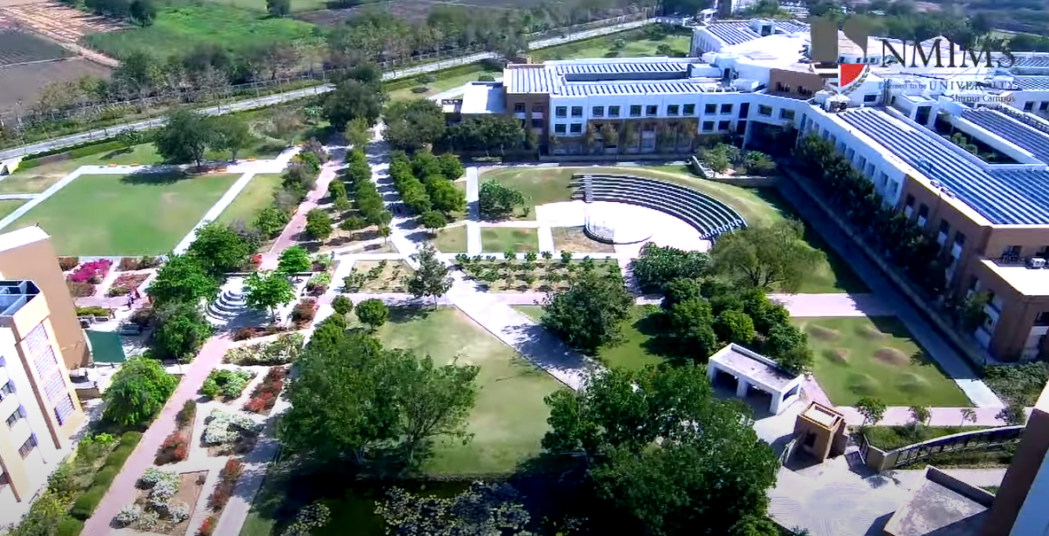
Thank You !!!

