Slide 1

Interactive Financials Dashboard Design
Data Analyst Internship - Task 4
Tool Used: Power BI

Slide 2
Objective
Design an interactive dashboard for business stakeholders using Power BI.
- Choose appropriate KPIs (Sales, Profit, Growth)
- Use filters/slicers for interactivity
- Include time-series analysis
- Add summary cards
- Apply a consistent color theme
- Create a navigation menu (if possible)

Slide 3
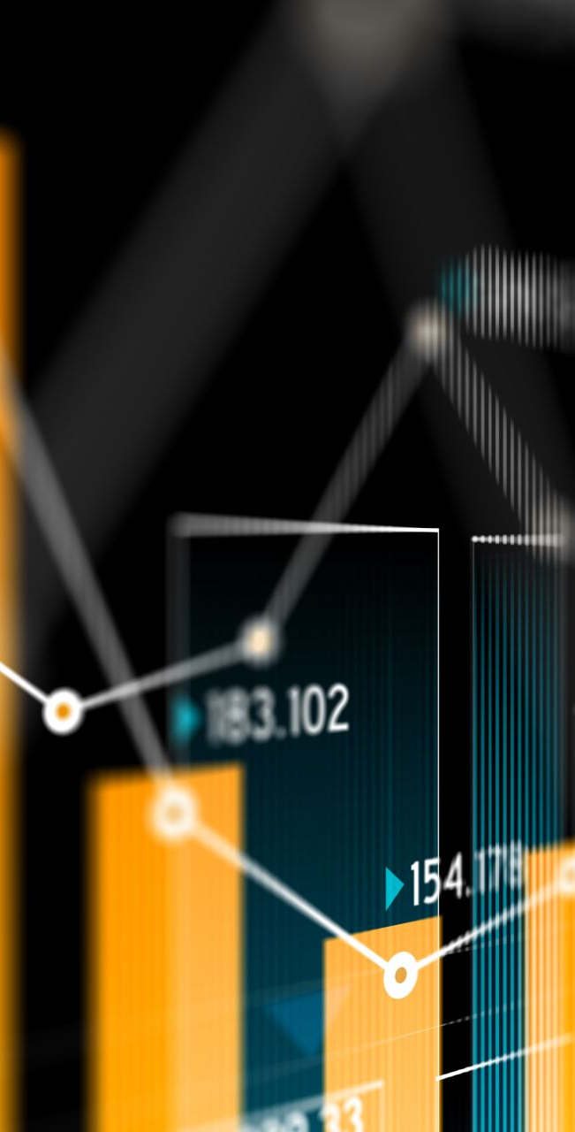
Dataset & Tools
• Dataset: Sales_Financial dataset from Kaggle
• Tool Used: Power BI
• Dashboard Type: Business Intelligence for Sales Analysis
• Data Scope: Time-series, KPIs, Profit, Growth trends

Slide 4
Dashboard Features
• KPIs: Total Sales, Total Profit, Monthly Growth Rate
• Filters: Region, Category, Sub-category, Date
• Visuals: Line charts, Bar charts, Cards, Slicers
• Navigation Menu: Multi-page navigation for ease of use

Slide 5
Visual Design & Interactivity
• Consistent Color Theme: Business-friendly palette
• Interactivity: Filters, slicers, drill-through enabled
• Summary Cards: Real-time calculation of KPIs
• Time-Series Analysis: Monthly & Yearly trend lines

Slide 6

Learnings & Outcome
• Learned how to use Power BI for dynamic dashboard creation
• Understood how to select and visualize KPIs
• Gained experience in making business-friendly interactive dashboards
• Improved understanding of BI tools & their application in real-world scenarios

Slide 7

Interview Questions
. Key Elements of a Dashboard: KPIs, visuals, filters/slicers, summary cards, time-series charts, clean layout, interactivity.
2. What is a KPI? A measurable value that shows business performance (e.g., Sales, Profit, Growth).
3. What are Slicers in Power BI? Interactive filters that let users control what data visuals display.
4. Power BI vs Tableau: Power BI = budget-friendly, Excel integration. Tableau = powerful visuals, better cross-platform.
5. Making Dashboards Interactive: Use slicers, drill-downs, tooltips, buttons, and synced filters.
6. Handling Large Datasets: Use data modeling, aggregate data, filter before loading, optimize DAX.
7. Charts for Trend Analysis: Line charts, area charts, combo charts, and time-based visuals.

