Slide 1

A project on PFA for Micro Credit Defaulter
By Sanika S. Shet
Data Science Intern

Slide 2
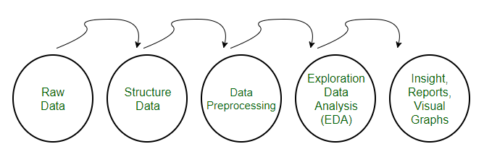
STEPS INCLUDED IN PROJECT ARE:

Slide 3
Data Preprocessing includes following steps: 1) Importing Libraries
import pandas as pd
import numpy as np
import matplotlib.pyplot as plt
import seaborn as sns
import warnings
warnings.filterwarnings('ignore')

Slide 4
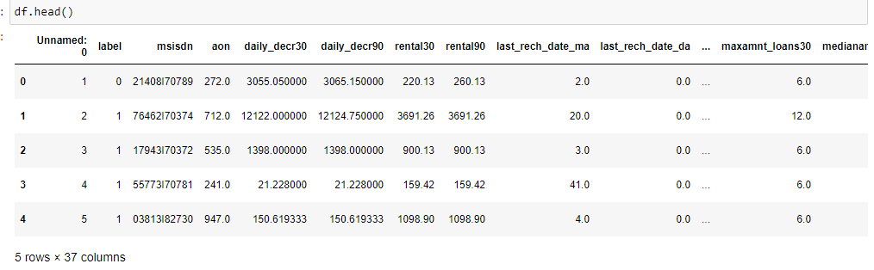
2) Importing the Datasets
We can use read_excel function as below:
df=pd.read_excel(r'C:\Users\SANIKA\Documents\Micro_credit_defaulter.xlsx')

Slide 5
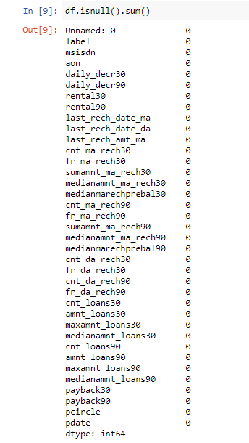
3) Handling Missing data:

Slide 6
5) Encoding Categorical data:
In this dataset 'pcircle' and 'msisdn' have datatype as object, hence we have to encode it to fit in the model.
Since, We are going to drop both columns hence , no need to encode the columns

Slide 7
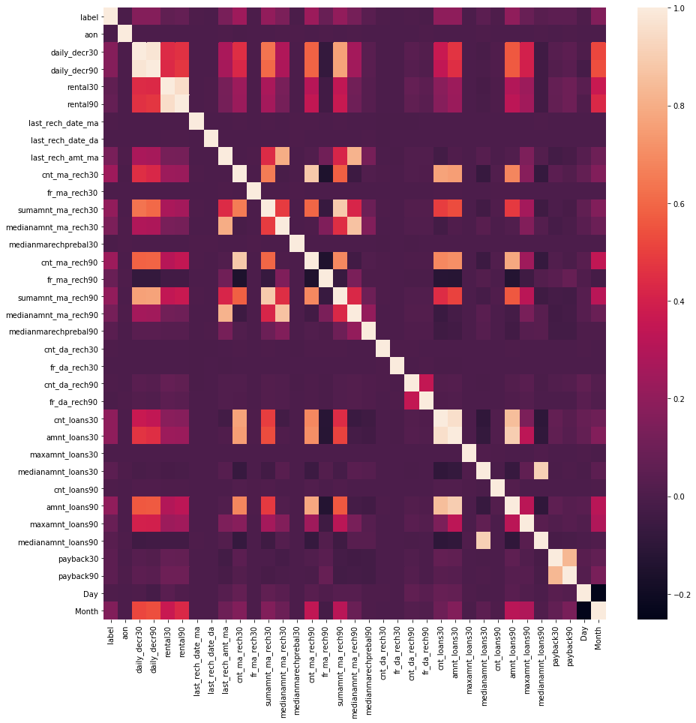
6)Feature Selection
Here, we have done feature selection by correlation heatmap.

Slide 8
#Selecting features based on correlation
columns = np.full((df_cor.shape[0],), True, dtype=bool)
for i in range(df_cor.shape[0]):
for j in range(i+1, df_cor.shape[0]):
if df_cor.iloc[i,j] >= 0.9:
if columns[j]:
columns[j] = False
selected_columns = df.columns[columns]
df = df[selected_columns]
By this, The dataset will have only those columns with correlation less than 0.9

Slide 9
7)Removing outliers
We have removed outliers by Zscore method.
from scipy.stats import zscore
z=np.abs(zscore(df))
threshold=5
print(np.where(z>5))
df_new=df[(z<5).all(axis=1)]

Slide 10
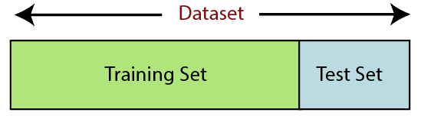
8) Splitting the Dataset into the Training set and Test set
Training Set: A subset of dataset to train the machine learning model, and we already know the output.
Test set: A subset of dataset to test the machine learning model, and by using the test set, model predicts the output.
For splitting the dataset, we will use the below lines of code:
from sklearn.model_selection import train_test_split
x_train,x_test,y_train,y_test=train_test_split(x,y,test_size=0.2,random_state=0)
dd text

Slide 11
9) Feature Scaling
Feature scaling is the final step of data preprocessing in machine learning.
#feature scaling
from sklearn.preprocessing import StandardScaler
sc=StandardScaler()
x =sc.fit_transform(x)

Slide 12
Model/s Development and Evaluation
Classification Algorithms Used are:
1)Logistic Regression
2)Ridge Classifier
3)Random Forest Classifier
4)KNeighbors Classifier
5)XGBoost Classifier
6)GaussianNB
7)Decision Tree classifier

Slide 13
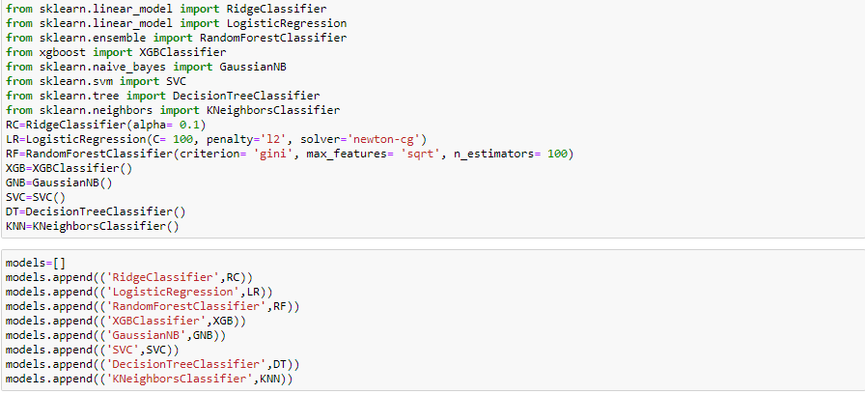
Run and Evaluate selected models

Slide 14
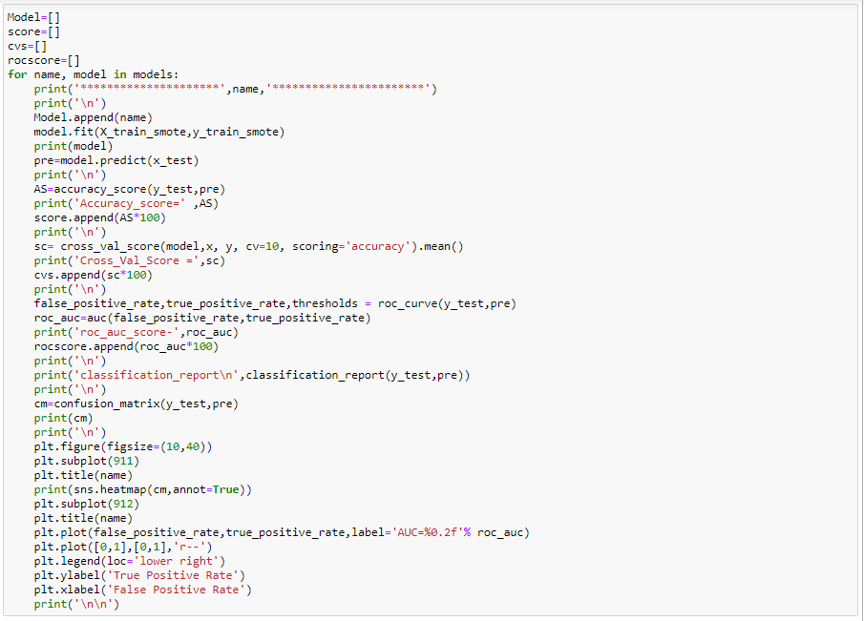

Slide 15
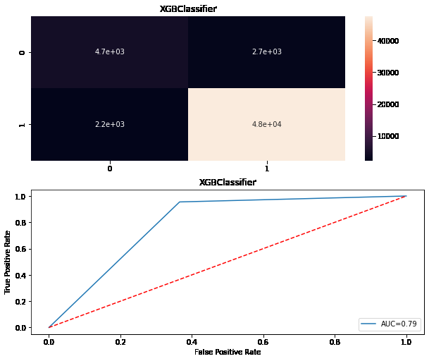
Results: I choose XGBClassifier as my final model because it performed well on my dataset with 91% Accuracy score

Slide 16
********************* XGBClassifier *********************** XGBClassifier(base_score=0.5, booster='gbtree', colsample_bylevel=1, colsample_bynode=1, colsample_bytree=1, gamma=0, gpu_id=-1, importance_type='gain', interaction_constraints='', learning_rate=0.300000012, max_delta_step=0, max_depth=6, min_child_weight=1, missing=nan, monotone_constraints='()', n_estimators=100, n_jobs=0, num_parallel_tree=1, random_state=0, reg_alpha=0, reg_lambda=1, scale_pos_weight=1, subsample=1, tree_method='exact', validate_parameters=1, verbosity=None) Accuracy_score= 0.9138087429787531 Cross_Val_Score = 0.9231860240360785 roc_auc_score- 0.7946477981623601 classification_report precision recall f1-score support 0 0.67 0.63 0.65 7359 1 0.95 0.95 0.95 49967 accuracy 0.91 57326 macro avg 0.81 0.79 0.80 57326 weighted avg 0.91 0.91 0.91 57326
Confusion matrix: [[ 4668 2691] [ 2250 47717]]

Slide 17
THANK YOU

