Slide 1

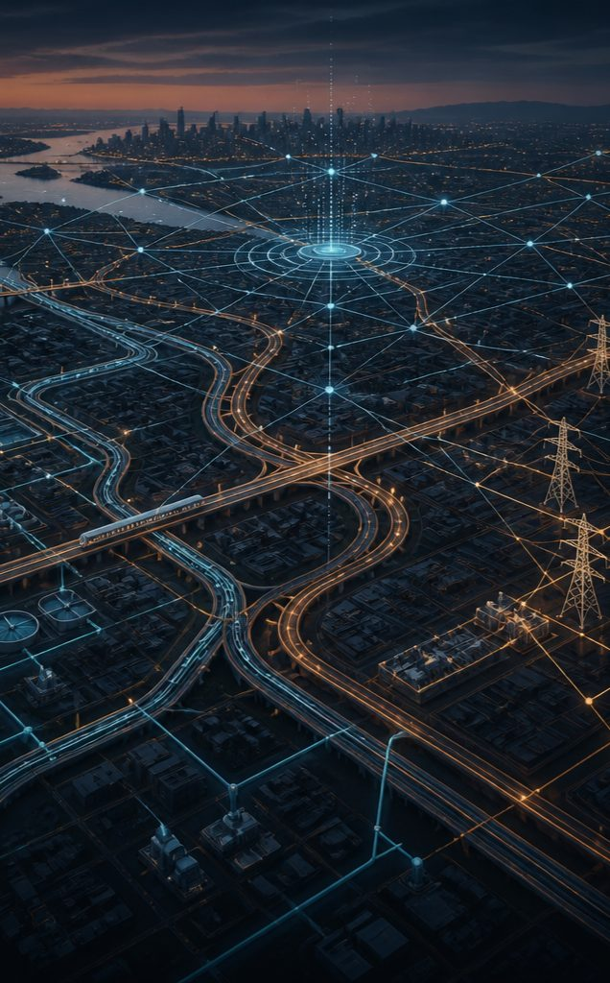

PROJECT 1
GridRCA: A RAG-Driven Framework for Data
Lineage-Aware Root-Cause Investigation in Power
Grid Operations
PROJECT 2
An Agentic AI Framework for Continuous
Cross-Domain Urban Infrastructure Monitoring,
Grid Operations
STUDENT NAME
REGISTER NO.
Sanika Yashwant Gaikwad
25MML1004
PROGRAM
URBAN SYSTEMS /
GRID OPERATIONS
INSTITUTION
DATE
VIT Chennai
MTech AIML
28 Aug 2026

Slide 2
Project 1 - GridRCA: Power Grid Root-Cause Investigation
PROBLEM STATEMENT
TECHNICAL OBJECTIVES
Power grids generate operational
data and alarms from multiple sources.
Data Engineering
Data Lineage
Machine Learning
RAG
Integrate
Track the origin
Explore anomaly
Build a knowledge
heterogeneous
and
detection and
base and
An alarm can indicate what
happened, but understanding why
it happened requires connecting
information across telemetry,
equipment history, maintenance,
grid relationships and technical
knowledge.
operational and
transformation
identification of
Retrieve relevant
historical
of data used during
relevant signals.
technical evidence.
power-grid data.
investigation.
Graph / Topology
LLM-Based RCA
Evaluation
Represent grid
Use retrieved
Explore comparison of RAG-based
relationships
evidence and
RCA with conventional RCA
and use topology
grid context for
The proposed GridRCA framework
explores the use of RAG, data lineage and
grid topology for root-cause investigation.
as investigation
root-cause
approaches.
context.
reasoning.
DATASET
Public Data
Synthetic Data
Knowledge Base
IEEE 30-Bus | PSML / GridSTAGE
Telemetry | Faults | Equipment History |
Maintenance | Incidents
Technical and operational documents
Used for grid structure, electrical
information and validation.
Used as the retrieval source for RAG.
Generated to represent controlled
investigation scenarios.

Slide 3

Technical Approach & Expected Outcomes
TECHNICAL APPROACH
01
02
03
04
05
06
07
Power Grid
Data
Anomaly
Topology +
RAG
Root-Cause
Recommendation
Data
Engineering
Detection
Data Lineage
Investigation
TECHNICAL STACK
EXPECTED OUTCOMES
Data Engineering
ML / Anomaly Detection
Detection of abnormal grid conditions
Lineage-aware investigation of operational data
Topology-aware root-cause analysis
Retrieval of relevant supporting evidence
Explainable RCA through RAG
Investigation and response
recommendations
Framework for evaluating RAG-based RCA
Python | PostgreSQL
Machine Learning |
Time-Series Analysis
Graph & Lineage
RAG / AI
Grid Topology | Data Lineage
Vector Database | Retrieval LLM |
RAG
Application
Deployment
FastAPI | Streamlit
Docker

Slide 4
Project 2 - Urban Infrastructure Monitoring, Diagnosis & Decision Support
PROBLEM STATEMENT
TECHNICAL OBJECTIVES
DATASET
Urban infrastructure such as Metro, Water, Drainage and Roads consists of interconnected assets.
Current systems often monitor these domains separately and mainly provide alerts when abnormal conditions or failures occur.
The proposed work focuses on understanding the condition, cause, impact and cross-domain dependencies of infrastructure incidents.
Data Engineering
Machine Learning
Real Data
Build a unified
Explore anomaly and
Weather, traffic, metro usage
pipeline to integrate
failure detection
and infrastructure information.
heterogeneous
from infrastructure
Purpose: provide real-world
contextual information.
infrastructure data.
telemetry.
Synthetic Data
Agentic AI
RAG & Knowledge
Asset telemetry for infrastructure
Develop domain-specific
Build a domain
such as escalators, elevators,
agents and coordination
knowledge base and
pumps and roads.
for infrastructure
retrieve relevant
Purpose: support controlled
monitoring and failure scenarios.
monitoring and
investigation.
information for
investigation.
Simulation
Infrastructure failure and
Digital Twin
Decision Support
response scenarios.
investigation.
Generate
Purpose: study incident behavior
and possible consequences.
Represent
infrastructure state
explainable incident
and explore what-if
insights and
simulation of
response
OVERALL DATASET
incidents and
recommendations.
Real Data + Synthetic
responses.
Data + Simulation
CONDITION / CAUSE / IMPACT / DEPENDENCY
PROPOSED, NOT YET EVALUATED

Slide 5
Technical Approach & Expected Outcomes
TECHNICAL APPROACH
01
02
03
04
05
Data Sources
Data Engineering
Monitoring & ML
Agentic Investigation
Decision Support
Data integration and
Unified infrastructure
Continuous
Cross-domain
What-if analysis and
preparation
data pipeline
infrastructure monitoring
investigation using
recommendations
agents and knowledge
TECHNICAL STACK
EXPECTED OUTCOMES
Data & Simulation
ML / Analytics
A framework for continuous infrastructure monitoring
Detection of abnormal infrastructure conditions
Cross-domain incident investigation
Analysis of infrastructure dependencies and impacts
What-if exploration of possible responses
Explainable decision support for operators
Python | Pandas | NumPy |
EPANET / WNTR
Machine Learning | Anomaly
Detection
Agentic AI
Digital Twin
LLM | Multi-Agent AI | RAG |
Knowledge Graph
Infrastructure State Model |
Simulation Engine
Application
PostgreSQL | Streamlit
DATA → MONITORING → INVESTIGATION → RESPONSE

