Slide 1


M.Tech Program
Advanced Industry Integrated Programs
Jointly offered by University and LTIMindTree
Review II
GridRCA: A RAG-Driven Framework for Data Lineage-Aware Root-Cause Investigation in Power Grid Operations
Team Member
Sanika Gaikwad (T9996)
Knowledge partner | Implementation partner

Slide 2
Power Grid RCA
Introduction
Power grids generate large amounts of telemetry data.
Detecting an abnormal event is not enough.
Operators also need to know where the problem is and why it happened.
GridRCA combines ML, grid topology, telemetry and technical knowledge.
The system provides root-cause candidates with supporting evidence.

Slide 3
Power Grid RCA
Objective
Detect and classify abnormal grid events.
Identify the most likely root-cause component.
Use grid topology to improve localization.
Combine multiple evidence sources for RCA.
Provide explainable and evidence-based results using RAG.
Provide results through a web-based dashboard

Slide 4
Power Grid RCA
System Modules
1. Data Layer
  PSML events
  Grid topology
  PMU telemetry
2. ML Layer
  Event classification
  Temporal models
3. RCA Layer
  Evidence scoring
  Topology-based analysis
  Candidate ranking
4. RAG Layer
  Knowledge retrieval
  Grounded explanation
5. Application Layer
  FastAPI backend
  React dashboard

Slide 5
Power Grid RCA
Methodology/Modeling Plan
Load PSML grid events and telemetry.
Build the 23-node, 34-branch grid topology.
Extract statistical and temporal features.
Classify disturbance events using ML models.
Generate RCA candidates using multiple evidence sources.
Rank candidates using topology and physical evidence.
Retrieve relevant technical knowledge using RAG.
Display RCA result and explanation to the user.

Slide 6
Power Grid RCA
Data preprocessing & EDA
799 PSML events identified.
23 buses/nodes and 34 branches extracted.
830,400 telemetry records loaded into PostgreSQL.
Telemetry includes voltage, power and reactive-power signals.
Statistical features extracted from time-series data.
Event types include:
  Forced Oscillation
  Generator Trip
  Branch Trip/Fault
  Bus Trip/Fault

Slide 7
Power Grid RCA
Approach/Algorithms/Tools…. Calibri body -36
Algorithms
Random Forest
1D CNN
BiGRU
InceptionTime
ResNet1D
Hybrid Fusion
Graph-based RCA
RAG
Sentence Transformers
ChromaDB
Semantic Search
Technology
Python
FastAPI
React + Vite
PostgreSQL
PyTorch
Scikit-learn

Slide 8
Power Grid RCA
Project plan/milestones progress
Milestone | Status
PSML data & topology | ✅ Completed
PostgreSQL database | ✅ Completed
Feature engineering | ✅ Completed
Event classification | ✅ Completed
RCA engine | ✅ Completed
Evidence & lineage | ✅ Completed
RAG knowledge system | ✅ Completed
Temporal & graph analysis | ✅ Completed
React + FastAPI integration | ✅ Completed
System health testing | ✅ Completed

Slide 9
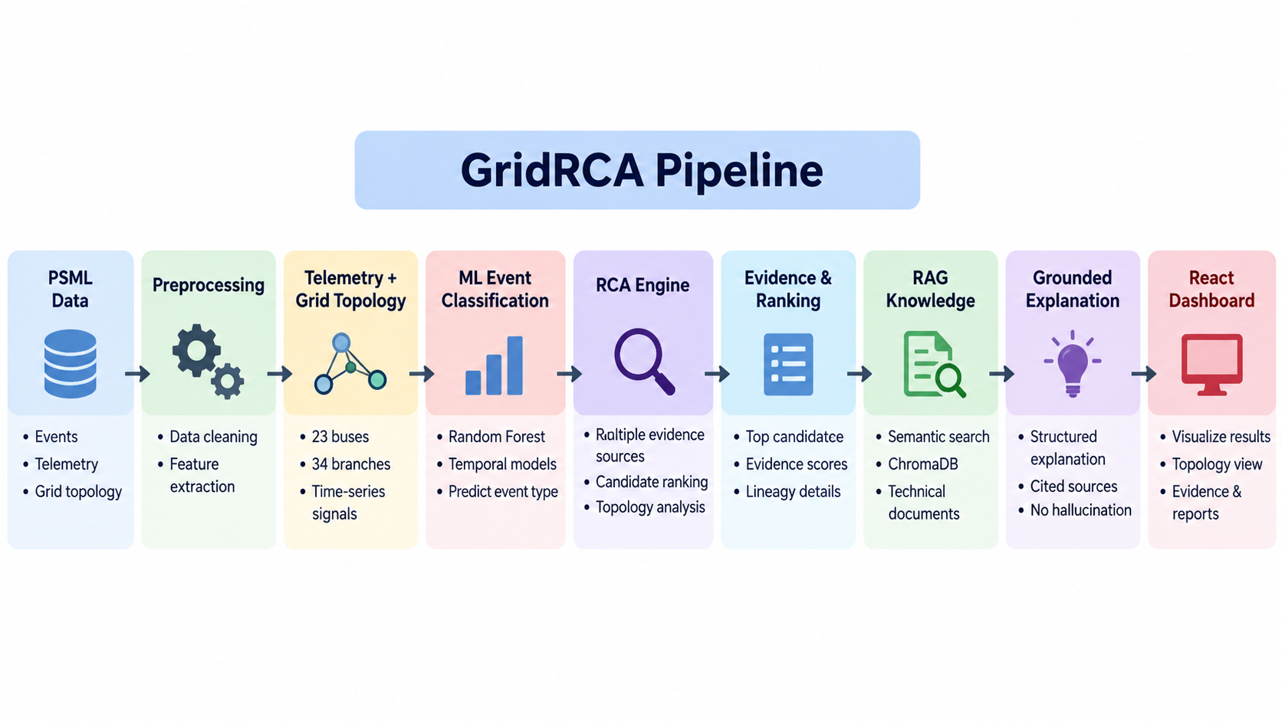
Power Grid RCA
Pipeline structure

Slide 10
M.Tech Program
Advanced Industry Integrated Programs
Jointly offered by University and LTIMindTree
Review II
Agentic AI Framework for Continuous Cross-Domain
Urban Infrastructure Monitoring, Diagnosis and
Decision Support
Team Member
Sanika Gaikwad (T9996)
Knowledge partner | Implementation partner

Slide 11
AGENTIC AI FOR URBAN INFRASTRUCTURE
Introduction
Urban infrastructure generates data across multiple domains such as weather, water, drainage and metro.
This data is often analyzed separately, making it difficult to understand cross-domain impacts.
Our system provides a unified Urban Infrastructure Intelligence Center for monitoring, anomaly detection, diagnosis and decision support.
The system currently focuses on real Chennai infrastructure data.

Slide 12
AGENTIC AI FOR URBAN INFRASTRUCTURE
Objective
Detect unusual conditions from real urban infrastructure data.
Combine information from different domains to understand possible impacts.
Provide evidence-based diagnosis and risk assessment.
Simulate possible mitigation scenarios before taking action.
Generate recommendations with human approval required.

Slide 13
AGENTIC AI FOR URBAN INFRASTRUCTURE
Modules
Water Intelligence
  Reservoir storage analysis
  Lake inflow/outflow anomaly detection
Decision Support
  Incident investigation
  Similar historical cases
  Scenario simulation
  Recommendation & human approval
Weather Intelligence
  Rainfall anomaly detection
  Historical rainfall analysis
Infrastructure Intelligence
  Drainage pumping assets
  Sewage flow meters
  MRTS stations
  Historical flood/inundation points

Slide 14
AGENTIC AI FOR URBAN INFRASTRUCTURE
Methodology
Statistical and ML-based anomaly detection
Cross-domain temporal correlation
Historical case similarity
Rule-based risk and decision scoring
RAG-based operational knowledge
Human-in-the-loop governance
Data → Preprocessing → Anomaly Detection → Multi-Agent Analysis → Diagnosis → Simulation → Decision Support

Slide 15
AGENTIC AI FOR URBAN INFRASTRUCTURE
Data preprocessing & EDA
20,055 Chennai rainfall records from 62 stations
121 years of monthly rainfall data (1901–2021)
912 reservoir storage records
1,989 lake flow records
1,368 infrastructure assets from KML datasets
945 historical flood/inundation observations
Cleaning, deduplication, feature engineering and exploratory analysis performed before modeling.

Slide 16
AGENTIC AI FOR URBAN INFRASTRUCTURE
Approach/Algorithms/Tools
ML / Analytics
  Isolation Forest
  Pearson correlation
  Rolling & seasonal rainfall features
  Haversine spatial proximity
AI Architecture
  Weather Agent
  Water Agent
  Drainage Agent
  Metro Agent
  Central Orchestrator
  RAG + historical case memory
Technology
  Python, FastAPI
  React + Vite
  PostgreSQL
  Scikit-learn
  Pandas / NumPy

Slide 17
AGENTIC AI FOR URBAN INFRASTRUCTURE
Project plan/milestones progress Calibri body -36
✓ Data collection & preprocessing
✓ Weather and water intelligence
✓ ML anomaly detection
✓ KML infrastructure data integration
✓ Multi-agent architecture
✓ Incident diagnosis & evidence
✓ Scenario simulation
✓ Decision ranking & human approval
✓ Analytics dashboard
✓ REST APIs + React control center
✓ Automated testing
Current Status:
End-to-end intelligence pipeline operational

Slide 18
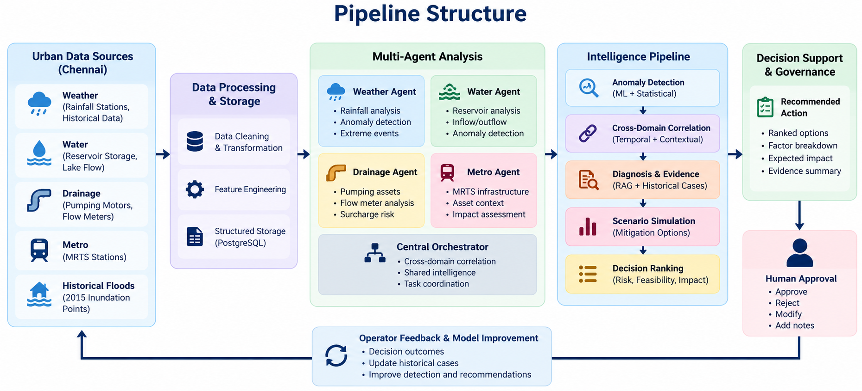
AGENTIC AI FOR URBAN INFRASTRUCTURE
Pipeline structure

