Slide 1


M.Tech Program
Advanced Industry Integrated Programs
Jointly offered by University and LTIMindTree
Review III
GridRCA: A RAG-Driven Framework for Data Lineage-Aware Root-Cause Investigation in Power Grid Operations
Team Member
Sanika Gaikwad (T9996)
Knowledge partner | Implementation partner

Slide 2
Power Grid RCA
Introduction
Power grids generate large amounts of measurement and event data.
Detecting an abnormal event does not directly identify its cause.
GridRCA combines telemetry, grid connections, machine learning and technical knowledge.
It ranks likely root-cause components and provides supporting evidence.

Slide 3
Power Grid RCA
Objective
Classify abnormal power-grid events.
Identify likely buses or branches involved in a disturbance.
Combine telemetry, timing, topology and physical evidence.
Use RAG to retrieve technical knowledge for explanations.
Display results through a web-based dashboard.

Slide 4
Power Grid RCA
Modules
1. Data Module
  PSML events, telemetry and grid topology.
2. Machine Learning Module
  Event classification and temporal models.
3. RCA Module
  Evidence scoring and candidate ranking.
4. RAG Module
  Technical knowledge retrieval and explanations.
5. Application Module
  FastAPI backend and React dashboard.

Slide 5
Power Grid RCA
Problem Statement
Power-grid disturbances can affect multiple connected components.
Abnormal telemetry does not always reveal the root cause.
A single model prediction may not provide sufficient evidence.
A system is needed to rank likely causes and explain its decisions using telemetry, topology and technical knowledge.

Slide 6
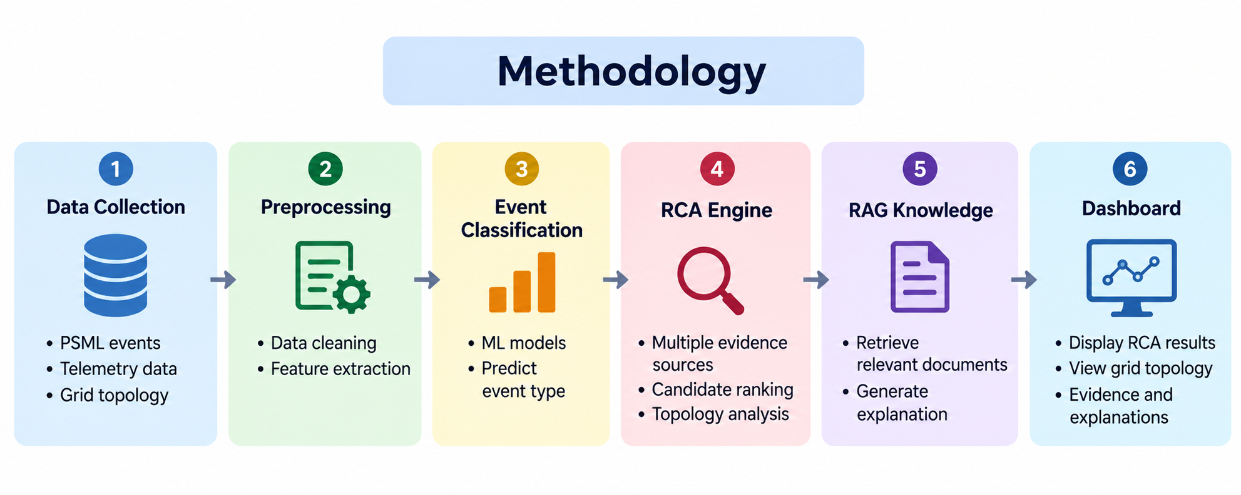
Power Grid RCA
Methodology

Slide 7
Power Grid RCA
Approach
Algorithms
  Random Forest
  1D CNN, BiGRU, InceptionTime
  ResNet1D and Hybrid Fusion
  Graph-based and multi-evidence RCA
RAG
  Sentence Transformers
  ChromaDB and semantic search
Technology Stack
  Python, FastAPI, React + Vite
  PostgreSQL, PyTorch, Scikit-learn

Slide 8
Power Grid RCA
Findings and Results
799 PSML event records identified.
23 nodes and 34 branches in the grid topology.
830,400 telemetry records loaded into PostgreSQL.
Random Forest baseline accuracy: 88.24%.
ResNet1D temporal model accuracy: 89.92%.
RAG knowledge base: 6 documents and 34 semantic chunks.
Event #550: top RCA candidate is Branch 102–151, CKT 1.
15/15 integration tests passed; frontend production build succeeded.

Slide 9
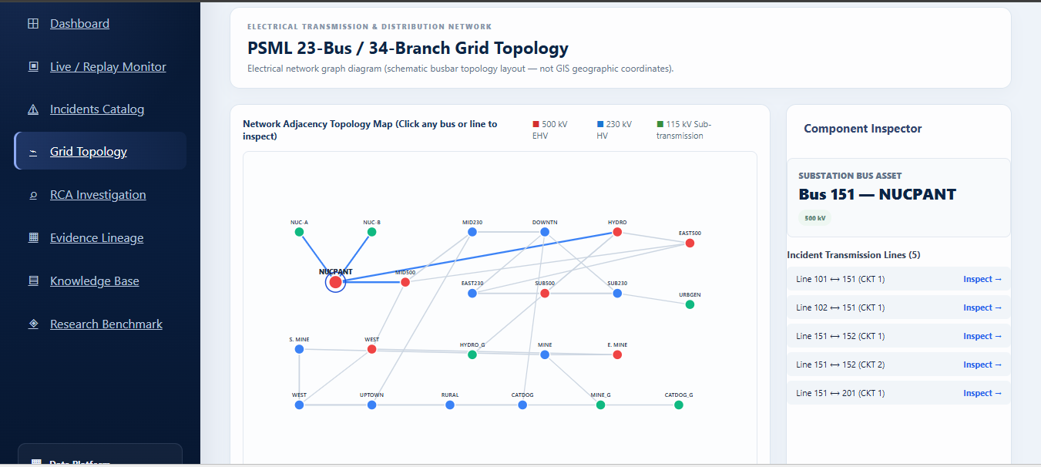
Power Grid RCA
Findings and Results

Slide 10
Power Grid RCA
Conclusion
GridRCA combines machine learning, grid topology and root-cause analysis.
Multiple evidence sources help rank likely grid components.
RAG retrieves technical knowledge to support explanations.
The React frontend and FastAPI backend provide an integrated interface.
System health checks passed for the tested components.
Further benchmark validation and advanced experiments remain future work.

Slide 11
Power Grid RCA
Reference
Shi, Jinquan & Cheng, Yingying & Zhang, Fan & Jiang, Miao & Lin, Jun & Shen, Yanbai. (2025). GridCodex: A RAG-Driven AI Framework for Power Grid Code Reasoning and Compliance. 10.48550/arXiv.2508.12682.
Zheng, X., Xu, N., Trinh, L. et al. A multi-scale time-series dataset with benchmark for machine learning in decarbonized energy grids. Sci Data 9, 359 (2022). https://doi.org/10.1038/s41597-022-01455-7’
Tanveer Ahmad, Hongcai Zhang, and Biao Yan. A review on renewable energy and electricity requirement forecasting models for smart grid and buildings. Sustainable Cities and Society, 55:102052, 2020.
Abdulaziz Almalaq and George Edwards. A review of deep learning methods applied on load forecasting. In 2017 16th IEEE international conference on machine learning and applications (ICMLA)

Slide 12
M.Tech Program
Advanced Industry Integrated Programs
Jointly offered by University and LTIMindTree
Review III
Agentic AI Framework for Continuous Cross-Domain
Urban Infrastructure Monitoring, Diagnosis and
Decision Support
Team Member
Sanika Gaikwad (T9996)
Knowledge partner | Implementation partner

Slide 13
AGENTIC AI FOR URBAN INFRASTRUCTURE
Introduction
Urban infrastructure includes water resources, drainage, transportation and weather-dependent services.
Problems in one domain can affect other infrastructure systems.
Existing monitoring systems often analyse infrastructure domains separately.
This project develops a multi-agent AI framework for cross-domain monitoring, investigation and decision support in Chennai.
The system combines real historical datasets, anomaly detection, knowledge retrieval and simulation.

Slide 14
AGENTIC AI FOR URBAN INFRASTRUCTURE
Objective
Develop specialized AI agents for five urban infrastructure domains.
Detect abnormal conditions using historical data and statistical/ML models.
Investigate potential cross-domain impacts using evidence and domain knowledge.
Compare mitigation options through scenario-based simulation.
Generate ranked recommendations with explanations.
Maintain human approval before operational actions.

Slide 15
AGENTIC AI FOR URBAN INFRASTRUCTURE
Modules
1. Weather Intelligence Agent
  Rainfall monitoring and anomaly detection.
  Historical rainfall and extreme-event analysis.
2. Water Infrastructure Agent
  Reservoir storage and lake inflow/outflow analysis.
  Water-resource stress assessment.
3. Drainage Infrastructure Agent
  Pumping motor and sewage flow-meter analysis.
  Historical flood exposure assessment.

Slide 16
AGENTIC AI FOR URBAN INFRASTRUCTURE
Modules
4. Train Infrastructure Agent
  Metro/MRTS station locations and flood exposure.
  Escalator, lift and train telemetry marked as data required.
5. Traffic Safety Agent
  Historical road accidents, fatalities and injuries.
  Live traffic monitoring marked as data required.

Slide 17
AGENTIC AI FOR URBAN INFRASTRUCTURE
Problem Statement
Urban infrastructure data is distributed across multiple domains and datasets.
Isolated monitoring makes cross-domain impact assessment difficult.
Historical data alone cannot establish current operational conditions.
Infrastructure operators need evidence-based diagnosis and comparison of mitigation options.
A unified system is required to combine domain intelligence, explainable findings and human-controlled decisions.

Slide 18
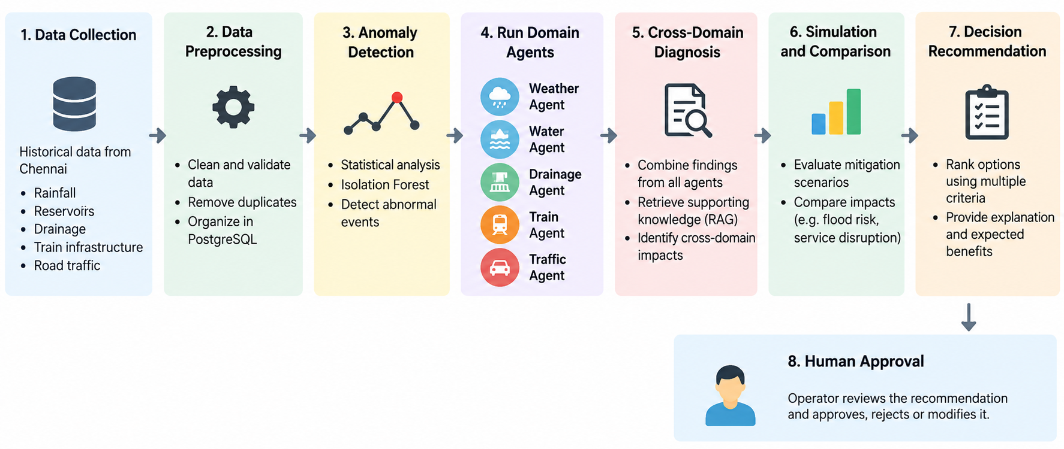
AGENTIC AI FOR URBAN INFRASTRUCTURE
Methodology

Slide 19
AGENTIC AI FOR URBAN INFRASTRUCTURE
Approach
Isolation Forest for rainfall and lake-flow anomaly detection.
Statistical correlation for reservoir storage and rainfall analysis.
Haversine distance for infrastructure proximity assessment.
RAG for retrieving supporting domain knowledge.
Rule-based composite risk scoring.
Multi-criteria decision ranking and scenario comparison.

Slide 20
AGENTIC AI FOR URBAN INFRASTRUCTURE
Findings and Results
Dataset Findings
  Rainfall: 20,055 cleaned station-day records reported across 62 stations.
  Water: Four major reservoirs with a combined capacity of 9,065 MCFT.
  Drainage: 1,208 pumping motors and 42 sewage flow meters.
  Flood data: 945 historical inundation observations.
  Train infrastructure: 118 station locations.
  Traffic: 28 annual records covering 1998–2025, with 165,289 reported accidents.

Slide 21
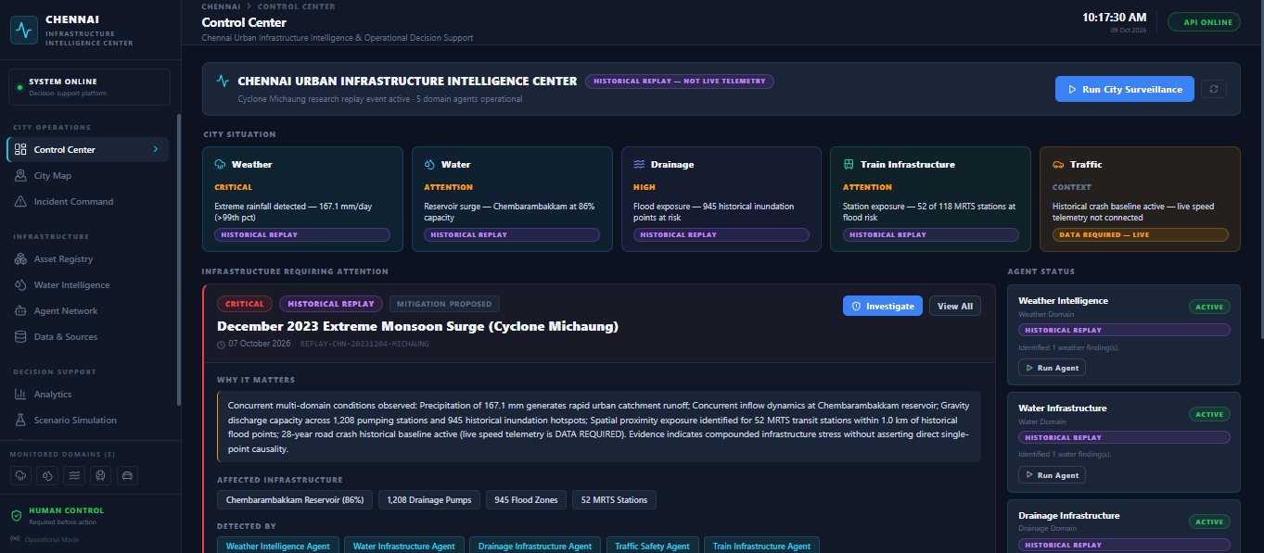
AGENTIC AI FOR URBAN INFRASTRUCTURE
Findings and Results

Slide 22
AGENTIC AI FOR URBAN INFRASTRUCTURE
Conclusion
Developed a multi-agent framework for Chennai's urban infrastructure intelligence.
Integrated historical datasets, anomaly detection, RAG-based evidence and cross-domain diagnosis.
Enabled scenario comparison and ranked mitigation recommendations.
Implemented human approval for operational decisions.
Backend tests and frontend build passed successfully.
Current Limitation: Live weather feeds, water/drainage SCADA, train GPS, escalator/lift telemetry and live traffic feeds are not connected.
Future Scope: Integrate verified real-time data, improve model validation and evaluate the framework across additional historical events.

Slide 23
vAGENTIC AI FOR URBAN INFRASTRUCTURE
Reference
OpenCity — Chennai urban infrastructure datasets.
NASA / relevant public meteorological data sources, where applicable to the collected datasets.
Jones, Castiel & Olsen, Sophia & Gallegos, Skyler. (2026). Agentic AI Consensus Framework for Continuous Monitoring and Autonomous Governance of Shadow Networking in Hybrid Cloud Ecosystems
Syam Kumar, Palagummi & DHEEPA, N & Havilah, Geddam & SRAVANI, KOYYALA. (2026). Agentic AI and Geospatial Intelligence Framework for Smart Government Infrastructure Monitoring, Predictive Analytics, and Decision Support Systems. Intelligent Government Infrastructure Monitoring and Prediction using Agentic AI and Geospatial Intelligence. International Journal for Research Trends and Innovation. 11. 18.

