Slide 1

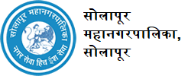
“SAMVED” HACKATHON 2026
Smart Water Distribution System
Problem Statement ID – PS-003
Problem Statement Title- Smart Water Pressure Management for Equitable Water Supply in Solapur Municipal Corporation
Theme- Equitable Urban Infrastructure
Team ID- FBEB3C7D
Team Name - FlowIQ

Slide 2




Smart Water Distribution System
FlowIQ
Idea
WorkFlow
  A smart IoT-based system that ensures fair water supply across all areas by monitoring pressure and flow in real time and automatically correcting imbalances.
….....
  Sensors measure pressure and flow in pipelines
  System detects low-supply zones
  Smart valves rebalance water flow
  Live status and alerts on dashboard
….....
Problem Solved
Innovation
Uneven pressure → Zone balancing
Leakages → Early detection
Manual control → Automation
No visibility → Real-time monitoring
….....
  Focus on fairness, not only monitoring
  Automatic correction, not just alerts
  Simple and scalable for municipalities
......

Slide 3
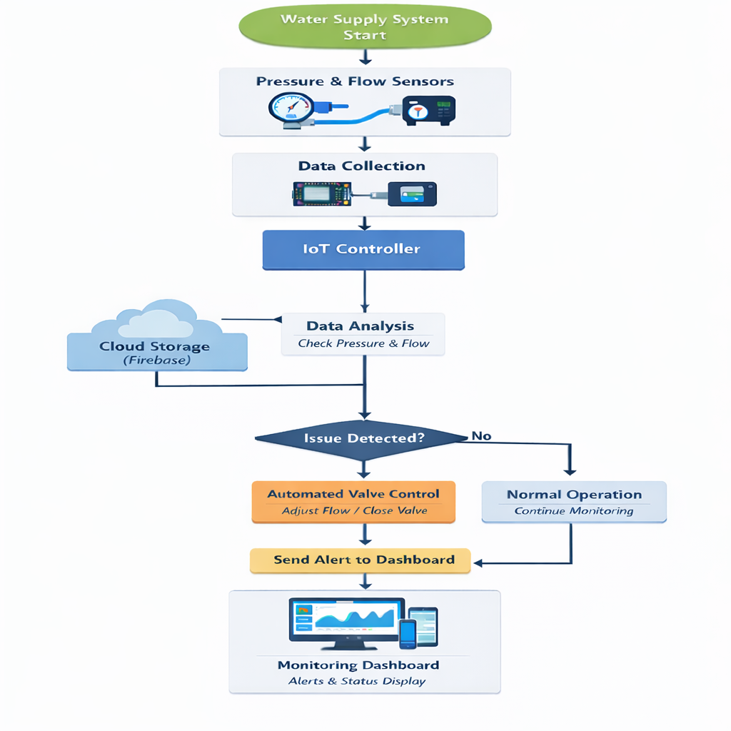
TECHNICAL APPROACH
FlowIQ
IoT Sensors
🌊 Flow sensors : to measure real-time water flow(YF-S201)
⚙️ Pressure sensors :to monitor pressure at different distribution zones (MPX5010)
🛢️ Water level sensors : for tanks and reservoirs(SC-SR04)
Hardware :
🔌 Arduino microcontroller for data collection GSM for data transmission
📊 Data analytics for leakage detection and demand prediction
🐍 Programming Language: Python
🌐 Framework: Flask
🔥 Database: Firebase
🖥️ Web dashboard : HTML, CSS, JavaScript
Flow Chart for water supply system

Slide 4


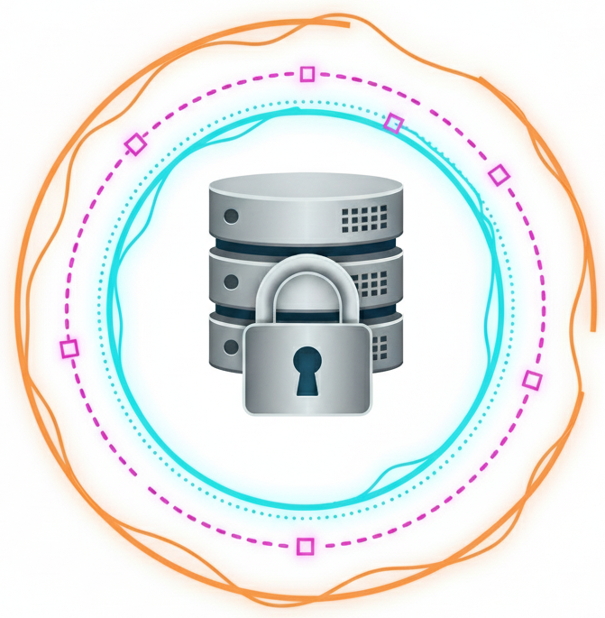
FlowIQ
FEASIBILITY AND VIABILITY
⚙️ Technical :
Uses existing IoT, cloud, and analytics technologies.
💰 Economic :
Reduces water loss and operational costs .
👥 Operational :
Easy to use with minimal staff training .
📈 Scalability:
Implemented zone-wise with low initial cost .
⏱️ Efficiency : Real-time monitoring improves decision-making
Feasibility of the Idea
Challenges & Risks
Strategies to Overcome Challenges
💸 High Initial Cost:
Sensors and infrastructure setup cost.
📡 Sensor Reliability :
Risk of malfunction or inaccurate data.
🌐 Connectivity Issues:
Network problems in remote /underground areas.
🚫👤 User Adoption:
Limited technical awareness among staff.
🔒 Data Security:
Cloud data privacy and security risks.
⏳Phase Deployment:
Start with high-priority zones to cut initial cost.
📡Reliable Sensing:
Use redundant sensors and regular maintenance.
🌐Robust Connectivity:
Adopt hybrid networks (GSM, LoRaWAN, Wi-Fi).
👤User Training:
Train staff for smooth system adoption .
🔒Data Security:
Ensure encryption, authentication, access control.
4

Slide 5

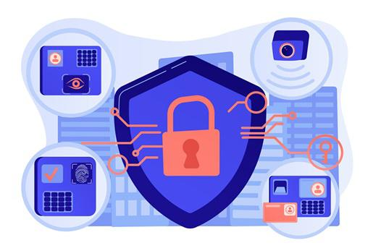


FlowIQ
IMPACT AND BENEFITS
IMPACT
1
2
3
Fair Access for Every Household:
System ensures families on highest hills get adequate pressure without expensive suction pumps (₹5,000-15,000)
4
Predictable Daily Life:
Live pressure updates via webapp no more waiting hours. Citizens get time back for work and family.
Direct Cost Savings:
Families save ₹500-1,000/month by avoiding private water tankers. For 10 lakh citizens = significant community savings.
Safe & Clean Water:
Prevents back-flow contamination - reduces Typhoid, Cholera, and gastroenteritis risk.
BENEFITS
Economic
Operational
Environmental
Social
Real-time monitoring for SMC
Data-driven decisions.
Faster complaint resolution
5-10% water loss reduction= lakhs of liters saved.
20-30% longer pipeline life sustainable growth.
For Citizens:₹500-1,000/month savings, No ₹10,000+ pump costs.
For SMC:60-70% cheaper repairs, 15-20% lower electricity, Reduced complaints.
Dignity and Time Restored.
Reducing Community Conflict and Building Trust.
5

Slide 6
RESEARCH AND REFERENCES
FlowIQ
  Artificial Intelligence based water Management System
    Source: IEEE Xplore https://ieeexplore.ieee.org/document/10039523
    The system will provide a platform for water users and water managers to access information, solve problems and make informed decisions for water resource management.
IoT Based Smart Automatic Water Management System with RF Communication and Remote Monitoring
    Source: IEEE Xplore : https://ieeexplore.ieee.org/document/9775927
    In this research, the level of water in the reserve tank and roof tank is monitored, and at the same time, the water pump is also controlled automatically depending on the current water level using an ultrasonic sensor and water level sensor.
ICT Smart Water Management System for Real-Time Applications
    Source: IEEE Xplore : https://ieeexplore.ieee.org/document/9837570
    The proposed application consists of various sensors used to measure water quality parameters. These parameters such as pH, Total Dissolved Solids (TDS), Ammonium (NH4), Sodium (Na), and Chloride (CL). The Arduino Mega is used as the micro-controller and Wi-Fi model to transfer the data from and to the database uploaded into the cloud.

