Slide 1
City Weather & Environmental Insights
~ By : SANIKA SUNIL LAWANDE

Slide 2
OBJECTIVES :
Analyze weather, air quality, and environment conditions across major Indian cities.
Identify trends, patterns, and anomalies in temperature, humidity, and AQI.
Support environment planning and public health awareness.
Compare environmental conditions across multiple cities.
Understand how weather conditions impact visibility and UV index.
Provide actionable recommendations for climate adaptation and pollution control.
Detect correlation between temperature, humidity, and AQI.

Slide 3
QUESTIONS :
Which city recorded the highest and lowest temperatures ?
Which city had the best and worst air quality ?
What is the average humidity in each city ?
How does weather condition vary by city ?
Is there a seasonal pattern in temperature and AQI levels ?
Which cities face extreme weather conditions frequently ?

Slide 4
DATASET :

Slide 5
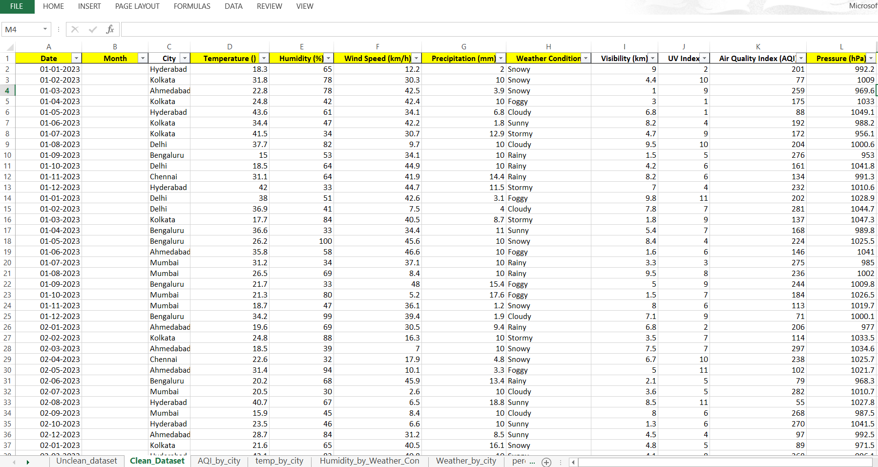

Slide 6
CHARTS :

Slide 7
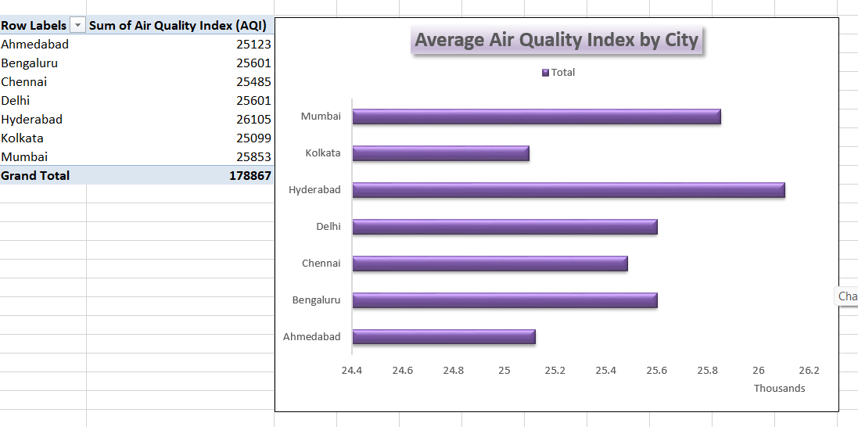

Slide 8
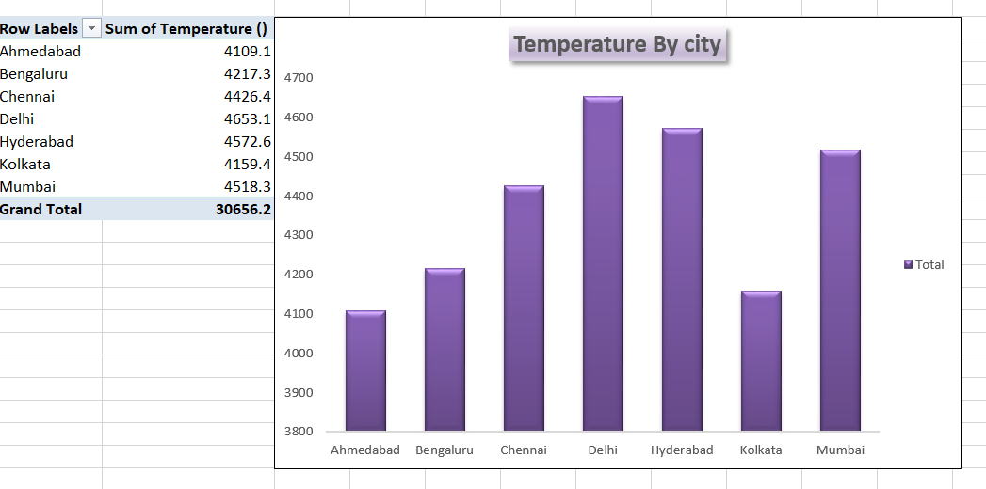

Slide 9
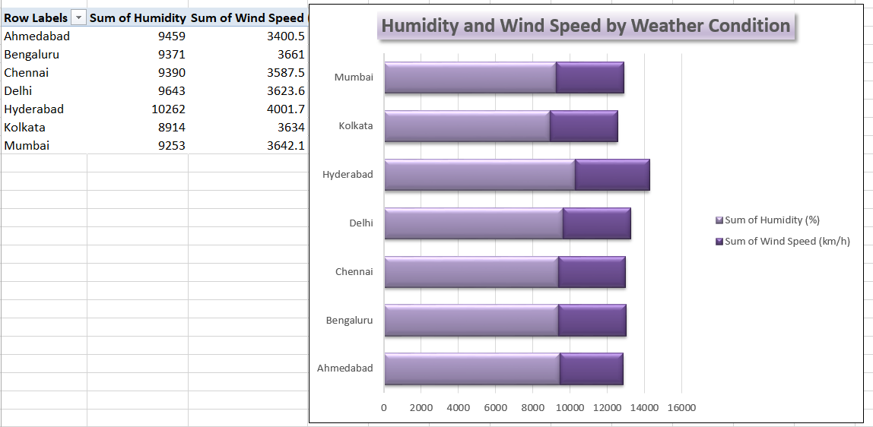

Slide 10
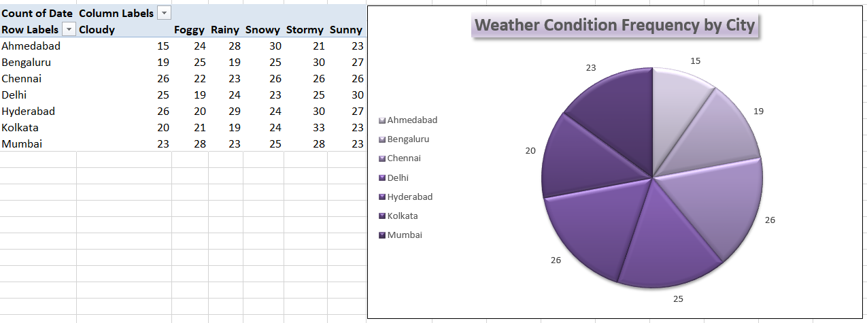

Slide 11
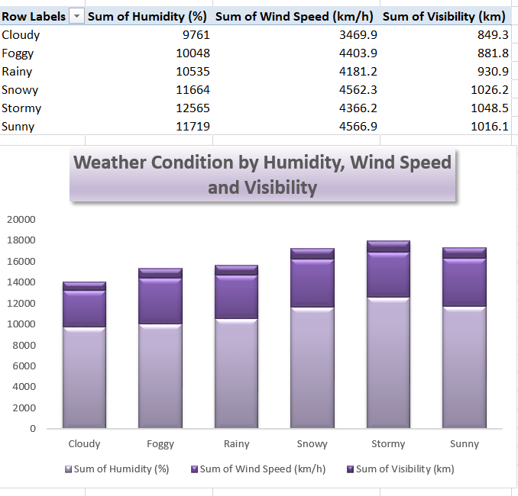

Slide 12
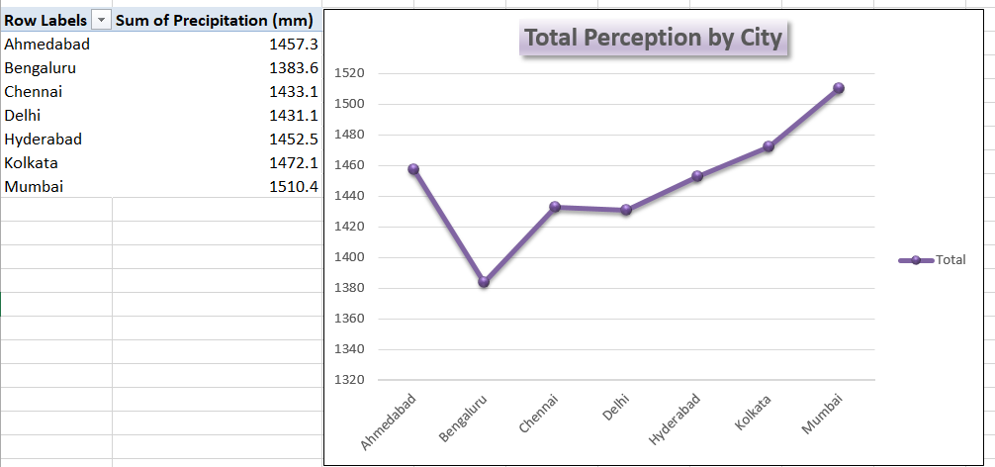

Slide 13
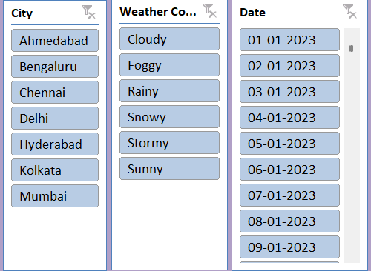
SLICERS :

Slide 14
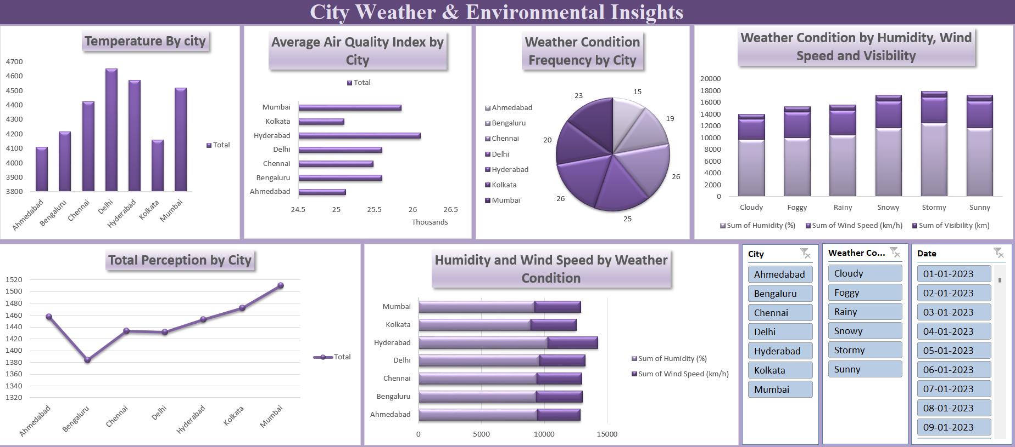
FINAL DASHBOARD :

Slide 15
INSIGHTS :

Slide 16
Highest temperature recorded : Bengaluru - 45°C
Lowest temperature recorded : Bengaluru – 15°C
Worst AQI : Ahmedabad, Chennai, Kolkata (300)
Best AQI : Multiple cities recorded lows around 50.
Highest humidity : Hyderabad (~75.6%), Delhi (75%).
Summer months show sharp AQI spikes in Delhi & Ahmedabad.
Foggy conditions lead to low visibility in winter months.

Slide 17
CONCLUSION :
Cities with extreme AQI need targeted pollution control.
Seasonal weather patterns affect both temperature and air quality.
High humidity cities may face increased discomfort and health issues.
Authorities should integrate real – time AQI monitoring with public health advisories

Slide 18
THANKYOU !!

