Slide 1
PREDICTION OF MONKEYPOX DISEASE USING MACHINE LEARNING TECHNIQUES

Slide 2
INTRODUCTION
Monkeypox is an infectious zoonotic disease (a virus that transmits from animals to people). Though less deadly, it develops symptoms that are similar to those of smallpox. Monkeypox has surpassed smallpox as the orthopoxvirus that poses the greatest threat to public health since smallpox was eradicated in 1980 and smallpox vaccinations were subsequently discontinued. Monkeypox has been spreading into cities and is often seen close to tropical rainforests; it primarily affects Central and West Africa.Beginning in May 2022, a significant number of monkeypox viruses began to spread over numerous nations, including the UK, Spain, Portugal, and the USA. The monkeypox virus has recently started to afflict humans in India as well. In response, the WHO and the US Centers for Disease Control and Prevention have stepped up their surveillance for orthopoxvirus infections and recommended healthcare professionals to be on the lookout for individuals who exhibit symptoms that resemble the rash of the smallpox, but actual symptoms of Monkeypox include fever, headache, muscle aches, and a rash that often develops into small fluid-filled blisters. Misdiagnosis results in ineffective therapies and permits patients to miss the ideal window for recovery, both of which have serious negative effects. As a result, the model selection for predicting the type of monkeypox is crucial. This study uses eight different classification models, including Decision Tree, Random Forest, Logistic Regression, Naive Bayes, KNN, SVM, and the ensemble algorithms Ada Boosting and Gradient Boosting, to categorize the intensity of monkeypox in the patients.

Slide 3
MOTIVATION
Machine learning techniques have the potential to be highly effective in predicting the likelihood of a person contracting Monkeypox. By analyzing data from previous outbreaks and identifying key risk factors, such as exposure to infected animals or contact with infected individuals, machine learning algorithms can be trained to accurately predict the likelihood of an individual contracting the disease.
The motivation for this project, therefore, is to develop an accurate and reliable prediction model for Monkeypox that can be used to identify at-risk individuals and implement preventative measures, such as vaccination or quarantine, to prevent the spread of the disease. Such a model could have significant implications for public health, potentially saving lives and reducing the overall impact of Monkeypox outbreaks.

Slide 4
PROBLEM STATEMENT
The project aims to predict the risk of monkeypox disease. Monkeypox is an infectious zoonotic disease (a virus that transmits from animals to people). Though less deadly, it develops symptoms that are similar to those of smallpox. A dataset containing medical risk factors for over 20,000 patients is used to build a predictive model.
The model will use machine learning techniques to analyze the provided information and make accurate predictions of the monkeypox. The goal of the project is to develop a tool for detection and the disease, addressing a significant public health concern using different classification models, to categorize the intensity of monkeypox in the patients.

Slide 5
Design and Methodology
DATA SET
The data set includes over 23,000 records and 10 attributes, each of which is a potential medical risk factor.
Detailed info about the dataset is given below
Systemic Illness:- This column contains different symptoms like Muscle Ache and Pain, Swollen Lymph Nodes, Fever, and None.
The other 8 columns tells whether a patient have that symptom or not
Rectal Pain
Sore Throat
Penile Edema
Oral Lesions
Solitary Lesion
Swollen Tonsils
HIV Infection
Sexually Transmitted Infection
The last column is the output attribute which gives MonkeyPox status whether it is positive or not.

Slide 6
DATA PREPROCESSING
Data preprocessing is the steps taken to clean, transform, and prepare raw data for analysis. This includes tasks such as removing missing values, handling outliers, standardizing variables, and converting categorical variables to numerical ones. In this model we have done “Label Encoding”
LABEL ENCODING
Label encoding is a table encoding technique used in machine learning to transform categorical variables into numerical values. In the given data set all the attributes are converted to numericals i.e. 'True' is converted to '1', and 'False' is converted to '0'. At the same time, 'Positive' is converted to '1', and 'Negative' is converted to '0'. In the systemic illness, the column has different values as 0, 1, 2, and 3. '0' stands for 'Muscle Ache and pain', '1' stands for 'Swollen Lymph Nodes', '2' stands for 'Fever', and '3' stands for 'None'.

Slide 7
Correlation Coefficient and Heatmap
The correlation coefficient is a numerical measure of the strength and direction of a linear relationship between two variables. In other words, it measures the extent to which changes in one variable are associated with changes in the other variable. The correlation coefficient ranges from -1 to 1, with -1 indicating a perfect negative correlation, 1 indicating a perfect positive correlation, and 0 indicating no correlation.
The correlation coefficient is an important tool in data analysis and machine learning, as it can help to identify relationships between variables and can be used in feature selection techniques to remove highly correlated features, which can reduce overfitting and improve the performance of the model.

Slide 8
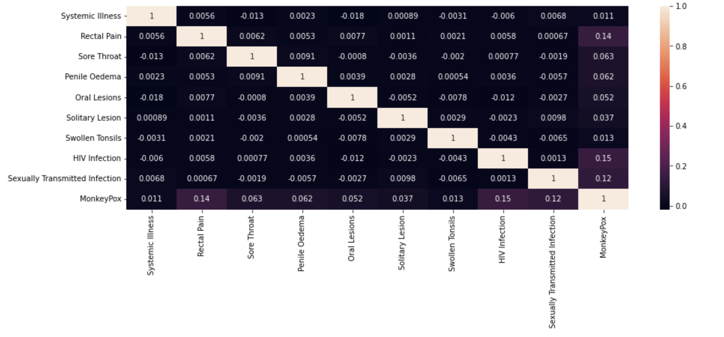
Correlation Coefficient and Heatmap

Slide 9
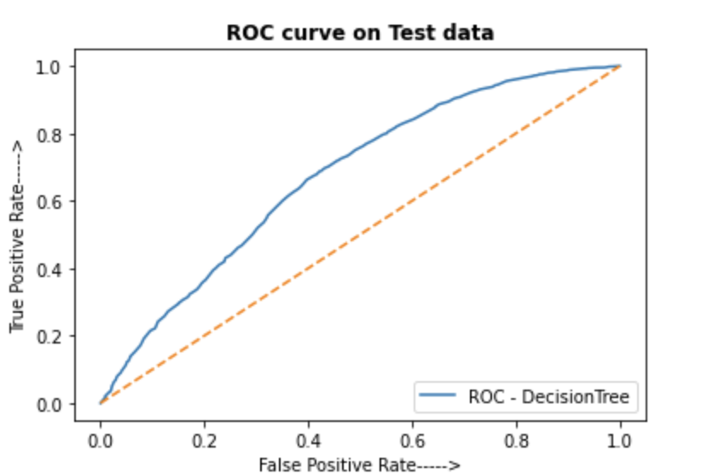
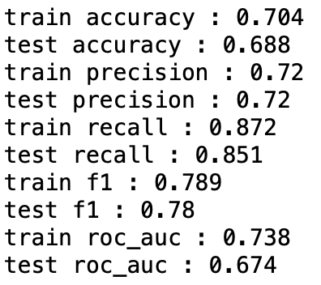
MACHINE LEARNING MODELS USED
DECISION TREE
Decision tree is a Machine Learning technique which uses flowchart-like models that helps make decisions based on different conditions. It recursively splits the data into subsets based on the values of the features until a stopping criterion is met. It can be used for both classification and regression tasks.

Slide 10
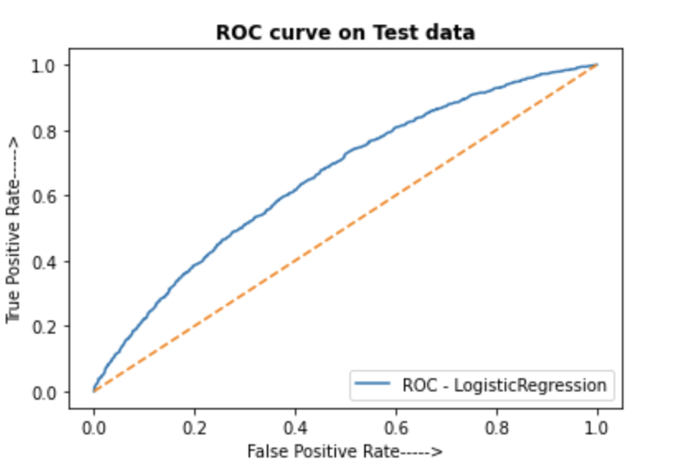
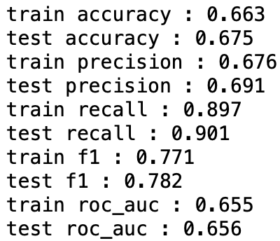
Logistic Regression
Logistic Regression is a popular classification algorithm used to predict binary or categorical outcomes. It estimates the probability of a binary response based on one or more input variables, by fitting a logistic function to the data. The model can be trained using a variety of optimization techniques and evaluated using various metrics like accuracy, precision, and recall.

Slide 11
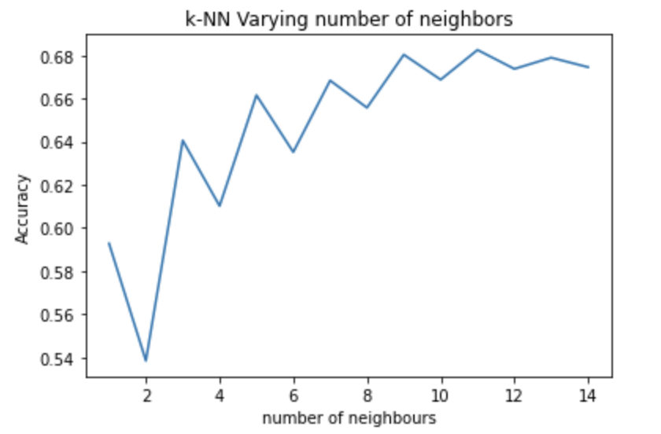
KNN
K-Nearest Neighbors (KNN) is a simple classification algorithm that assigns a class label to a new observation based on the class labels of its K-nearest neighbors in the training dataset. It measures the distance between data points using various metrics and selects the most frequent class label among the K-nearest neighbors.

Slide 12
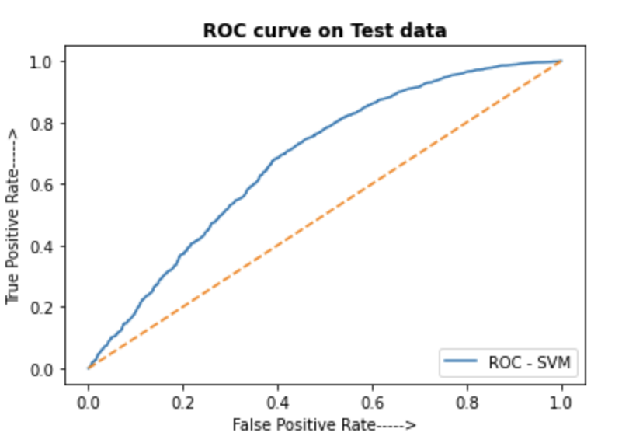
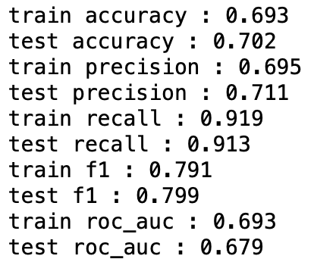
SVM
Support Vector Machines (SVMs) are a popular classification algorithm that finds the optimal hyperplane that separates the classes in the input data. SVMs maximize the margin between the hyperplane and the closest data points, and can handle non-linear decision boundaries using kernel functions. SVMs are particularly effective for small to medium-sized datasets, and are often used in image classification, text classification, and bioinformatics.

Slide 13
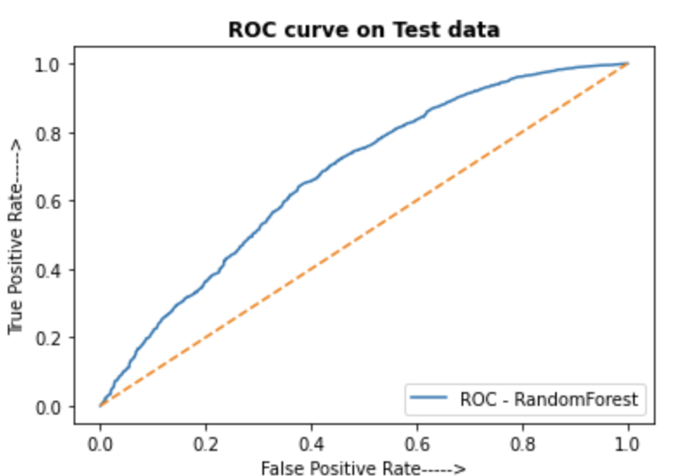
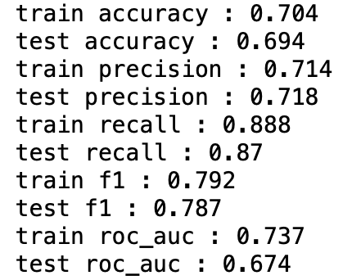
Random Forest
Random forest is an ensemble learning method that combines multiple decision trees to make more accurate predictions. It creates a set of decision trees on randomly sampled subsets of the data, and the final prediction is made by taking the majority vote or average of the predictions of all the trees. This helps to reduce the risk of overfitting and improves the overall performance of the model.

Slide 14
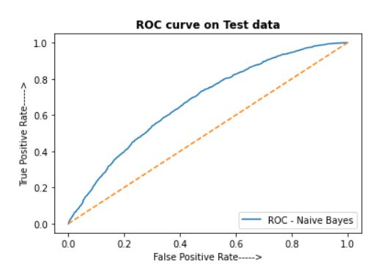
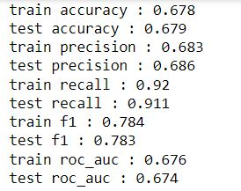
NAIVE BAYES
Naive Bayes is another classification algorithm based on Bayes' theorem. It assumes that the features are conditionally independent, given the class label. The algorithm computes the conditional probability of each class given the input features, and selects the class with the highest probability as the predicted output. Naive Bayes is particularly effective for high-dimensional datasets, and is often used for text classification and spam filtering.

Slide 15
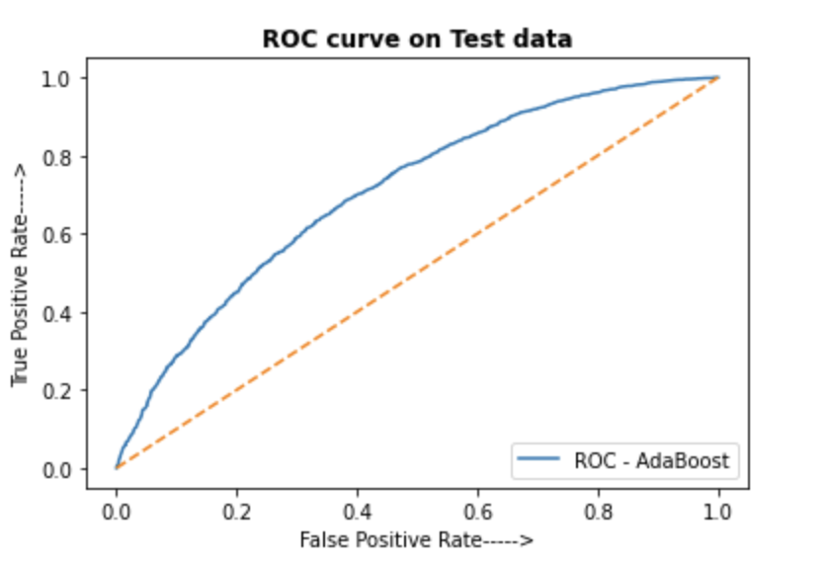
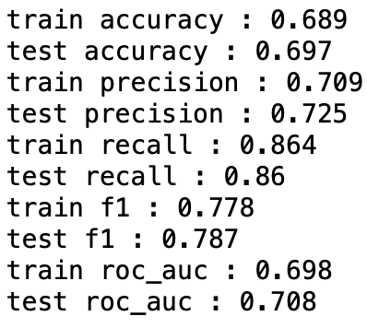
ADA BOOST
We are using ADA Boosting (AdaBoost-Adaptive Boosting- is a popular boosting algorithm that combines multiple weak classifiers to form a strong classifier. In AdaBoost, each weak classifier is trained on a subset of the training data, and assigned a weight based on its accuracy. The algorithm then adjusts the weights of the misclassified examples, and trains another weak classifier on the updated weights. This process is repeated for a fixed number of iterations or until the desired accuracy is achieved. The final prediction is a weighted sum of the predictions of the weak classifiers. AdaBoost is widely used in classification problems, and is particularly effective for datasets with complex, non-linear decision boundaries.)

Slide 16
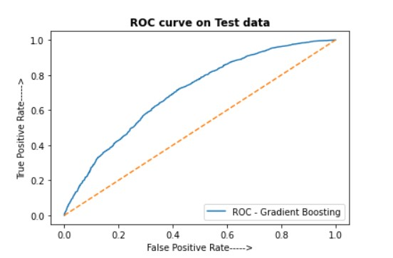
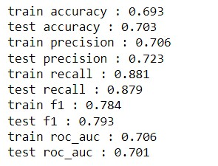
Gradient Boosting
Gradient Boosting (Gradient Boosting is a boosting algorithm that iteratively builds a strong classifier or regressor by combining multiple weak models, typically decision trees. The algorithm optimizes a loss function by adding weak models sequentially, each one focusing on the examples that were poorly predicted by the previous models. In each iteration, the algorithm computes the negative gradient of the loss function with respect to the predicted values, and trains a new model to minimize the residual error. The final prediction is a weighted sum of the predictions of all the weak models. Gradient Boosting is widely used in regression and classification problems, and is known for its high predictive accuracy) for the ensemble algorithm.

Slide 17
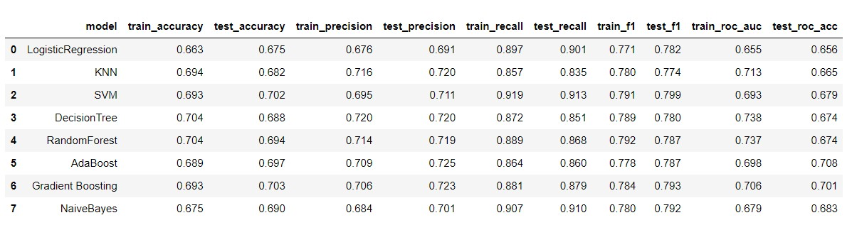
PERFORMANCE MEASURES OF VARIOUS MACHINE LEARNING APPROACHES
Different algorithms were applied to calculate the Accuracy and F1 score from the above figure the highest values are generated by SVM (70.2% & 79.99%) and Gradient Boosting(70.34% & 79.3%) as compared to all other methods.

Slide 18
Conclusion
In conclusion, we have explored the application of various machine learning techniques to predict MonkeyPox disease. Specifically, we evaluated eight different techniques which includes Decision Tree, Random Forest, Logistic Regression, Naive Bayes, KNN, SVM, and the ensemble algorithms Ada Boosting and Gradient Boosting, and we found that SVM and Gradient Boosting consistently outperformed the other methods in terms of accuracy and F1 score.
Our results demonstrate the potential of machine learning approaches for predicting MonkeyPox disease, and suggest that SVM and Gradient Boosting may be particularly effective methods for this task. However, we also acknowledge that there may be limitations and potential sources of bias in our approach, such as the quality and representativeness of our data.
Moving forward, we believe that further research is needed to refine and validate our approach, as well as to explore alternative machine learning algorithms and data sources. Nevertheless, our findings have important implications for understanding and addressing the MonkeyPox disease, and may ultimately contribute to more effective predictions.

Slide 19
Thank you
Submitted By
Anish Kumar Naik | 211627029
Ankit Goyal | 211627053
Sanika Choudhary | 211627047
Sanvith Reddy M | 211627039

