Slide 1
Financial Dashboard Using PowerBi
Sanika Chougule

Slide 2
01
Introduction to the Dashboard
content
02
DAX Functions Overview
03
Time Intelligence Functions
04
Logical and Conditional Functions
05
Ranking and Filtering Functions
06
Advanced Metrics

Slide 3
Introduction to the Dashboard
/
01

Slide 4
Purpose of the Dashboard
Comprehensive financial analysis
Supports decision-making
Evaluates key performance indicators
The financial dashboard offers a robust platform for analyzing performance across multiple dimensions. By aggregating data from various categories and regions, it enables users to visualize key trends and make informed strategic decisions concerning financial investments.
Designed for decision-makers, the dashboard streamlines the process of identifying opportunities and threats. It provides critical insights that aid in resource optimization and strategic planning to enhance overall business growth.
The dashboard systematically tracks and evaluates essential KPIs, allowing stakeholders to measure business success against predefined targets. This facilitates timely interventions and strategic pivots to align with business goals.

Slide 5
Dataset Overview
Transactional data from 2018-2023
Key columns in the dataset
Multidimensional financial analysis
The dataset encompasses detailed transactional records spanning five years, offering a historical perspective on sales activities. This timeframe allows for comprehensive trend analysis and performance benchmarking.
The dataset features vital attributes such as Sales Amount, Profit, Category, Region, and Date. Each column serves a unique purpose, enabling detailed segmentation and multidimensional analysis of financial metrics.
Through the diverse columns available, users can conduct multifaceted analyses, resulting in insights that reflect performance variations by geography, product category, or time period.

Slide 6
DAX Functions Overview
/
02

Slide 7
Aggregate Functions
Total Sales calculation
Total Profit computation
The Total Sales function aggregates the revenue generated, providing a clear picture of overall financial performance. Utilizing the SUM function, it allows stakeholders to track sales across different dimensions.
Similar to Total Sales, this function computes the overall profit by summing profit entries. This DAX calculation plays a pivotal role in assessing the profitability of various business units.

Slide 8
Ratio and Percentage Calculations
Profit Margin formula
The Profit Margin formula determines the ratio of profit to sales, expressed as a percentage. It offers insights into the efficiency of profit generation relative to sales performance, vital for profitability assessments.
1
Contribution to Total Sales
This function calculates each category's or region's contribution to overall sales, highlighting the relative importance and performance of different segments within the business.
2

Slide 9
Time Intelligence Functions
/
03

Slide 10
Year-to-Date Sales
Cumulative sales calculation
Importance for trend analysis
The Year-to-Date Sales formula aggregates totals from the start of the year, offering stakeholders an understanding of current performance vis-à-vis annual targets and prior periods.
By utilizing YTD data, users can identify growth trends over the year, facilitating timely adjustments to strategies based on real-time performance insights.

Slide 11
Logical and Conditional Functions
/
04

Slide 12
Pass/Fail Indicator
Categorizing outcomes based on profits
This function categorizes each outcome as "Pass" or "Fail" based on profitability metrics. It allows organizations to quickly assess performance against financial expectations.

Slide 13
High Performer Identification
Flags for above-average performance
By identifying high-performing categories or regions, stakeholders can recognize successful areas and potentially replicate those strategies across underperforming segments.

Slide 14
Ranking and Filtering Functions
/
05

Slide 15
Top 10 Products by Sales
Identifying top-performing products
This function ranks products based on sales performance, providing valuable insights into which items contribute most significantly to revenue, guiding inventory and marketing strategies.

Slide 16
Filtered Total Sales
Summing sales for specific categories
By focusing on sales within selected categories, this function allows for precise assessments of performance, aiding targeted marketing campaigns and resource allocation.

Slide 17
Advanced Metrics
/
06

Slide 18
Average Sales Per Region
Insights into regional performance
Calculating average sales across regions provides insights into specific market dynamics, informing strategies tailored to enhance performance in lower-performing areas.

Slide 19
Score Improvement Tracking
Percentage change for growth analysis
This metric tracks the percentage change between two sales periods, helping stakeholders understand growth trends and investment effectiveness in driving sales and profitability.
2
0
2
2

Slide 20
Page Descriptions
/
07

Slide 21
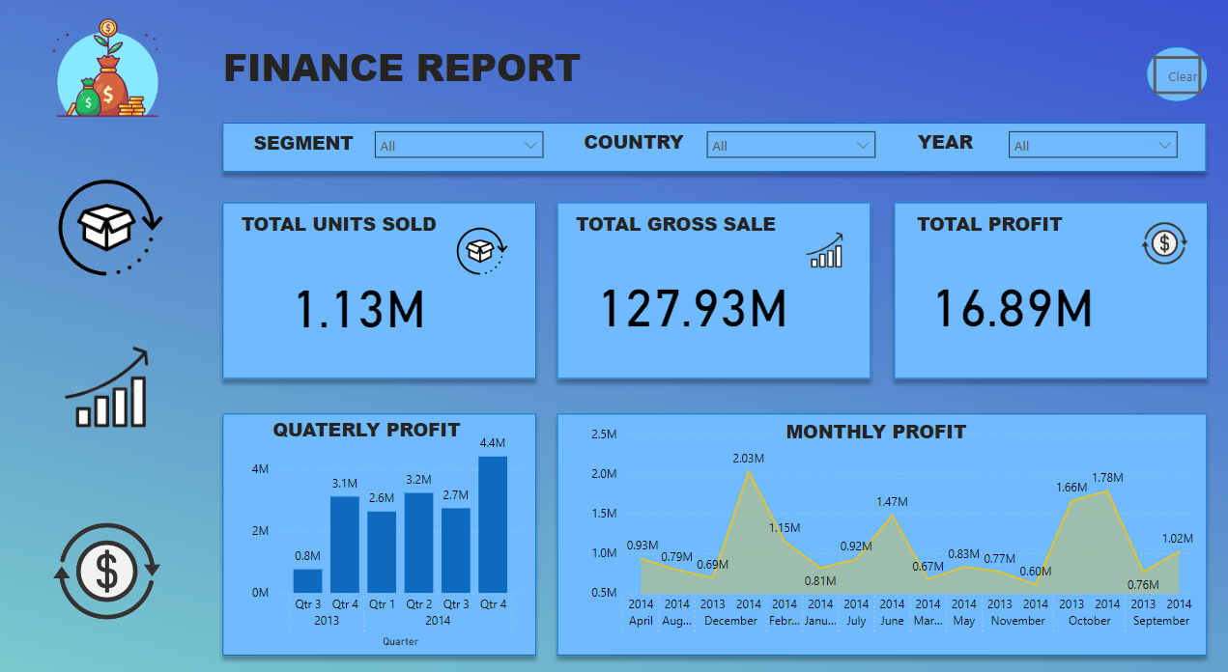
Page 1

Slide 22
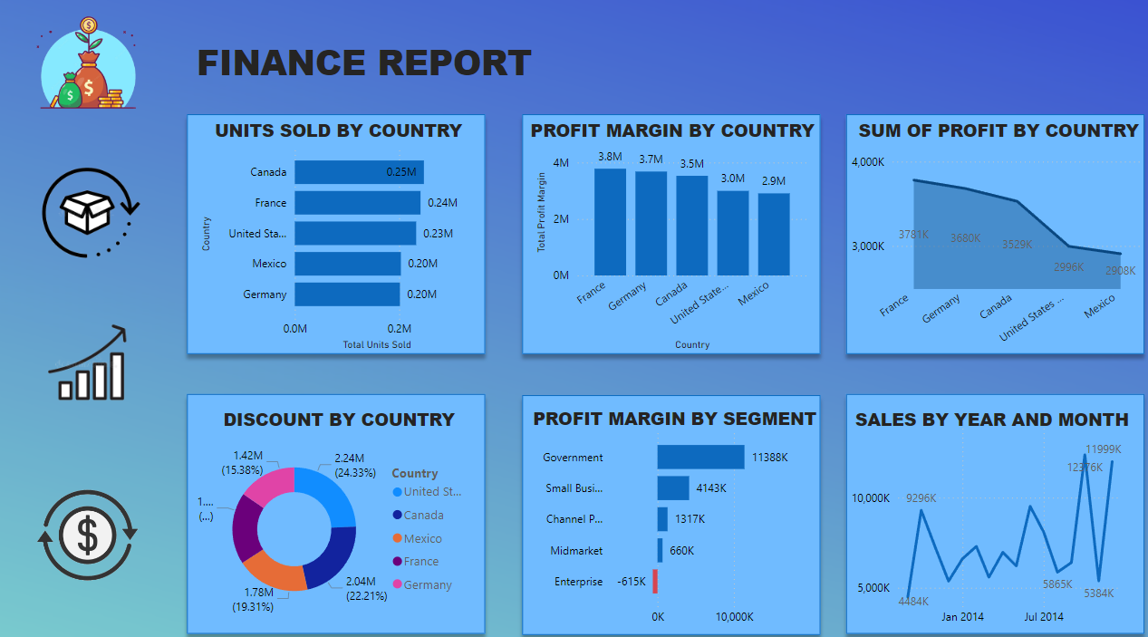
Page 2

Slide 23
Overview Page
KPI Cards: Sales and Profit metrics
Line Chart: Monthly Sales Trend
The Overview page features KPI cards that succinctly display Total Sales, Total Profit, Average Sales, and Profit Margin, allowing for quick assessments of overall financial health.
The line chart illustrates sales trends over time, making it easy to identify patterns, seasonal variations, and growth opportunities by showcasing changes in monthly sales.
Bar Chart: Sales by Category
Insights into sales performance
Enabling a visual representation of performance, the bar chart effectively compares sales across various categories, facilitating identification of top and bottom performers.
Overall insights reveal that sales exceeded $5 million in the last fiscal year, indicating a notable 10% year-over-year growth, thus underscoring effective strategies and market conditions.

Slide 24
Thank you for listening.
Sanika Chougule

