Slide 1


CONTENT
Problem Statement
Existing Solutions
Pros and Cons of Existing Solutions
Proposed Solution
Novelty of the Solution
Block Diagram/Flow Chart
Technical Description
Cost Estimate
References

Slide 2


PROBLEM STATEMENT
Traditional group savings and lending systems lack transparency and accountability, leading to disputes, financial mismanagement, and loss of trust.

Slide 3
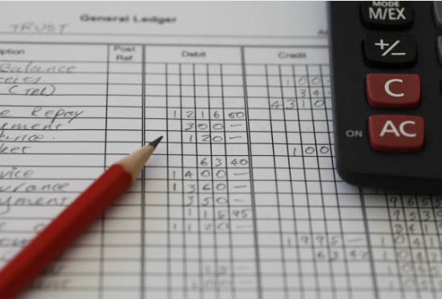
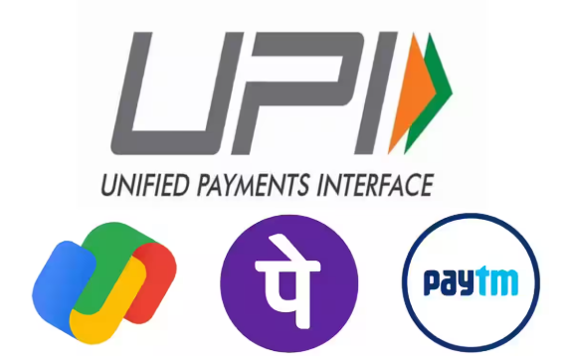
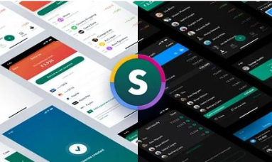
EXISTING SOLUTIONS
1. Manual Record-Keeping
Involves maintaining financial records using handwritten ledgers or journals.
2. Generic Digital Platforms
Unified Payments Interface is a real-time payment system that facilitates instant fund transfers between bank accounts through mobile applications.
3. Financial Apps
Financial apps like Splitwise are designed to track shared expenses among groups, making it easier to split bills and manage contributions.

Slide 4
Pros and Cons of EXISTING SOLUTIONS
Solutions | Pros | Cons
Manual Record-Keeping | Low cost | Error-prone, lacks accountability
Generic Digital Platforms | Easy transactions | No anomaly detection or audit tools
Financial Apps | Useful for expense tracking | Not customized for group lending

Slide 5
PROPOSED SOLUTION
Develop an AI-powered system integrating digital tools like UPI to ensure:
Real-time transaction tracking: The system integrates UPI to monitor all group transactions instantly and notify members for transparency.
Automated audits and anomaly detection: AI algorithms analyze transaction data to detect irregularities and alert administrators for corrective action
Transparent digital ledger accessible to all members: A shared, secure ledger accessible to all members records contributions, loans, and repayments.
Communicate
Iterate

Slide 6
NOVELTY / SCOPE OF SOLUTION
Novelty:
Combines AI with UPI for real-time transaction tracking, anomaly detection, and automated auditing.
Provides a transparent digital ledger for easy tracking of contributions, loans, and repayments.
Proactively identifies fraud through AI-powered anomaly detection.
Ensures compliance with group rules via automated audits.
Scope:
Applicable to rural and urban savings groups, microfinance, and lending circles.
Promotes financial inclusion by leveraging digital tools in underserved areas.
Customizable for different group needs and adaptable for global use.

Slide 7
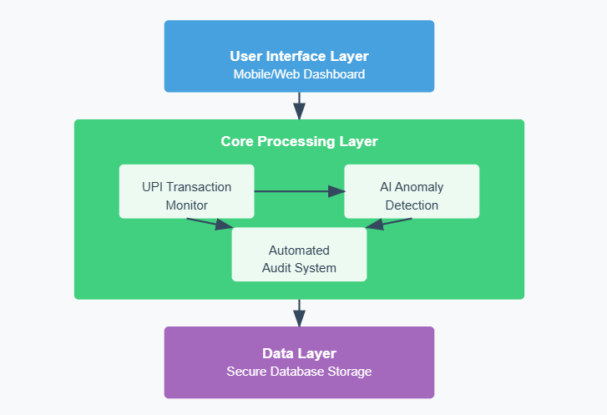
BLOCK DIAGRAM/FLOW CHART

Slide 8
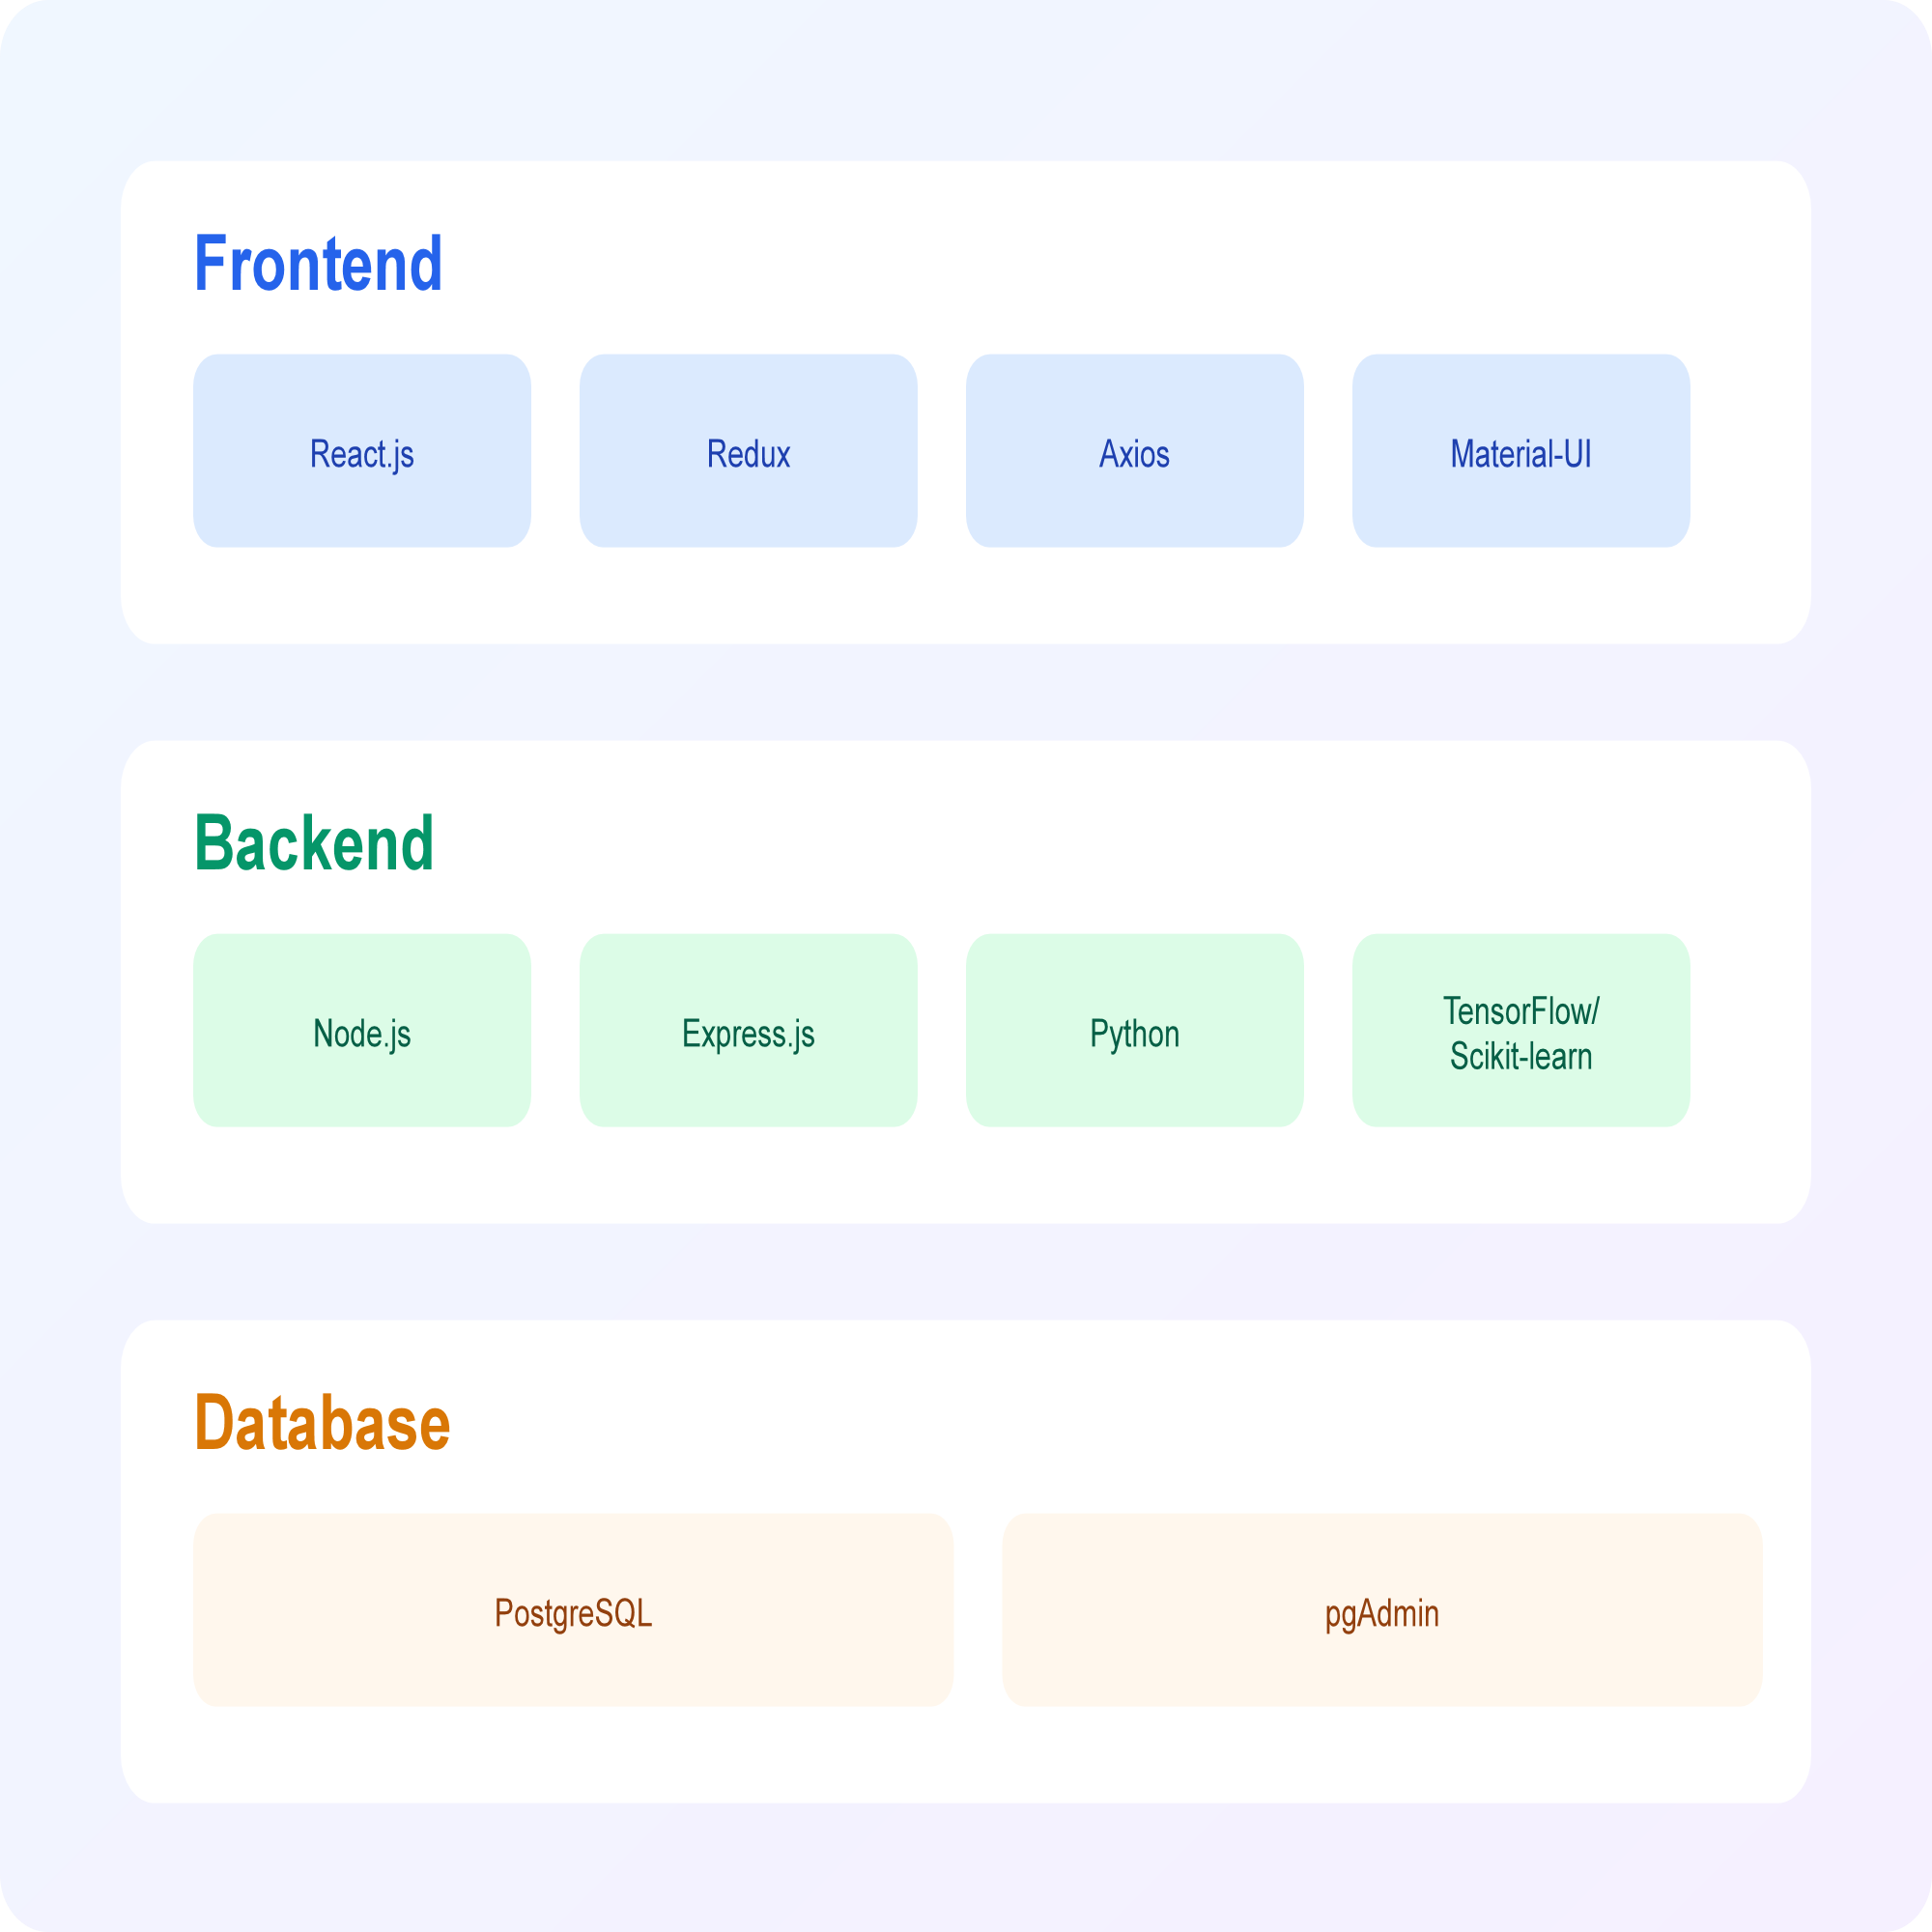
TECHNICAL DESCRIPTION

Slide 9
REFERENCES
1. Fraud Detection with ML
https://ieeexplore.ieee.org/document/10522197/
Compares ML algorithms (decision trees, neural networks) for financial fraud detection.
2. Deep Learning for Fraud
https://ieeexplore.ieee.org/document/10150467/
Reduces false positives in transactions using neural networks.
3. AI in Banking Tools
https://ieeexplore.ieee.org/document/10717099/
Enhances operational efficiency & automated auditing processes.
4. ComplyAdvantage Solution
https://complyadvantage.com/press-media/complyadvantage-takes-on-payment-fraud-with-new-ai-powered-solution/
Monitors 50+ fraud patterns (e.g., UPI scams) in real-time.

Slide 10


Slide 11

Questions…..

