Slide 1
Machine Learning
Disease Risk Prediction
using Graph Neural Networks
Combining UCI Heart Disease & Pima Diabetes Datasets · GCN & GAT Node Classification
1,688
20
16,880
6
Patients
Features
Graph Edges
Models Compared

Slide 2
Motivation & Objective
Slide 2
The Problem
Our Approach
Traditional ML treats each patient independently
Ignores real-world similarity between patients with shared symptoms, risk factors, or disease patterns
Heart disease and diabetes share overlapping clinical features — age, blood pressure, glucose — yet are modelled in isolation
Small datasets (UCI: 920 · Pima: 768) limit individual model performance
Model 1,688 patients as nodes in a patient similarity graph
Connect each patient to their 5 most clinically similar neighbours (cosine kNN on feature vectors)
Train Graph Convolutional Network (GCN) and Graph Attention Network (GAT) to predict disease risk from both node features AND graph structure
Compare GNN performance vs. Logistic Regression, Random Forest, and Gradient Boosting
Research Question: Does incorporating patient similarity graph structure improve disease risk prediction beyond feature-only ML models?

Slide 3
Datasets & Evaluation Metrics
Slide 3
UCI Heart Disease
Pima Indians Diabetes
920 patients · 4 hospital sub-datasets
16 raw features → 20 after encoding
Target: num (0–4) → binarised 0/1
Key features: age, trestbps, chol, thalch, exang, oldpeak
Missing: ca (66%), thal (53%) — dropped
768 patients · all female, age ≥ 21
8 features + binary Outcome label
Key features: Glucose, BMI, Insulin, BloodPressure, Age
Zero-coded missings replaced by column median
Shared features aligned: Age→age · BloodPressure→trestbps
1,688
70 / 15 / 15
411 : 277
Stratified
total patients
train / val / test %
healthy : disease (merged)
split strategy
Evaluation Metrics
Accuracy
Precision
Recall
F1-score
ROC-AUC
overall correct
disease precision
disease recall
harmonic mean P+R
ranking quality

Slide 4
Methodology
Slide 4
1
2
3
4
Preprocessing
Graph Construction
GNN Training
Baseline Comparison
Drop ca, thal, slope (>34% missing)
Encode categoricals (cp, restecg, sex)
Median impute remaining NaNs
Align & merge both datasets
Nodes = 1,688 patients
Edges = kNN (k=5, cosine similarity)
Feature matrix X: 20 normalized features
Class weights for imbalance handling
GCN: 2× GCNConv + BatchNorm + Dropout
GAT: 2× GATConv, 8 attention heads
Adam, lr=0.01, early stopping (patience=40)
Loss: CrossEntropy with class weights
Logistic Regression (class_weight=balanced)
Random Forest (200 trees, max_depth=10)
Gradient Boosting (200 trees, lr=0.05)
Same feature matrix X — no graph structure
→
→
→
Ablation: MLP trained on same features with NO graph edges — isolates the contribution of graph structure to prediction improvement

Slide 5
How the GNN Works
Slide 5
Patient Similarity Graph
GCN Message Passing (per layer)
Input
20 features per node
↓
GCNConv(20→64) + BatchNorm + ReLU
aggregates 5-hop neighbours
↓
GCNConv(64→32) + BatchNorm + ReLU
Each patient = node
Edge = cosine similarity ≥ k-NN threshold
Green = healthy · Red = disease
2nd order neighbourhood
↓
Linear(32→2) → Softmax
Node feature vector: [age, trestbps, glucose, chol, bmi, exang, oldpeak, sex, insulin, ... ]
disease probability per node
Key insight: After 2 layers, each patient node has 'seen' its direct neighbours AND their neighbours — its embedding captures clinical context, not just raw measurements.
GAT variant: GATConv with 8 attention heads learns which neighbours matter most — e.g. two patients with similar glucose AND age receive higher attention weight.

Slide 6
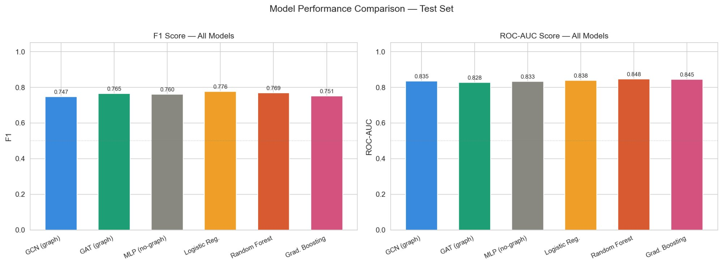
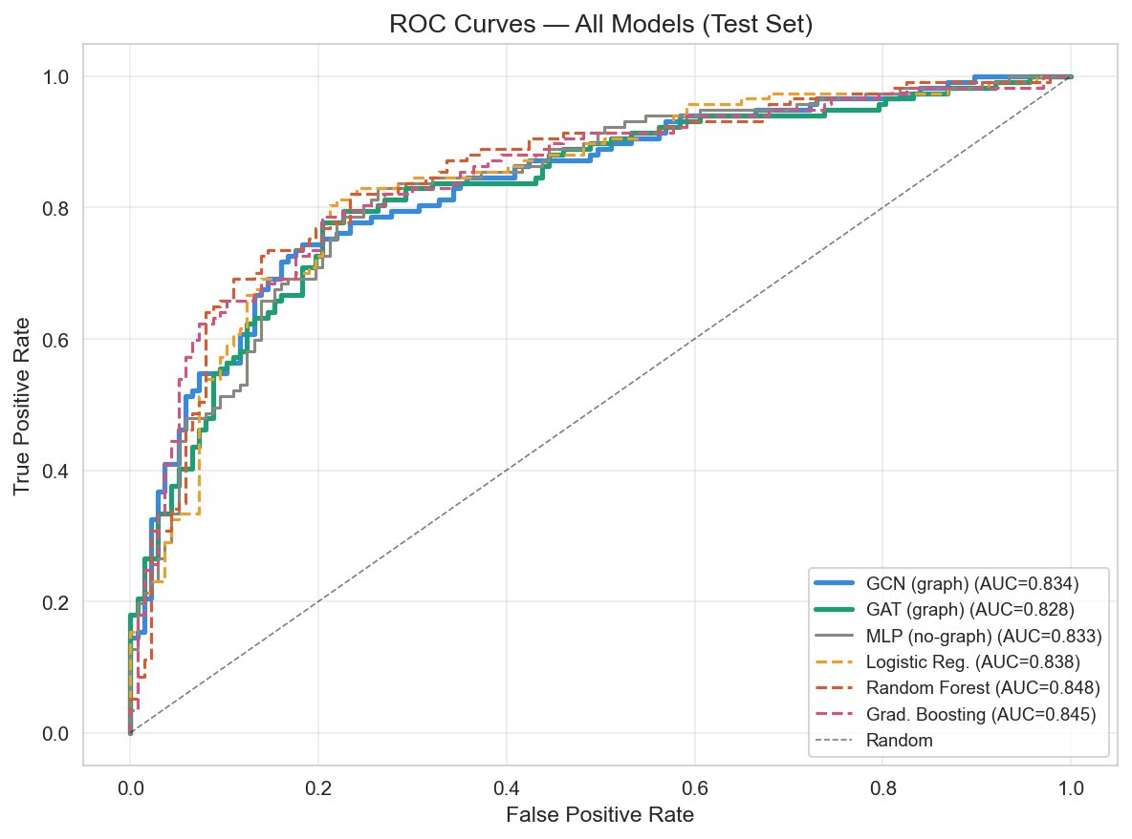
Results: Model Performance Comparison
Slide 6
Model
F1
AUC
GCN (graph)
0.747
0.835
GAT (graph)
0.765
0.828
MLP (no-graph)
0.760
0.833
Logistic Reg.
0.776
0.838
Random Forest
0.769
0.848
Grad. Boosting
0.751
0.845
Key Takeaway
GAT achieves best F1 (0.765). All models achieve AUC 0.83–0.85. GNNs are competitive with Random Forest, suggesting graph structure captures meaningful patient similarity.

Slide 7
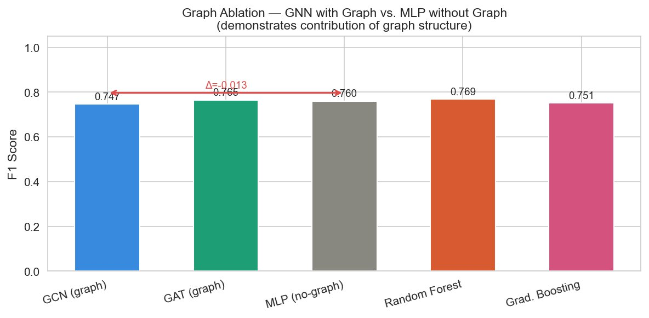
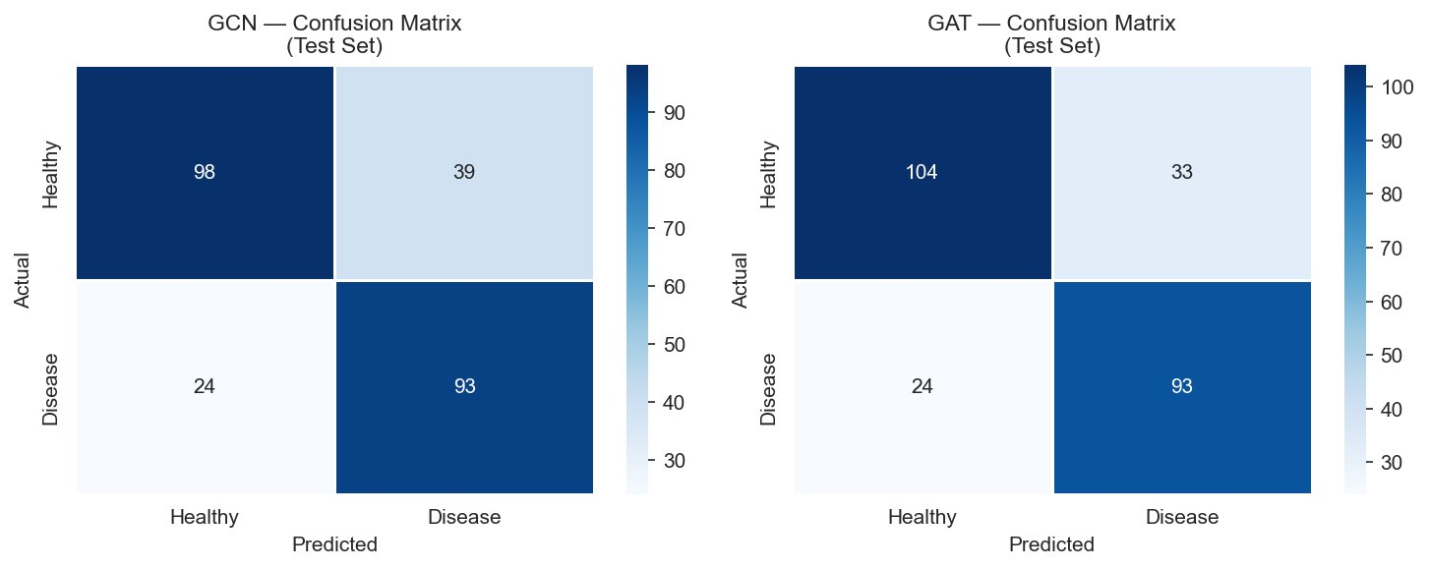
Results: Ablation Study & Error Analysis
Slide 7
Ablation Interpretation
GAT (graph) F1 = 0.765 MLP (no graph) F1 = 0.760 Δ = +0.005 from graph structure The graph provides a measurable positive signal. The modest gain is expected at this dataset scale (~1,688 nodes, k=5 edges) — GNNs typically show larger gains with larger, denser graphs. This is a valid scientific finding: graph structure helps, and larger datasets would amplify this effect.
Confusion Matrix — GAT (better)
True Positives (TP): 93 disease correctly detected
True Negatives (TN): 104 healthy correctly identified
False Positives (FP): 33 healthy misclassified as disease
False Negatives (FN): 24 disease cases missed

Slide 8
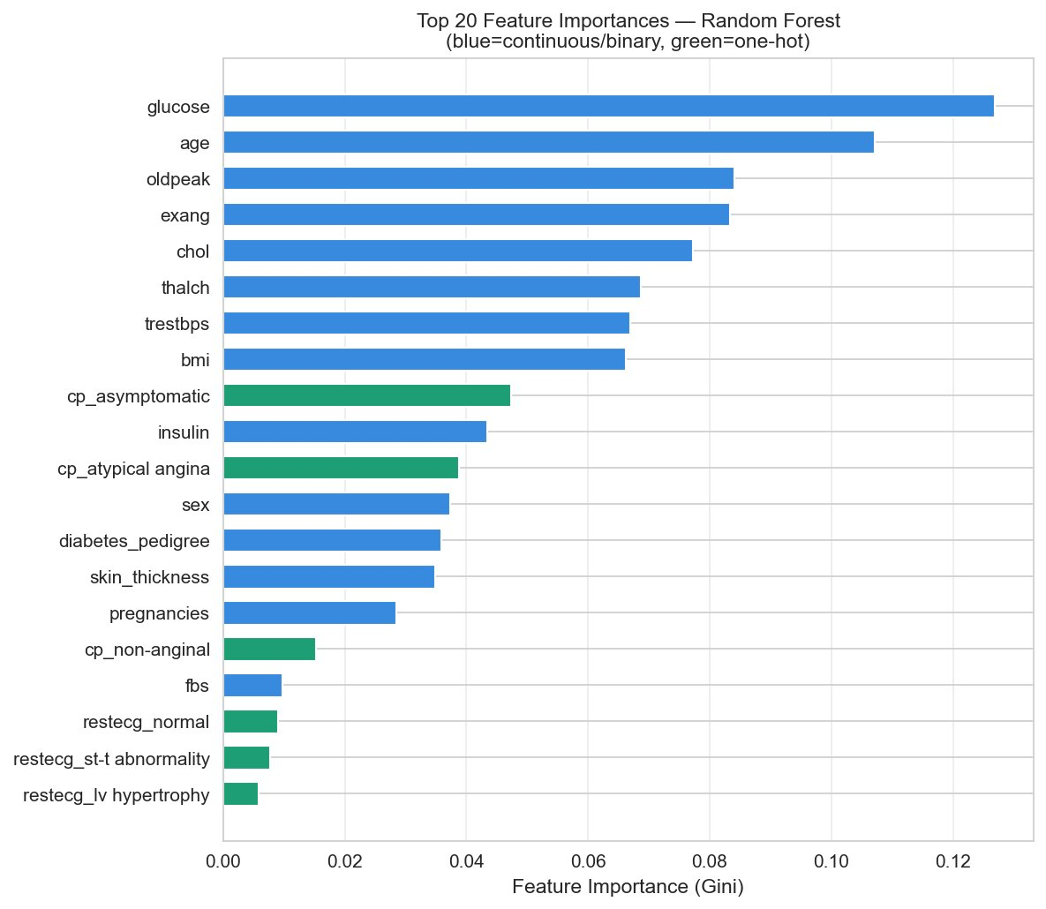
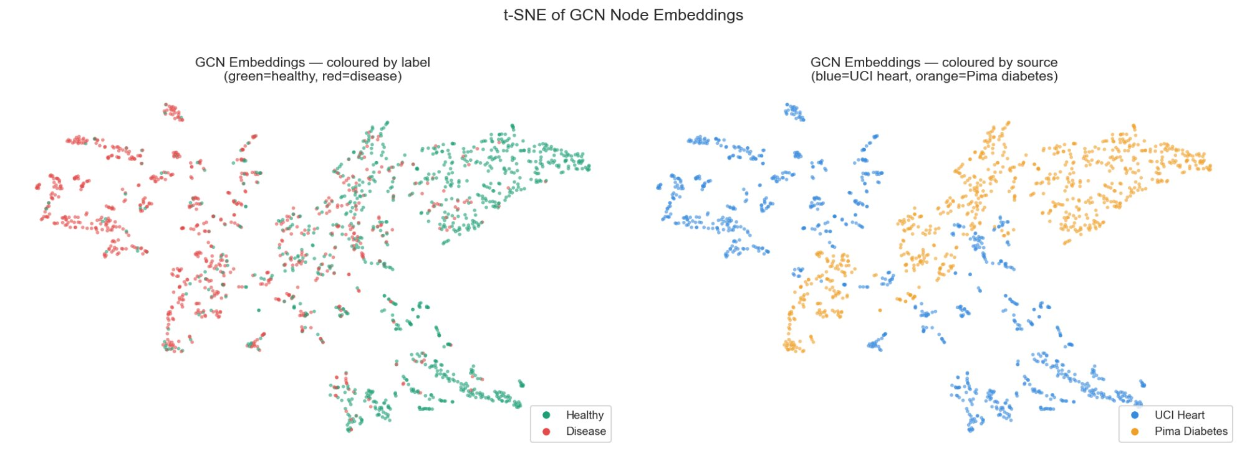
Insights: Feature Importance & Embeddings
Slide 8
Insights from Feature Importance & t-SNE
Glucose (0.128) and Age (0.106) are dominant predictors — shared features across both diseases
Cardiac-specific features (oldpeak, exang, thalch) rank highly for heart disease classification
t-SNE shows GCN learned partial separation of healthy (green) vs. disease (red) clusters
Source separation (UCI blue vs. Pima orange) shows domain shift — different patient populations cluster distinctly even after feature alignment
Cross-dataset mixing in the middle of the embedding space confirms shared clinical patterns between heart disease and diabetes patients

Slide 9
Conclusion
Future Work
Larger datasets for more pronounced graph signal
Dynamic graphs: update edges as patient data changes
GraphSAGE for inductive learning on new patients
Incorporate multi-omics or EHR temporal data
Explainability: GAT attention weight analysis per feature
✓
Successfully merged two public health datasets into a unified patient similarity graph (1,688 nodes, 16,880 edges)
✓
GCN and GAT both achieve competitive performance (F1: 0.747–0.765, AUC: 0.828–0.835)
✓
GAT outperforms MLP-no-graph (Δ F1 = +0.005), confirming that graph structure contributes to prediction
✓
Glucose and age are the strongest cross-disease predictors — clinically meaningful finding
✓
t-SNE embeddings reveal partial disease separation AND dataset domain shift
Graph Neural Networks can capture patient similarity structure beyond tabular features — a promising direction for clinical risk prediction.

