Slide 1


DATA SCIENCE AND DATA ANALYTICS
Excel Project Presentation on
“Book Sales Data Analysis”
Presented By
Sanika Rajendra Kanavaje
Under The Guidance of
Prof. Sandip Gupta

Slide 2

DATA SCIENCE AND DATA ANALYTICS
Outline:
Introduction
Objectives
Problem Statements
Dashboard

Slide 3

DATA SCIENCE AND DATA ANALYTICS
Introduction:
•This project focuses on analyzing the data of sales using Excel.
•It aims to uncover trends that can help to understand the insights of generation with genre and language.
•The analysis provides valuable information for improving strategies for book sales.
•The findings will guide Authors to improve their creations,thinking and there approach according to sales of books.

Slide 4
DATA SCIENCE AND DATA ANALYTICS
Objectives:
•To represents the books sales statistics using Dashboard (Excel).
•To analyze the data of books which are mostly sold.
•Identify key patterns and trends related to books languages and their genres.
•Support to creates more books as per sales.

Slide 5
DATA SCIENCE AND DATA ANALYTICS
Problem Statements:
1. Language Vs Books :-
Analyze how different Languages are distributed in books.
2. Genre of Book Vs Sales of Book :-
Investigate the relationship between genre and sales status to identify trends in our
generation .
3. Language Vs Sales :-
Analyze the sales where which language is mostly preferred to identify trends in our market.

Slide 6
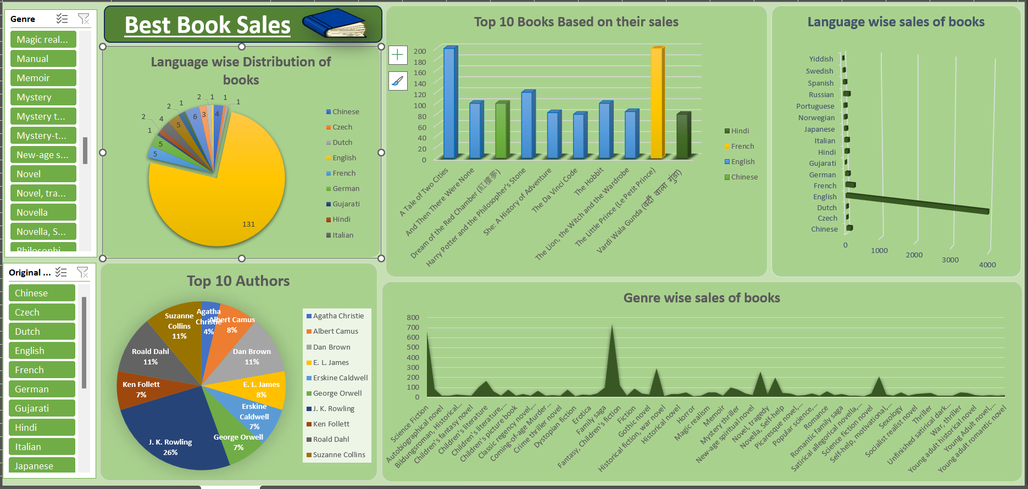
DATA SCIENCE AND DATA ANALYTICS
Dashboard:

Slide 7
DATA SCIENCE AND DATA ANALYTICS
THANK
YOU!
.

