Slide 1
IBM University Engagement Project Submission
“Exploring the Power of Agentic AI with IBM Granite and LangFlow”

Slide 2

Project Tile – AI-Powered Interview Trainer Agent
Domain of Project – Education / Career Development / Artificial Intelligence
Student Name | Recent Passport Photo | Email ID | Mobile number [WhatsApp]
Sanika Vinod Modak |  | sanikamodak17@gmail.com | 7972976997

Slide 3
Problem Statement -
Problem Statement : Interview Trainer Agent
The Challenge: Job candidates often struggle to prepare effectively for interviews because interview questions, role expectations, technical requirements, and HR guidance are scattered across different sources. Traditional interview preparation platforms often provide generic questions without considering the candidate's resume, experience level, target role, or specific skill gaps.
The Objective
Build an AI-powered Interview Trainer Agent that provides personalized interview preparation based on a candidate's profile, experience, skills, resume, and target job role. The solution should:
Personalized Interview Questions – Generate questions based on the candidate's profile, experience, skills, and target job role.
RAG-Based Interview Knowledge Retrieval – Retrieve role-specific interview questions, industry expectations, behavioral scenarios, and HR guidelines from a knowledge base.
Answer Evaluation & Feedback – Evaluate candidate answers, provide scores, identify weaknesses, and suggest improvements.
Model Answers – Generate relevant model answers to help candidates understand how strong responses can be structured.
Preparation Strategy – Provide a structured preparation strategy covering technical, behavioral, HR, and soft-skill preparation.
Multi-Agent / Multi-Tool System –
Interview Question Generation Tool
Interview Answer Evaluation Tool
Preparation Strategy Tool
Interview Preparation Flow

Slide 4
Proposed Solution -
Proposed Solution: AI-Powered Interview Trainer Agent
The proposed solution is an Agentic AI interview preparation platform built using LangFlow, IBM Granite, RAG, FastAPI, and a web frontend.
The system accepts a candidate's profile information, resume, experience level, and target job role.
A RAG-based knowledge system retrieves relevant interview questions, technical concepts, behavioral scenarios, HR guidelines, and role-specific expectations from the interview knowledge base.
Key capabilities:
1. Interview Question Generator
Generates personalized technical, HR, behavioral, and role-specific interview questions.
2. Answer Evaluation Agent
Evaluates candidate responses and provides a score, strengths, weaknesses, and improvement suggestions.
3. Preparation Strategy Agent
Creates a personalized day-by-day preparation plan based on the candidate's role and skill gaps.
4. RAG Knowledge Retrieval
Retrieves relevant interview knowledge before generating responses.
5. Interview Preparation Flow
Combines question generation, answer evaluation, and preparation planning into one complete workflow.
6. Interactive Web Interface
Provides a simple frontend for candidates to enter their details, practice questions, and receive AI-generated feedback.

Slide 5
Technology Used
Langflow platform -Used for visually designing and orchestrating the Agentic AI and RAG workflow.
IBM Grainte model - for eg – ibm/granite-4-h-small – For natural language understanding, reasoning, and personalization
IBM watsonx.ai / IBM Cloud- Used to access and deploy IBM Granite models and provide the AI infrastructure.
RAG- Retrieval-Augmented Generation is used to retrieve relevant interview knowledge before generating responses.
Vector Knowledge Base- Used to store and retrieve interview-related knowledge such as:
Technical questions
HR questions
Behavioral scenarios
Role expectations
Interview preparation guidelines
FastAPI- Used as the backend API layer connecting the frontend with the AI services.
HTML/CSS/JavaScript- Used to build the web-based frontend interface.

Slide 6
Langflow component Used -
LangFlow Components Used
1. Chat Input
Accepts candidate information, job role, experience level, interview queries, and candidate answers.
2. IBM watsonx AI / Granite Model
Processes user requests and generates intelligent interview-related responses.
3. RAG / Knowledge Retrieval
Retrieves relevant information from the interview knowledge base before generating answers.
4. Prompt / Instruction Component
Provides structured instructions to Granite for generating questions, evaluating answers, and creating preparation strategies.
5. Chat Output
Displays generated questions, model answers, scores, feedback, and preparation recommendations.
6. File / Document Component
Supports interview knowledge documents and candidate resume information.
7. Flow / Agent Orchestration
Coordinates the different AI capabilities into a complete interview preparation workflow.

Slide 7
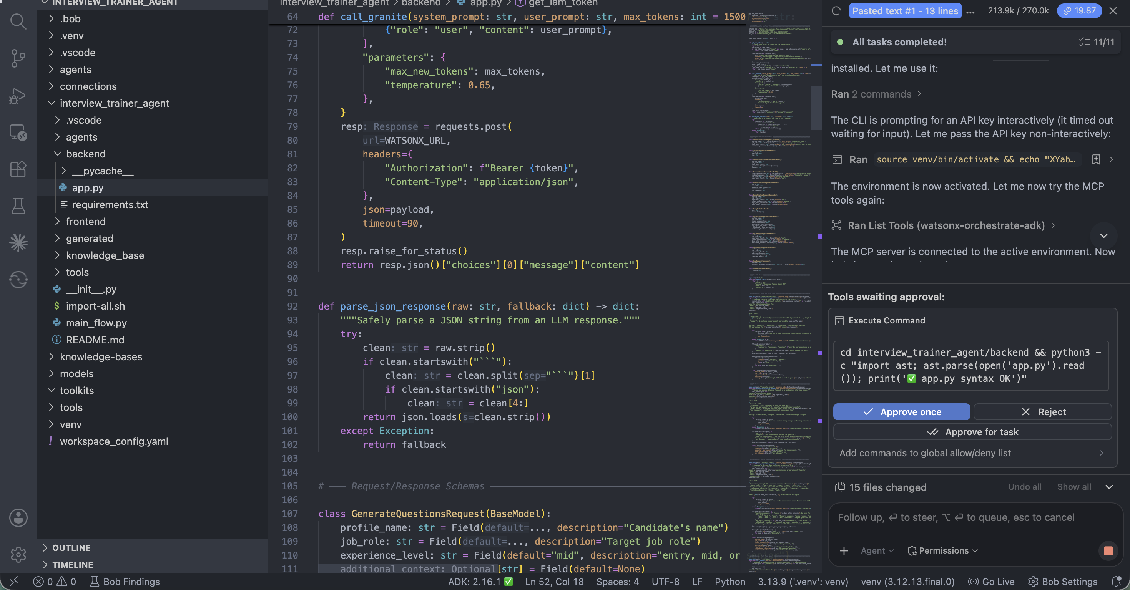

Slide 8
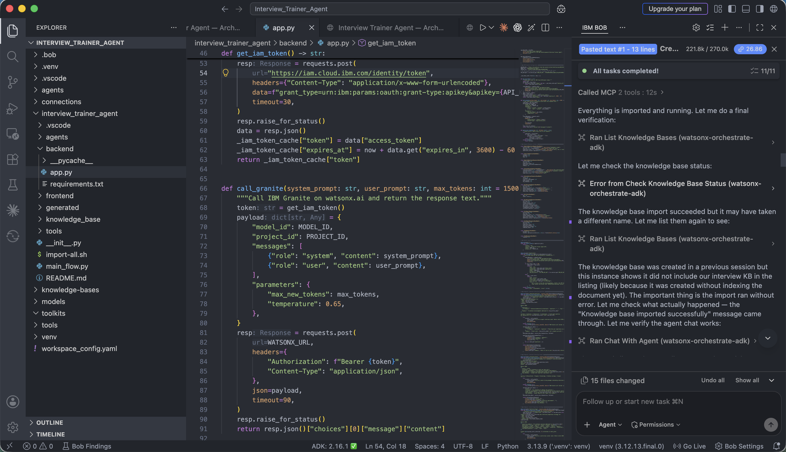

Slide 9
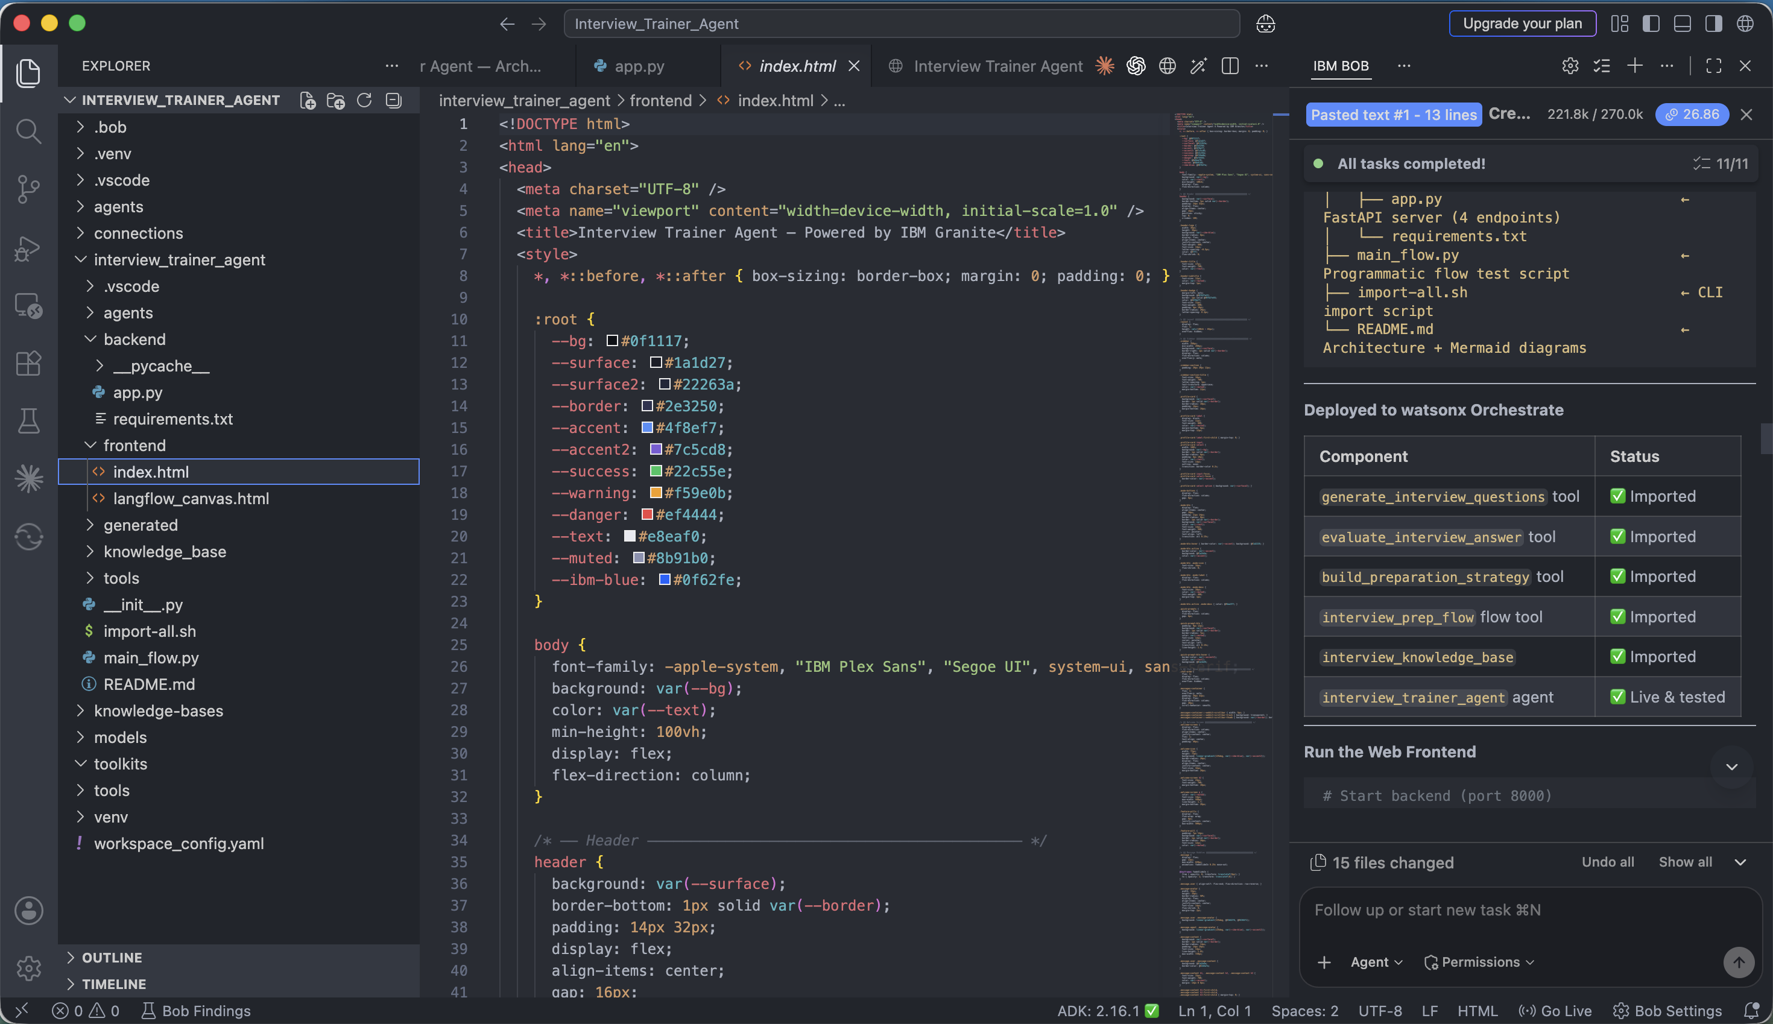

Slide 10
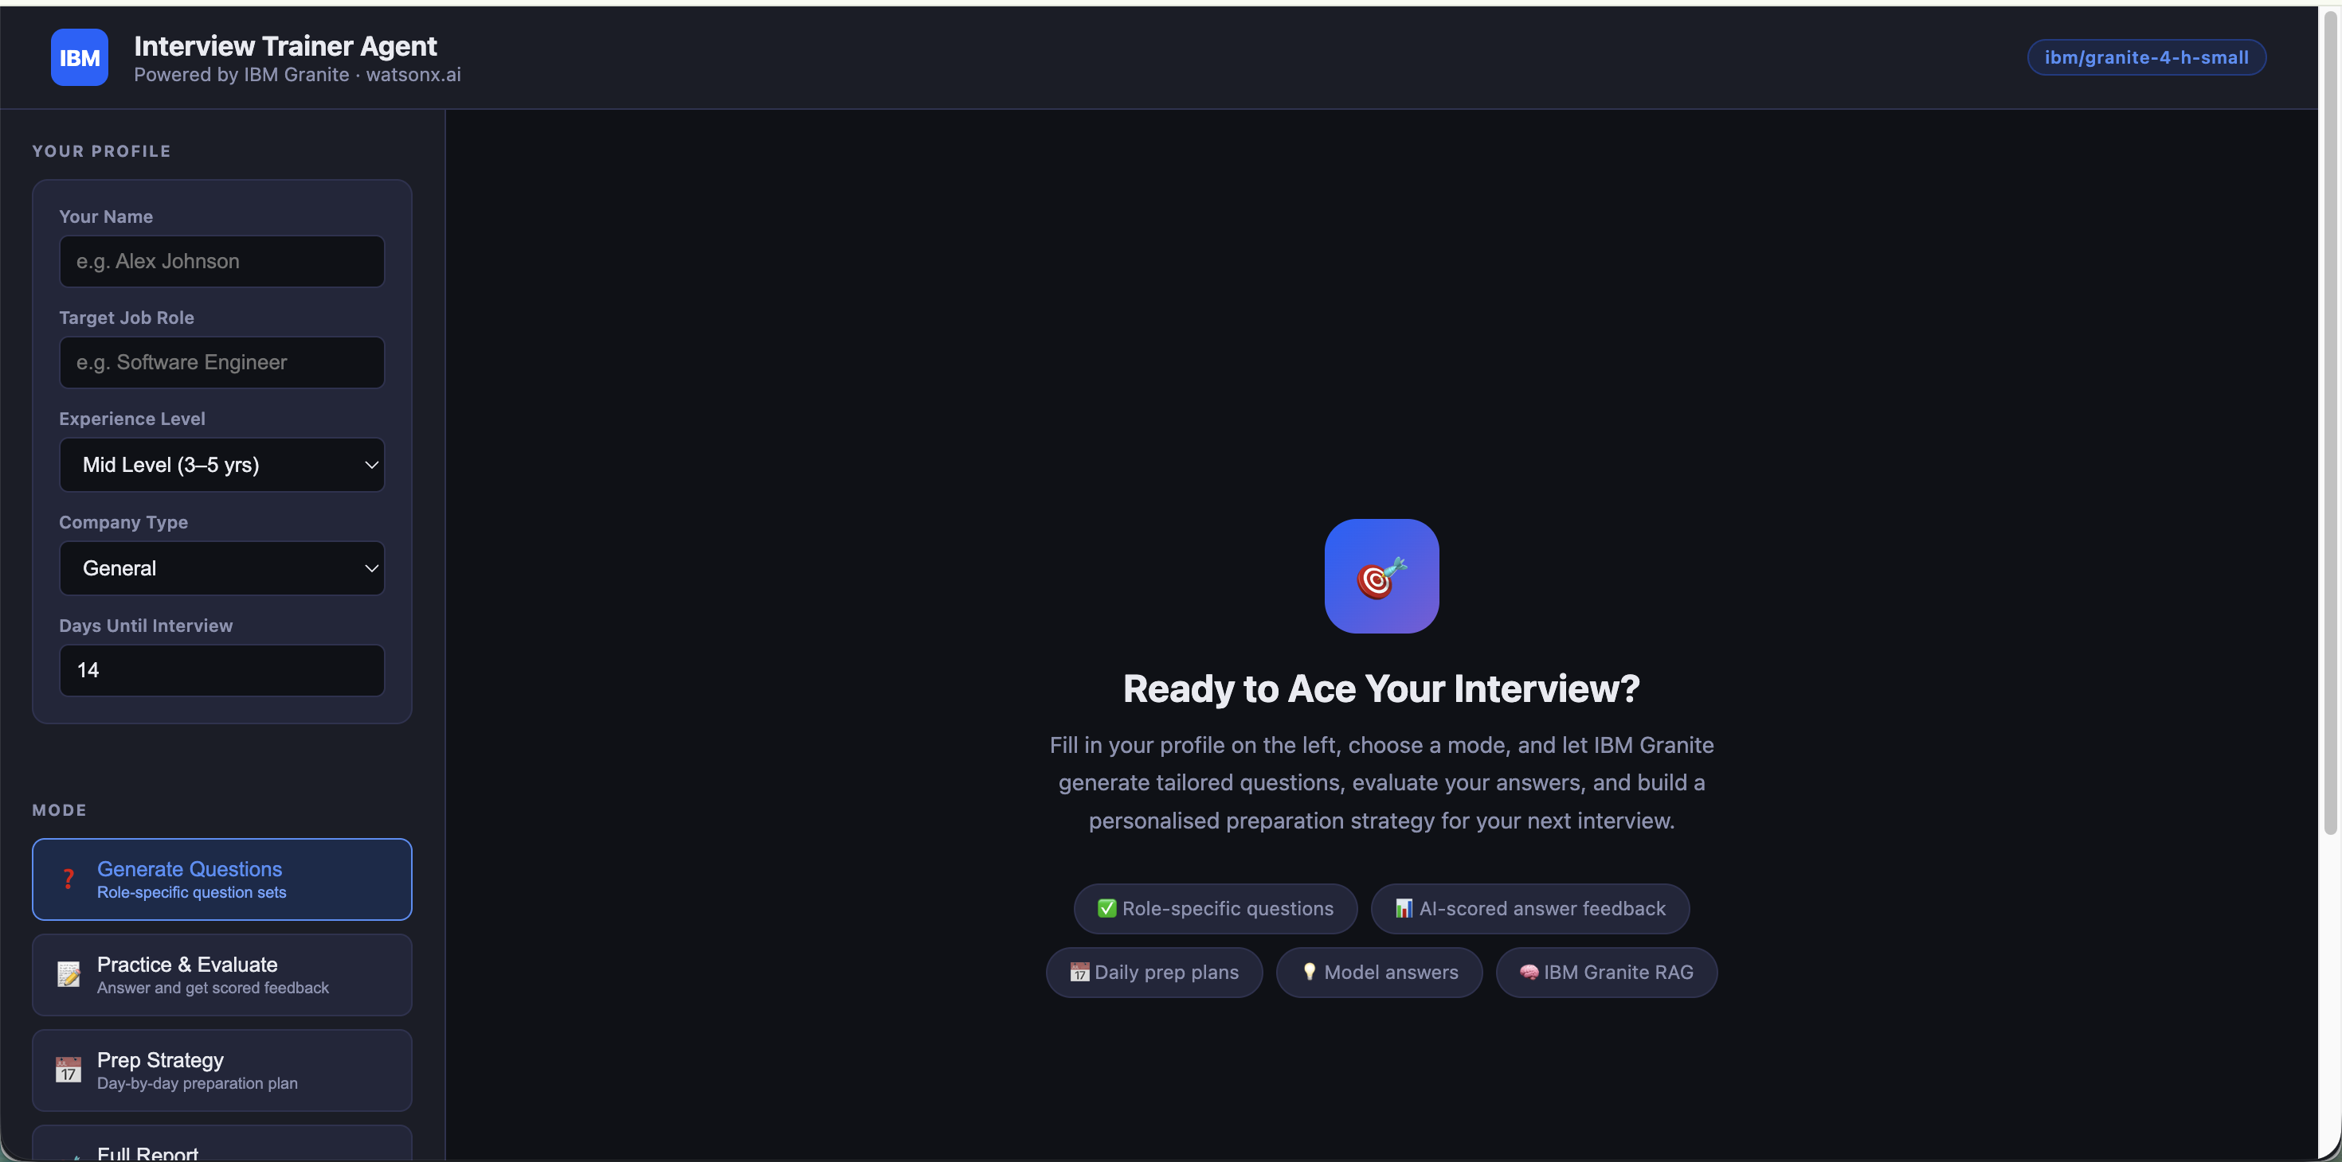

Slide 11
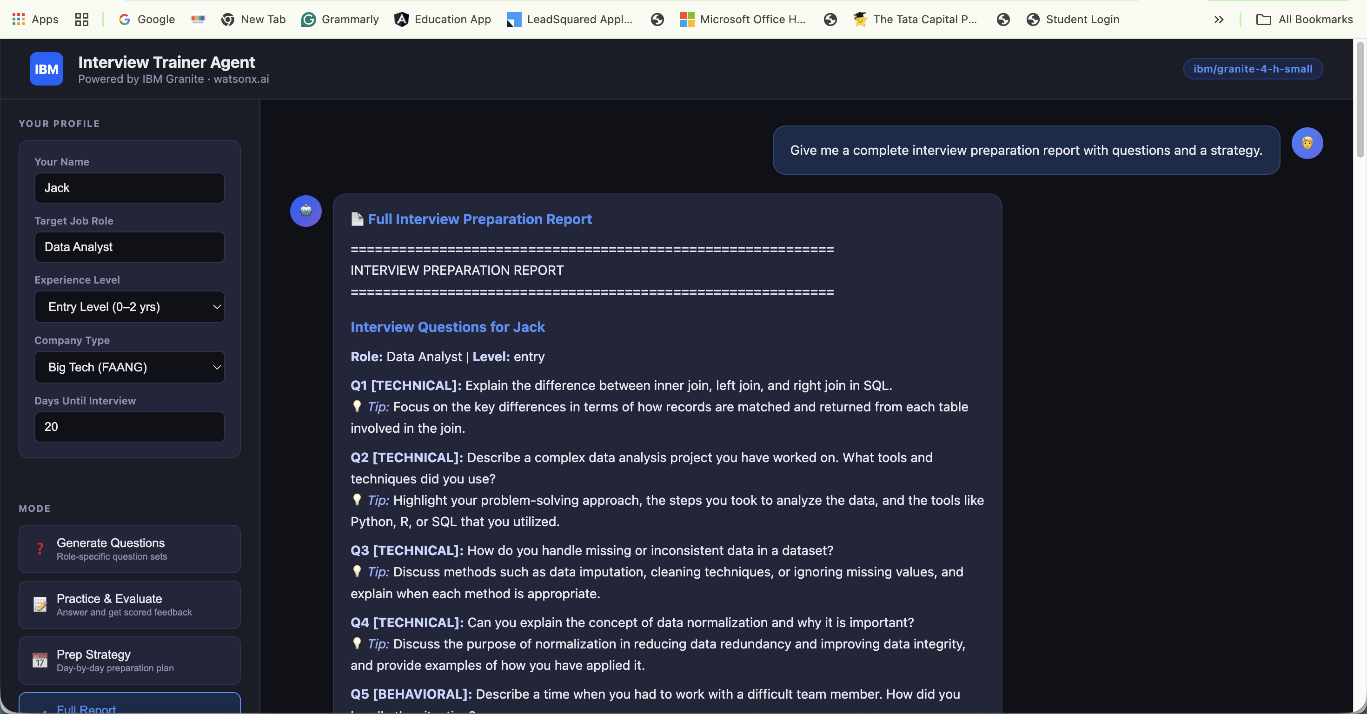

Slide 12
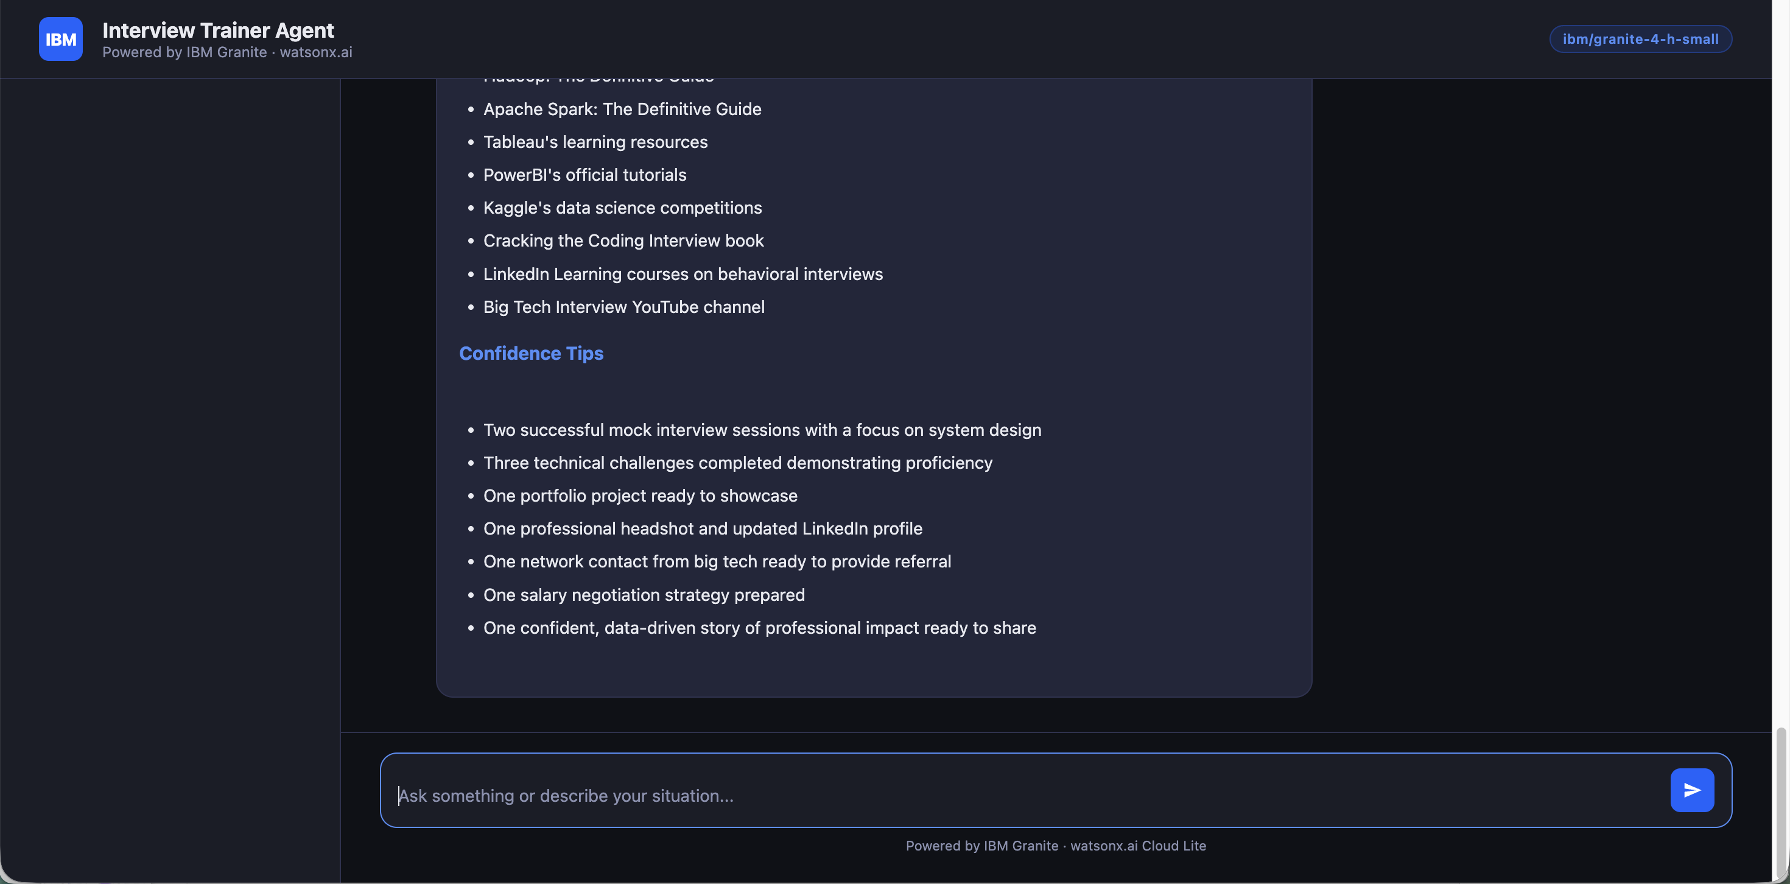

Slide 13
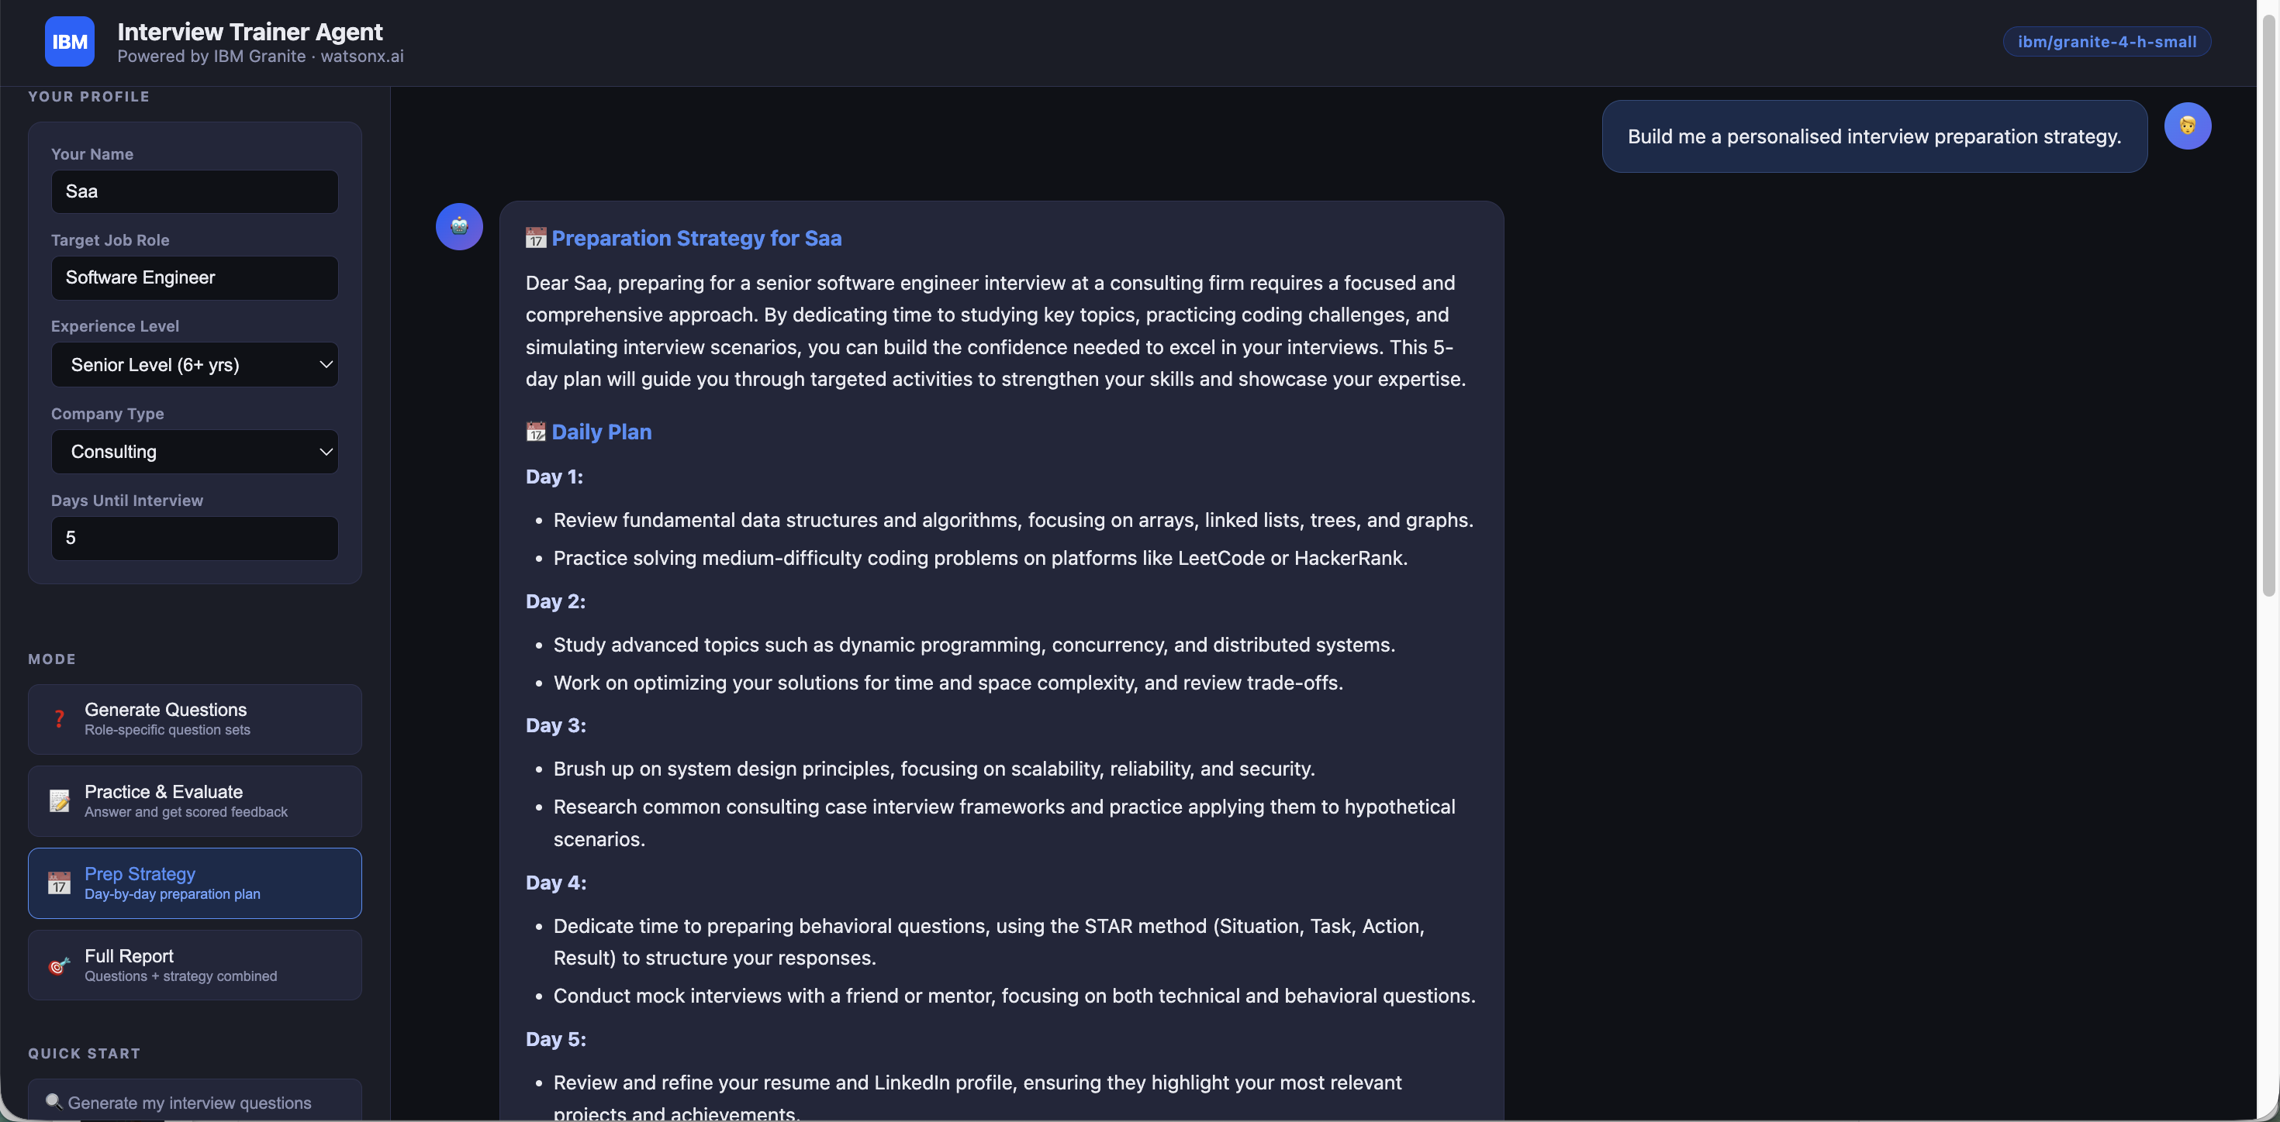

Slide 14
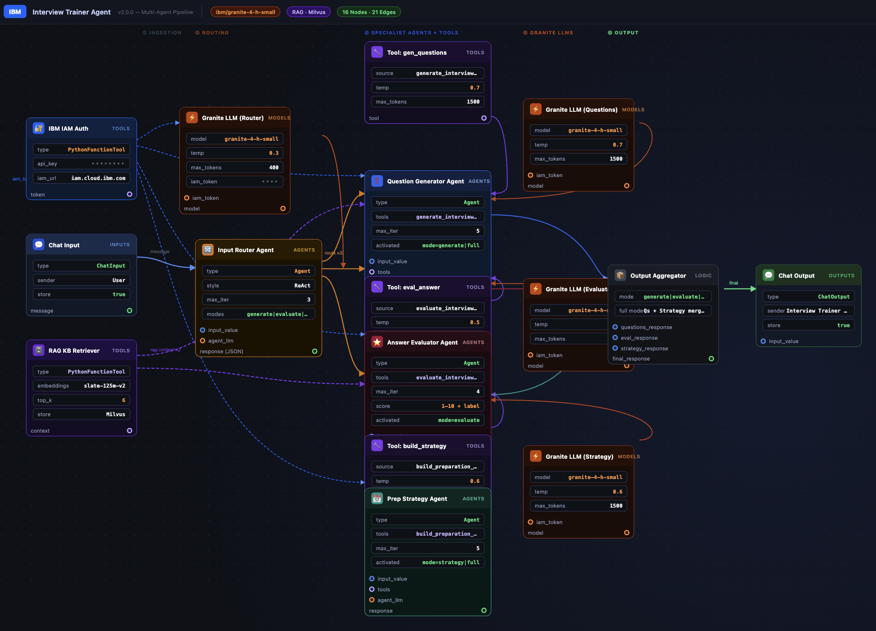
Workflow -

Slide 15
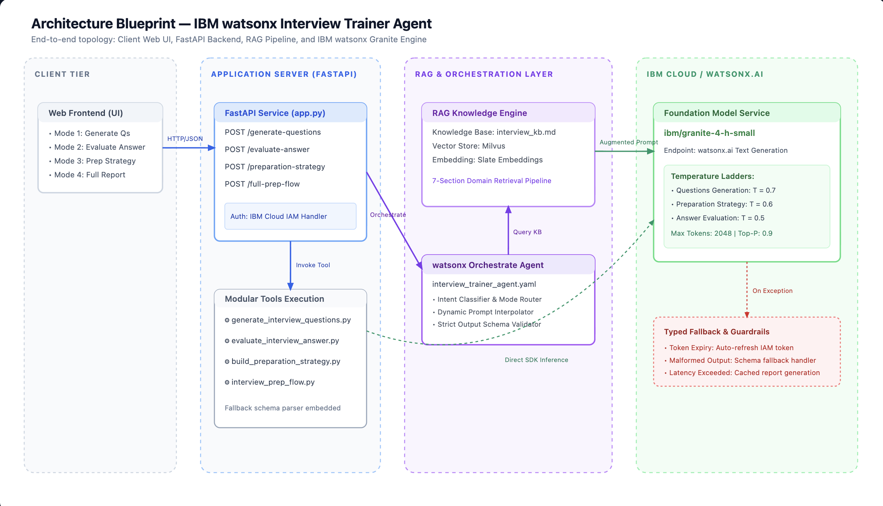
Architecture blueprint

Slide 16

Role of Agentic AI in the solution
Role of Agentic AI in Interview Trainer Agent
Agentic AI enables the Interview Trainer Agent to function as an intelligent and goal-oriented system rather than a simple chatbot. Using IBM watsonx.ai and IBM Granite, the system can coordinate multiple specialized interview preparation tasks.
Each specialized tool performs a specific role, such as generating interview questions, evaluating candidate answers, or building a preparation strategy.
The Agentic AI approach enables the system to understand the candidate's context, including their profile, skills, experience, and target job role, and use this information to provide more relevant interview preparation.
RAG allows the system to retrieve relevant interview knowledge before generating responses, helping the agent provide role-specific and context-aware guidance.
The system can also evaluate candidate responses and provide improvement suggestions, creating a feedback loop that supports continuous preparation.
Overall, Agentic AI makes the Interview Trainer Agent personalized, context-aware, task-oriented, and interactive, acting as an intelligent digital interview coach.

Slide 17
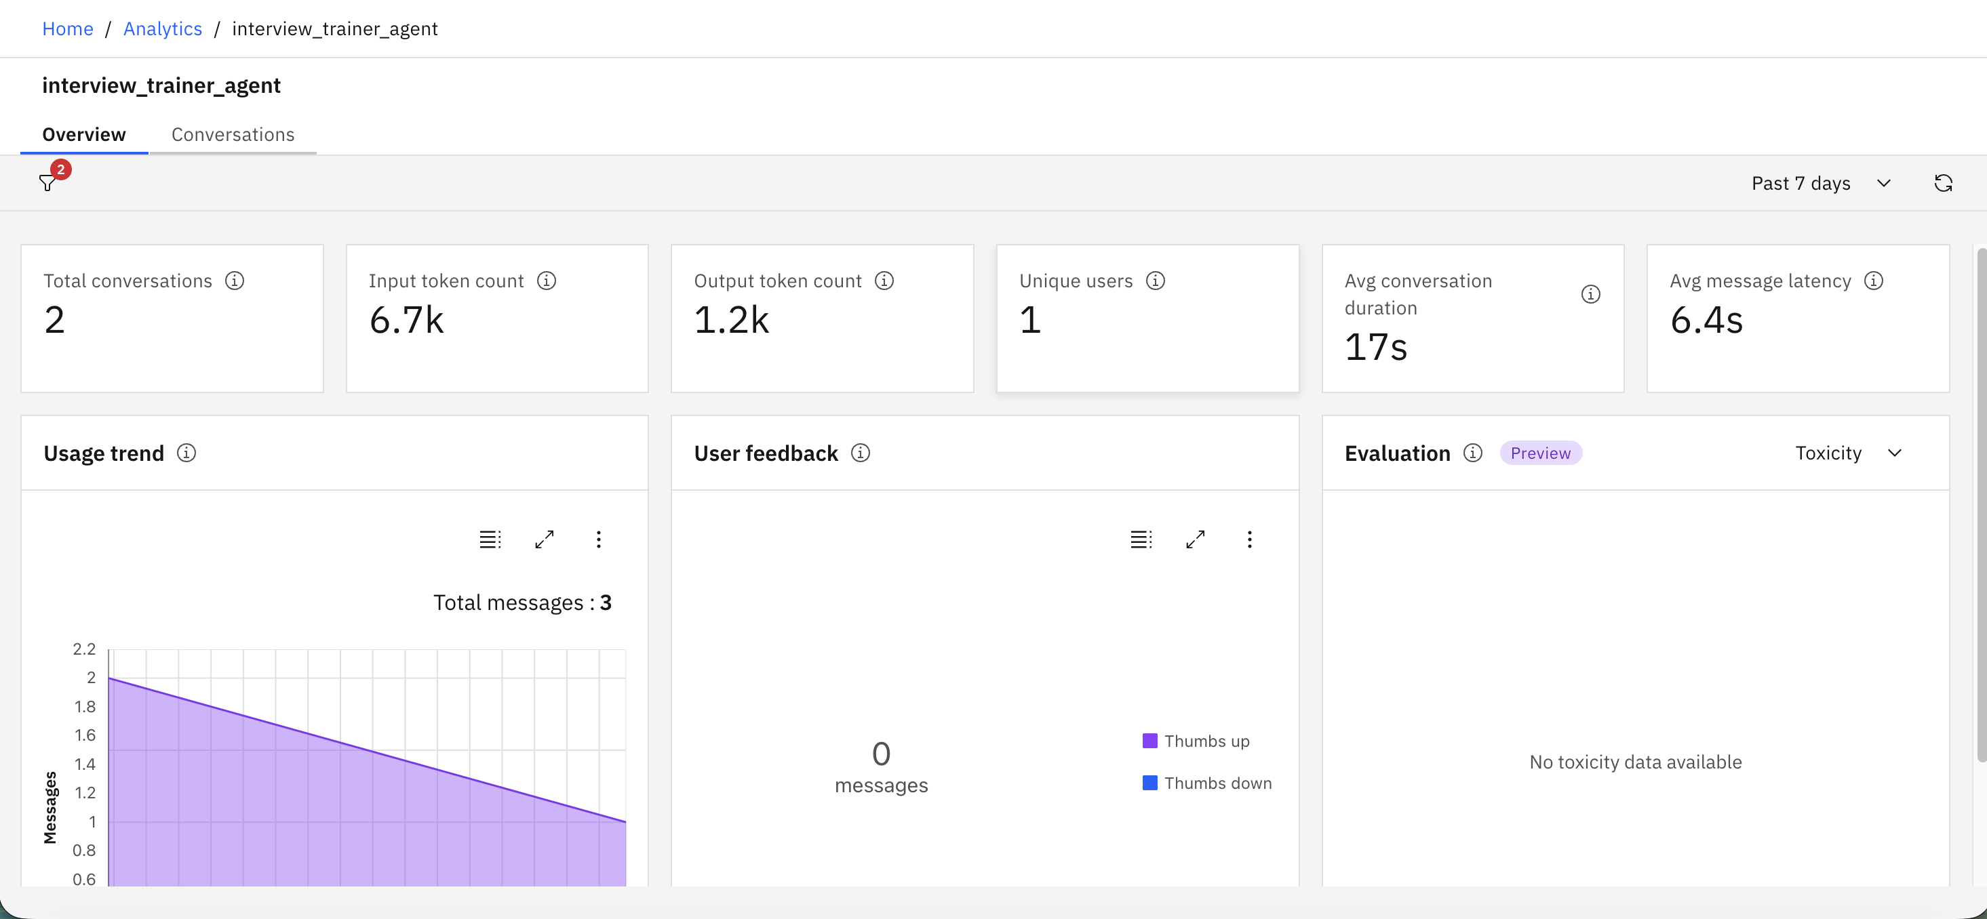
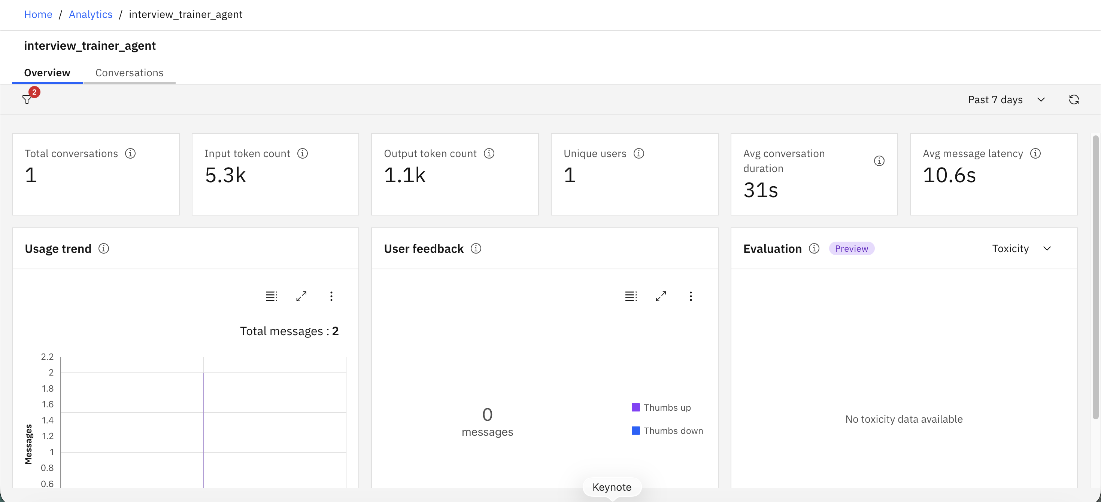
Token Usage
Before Prompt
After the Prompt
·
·
·

Slide 18
Novelty and Uniqueness
The proposed Interview Trainer Agent stands out by combining Agentic AI, RAG, IBM Granite, and personalized interview preparation into a single intelligent system.
Personalized Interview Training – Generates questions according to the candidate's profile, skills, experience, and target role.
RAG-Based Interview Intelligence – Retrieves relevant interview knowledge before generating responses.
Multi-Tool Intelligence – Uses specialized tools for question generation, answer evaluation, and preparation strategy.
AI-Based Answer Evaluation – Evaluates candidate responses, provides scores, identifies weaknesses, and suggests improvements.
Role-Specific Preparation – Tailors interview preparation according to the selected job role and industry expectations.
Model Answer Generation – Provides example answers to help candidates understand effective response structures.
Structured Preparation Strategy – Creates a focused preparation plan instead of providing only a list of questions.
Interactive Feedback Loop – Allows candidates to improve their preparation using AI-generated feedback.
IBM Granite Integration – Uses IBM Granite through IBM watsonx.ai for the core AI capabilities.
This makes the solution an intelligent and personalized digital interview coach rather than a static interview question generator.

Slide 19
Git Hub Link
Github URL –
https://github.com/sanikamodak17/interview-trainer-agent.git
·
·
·

Slide 20
Future Scope
1. Voice-Based Mock Interviews
The system can be enhanced with voice input and speech output to conduct realistic voice-based mock interviews.
2. Real-Time Adaptive Interviews
The agent can dynamically select the next question based on the candidate's previous answer, performance, and difficulty level.
3. Resume-to-Interview Pipeline
The system can automatically analyze a candidate's resume and generate interview questions based on their projects, skills, education, and experience.
4. Job Description Analysis
Users can upload a job description and receive interview preparation specifically aligned with the requirements of that position.
5. Company-Specific Interview Preparation
The system can provide preparation based on company-specific interview patterns, technologies, and expectations.
·
·
·

Slide 21
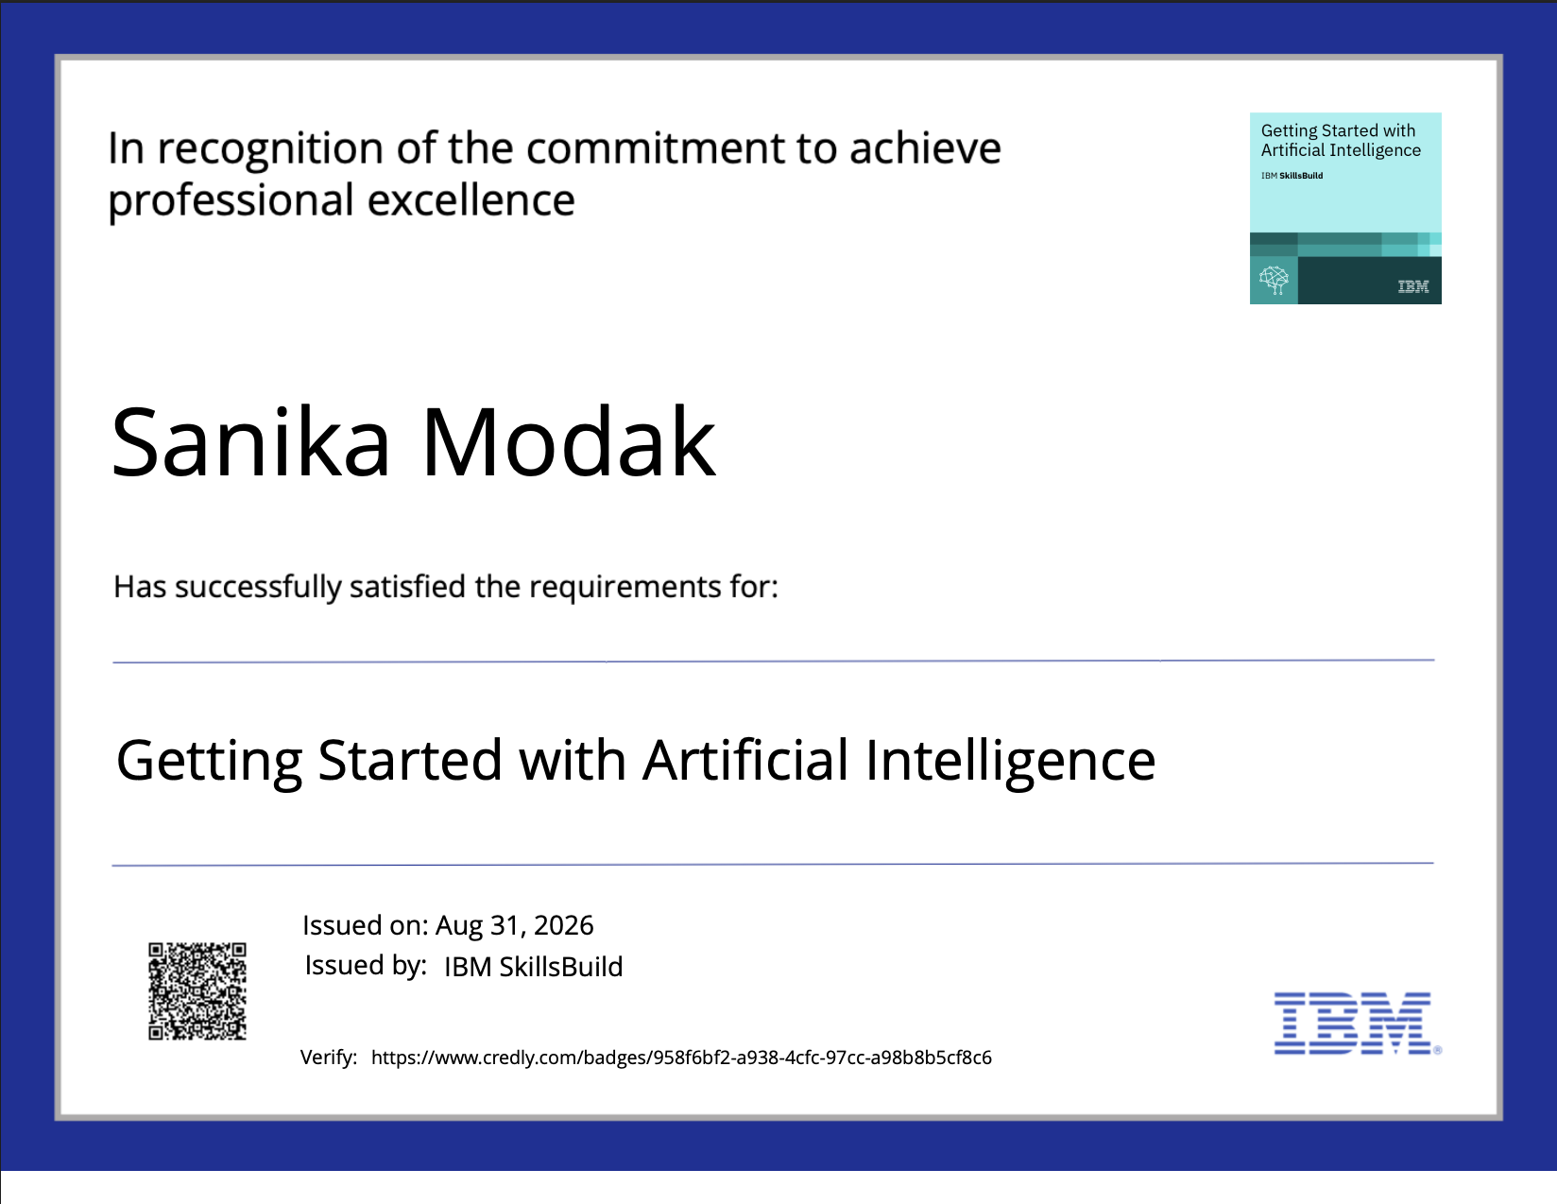
Certificates Earned:
Credly certificate

Slide 22
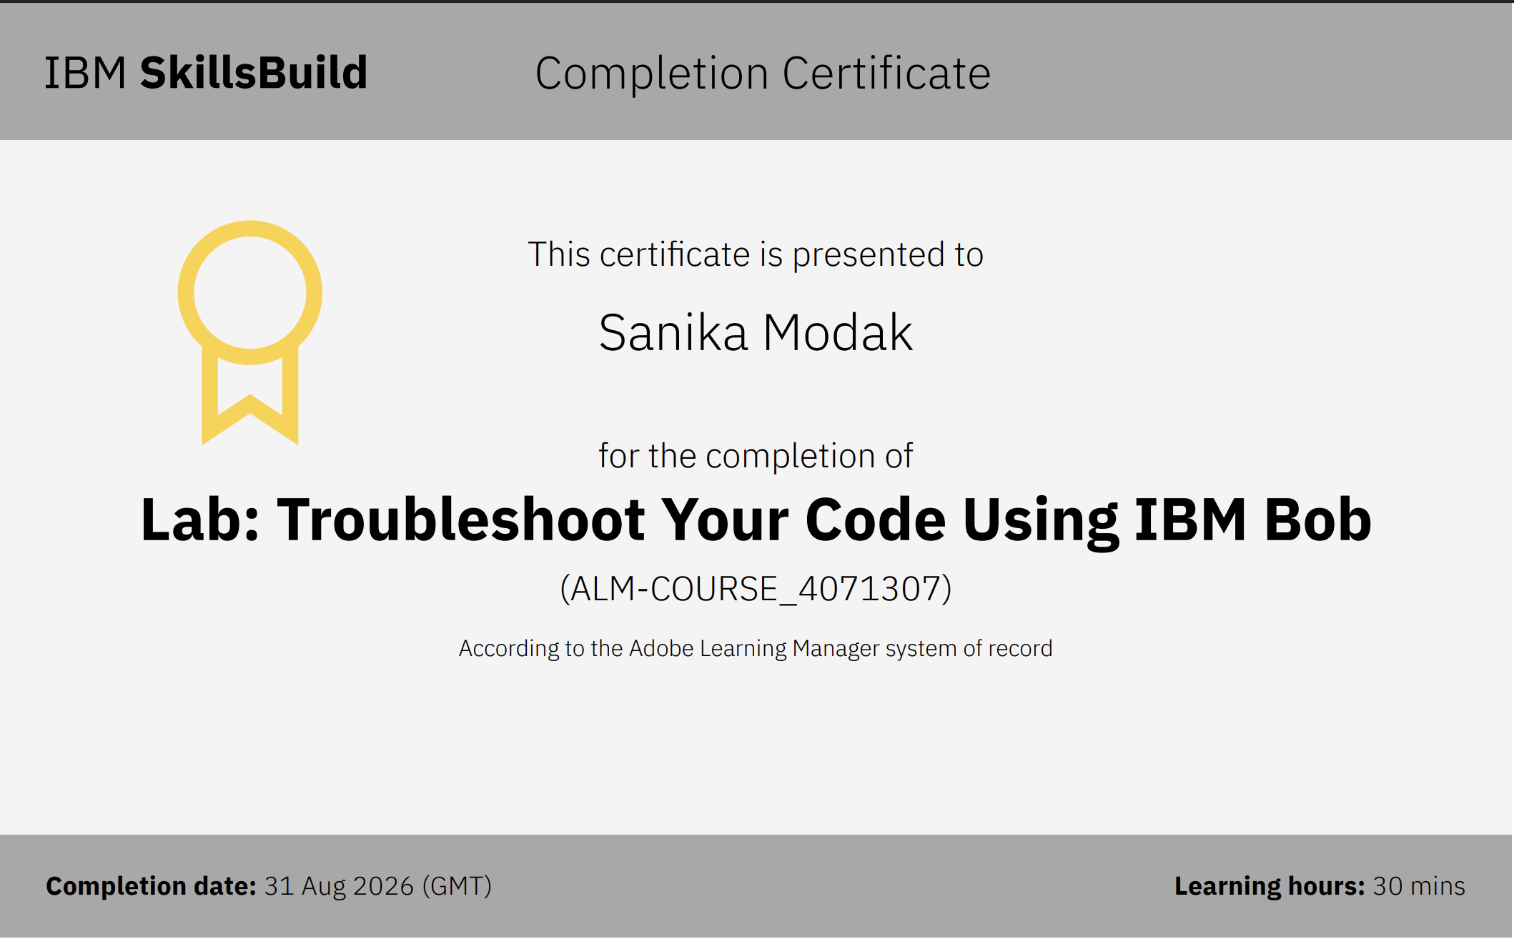
Certificates Earned:​
IBM BOB Certificate

Slide 23


