Slide 1
ADVENTUREWORKS
Presented by: Group 2
Sales Analysis & Business Intelligence
Excel • Power BI • Tableau • SQL
End-to-end Data Analytics Project

Slide 2
| Today’s Agenda
Group Details 8 PowerBI Dashboard
Summary & objective Of Project 9 Tableau Dashboard
DataSet & Data Sources 10 SQL Queries
Data Preparation 11 Key Insights
Data Model 12 Challenges & Solutions
KPIs 13 Team Contribution
Excel Dashboard 14 Conclusion & Next Steps

Slide 3
01 | Members Details Of Group No 2
Name E-Mail ID
Vaibhav Jagtap jagtap2499@gmail.com
Sanika Patil sanikap043@gmail.com
Rohan Reddy. bomminenirohanreddy@gmail.com
Varsha Barawkar varshabarawkar0@gmail.com
Maddha Prabhu prabhumanu810@gmail.com
Atul Singh atuls6730@gmail.com
Priyadharshini Muthaiah dharshinideva472@gmail.com

Slide 4
02 | Project Summary & Objective
AdventureWorks Sales Analysis is an end-to-end data analytics project focused on analyzing sales performance and generating meaningful business insights. The project includes data cleaning, transformation, SQL analysis, data modeling, KPI creation, and dashboard development using Excel, Power BI, and Tableau.
The analysis helps identify top-performing products, sales territories, customer performance and sales trends.
Interactive dashboards were developed using Excel, Tableau and Power BI for better visualization and decision making.
SQL was used to extract, transform and analyze the data and generate meaningful business insights.
ANALYZE
IDENTIFY
COMPARE
VISUALIZE
Understand sales, cost and
profit performance.
Find top products, customers
and regions.
Analyze year, month and
quarter trends.
Build interactive dashboards
across 3 tools.
Key Business Questions
• Performance: How are Sales and Profit performing over time?
• Products: Which products and categories drive Sales and Profit?
• Customers: Who are our highest-value customers?
• Geography: Which regions contribute the most to Sales?
• Profitability: Where can we improve the relationship between Sales, Cost and Profit?

Slide 5
03 | Dataset & Data Sources
AdventureWorks sales model
FACT SALES
PRODUCT
CUSTOMER
DATE / REGION
Fact Internet Sales
&
Fact Internet Sales New
DimProduct
DimProdCategory
DimProdSubCategory
DimCustomer
DimDate
DimSalesTerritory
Core dimensions
Product • Customer • Date • Sales Territory

Slide 6
04 | Data Preparation
Power Query transformation pipeline
MERGE
/
RELATE
RAW DATA
→
IMPORT
→
CLEAN
→
APPEND
→
→
CALCULATE
→
DATA MODEL
Calculated Fields
Year • Month • Quarter • YearMonth • Weekday • Financial Month • Financial Quarter
Sales Amount • Production Cost • Profit

Slide 7
05 | Data Model
Star-style model connecting facts with dimensions
DIM DATE
DIM PRODUCT
DateKey
ProductKey
FACT INTERNET SALES
DIM SUBCATEGORY
DIM CUSTOMER
CustomerKey
ProductSubCategoryKey
FACT INTERNET SALES NEW
DIM SALES TERRITORY
DIM CATEGORY
SalesTerritoryKey
ProductCategoryKey

Slide 8
06 | KPI’s
Total Sales Total Profit Production Cost
Total Orders Total Customers Profit Margin %
₹29.36M
₹12.08M
₹17.28M
60,398
18,484
41.15%
The dashboard tracks Total Sales, Total Profit, Production Cost, Total Orders, Customer Count, and Profit Margin to provide a quick overview of overall business performance.

Slide 9
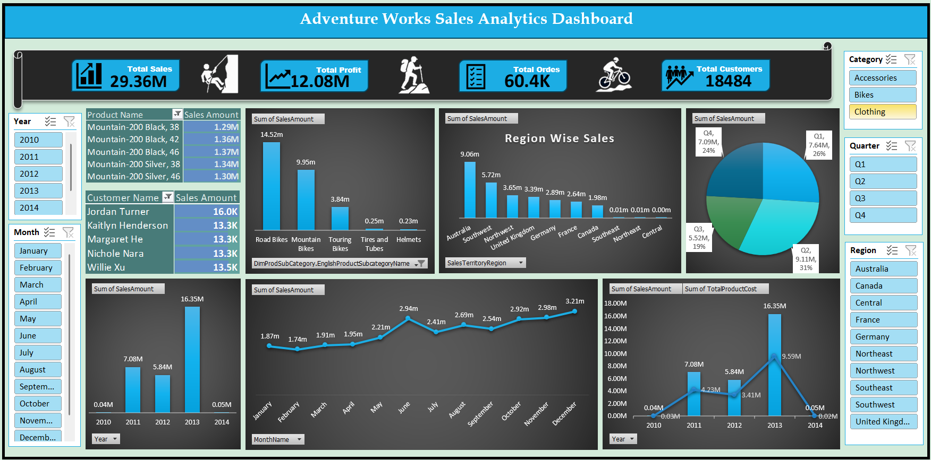
07 | Excel Dashboard
INSERT FINAL EXCEL DASHBOARD SCREENSHOT HERE

Slide 10
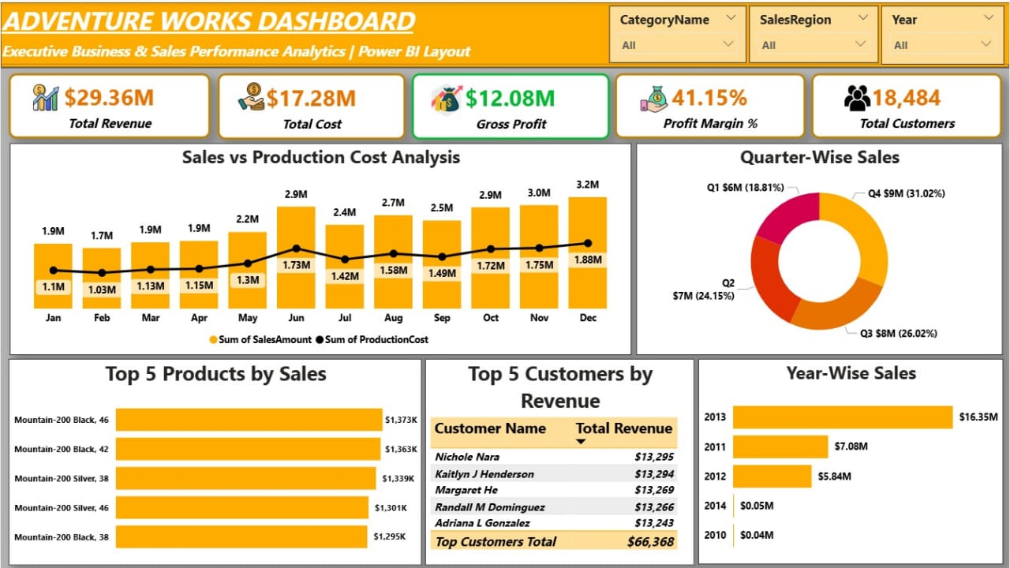
08 | Power BI Dashboard
INSERT FINAL POWER BI DASHBOARD SCREENSHOT HERE

Slide 11
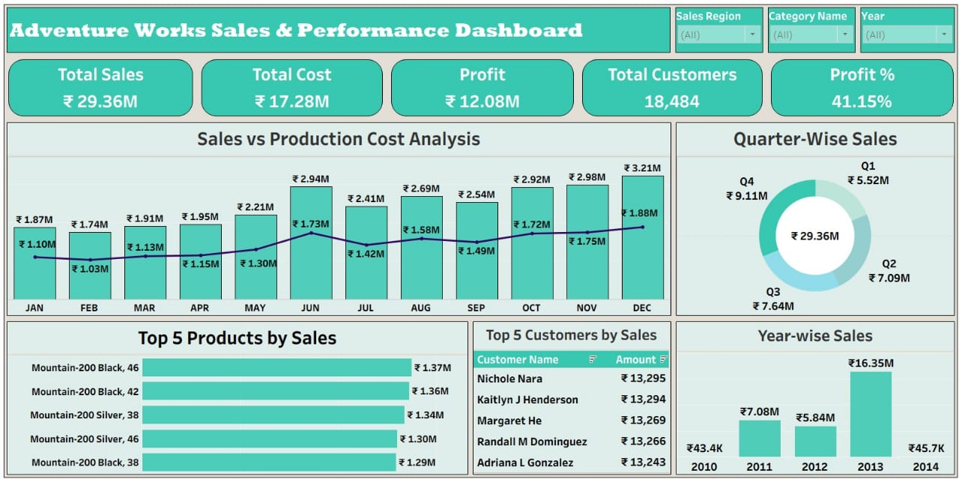
09 | Tableau Dashboard
INSERT FINAL TABLEAU DASHBOARD SCREENSHOT HERE

Slide 12
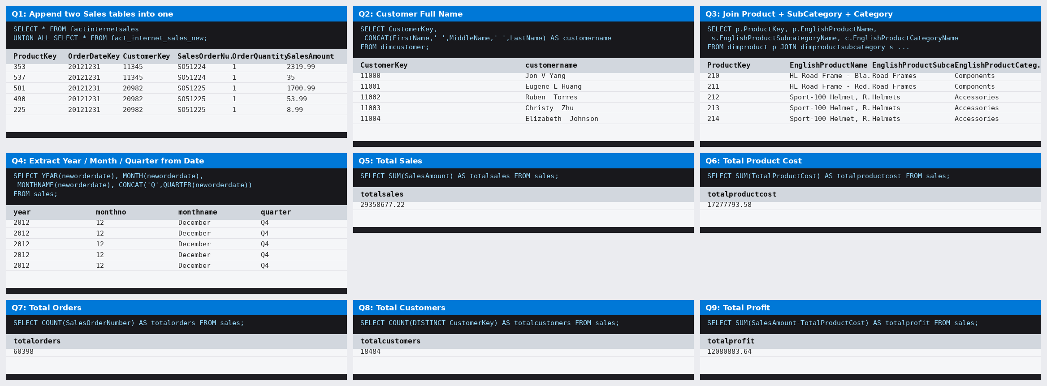
10 | SQL Queries
INSERT FINAL TABLEAU DASHBOARD SCREENSHOT HERE

Slide 13
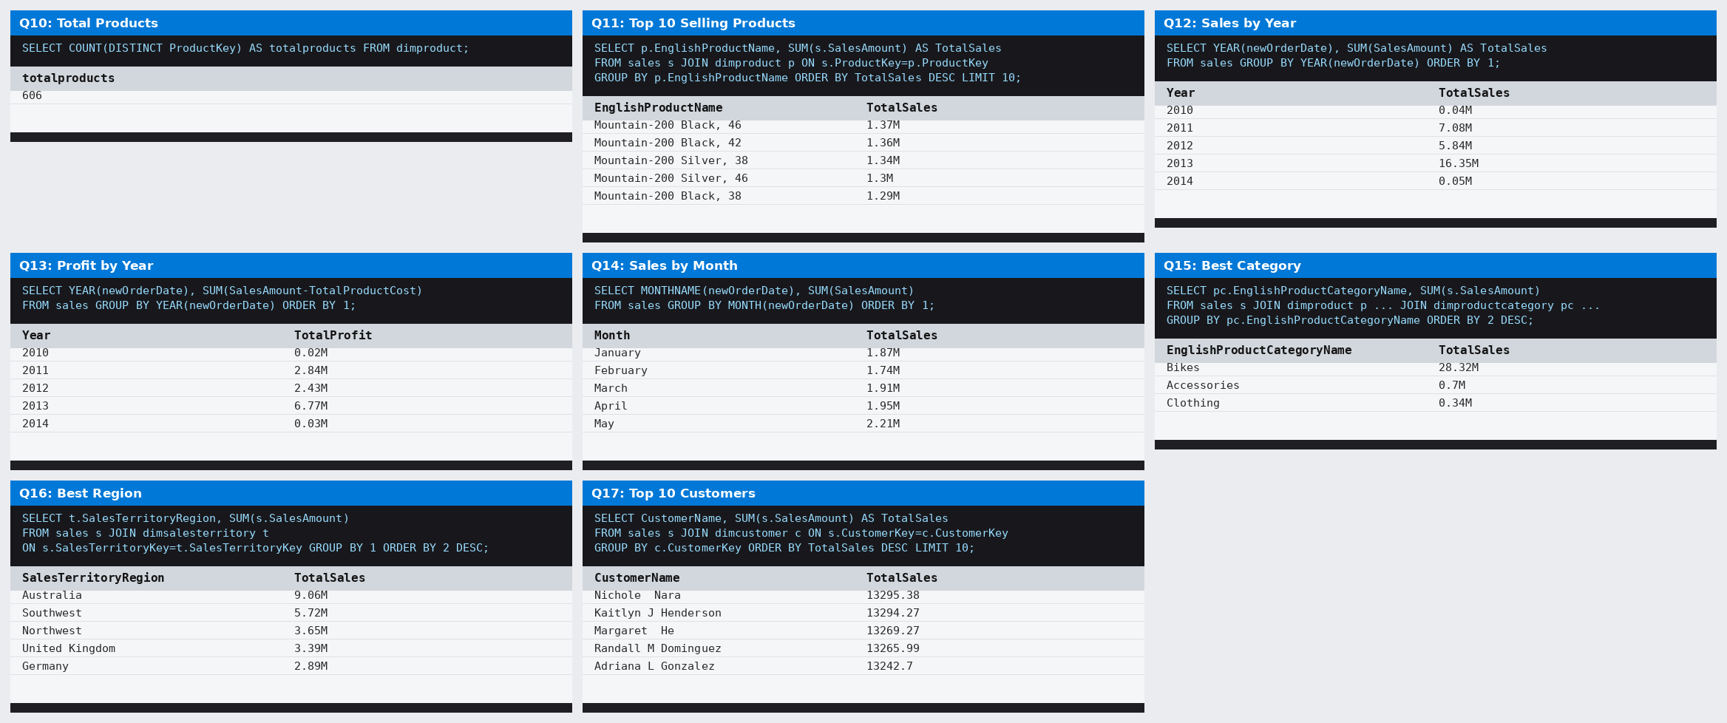
10 | SQL Queries
INSERT FINAL TABLEAU DASHBOARD SCREENSHOT HERE

Slide 14
11 | Key Insights
PRODUCT
REGION
Top-performing product/category identified from sales contribution.
Bikes is the Highest Sales Contribution in Category
28.32M
Best and weakest sales Country identified.
United States with 9.39M is Highest
Canada with 1.98M is lowest
CUSTOMER
TREND
High-value customers and contribution patterns identified.
Strong and weak periods identified across years/months.
Customer Name | Sales Amount
Jordan Turner | 15,999
Kaitlyn Henderson | 13,294
Margaret He | 13,269
Nichole Nara | 13,295
Willie Xu | 13,490

Slide 15
12 | Challenges & Solutions
COMBINING SALES TABLES
TABLE RELATIONSHIPS
Used Append / Union to combine compatible sales datasets.
Connected tables using matching keys and data types.
DISTINCT CUSTOMER COUNT
FINANCIAL CALENDAR
Used Data Model / Distinct Count to avoid duplicate customers.
Created Financial Month and Quarter logic.
KPI & CHART FORMATTING
SLICER CONNECTIVITY
Applied K/M formats and consistent dashboard design.
Connected visuals/Pivots and validated filter behavior.

Slide 16
13 | Team Contribution
MODULE
RESPONSIBILITY
Data Preparation
Power Query, cleaning, append / merge
Data Modeling
Relationships and calculated fields
Excel
Pivot tables, KPIs, charts and dashboard
Power BI
Interactive report and visual analytics
Tableau
Visual exploration and dashboard
Presentation
Insights, documentation and final story
My contribution: Data modeling • KPI creation • Dashboard development • Validation • Presentation

Slide 17
14 | Conclusion & Next Steps
From raw data to an end-to-end analytics solution
WHAT WE ACHIEVED
NEXT STEPS
• Prepared and modeled the data
• Built calculations and KPIs
• Developed Excel, Power BI and Tableau dashboards
• Created interactive analysis for products, customers and regions
• Add forecasting
• Customer segmentation
• Advanced profitability analysis
• Automated refresh
• Improve dashboard performance
THANK YOU

