Slide 1
CLOUD NOTICE

Slide 2
Problem statement :
Need a system solution to give notice regarding the college to all the college students in easier way.

Slide 3
Introduction :
In colleges the life is little bit busy to see all the notice boards everyday physically . So there is a need to have a system to deliver all the important notices to the students on time .
Here we have a solution for this problem , a QR code is all for this problem . On scanning of this QR code , Scanner will asked to login information after logging to the system it will show all the latest notices regarding the college as well as regarding to specific department .

Slide 4
Objectives :
To build a system to simplify a student’s busy life .
A system which will help college to provide all the notices to the students on the time with ease way .

Slide 5
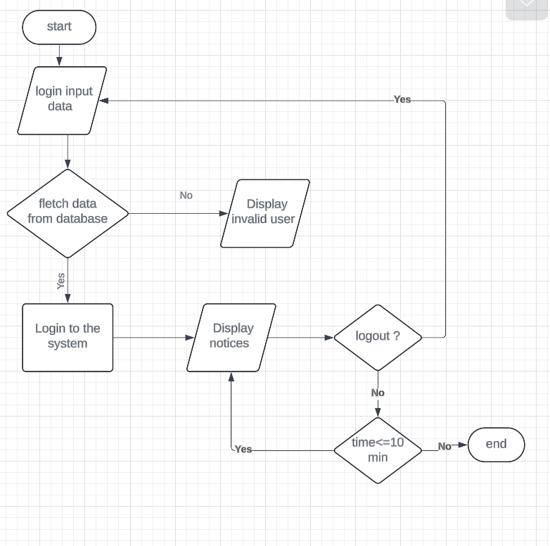
Flow chart :

Slide 6
Technologies used
HTML
CSS
JavaScript
XAAMP

Slide 7
Advantages :
This system will save the time of students and college as well .
The notices will reach to students on the time or before the time .
Digitalization of college facilities .

Slide 8
Conclusion :
In this way a solution to a student’s problem will solved .

