Slide 1
Consumer Segmentation
By
SANIKOMMU NARENDRA
B.E CSE III YEAR
MVSR ENGINEERING COLLEGE

Slide 2
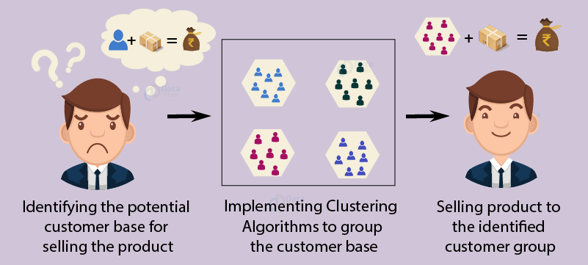
Consumer Segmentation

Slide 3
Consumer Segmentation Using K Means Clustering
Customer Segmentation is the subdivision of a market into discrete customer groups that share similar characteristics. Customer Segmentation can be a powerful means to identify unsatisfied customer needs. Using the above data companies can then outperform the competition by developing uniquely appealing products and services.

Slide 4
Market Segmentation Aproaches
Demographic information, such as gender, age, familial and marital status, income, education, and occupation.
Geographical information, which differs depending on the scope of the company. For localized businesses, this info might pertain to specific towns or counties. For larger companies, it might mean a customer’s city, state, or even country of residence.
Psychographics, such as social class, lifestyle, and personality traits.
Behavioral data, such as spending and consumption habits, product/service usage, and desired benefits.

Slide 5
Advantages of Consumer Segmentation
Determine appropriate product pricing.
Develop customized marketing campaigns.
Design an optimal distribution strategy.
Choose specific product features for deployment.
Prioritize new product development efforts.

Slide 6
The Challenge
You are owing a supermarket mall and through membership cards, you have some basic data about your customers like Customer ID, age, gender, annual income and spending score. You want to understand the customers like who are the target customers so that the sense can be given to marketing team and plan the strategy accordingly.

Slide 7
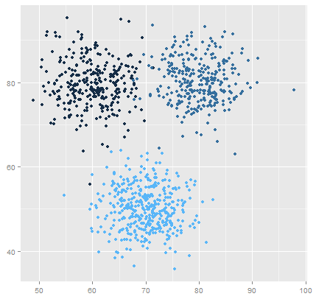
K Means Clustering Algorithm
Specify number of clusters K.
Initialize centroids by first shuffling the dataset and then randomly selecting K data points for the centroids without replacement.
Keep iterating until there is no change to the centroids. i.e assignment of data points to clusters isn’t changing.

Slide 8
Environment and tools
scikit-learn
seaborn
numpy
pandas
matplotlib

Slide 9
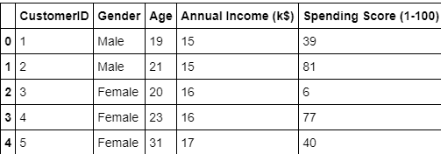
Sample Dataset

Slide 10
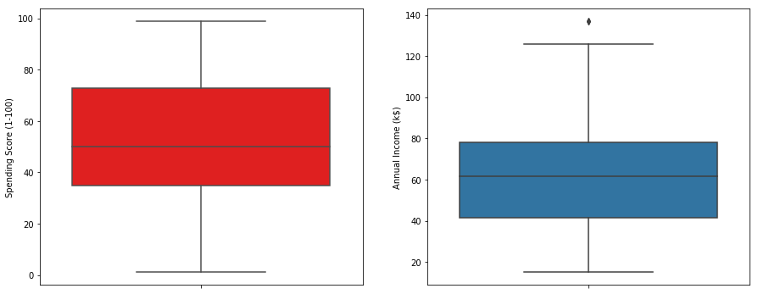
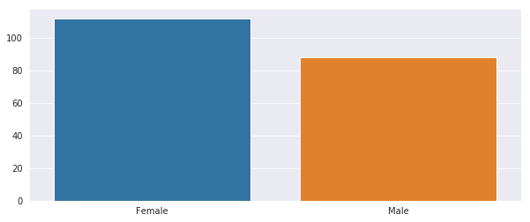
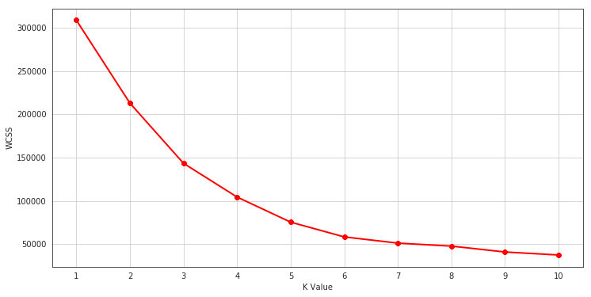
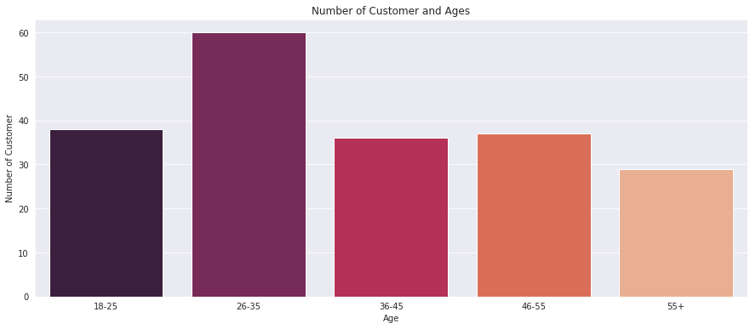
Visuals From Consumer Segmentation Project

Slide 11
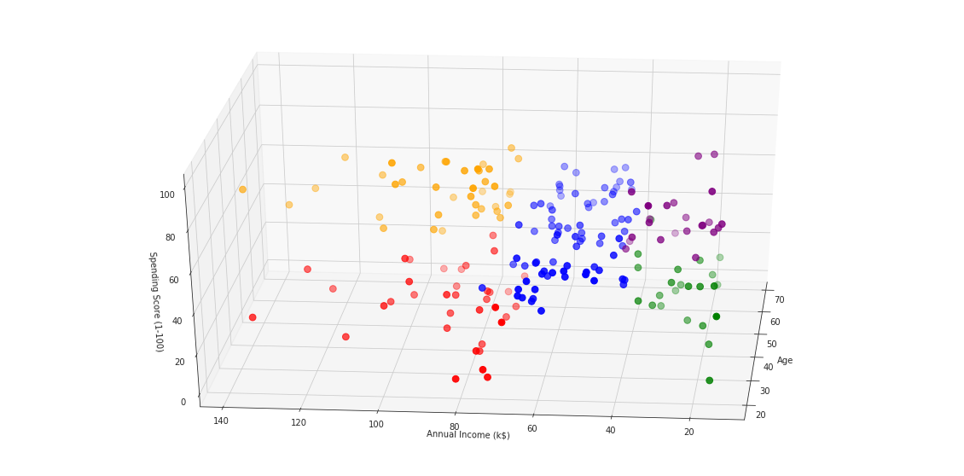
Result Of Consumer Segmentation

Slide 12
Thank You

