Slide 1
DESIGN PROJECT: DESIGN OF DIGITAL CONTROLLER FOR THE MODIFIED ACC BENCHMARK PROBLEM
By Shravan Sanil

Slide 2
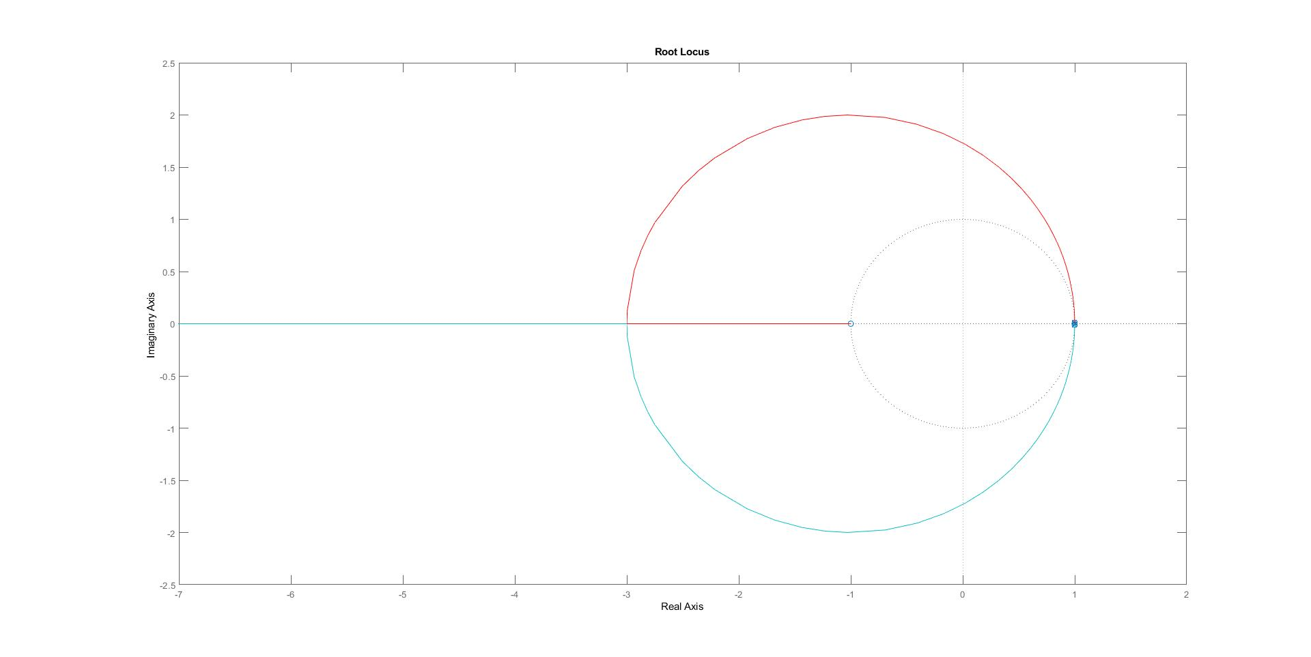
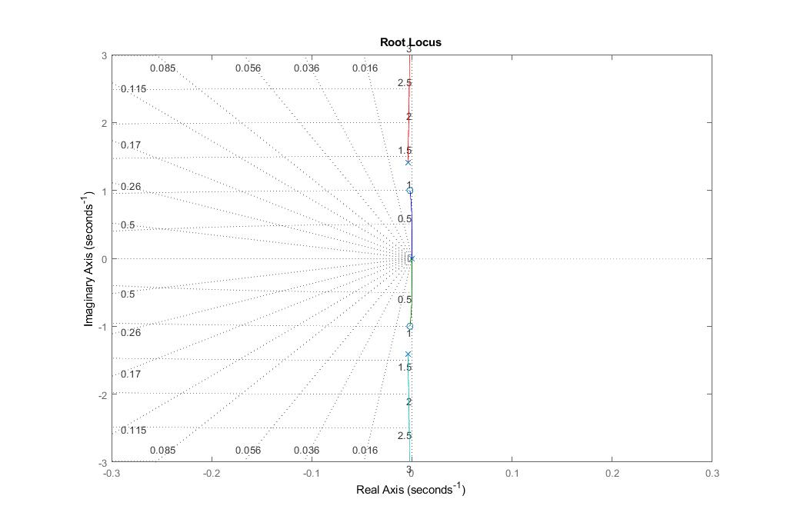
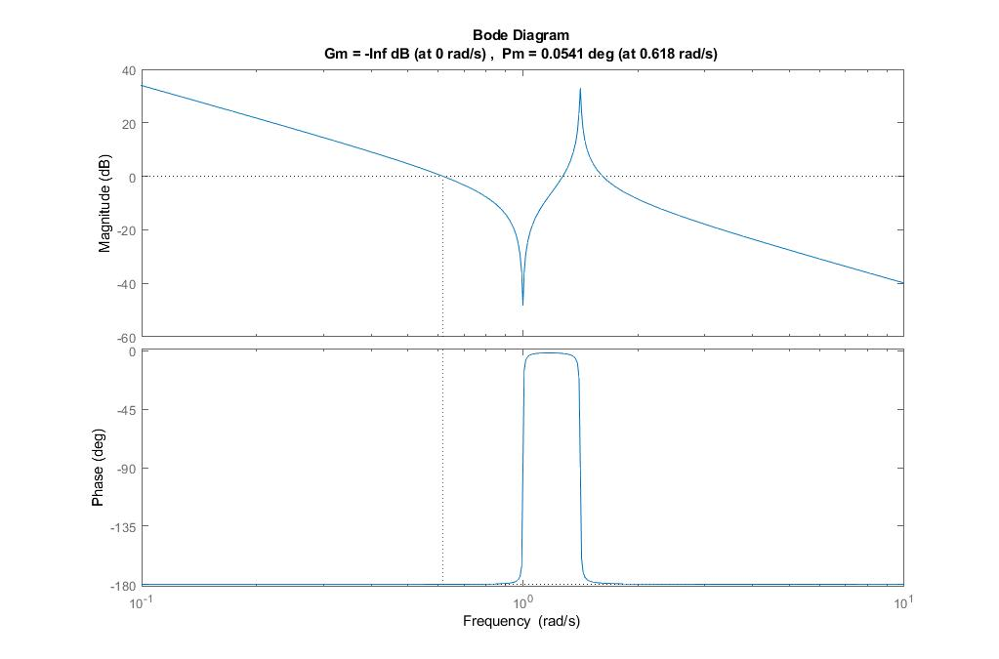



PLANT DESCRIPTION
Collocated Transfer Function
$$G_{c}=\frac{1}{s^{2}}.\frac{s^{2}+0.004s+1}{s^{2}+0.008s+2}$$
Zero Order Hold
$$G_{c,d}=\frac{5z^{−1}−4⋅999z^{−2}−4⋅999z^{−3}+5z^{−4}}{1−{4z}^{−1}+5⋅999z^{−2}−4z^{−3}+z^{−4}}×{10}^{−5}$$
$$T_{s}=0.01s$$
$$Root Locus Bode Plot$$

Slide 3
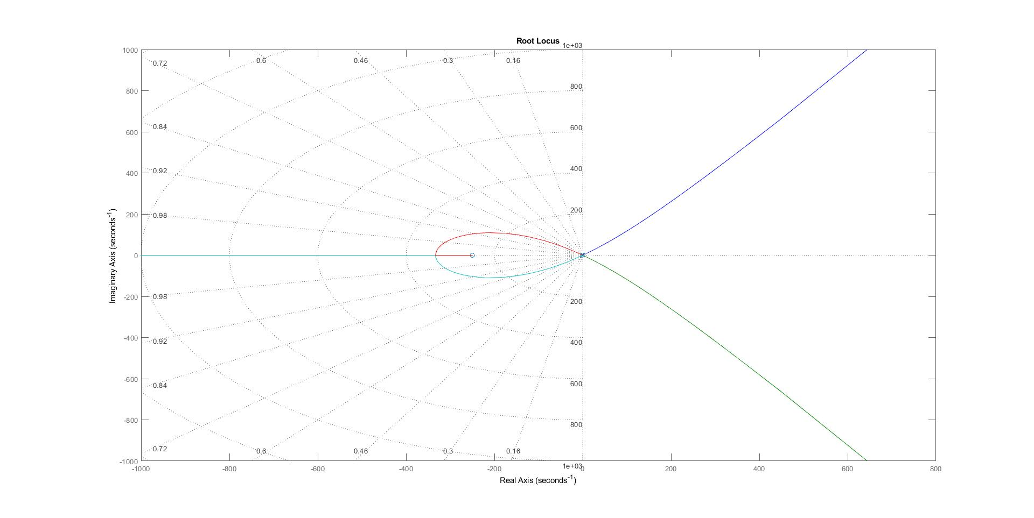
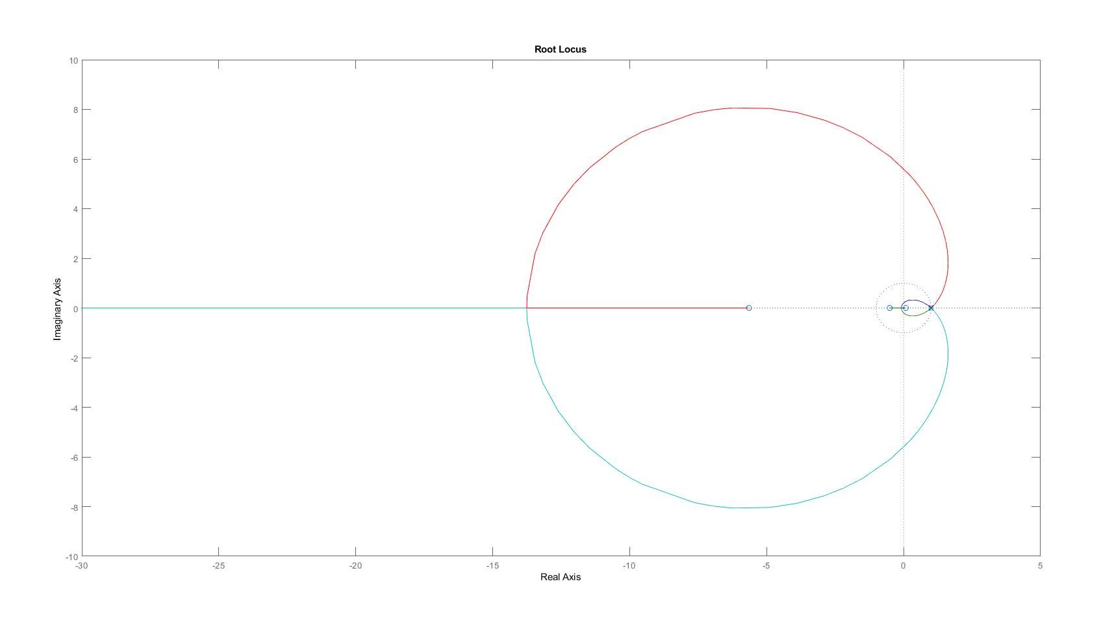
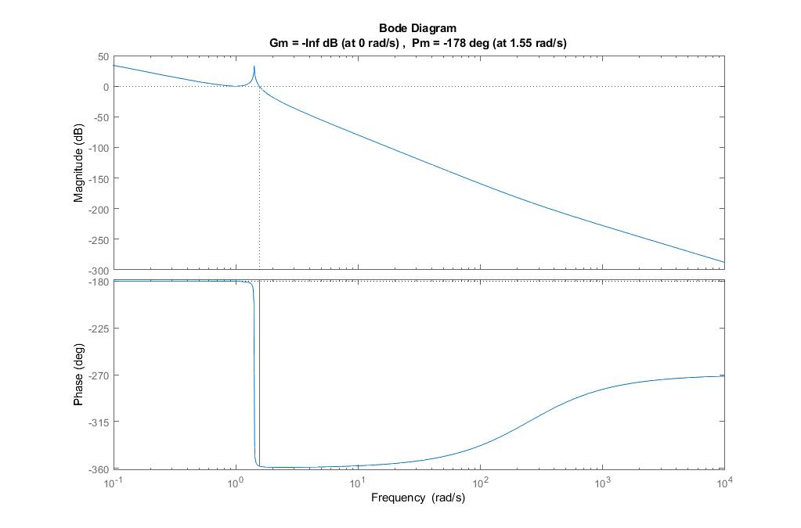

PLANT DESCRIPTION
Non-Collocated Transfer Function
$$G_{nc}=\frac{1}{s^{2}}.\frac{0.004s+1}{s^{2}+0.008s+2}$$
Zero Order Hold
$$G_{nc,d}=\frac{1.083z^{−1}+6.583z^{−2}+2.583z^{−3}+0.25z^{−4}}{1−{4z}^{−1}+5⋅999z^{−2}−4z^{−3}+z^{−4}}×{10}^{−9}$$
$$T_{s}=0.01s$$
$$Root Locus Bode Plot$$

Slide 4
CHALLENGES
Impulse disturbance exist on the non-collocated part of the system.
Both the system have their poles and zeros very close to imaginary axis.
Both plant margins are far from stable having negative high gain and phase margins.

Slide 5
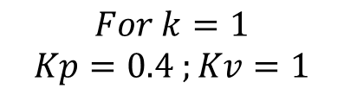
DESIGN APPROACH
Stabilizing the collocated and the non-collocated system using Proportional Gain with Velocity Feedback from the collocated response
Still integrals tend to disturb the non-collocated system and make it more unstable, integral controller is not used.
Using basic of design of PID Controllers, we tend to get the values for Kp and Kv.
Hence iterating and simulating for obtained values from calculation as well as computing the nearby values, the best obtained results are from the values
$$For k=1$$
$$Kp=0.4 ;Kv=1$$

Slide 6
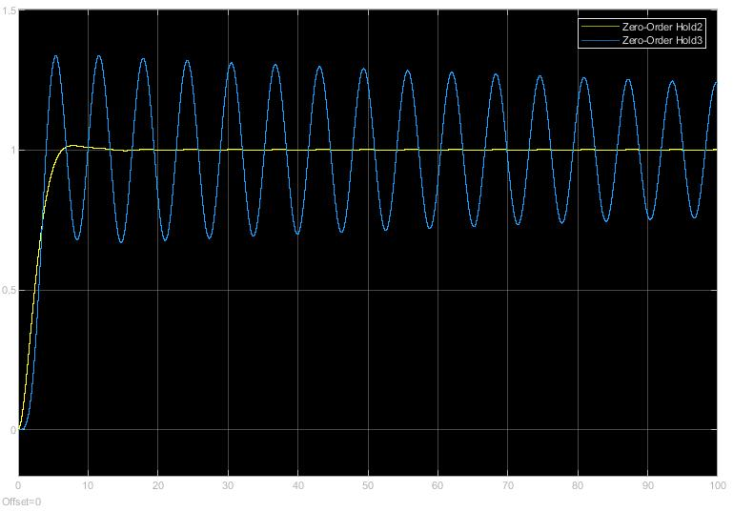
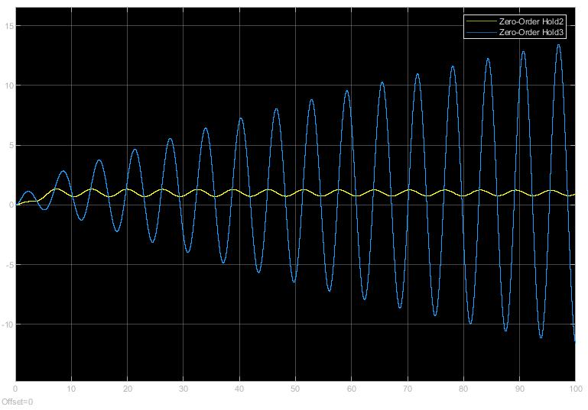

Step Responses
$$disturbance$$
$$without impulse distubance with impulse disturbance$$

Slide 7
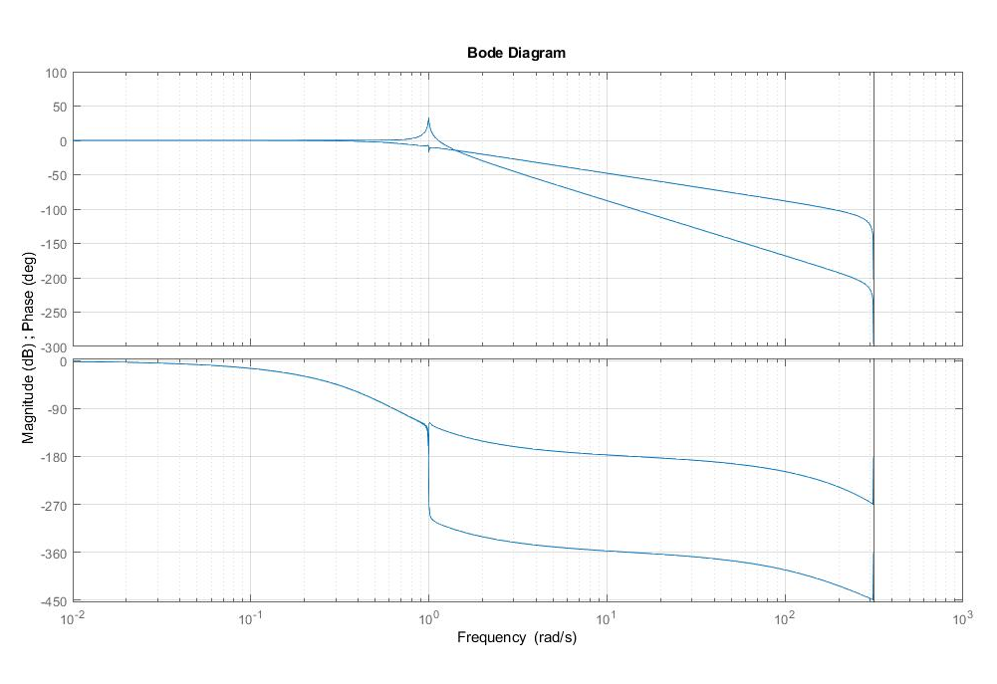
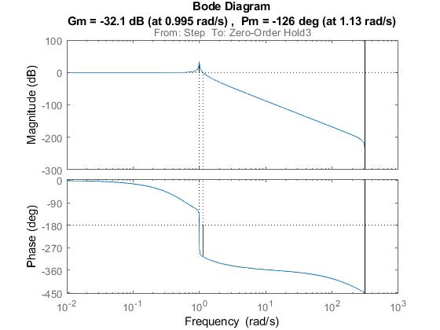
Non-collocated
$$Complex Pole Pair Frequency which makes non−collocated unstable‼$$

Slide 8
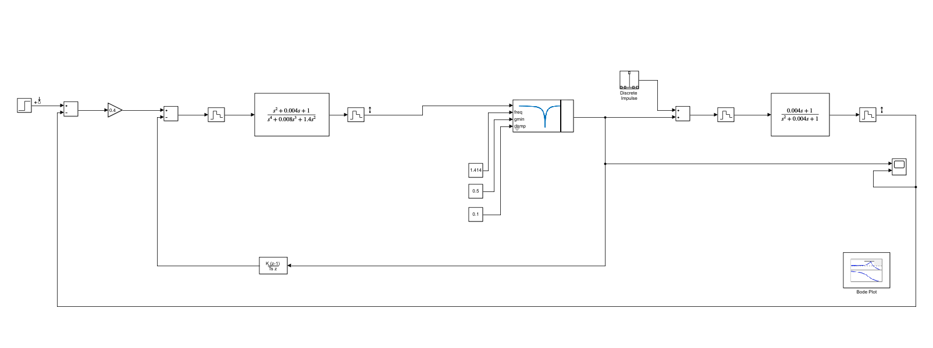
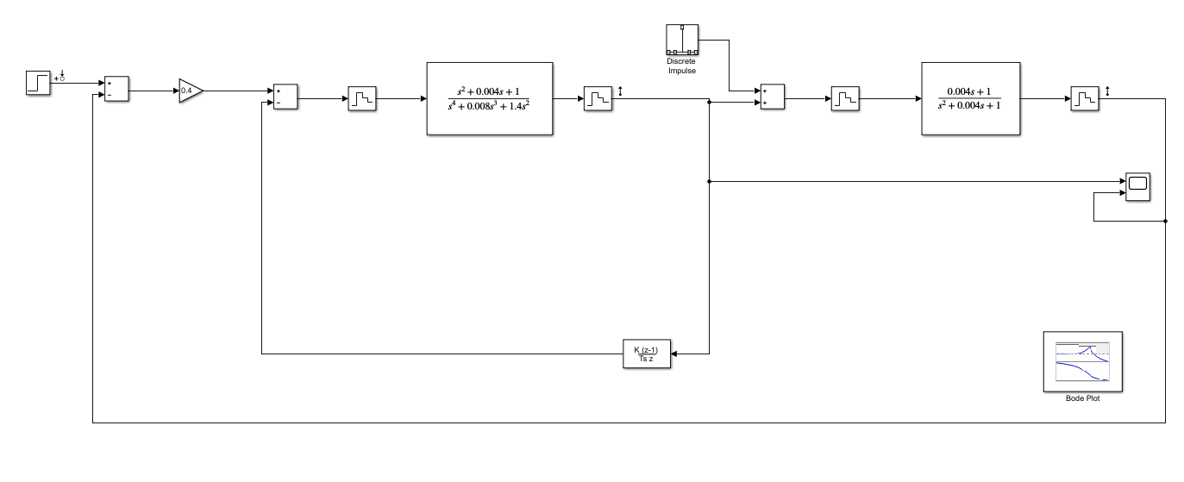












SIMULATION BLOCK DIAGRAM
$$PV Control+Notch Filter Block Diagram$$
$$PV Control Block Diagram$$
$$Gc$$
$$Gc$$
$$Gnc/Gc$$
$$Kp$$
$$Discrete Notch Filter$$
$$Gnc/Gc$$
$$Kp$$
$$Collocated Velocity Feedback$$
$$Collocated Velocity Feedback$$
$$Non−Collocated Position Feedback$$
$$Non−Collocated Position Feedback$$

Slide 9
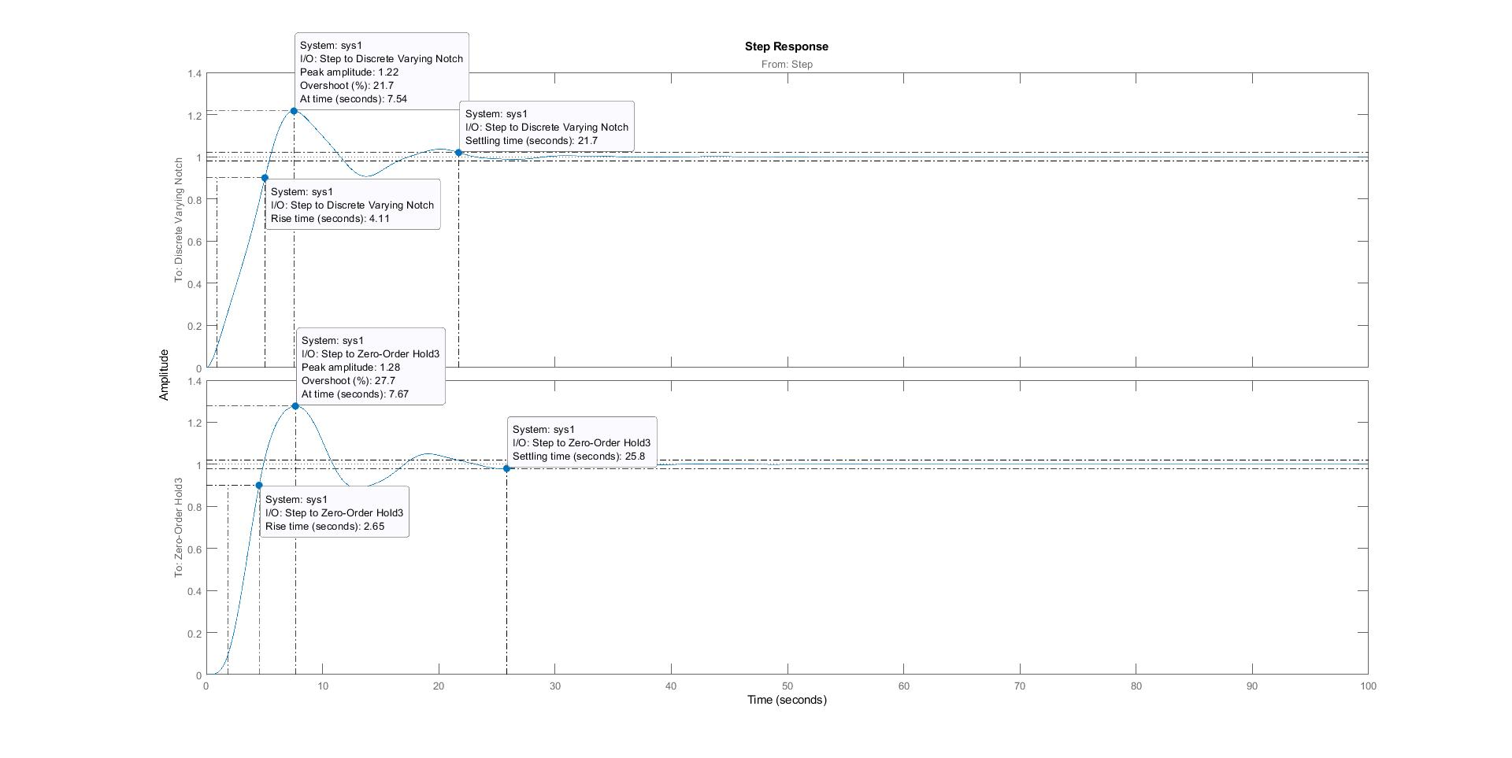
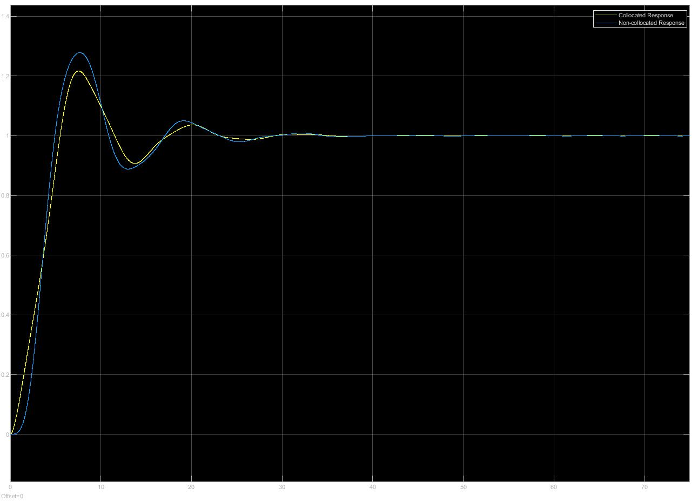
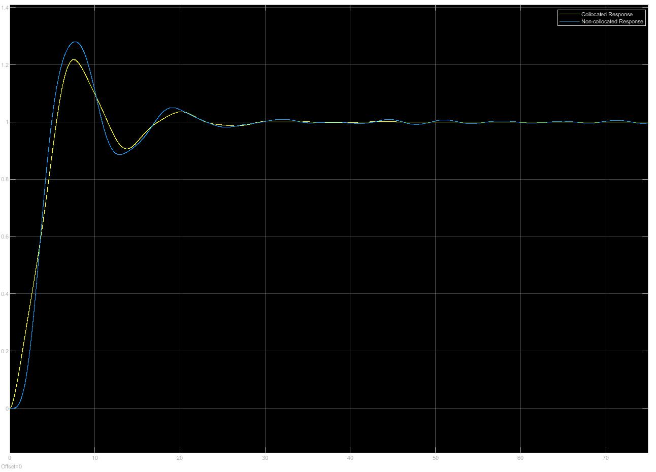
STEP RESPONSES
$$with impulse disturbance with white noise disturbance$$

Slide 10
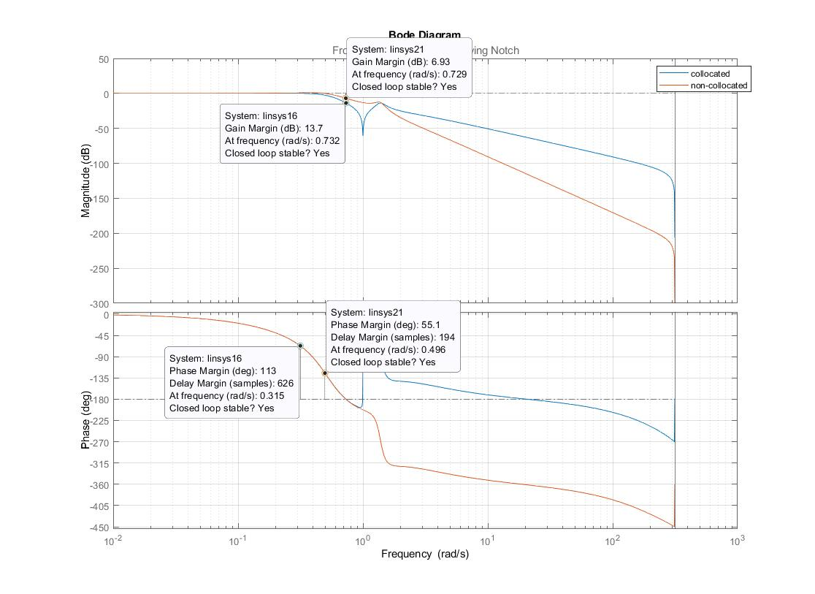
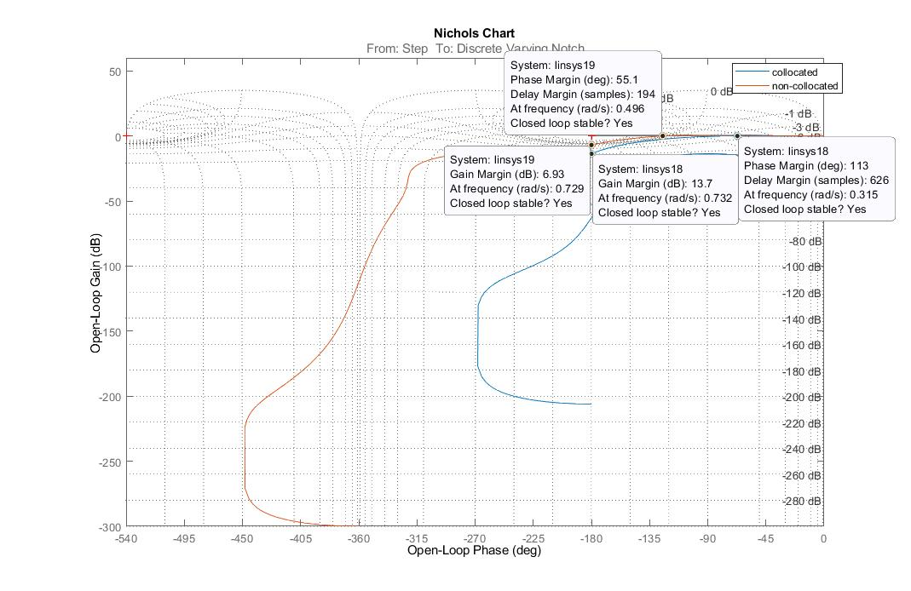
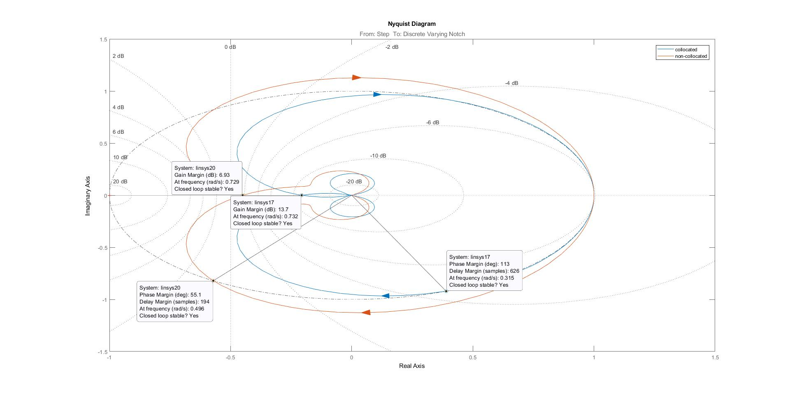
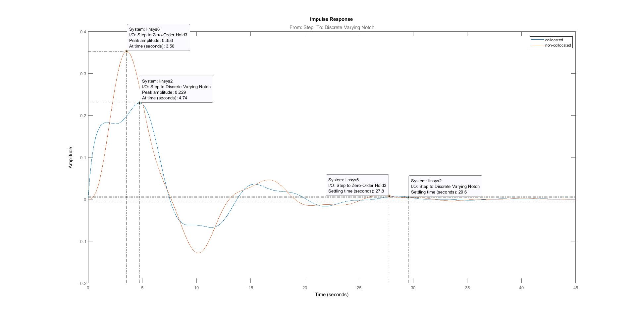
IMPORTANT RESULTS

Slide 11
REQUIRED VS OBTAINED SPECIFICATION
Required
Obtained
Gain Margins ≥ 6 dB
Phase Margin ≥ 30⁰
Mass #2 Settling time < 40s with impulse disturbance ‘d’
GM Collocated =13.7 dB
Non-Collocated= 6.93 dB
PM Collocated =113⁰
Non-Collocated= 55⁰
Mass #2 Settling time= 25.8 sec

Slide 12
SAMPLE DATA EFFECTS AND COMPENSATION
The sampling data is set to Ts=0.01s which satisfies Nyquist-Shannon theorem and also Ts < P.M/ω_{c}(cross-over frequency) and it is well greater not to generate quantization errors.
Since integral control is not used, hence the compensation for z=1 is not required.
Velocity feedback consists of a derivative term and the derivative action is developed using Backwards Difference Method rather than Trapezoidal as it develops a pole z=-1 which makes the digital system unstable.

