Slide 1
KeyChha – A Typing Practice Web Application
Presented by - Sanil Maharjan

Slide 2
Introduction
Typing is a vital modern skill, yet many learners face challenges with speed, accuracy, and consistency.
To address this, KeyChha offers an online platform that tracks progress (WPM, accuracy, mistakes) through simple login and profile features.
By combining personalization with fun practice, it keeps learners motivated while building confidence, precision, and speed.

Slide 3
Problem Statement
Typing feels hard to learn when practice is too general, mistakes aren’t highlighted, and progress isn’t tracked, leaving learners frustrated and unmotivated.
An interactive platform with personal feedback and clear progress tracking keeps practice engaging while steadily improving speed and accuracy.

Slide 4
Objectives
To create an easy, interactive typing platform that improves speed, accuracy, and confidence with feedback and progress tracking.
To use smart algorithms that analyze performance, target weaknesses, and raise difficulty step by step for steady improvement.

Slide 5
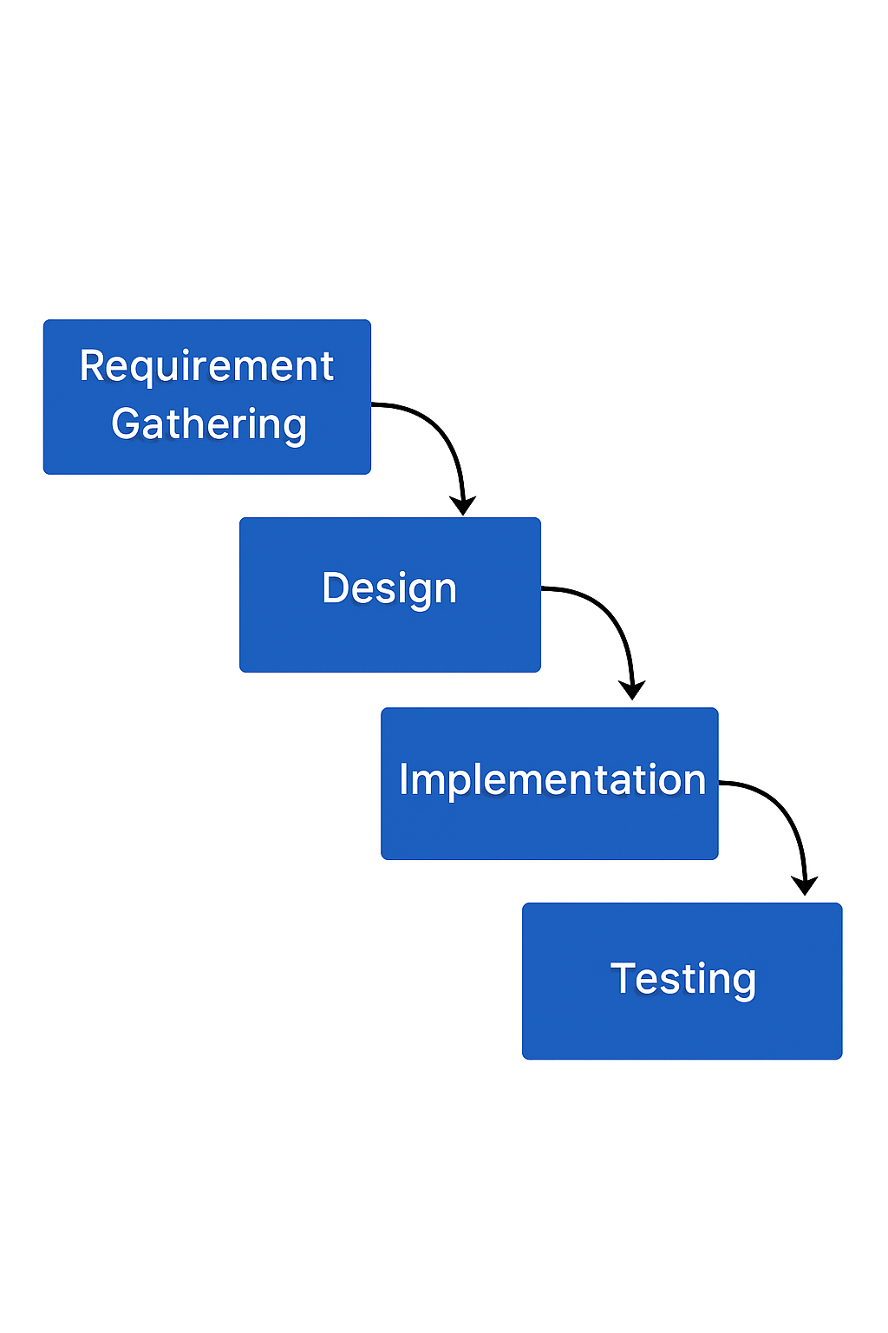
Methodology of the Proposed System
The system was built using the Waterfall model, moving step by step from requirements to design, then implementation, and finally testing.
This model was chosen because it is simple, clear, and works well when requirements are already well-defined.
Deployment and maintenance are not included since it is an academic project, where the focus is mainly on learning and demonstrating the core development phases.

Slide 6
Requirement Analysis
Functional Requirements
Non-Functional Requirements
Navigation Hub
Account Management
Guest Access
User Profile
Lesson Progression
Performance Analytics
Adaptive Vocabulary
User Interface
System Scalability
Operational Stability
Data Security
Cross‑Platform Usability
Performance Efficiency
System Dependability

Slide 7
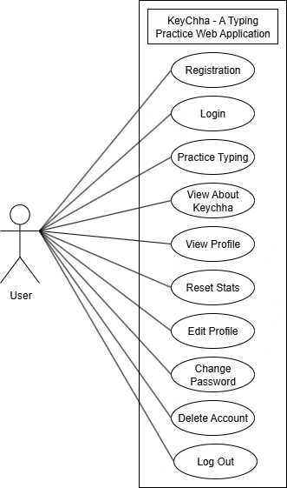
Use Case Diagram of KeyChha

Slide 8
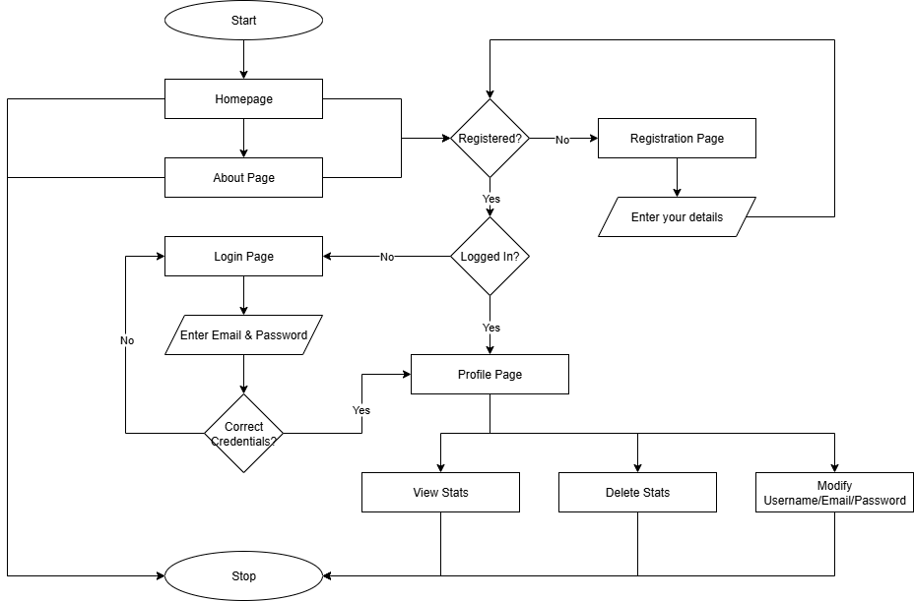
System Flow for User

Slide 9
Algorithms Proposed

Slide 10
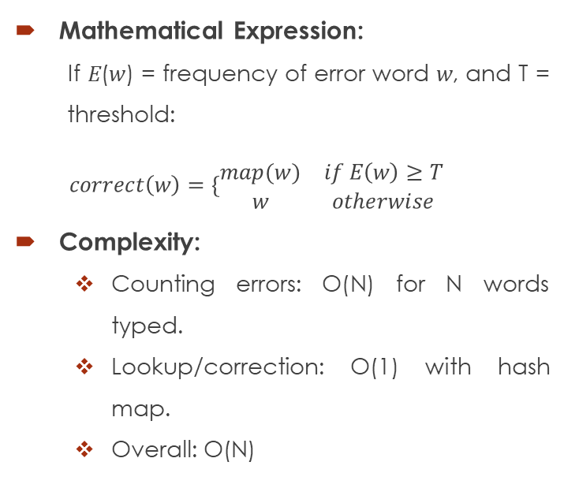
Error Frequency Analysis (Rule-Based)
Checks how often a user makes the same error (like typing "teh").
If the error frequency crosses a threshold → applies a correction rule automatically.
Mathematical Expression:
If 𝐸(𝑤) = frequency of error word 𝑤, and T = threshold:
$$correct\left(w\right)=\{\begin{matrix}map(w) & if E\left(w\right)≥T \\ w & otherwise\end{matrix}$$
Complexity:
Counting errors: O(N) for N words typed.
Lookup/correction: O(1) with hash map.
Overall: O(N)

Slide 11
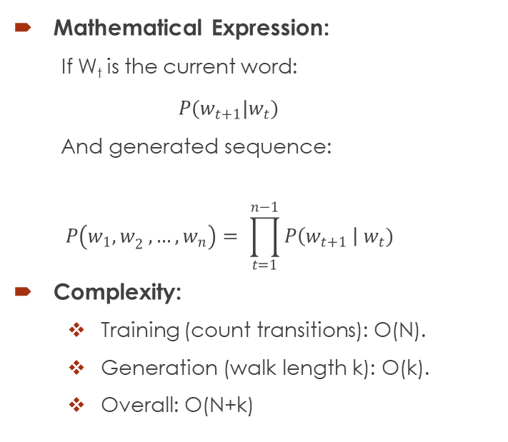
Markov Chains (Probability-Based Word Generation)
The next word depends only on the current word (bigram assumption).
Uses probabilities from training data → e.g., "the" is likely to be followed by "dog".
Mathematical Expression:
If W_{t} is the current word:
$$P(w_{t+1}|w_{t})$$
And generated sequence: $$P\left(w_{1}{,w}_{2},…,w_{n}\right)= \prod_{t=1}^{n−1}{P\left(w_{t+1} \right| w_{t})}$$
Complexity:
Training (count transitions): O(N).
Generation (walk length k): O(k).
Overall: O(N+k)

Slide 12
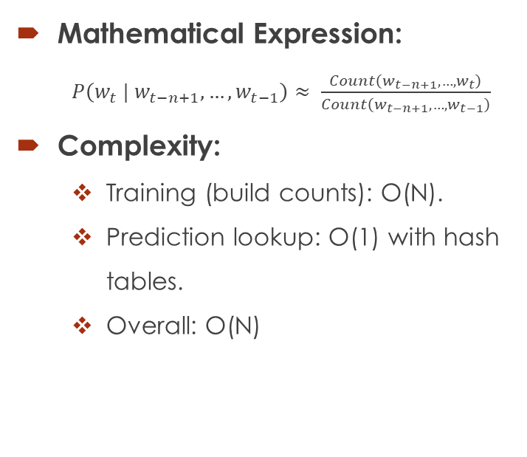
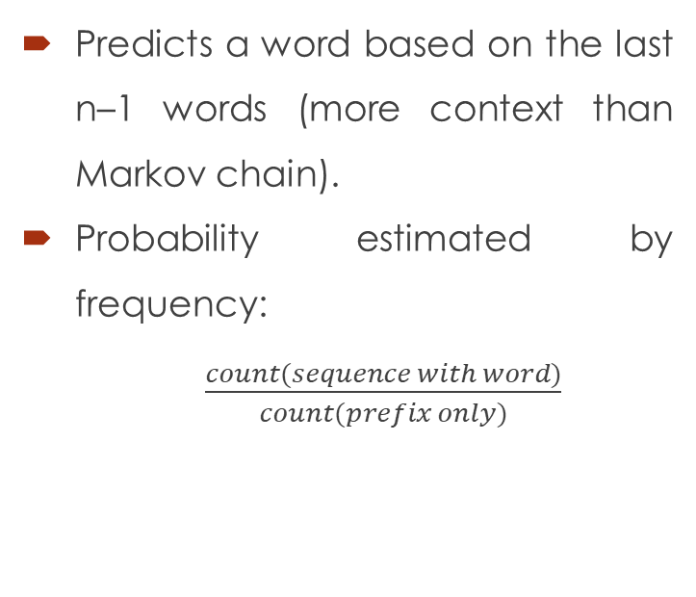
N-Gram Model (Adaptive Practice)
Predicts a word based on the last n–1 words (more context than Markov chain).
Probability estimated by frequency:
$\frac{count(sequence with word)}{count(prefix only)}$
Mathematical Expression:
$P\left({w_{t} | w}_{t−n+1},…,w_{t−1}\right)≈ \frac{Count\left(w_{t−n+1},…,w_{t}\right)}{Count\left(w_{t−n+1},…,w_{t−1}\right)}$
Complexity:
Training (build counts): O(N).
Prediction lookup: O(1) with hash tables.
Overall: O(N)

Slide 13
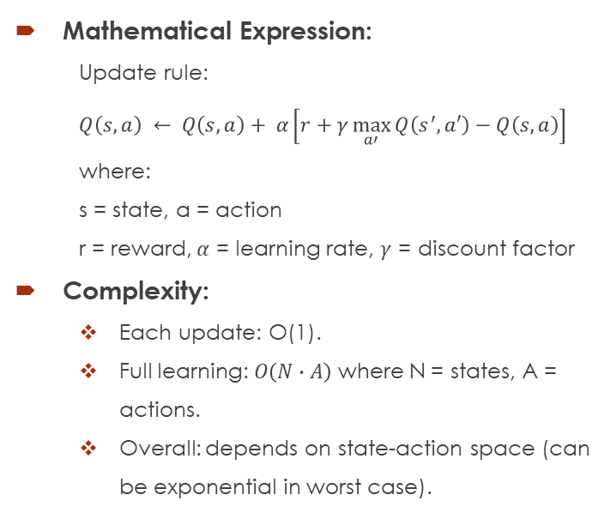
Reinforcement Learning
Learns by trial and error: adjusts estimates of action values (Q(s,a)) over time.
Uses rewards to refine future choices and maximize long-term performance.
Mathematical Expression:
Update rule:
$$Q\left(s,a\right) ← Q\left(s,a\right)+ α\left[r+γ\max_{a′}{Q\left(s^{′},a′\right)−Q\left(s,a\right)}\right]$$
where:
s = state, a = action
r = reward, $α$ = learning rate, $γ$ = discount factor
Complexity:
Each update: O(1).
Full learning: $O\left(N∙A\right)$ where N = states, A = actions.
Overall: depends on state-action space (can be exponential in worst case).

Slide 14
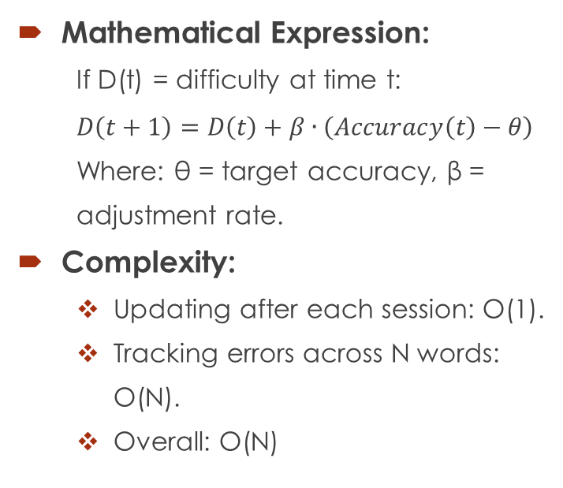
Personalized Typing Difficulty Curve
Dynamically adjusts difficulty based on learner accuracy.
Accuracy above target → increases difficulty; below → decreases it.
Mathematical Expression:
If D(t) = difficulty at time t:
$$D\left(t+1\right)=D\left(t\right)+β∙\left(Accuracy\left(t\right)−θ\right)$$
Where: θ = target accuracy, β = adjustment rate.
Complexity:
Updating after each session: O(1).
Tracking errors across N words: O(N).
Overall: O(N)

Slide 15
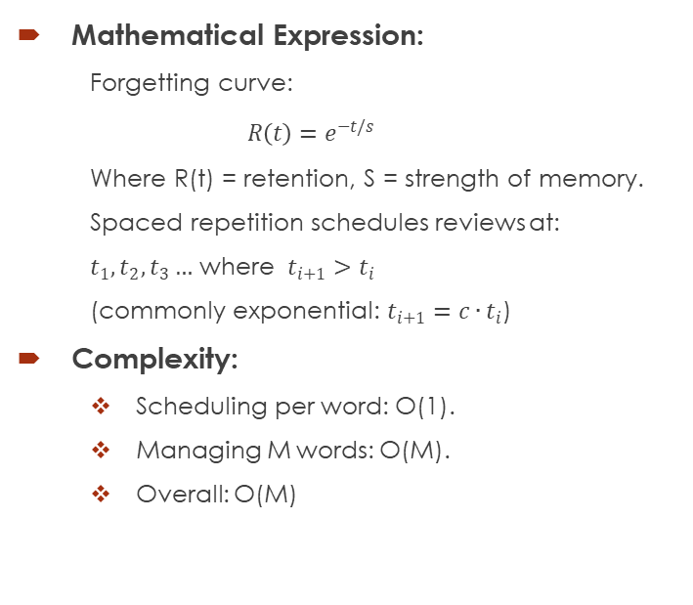
Spaced Repetition Curve
Models memory decay and schedules reviews before forgetting happens.
Correct answers increase intervals (next review shown later); hard words repeat sooner.
Mathematical Expression:
Forgetting curve:
$$R\left(t\right)=e^{−t/s}$$
Where R(t) = retention, S = strength of memory.
Spaced repetition schedules reviews at:
$t_{1},t_{2},t_{3}…$ where $t_{i+1}>t_{i}$
(commonly exponential: $t_{i+1}=c∙t_{i}$)
Complexity:
Scheduling per word: O(1).
Managing M words: O(M).
Overall: O(M)

Slide 16
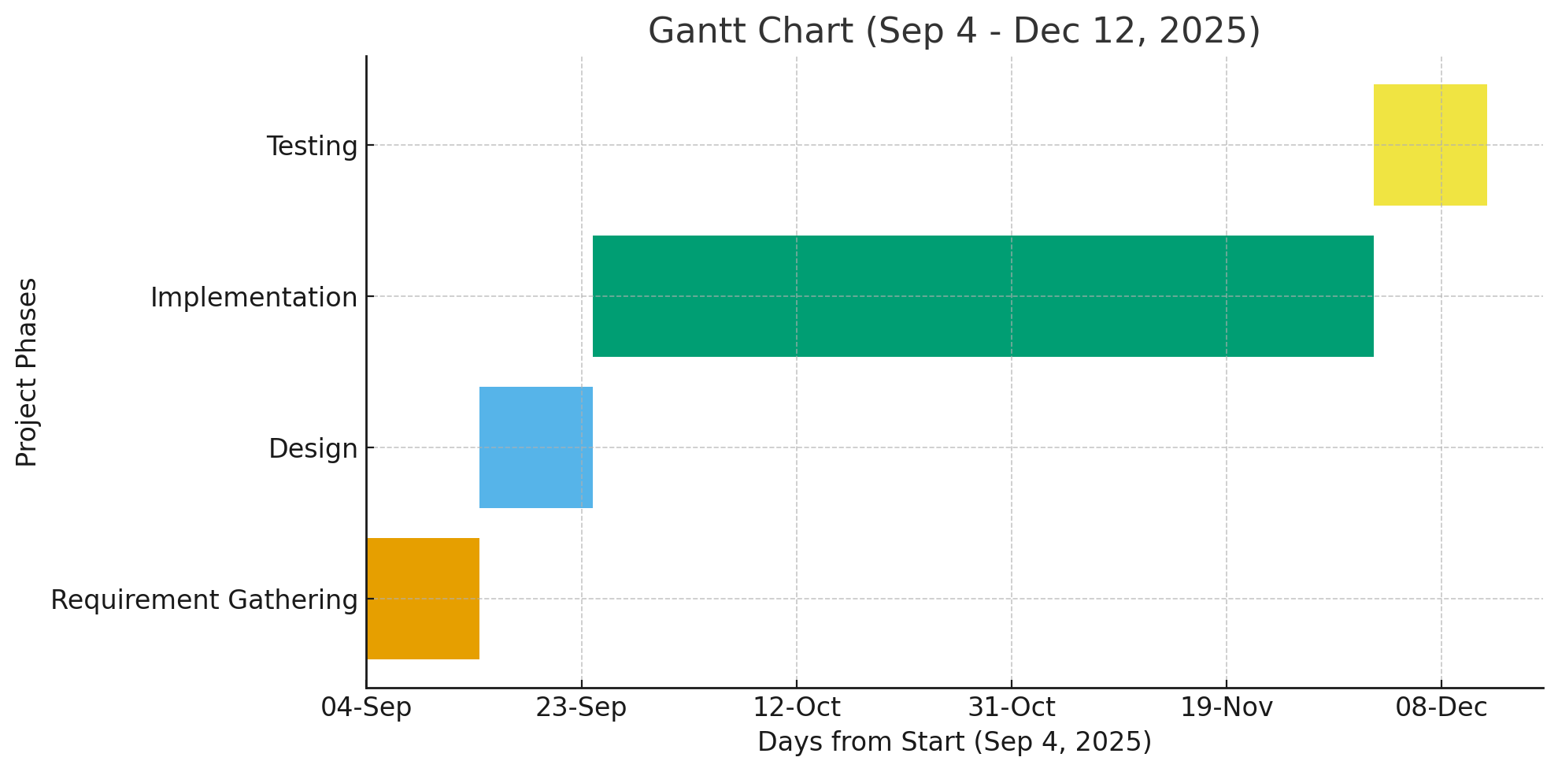
Gantt chart of Project Activities

Slide 17
Expected Outcome
Users improve typing skills through structured practice and feedback, while personalized word sets ensure engaging learning and steady gains in speed, accuracy, and overall proficiency.

