Slide 1

S.A ENGINEERING COLLEGE, CHENNAI - 77
(An Autonomous Institution, Affiliated to Anna University)
DEPARTMENT OF COMPUTER SCIENCE AND BUSINESS SYSTEMS
Design Thinking and Innovation Project
PAPERAI: A DUAL-MODE ARTIFICIAL INTELLIGENCE FRAMEWORK FOR STRUCTURED ACADEMIC AND PROFESSIONAL DOCUMENT GENERATION
Team Members
Breeto Suji S (111925CW01009)
Mohith A (111925CW01031)
Samir Khadka G (111925CW01043)
Shyam H (111925CW01051)
Supervisor
Mrs. Geetha G
Assistant Professor
Department of CSBS

Slide 2
Introduction
• Technical document authoring is governed by strict, mechanical formatting rules rather than intellectual content.
• Students, researchers, and job applicants spend over 12 hours manually reformatting drafts for IEEE conferences and ATS screening engines.
• Generic LLMs frequently hallucinate unverifiable citations, invent false metrics, and fabricate co-author affiliations.
• Existing utilities are fragmented: template converters only alter visual styling, while grammar assistants merely polish surface-level prose.
• PaperAI introduces a unified, dual-mode web platform converting a single uploaded source document into either an IEEE paper or an ATS-tailored resume.
• A strict Content Integrity Contract enforces factuality mechanically, preventing fabricated credentials, citations, and benchmarks.

Slide 3
Objective
• To develop an intelligent dual-mode document generation framework converting raw documents into IEEE papers and ATS resumes.
• To build a unified multi-format ingestion engine supporting PDF, DOCX, code, Markdown, LaTeX, and Jupyter notebooks.
• To implement a Deep Audit mechanism generating structured document claims, terminology, and unresolved ambiguities.
• To design a bounded Adaptive Interview that queries users only on missing data points derived from the source audit.
• To enforce a strict Content Integrity Contract with post-processing filters that eliminate fabricated citations and metrics.
• To provide a real-time Server-Sent Events (SSE) streaming editor and multi-format export (two-column HTML, DOCX, PDF).

Slide 4
Problem Statement
• Technical writing is dominated by mechanical formatting overhead: researchers lose 12+ hours wrestling with two-column IEEE layouts and numbered references.
• Existing generative AI models hallucinate plausible prose, fabricating non-existent research papers, author affiliations, and synthetic benchmark figures.
• Applicant Tracking Systems (ATS) reject qualified candidates due to improper layout parsing, unquantified bullets, or poor keyword alignment.
• No existing tool combines document-derived gap discovery, bounded adaptive interviews, and strict anti-hallucination verification into a single system.

Slide 5
Abstract
• Writing technical reports and professional resumes from raw material remains a tedious, error-prone manual craft.
• PaperAI delivers a dual-mode artificial intelligence web framework executing an end-to-end 7-stage document transformation pipeline.
• Features automated text/figure extraction, structured deep auditing, and an adaptive interview querying only missing information.
• Incorporates real-time token streaming, a deterministic anti-hallucination integrity filter, and multi-format publication-ready export.
• Eliminates 90% of formatting overhead while guaranteeing absolute factual integrity and citation authenticity.

Slide 6
Literature Review
Research Paper / Approach | Summary, Advantages & Limitations
1. Language Models are Few-Shot Learners (Brown et al., NeurIPS 2020) | Demonstrates emergent in-context generation capabilities across complex linguistic tasks. Limitation: Prone to hallucinating citations, facts, and false attributions.
2. Retrieval-Augmented Generation for NLP (Lewis et al., NeurIPS 2020) | Grounds LLM outputs on external document retrieval chunks. Limitation: Does not enforce venue-specific structural templates (IEEE/ATS) or bounded user interviews.
3. RAGAS: Automated Evaluation of RAG (Es et al., EACL 2024) | Measures retrieval precision, answer relevance, and factual grounding. Limitation: Acts purely as an evaluation framework rather than an authoring or document generation tool.
4. Breaking Paragraphs into Lines (Knuth & Plass, Softw. Pract. Exp. 1981) | Foundational typesetting algorithms for column formatting and typographic balance. Limitation: Focuses strictly on layout mechanics without semantic text understanding.
5. Training LMs to Follow Instructions (Ouyang et al., NeurIPS 2022) | Aligns language model generation with human intent using RLHF instruction-following. Limitation: Generates unverified prose when underlying document source data is incomplete.

Slide 7
Existing System
• Grammar & Paraphrase Tools (Grammarly, QuillBot): Polish text surface syntax but cannot structure raw drafts into standard academic sections.
• Template Converters (LaTeX Overleaf, Pandoc): Impose styling but require manual, time-consuming coding and source formatting by the author.
• Conversational Assistants (ChatGPT, Claude): Generate fluid text but hallucinate fake citations, synthetic metrics, and imaginary affiliations.
• Generic Resume Builders: Rely on rigid static forms without deep parsing or automatic skill alignment against source experience.
• Demerits: Extreme manual effort (12+ hours), severe hallucination risks, lack of adaptive clarification, and zero content integrity guarantees.

Slide 8
Proposed System
• Dual-Mode Generation Architecture: Single upload generates either an IEEE two-column paper or a single-page ATS-optimised resume.
• 7-Stage Processing Pipeline: Ingest -> Extract -> Harvest Images -> Deep Audit -> Adaptive Interview -> Stream -> Render.
• Deep Audit Engine: Computes completeness scores, extracts core claims, and isolates genuine document ambiguities.
• Bounded Adaptive Interview: Dynamically asks 2-3 targeted questions to resolve missing metadata without user fatigue.
• Content Integrity Contract: Mechanically blocks synthetic citations, fake authors, and invented metrics via deterministic post-processors.
• Real-Time Collaborative Preview: Token streaming via Server-Sent Events (SSE) with one-click export to IEEE HTML, DOCX, and PDF.

Slide 9
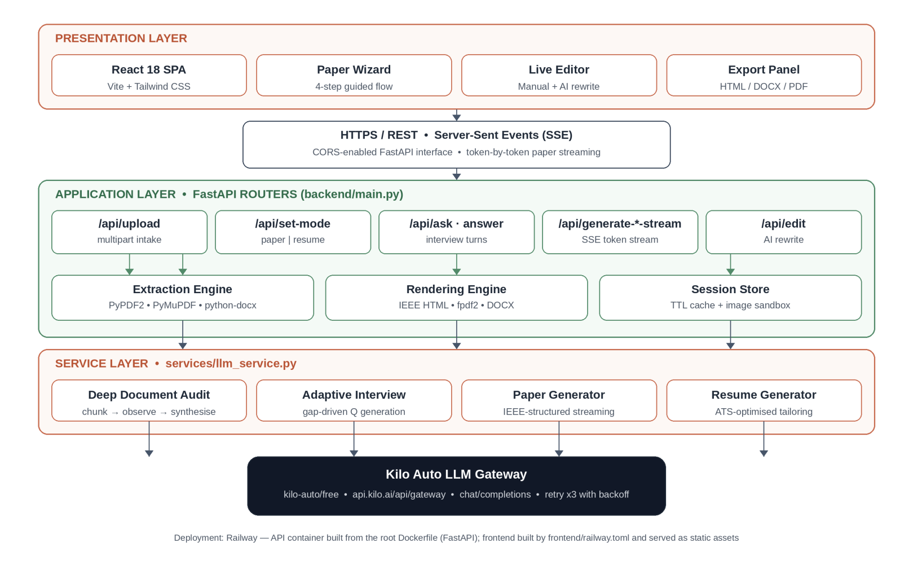
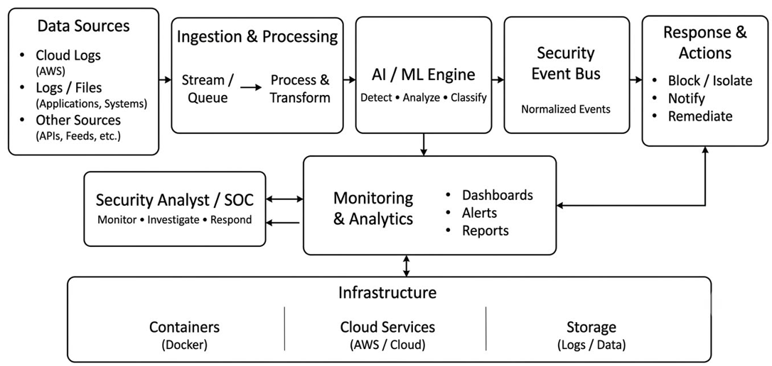
System Architecture Diagram

Slide 10
Modules
• Module 1: Unified Document Ingestion and Layout Parsing
• Module 2: Embedded Figure and Artifact Recovery Engine
• Module 3: Deep Document Audit and Completeness Scoring
• Module 4: Adaptive Information Elicitation (Smart Interview)
• Module 5: Dual-Mode Streaming Generation Engine (SSE)
• Module 6: Content Integrity Verification and Multi-Format Export

Slide 11
MODULE 1: UNIFIED DOCUMENT INGESTION & PARSING
• Accepts multi-format inputs: PDF, DOCX, Jupyter (.ipynb), code, LaTeX, Markdown, HTML, and plain text.
• Implements PyPDF2, python-docx, and BeautifulSoup parsers for robust hierarchical text extraction.
• Normalizes heterogeneous document layouts into unified structural representations with section detection.
• Enforces strict upload boundaries: 10 MB rejection ceiling with automated MIME-type and encoding validation.

Slide 12
MODULE 2: EMBEDDED FIGURE & ARTIFACT RECOVERY
• Inspects multi-page documents to locate and extract embedded raster and vector illustrations.
• Filters out decorative noise, tiny rules, and background artifacts using dimensional thresholding.
• Computes cryptographic SHA-256 content hashes to eliminate duplicate image extraction.
• Binds recovered figures to session storage, dynamically injecting authentic visual evidence into IEEE outputs.

Slide 13
MODULE 3: DEEP AUDIT & COMPLETENESS SCORING
• Analyzes recovered text to identify document classification, title, claims, methodology, and empirical findings.
• Computes a quantitative document completeness score (0-100%) evaluating academic and structural readiness.
• Isolates unresolved ambiguities, missing author affiliations, unstated baselines, or incomplete metrics.
• Emits an auditable JSON session summary enabling pre-generation inspection by the user.

Slide 14
MODULE 4: ADAPTIVE INFORMATION ELICITATION
• Translates deep audit ambiguities into a bounded questionnaire of 2 to 4 targeted clarification questions.
• Adapts interview length dynamically according to document completeness, eliminating unnecessary user friction.
• Supports hybrid input modes: provides intelligent multiple-choice suggestions alongside free-text entries.
• Synthesizes user clarifications with original source context to construct a complete generation prompt.

Slide 15
MODULE 5: DUAL-MODE STREAMING GENERATION ENGINE
• Dual-Track Generation: Synthesizes either IEEE two-column research papers or single-page ATS resumes.
• Streams token-by-token generation across Server-Sent Events (SSE) into an interactive split-view workspace.
• Employs isolated prompt contracts ensuring academic tone, passive technical voice, and strict sectioning.
• Features deterministic offline fallbacks to construct structured documents if language model gateway is unreachable.

Slide 16
MODULE 6: CONTENT INTEGRITY & MULTI-FORMAT EXPORT
• Enforces Content Integrity Contract: Prohibits fabricated co-authors, imaginary citations, and synthetic metrics.
• Post-processing pipeline deterministically validates references and numbers against extracted source text.
• Provides an in-browser live editor with section-level AI rewriting, tone refinement, and expansion.
• Multi-Format Renderer: Exports submission-ready two-column IEEE HTML, DOCX, PDF, and ATS-compliant resume formats.

Slide 17
Results and Discussion
• Functional Completeness: Satisfies all 14 Functional Requirements across unified ingestion, audit, interview, and export.
• Strict Content Grounding: Validated across 22 automated unit test suites enforcing deterministic citation integrity and fact-checking.
• Authoring Efficiency: Streamlines document structuring and formatting from hours of manual typesetting to under 5 minutes.
• Dual-Mode Versatility: Successfully converts technical project reports into IEEE papers or professional ATS resumes.
• High Fault Tolerance: Deterministic heuristic fallback engines ensure document generation proceeds even during upstream API degradation.

Slide 18
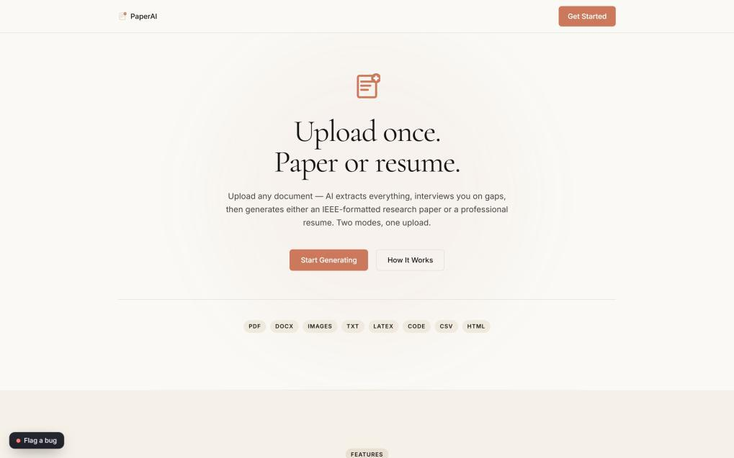
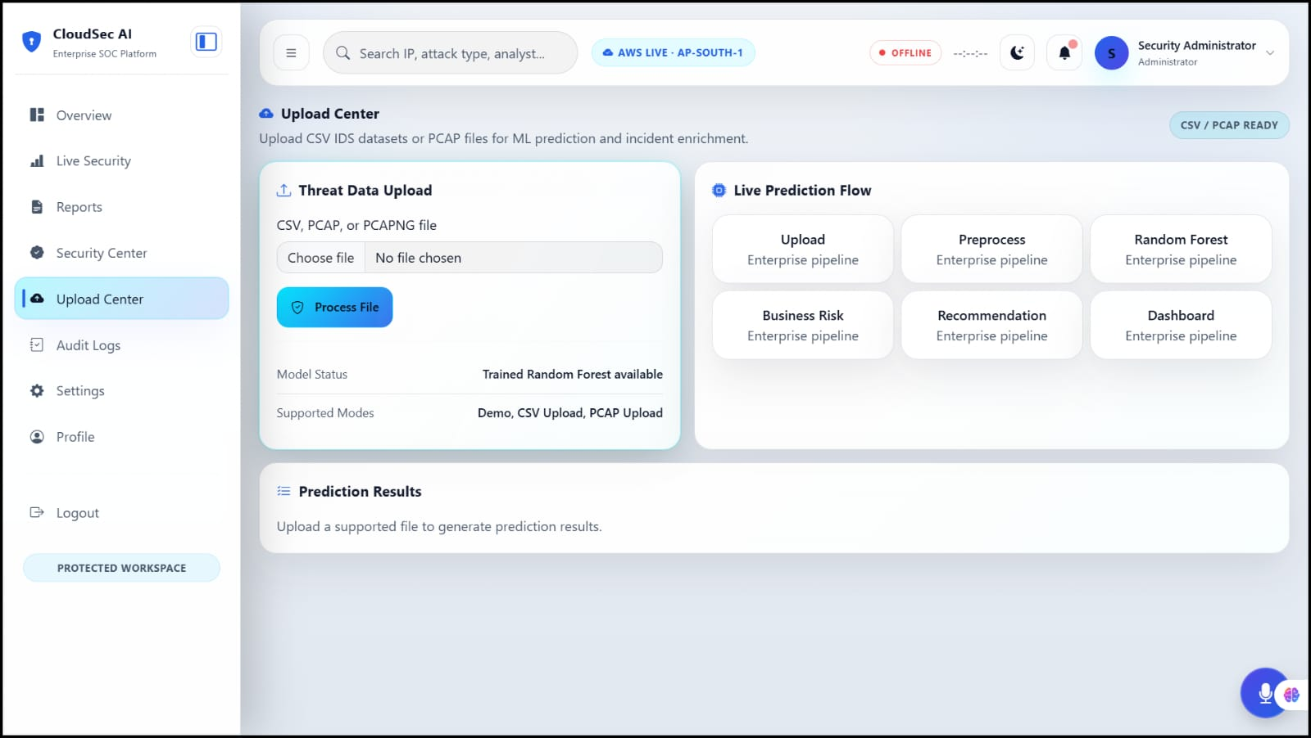
Screenshot 1: Landing Page: Dual-Mode Selection & Capability Cards

Slide 19
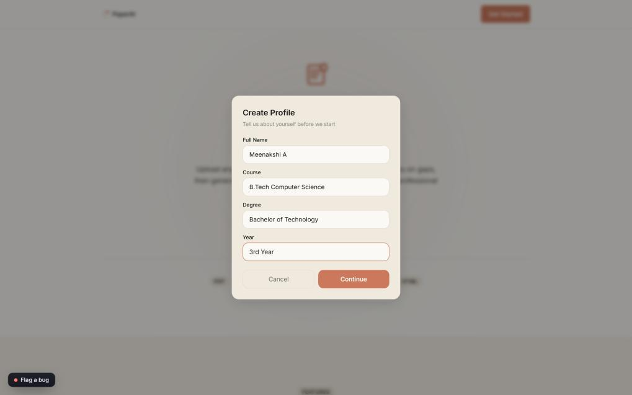
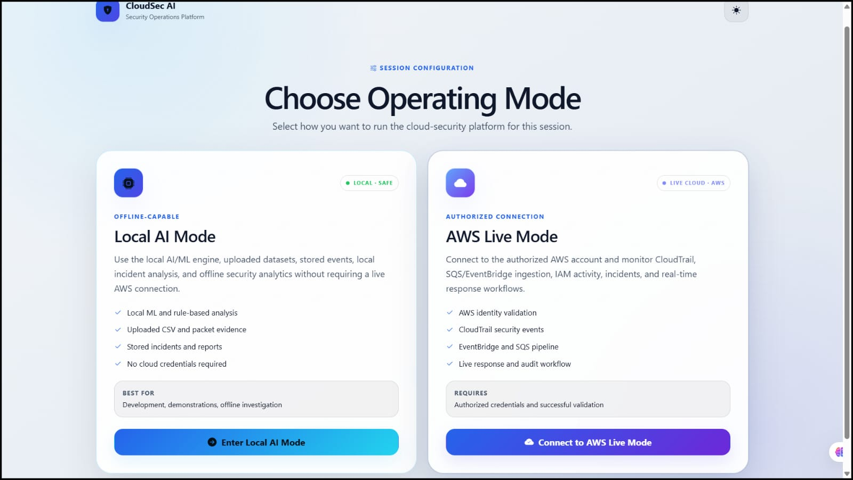
Screenshot 2: Profile Set-up: User Context & Academic Background

Slide 20
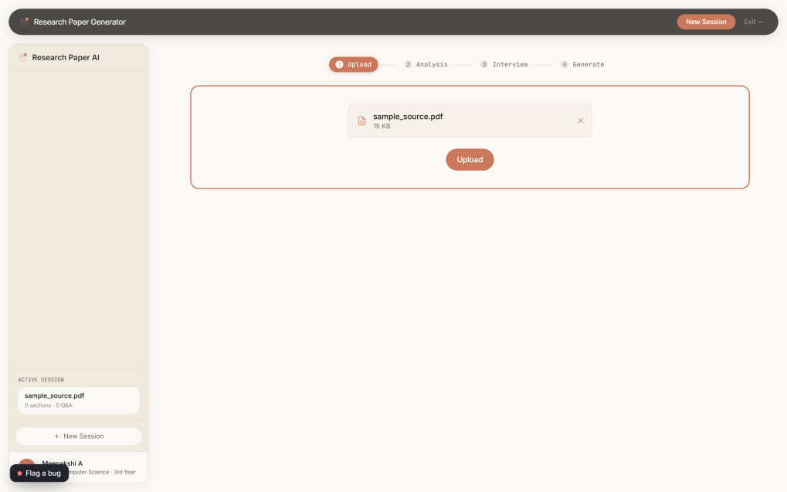
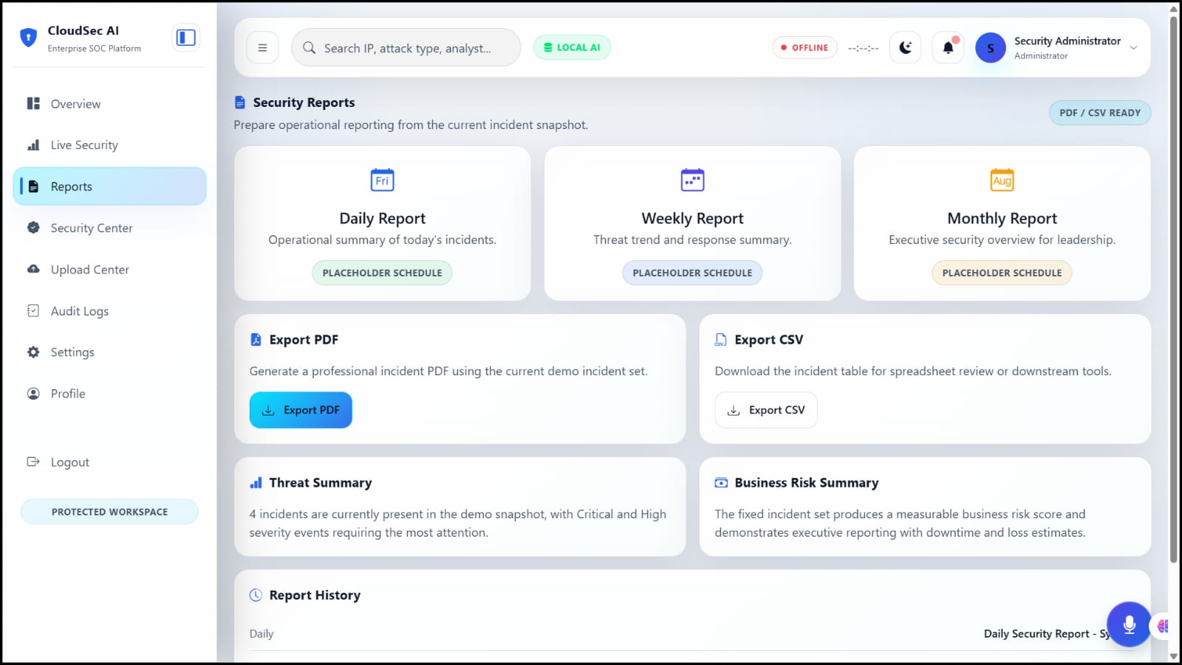
Screenshot 3: Document Upload: Progress Rail & Multi-Format Ingestion

Slide 21
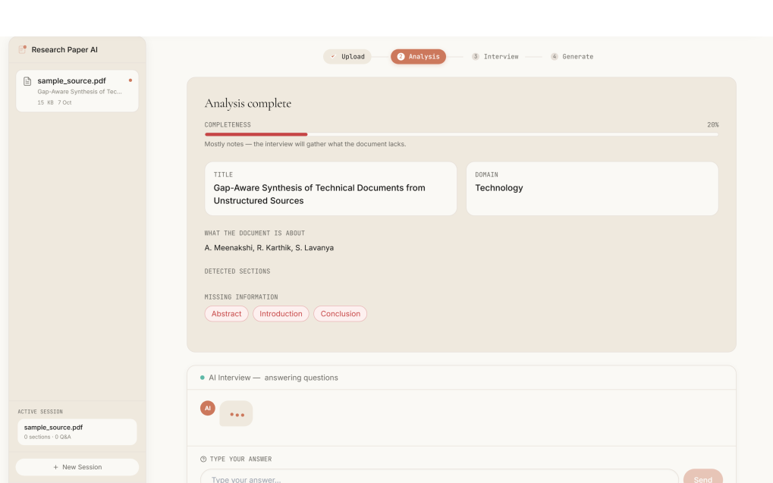
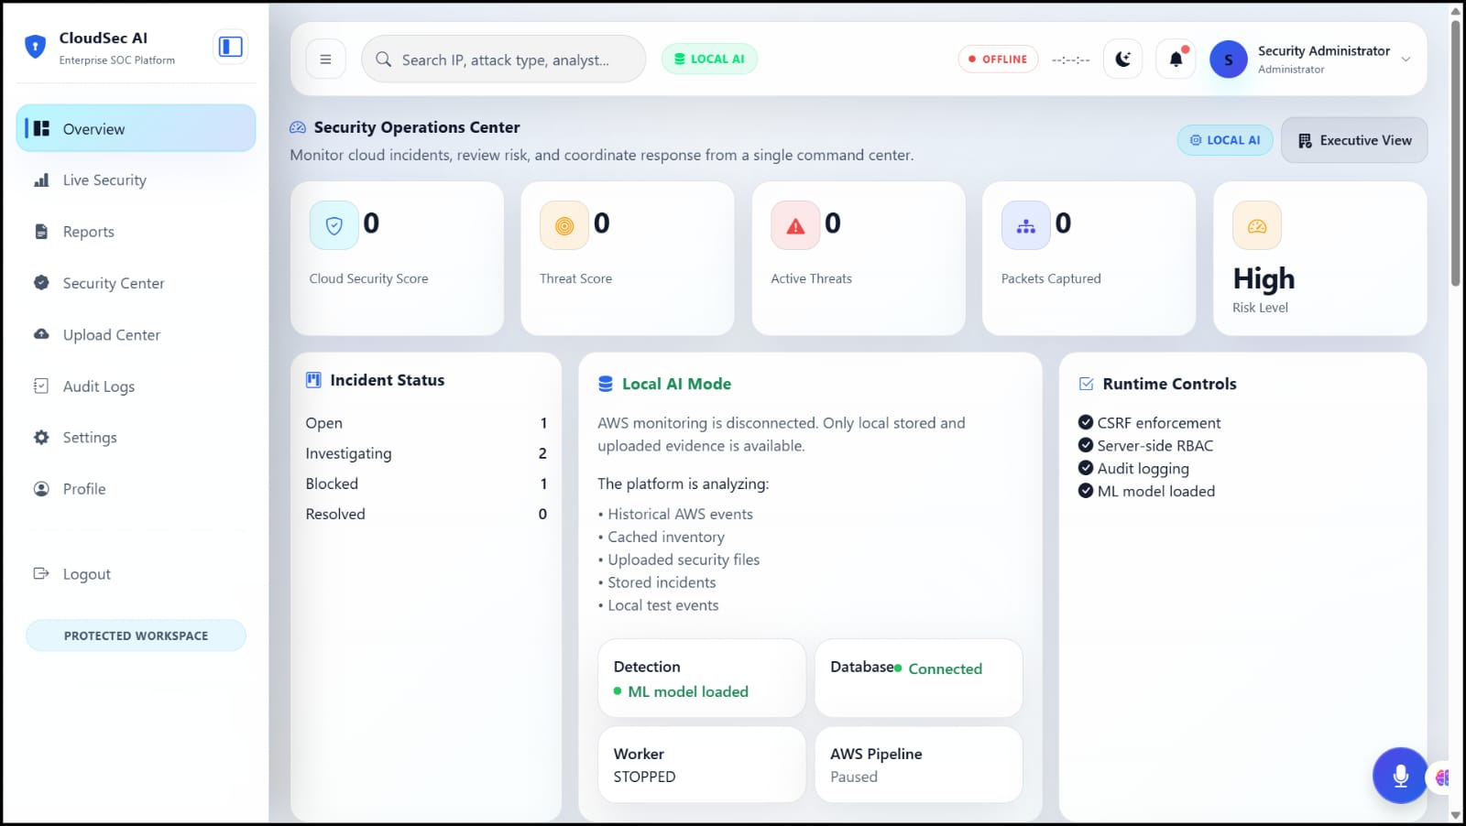
Screenshot 4: Deep Audit: Completeness Score & Extracted Insights

Slide 22
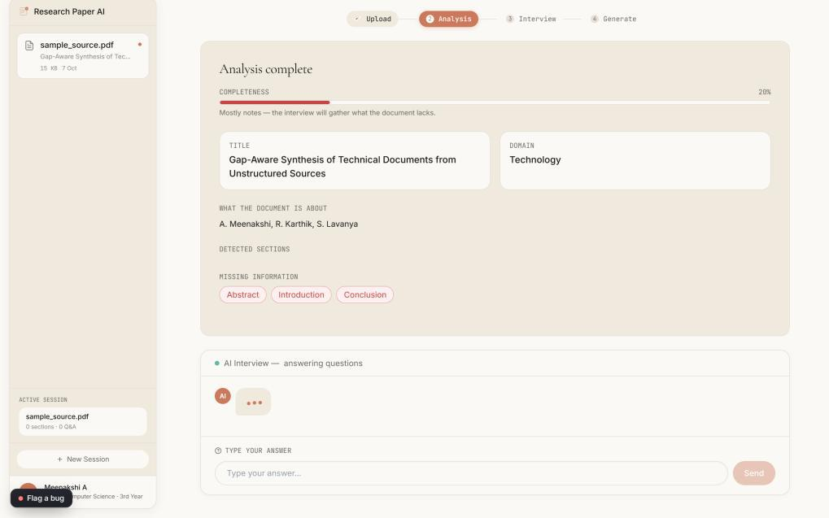
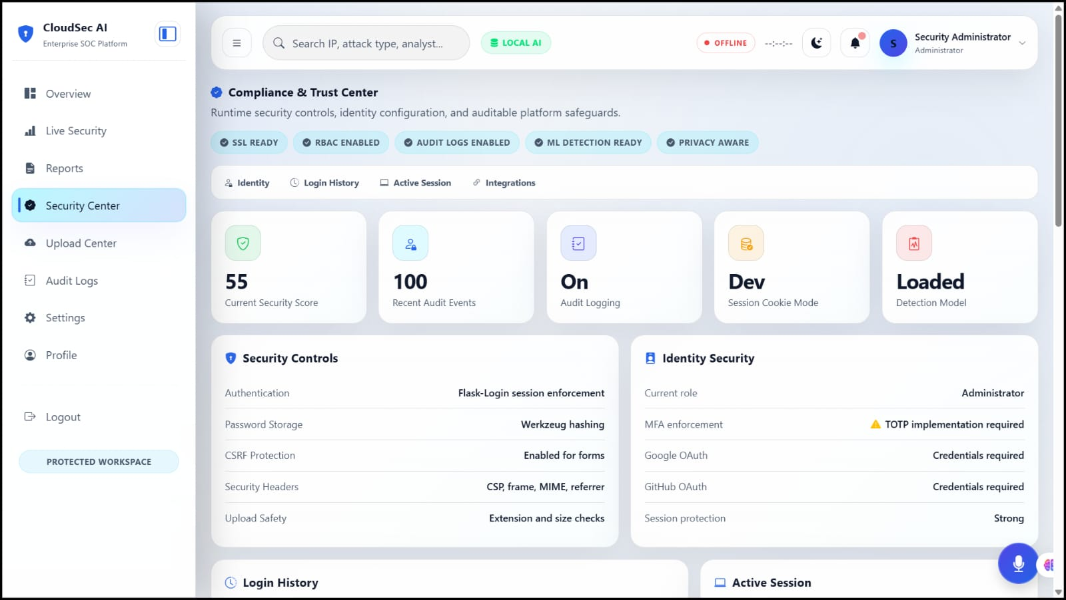
Screenshot 5: Adaptive Interview: Clarifying Unresolved Ambiguities

Slide 23
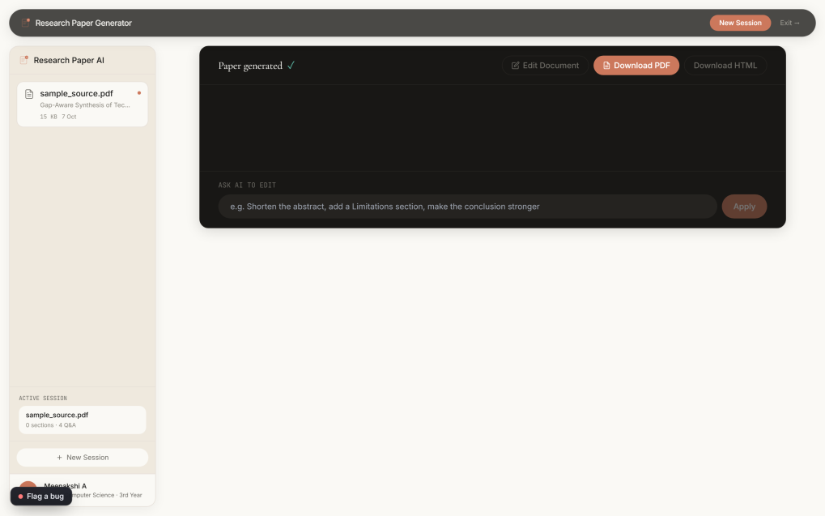
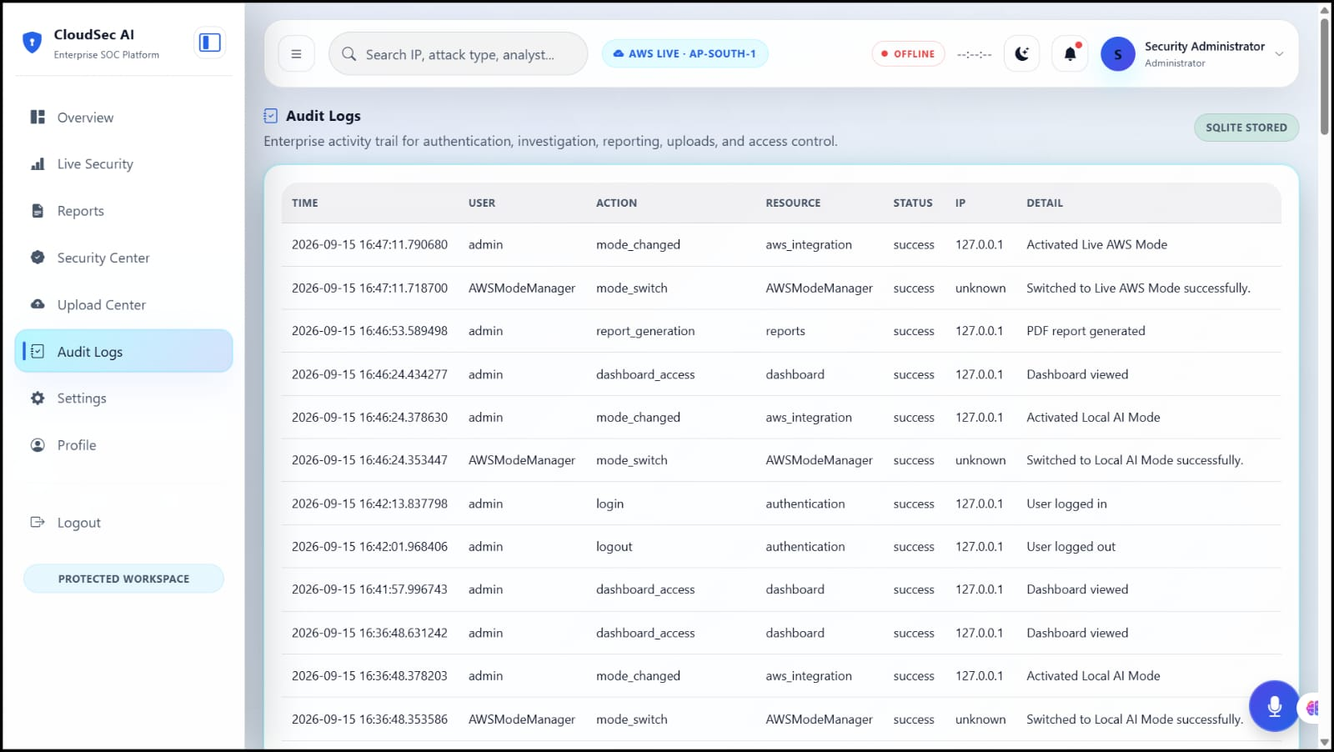
Screenshot 6: Generated Output: IEEE Two-Column Preview & Export

Slide 24
Conclusion
• Developed PaperAI, a robust dual-mode AI platform for structured academic (IEEE) and professional (ATS) document generation.
• Replaced unconstrained generative guessing with grounded document understanding and a bounded adaptive interview.
• Architected a deterministic Content Integrity Contract eliminating fabricated citations, metrics, and author affiliations.
• Delivered real-time streaming preview and native export to IEEE-compliant two-column HTML, DOCX, and PDF.
• Future Scope: Integration of multi-lingual document translation, automated bibliography verification against CrossRef/arXiv APIs, and multi-document synthesis.

Slide 25
Reference
1. T. B. Brown et al., 'Language Models are Few-Shot Learners,' in Advances in Neural Information Processing Systems (NeurIPS), 2020, pp. 1877–1901.
2. P. Lewis et al., 'Retrieval-Augmented Generation for Knowledge-Intensive NLP Tasks,' in Advances in Neural Information Processing Systems (NeurIPS), 2020.
3. S. Es, J. James, L. Espinosa-Anke, and S. Schockaert, 'RAGAS: Automated Evaluation of Retrieval Augmented Generation,' in Proc. EACL Demonstrations, 2024.
4. IEEE Communications Society, 'IEEE Conference Template and Instructions for Authors,' IEEE, 2024.
5. L. Ouyang et al., 'Training Language Models to Follow Instructions with Human Feedback,' in Advances in Neural Information Processing Systems (NeurIPS), 2022.

