Slide 1
SysGuard
Linux System Health Monitor
C++17 • Linux • System Programming • Process Monitoring
Sanish Panda | B.Tech CSE | Capstone Project
SysGuard • Linux System Health Monitor 1

Slide 2
1. Problem Statement
Why SysGuard?
Linux exposes system-health information through different commands and virtual interfaces.
Checking CPU, memory, storage and processes separately makes routine diagnosis less convenient.
SysGuard combines these checks into one lightweight terminal application.
The project connects C++ application logic with Linux operating-system concepts.
CPU
Usage & load
Memory
RAM & swap
Storage
Filesystem usage
Processes
PIDs & states
SysGuard • Linux System Health Monitor 2

Slide 3
2. Objectives
What the project was built to demonstrate
Monitor CPU utilization and system load.
Monitor RAM, swap and root filesystem usage.
Display Linux and basic computer-architecture information.
List and search Linux processes and provide controlled termination.
Calculate overall health and save monitoring snapshots.
Demonstrate modular C++ design and Linux user-space/kernel-space concepts.
SysGuard • Linux System Health Monitor 3

Slide 4
3. Development Process
Six-stage capstone workflow
Introduction
Requirements
Design
01
02
03
Problem, objective, scope
PRD, modules, plan
Architecture, UML, implementation plan
Prototype
Testing
Final
04
05
06
Core C++ modules and integration
Debugging, validation, documentation
GitHub, report, PPT, presentation
SysGuard • Linux System Health Monitor 4

Slide 5
4. Technology Stack
Development environment
Operating System
Ubuntu 26.04.1 LTS
Verified development environment
Application
C++17
Ubuntu 26.04.1 LTS
6.18.40.1-microsoft-standard-WSL2
x86_64
AMD Ryzen 7 6800H with Radeon Graphics
16 cores reported by the application
Driver source
C / Linux kernel APIs
Compiler
GNU g++
Build
GNU Make
Version control
Git + GitHub
Interface
Terminal / CLI
SysGuard • Linux System Health Monitor 5

Slide 6
5. System Architecture
Application → Linux interfaces → kernel
SysGuard C++ CLI — User space
Linux interfaces — /proc • uname() • statvfs() • signals
Linux Kernel — Process / memory / filesystem / device layer
CPU • RAM • Storage • Processes
SysGuard • Linux System Health Monitor 6

Slide 7
6. Main Modules & Linux Interfaces
How the application is organized
SystemInfo
CPUMonitor
uname(), /proc/uptime, /etc/os-release
/proc/stat, /proc/cpuinfo, /proc/loadavg
MemoryMonitor
DiskMonitor
/proc/meminfo
statvfs()
ProcessMonitor
HealthMonitor
/proc + Linux signals
Threshold-based status
Logger
sysguard.log
SysGuard • Linux System Health Monitor 7

Slide 8
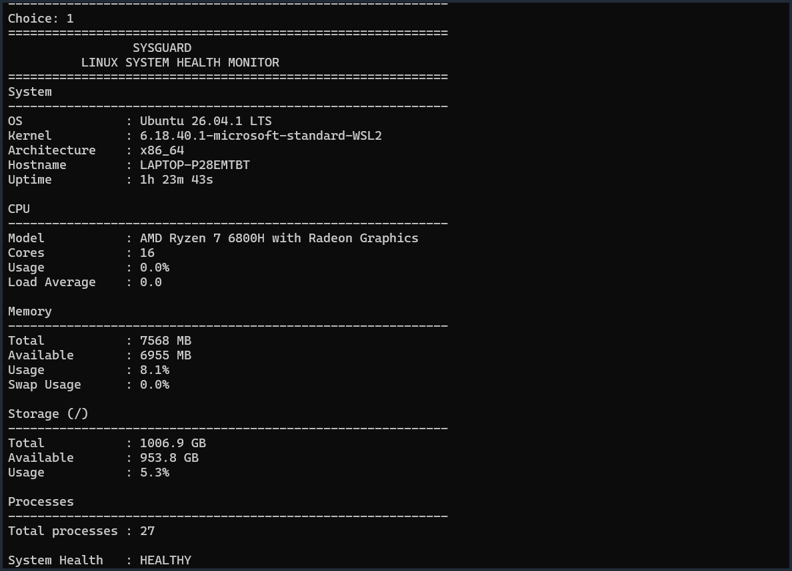
7. Live Dashboard
Actual SysGuard output captured during testing
CPU
0.0% usage • Load 0.0
Memory
8.1% used
Storage
5.3% used
Overall health
HEALTHY
SysGuard • Linux System Health Monitor 8

Slide 9
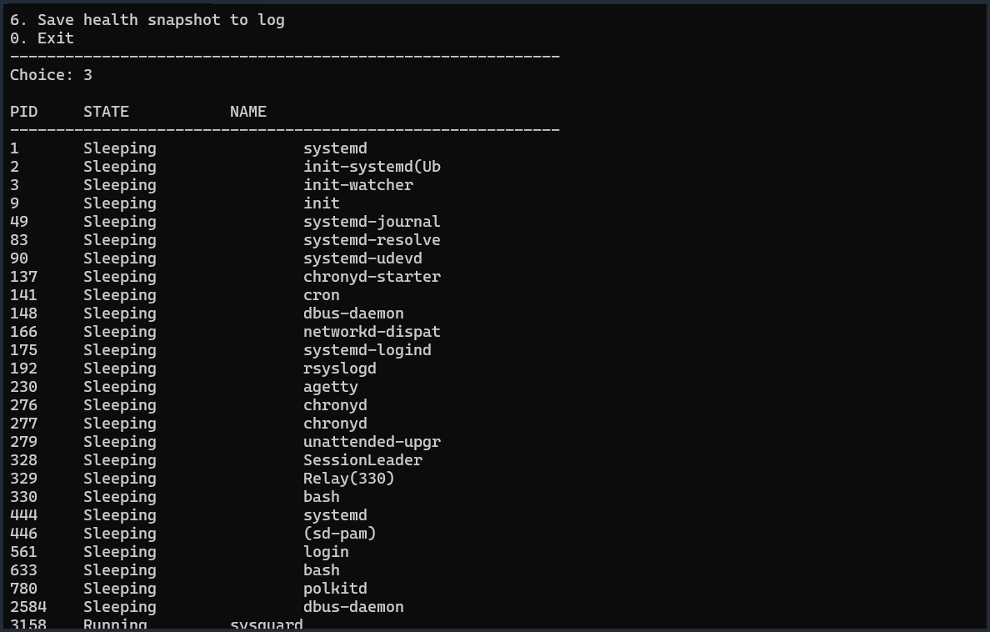
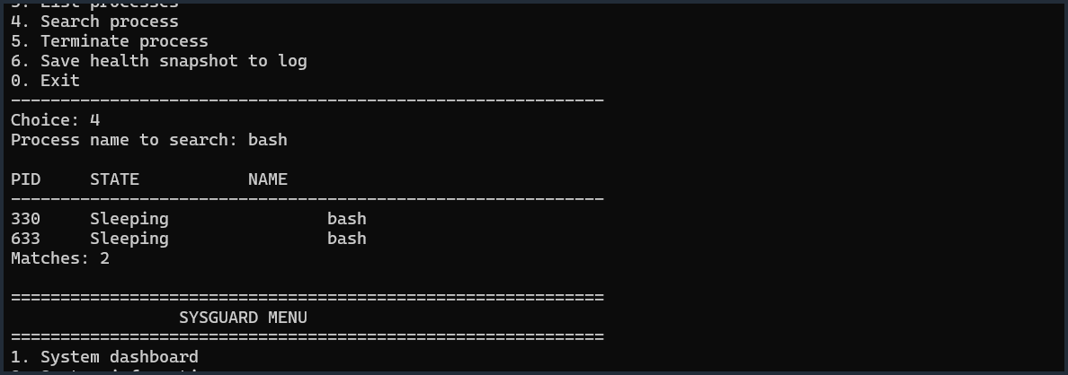
8. Process Monitoring
Enumeration and search of Linux processes
Verified search
Query: bash • 2 matches • PIDs 330 and 633
SysGuard • Linux System Health Monitor 9

Slide 10
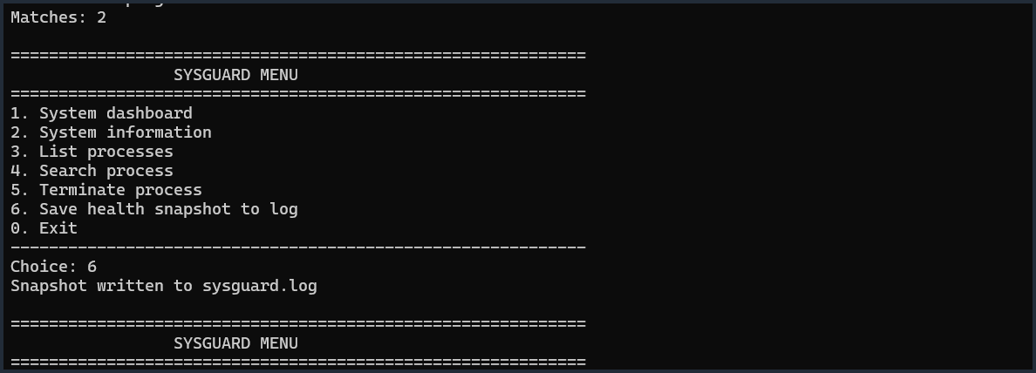
9. Testing & Results
What was actually verified
Build with make
PASS
Application launch
PASS
Dashboard
PASS
System information
PASS
Process listing
PASS
Log result
Process search
PASS
Snapshot written to
sysguard.log
Health snapshot logging
PASS
Driver runtime test in WSL2
NOT VALIDATED
SysGuard • Linux System Health Monitor 10

Slide 11
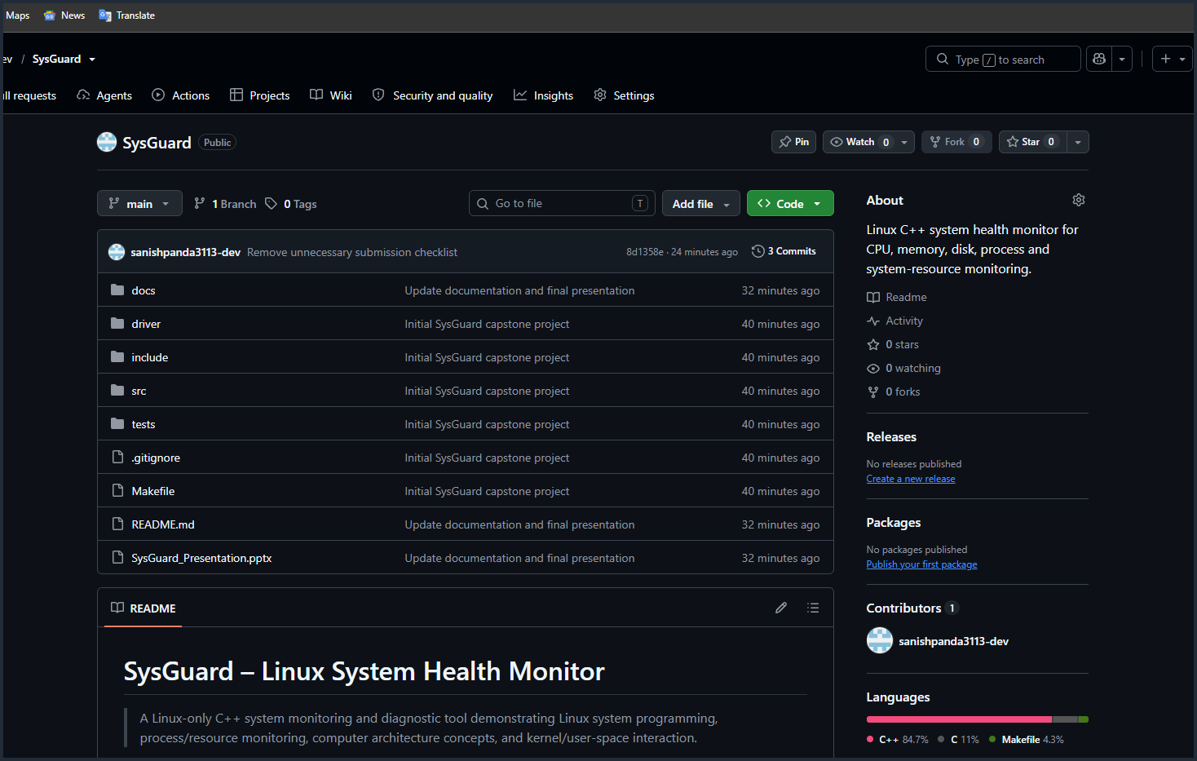
10. Device Driver, Limitations & Future Scope
Transparent project status
Character driver
WSL limitation
Future improvements
Source: driver/sysguard_driver.c
Designed device:
/dev/sysguard
Uses the Linux misc-device framework.
The running WSL2 kernel did not provide the matching kernel development tree.
Therefore driver loading was not validated in this environment.
• ncurses real-time UI
• Per-process CPU/RAM metrics
• Configurable thresholds
• Temperature/network monitoring
• Extended ioctl support
GitHub Repository
github.com/sanishpanda3113-dev/SysGuard
Source • Documentation • Driver • Tests • PPT
Project: Working & Demonstrable
SysGuard • Linux System Health Monitor 11

