Slide 1
School of Computer Science & Engineering
AI Application Development – IA1
AI-Powered Codebase Understanding and Exploration Tool

Slide 2
Team members & roles
Team member name | Role
Mudiyala Sai Sanith Reddy | Team Lead
Ojas Manjunath Kandur | Developer
Parimal R | Development Lead
M Karthikeyan | Customer Contact Lead
Pranav Aradhya M | Test Lead
Notes:
Talk about how they are managing their documents, how google docs does automatic versioning
As them what they know about Android and IoS versions

Slide 3
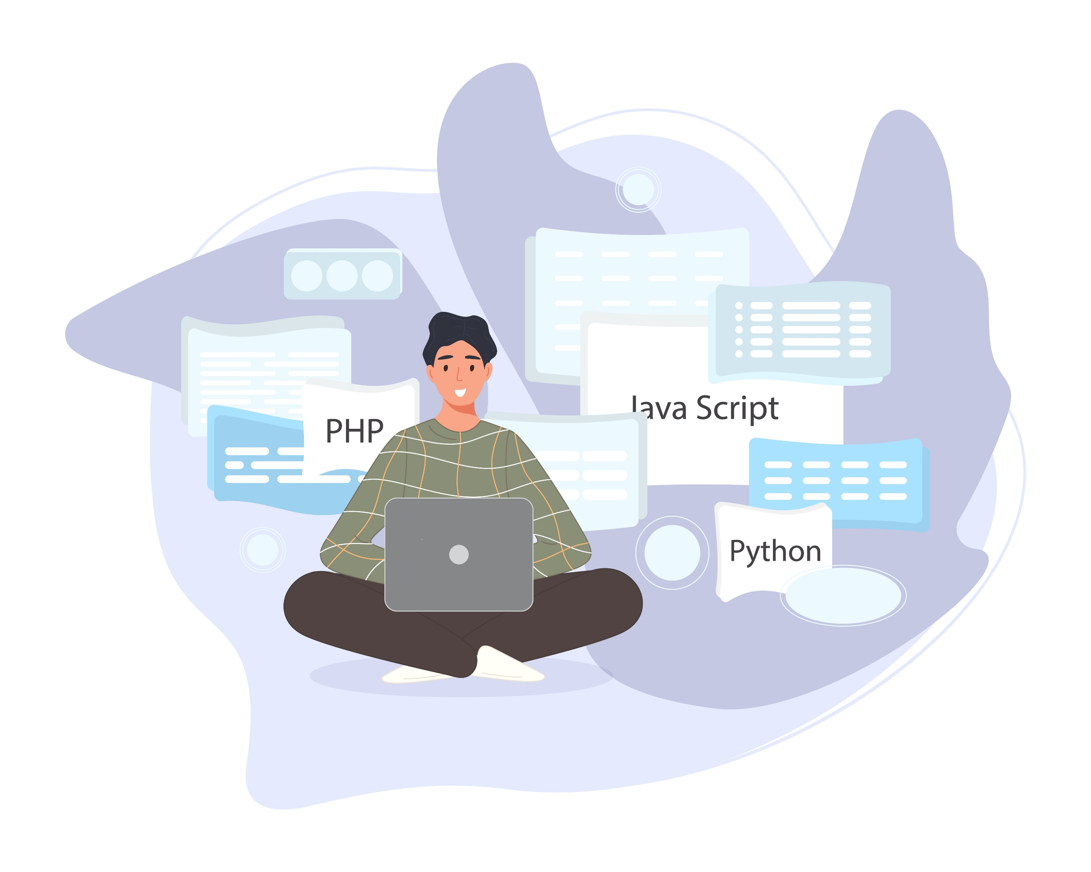
Problem Statement:
Developers struggle to understand large and complex codebases efficiently. There is a need for an AI-powered system to analyze and explain code automatically.
Notes:
Talk about how they are managing their documents, how google docs does automatic versioning
As them what they know about Android and IoS versions

Slide 4
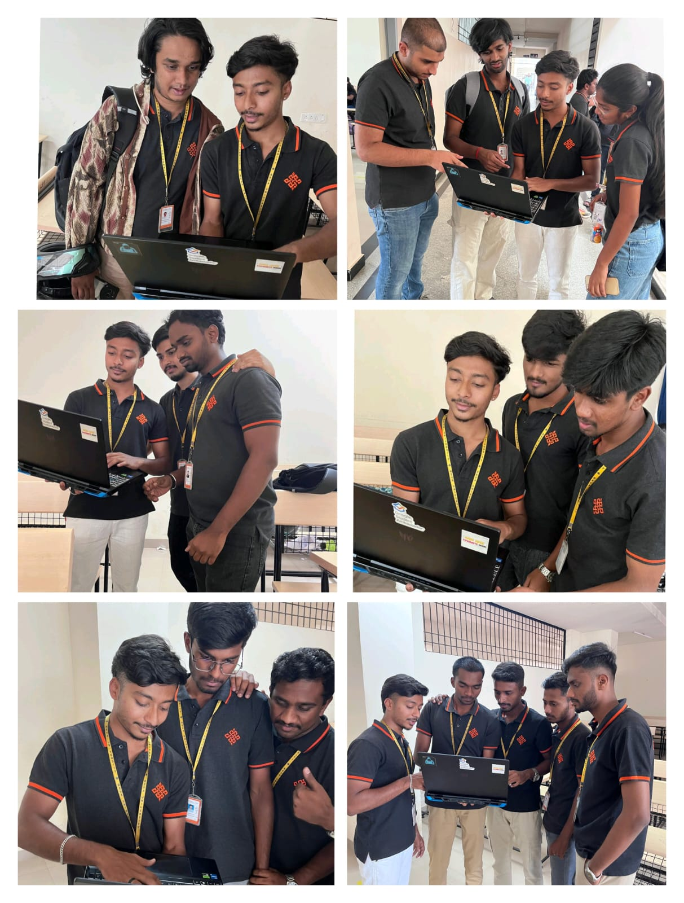
User/ Customer Understanding:
Conducted interviews with students and developers
Majority reported difficulty in understanding large codebases
Current methods include manual reading and trial-and-error
Significant time spent in code analysis before development
Strong interest in AI-based automated solutions
Notes:
Talk about how they are managing their documents, how google docs does automatic versioning
As them what they know about Android and IoS versions

Slide 5
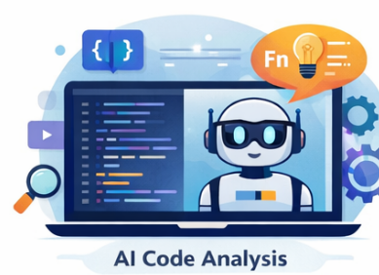
Ideal Customer Profile (ICP)
Target Users:
Software Developers
Computer Science Students
Open-source Contributors
Characteristics:
Work with complex or unfamiliar codebases
Value efficiency and productivity
Open to adopting AI tools
Notes:
Only stress on the 1st sentence – the definition
Come back to the 2nd sentence in the end as part of revision

Slide 6
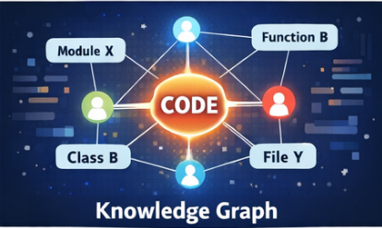
Ideal Customer Profile (ICP)
Needs:
Faster understanding of code
Reduced manual effort
Improved development speed
Notes:
Only stress on the 1st sentence – the definition
Come back to the 2nd sentence in the end as part of revision

Slide 7
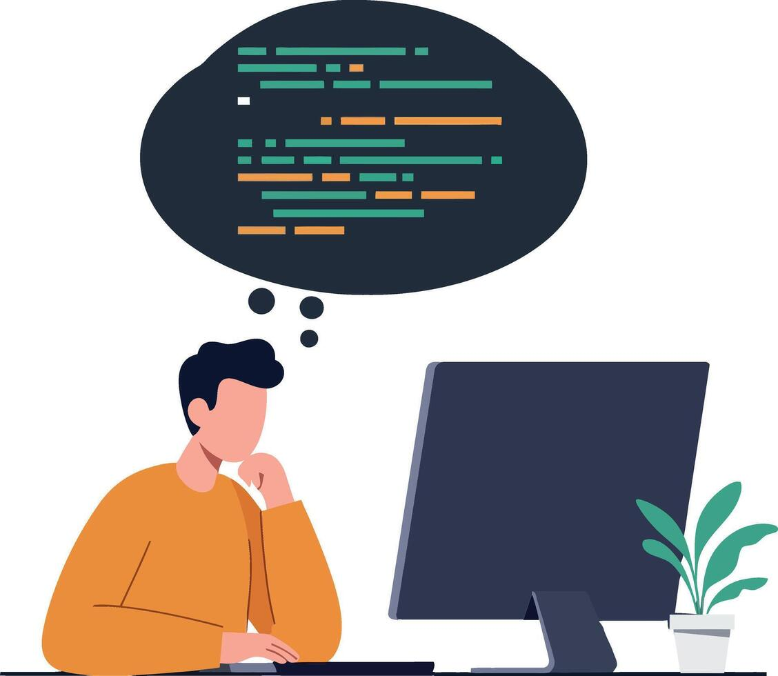
Customer Persona (CP):
Name: Manoj Kumar Age: 20 Profession: Computer Science Student
Background:
Works on academic and personal coding projects
Uses GitHub to explore repositories
Pain Points:
Struggles to understand large codebases
Difficulty tracking dependencies
Time-consuming debugging
Needs:
Clear code explanations
Easy navigation
Faster learning
Notes:
Only stress on the 1st sentence – the definition
Come back to the 2nd sentence in the end as part of revision

Slide 8

Product USP:
AI-powered automatic code analysis and explanation
Generates knowledge graph of code relationships
Supports natural language queries for easy interaction
Significantly reduces time required to understand codebases
Notes:
Only stress on the 1st sentence – the definition
Come back to the 2nd sentence in the end as part of revision

Slide 9
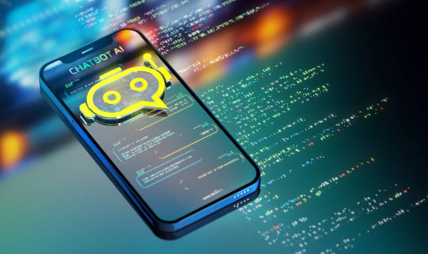
Use Cases & High level Requirements:
Use Cases:
Upload a code repository → System analyzes structure
Ask questions about code → AI provides explanations
Search for functions → View dependencies and usage
Explore relationships → Visual knowledge graph
Functional Requirements:
Code ingestion and parsing
AI-based summarization
Query processing system
Relationship extraction
Notes:
Only stress on the 1st sentence – the definition
Come back to the 2nd sentence in the end as part of revision

Slide 10
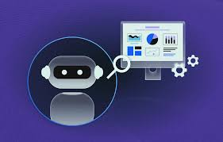
Use Cases & High level Requirements:
Non-Functional Requirements:
Fast response time (< 2 seconds)
Secure data handling
Scalable for large repositories
Reliable system performance
Notes:
Only stress on the 1st sentence – the definition
Come back to the 2nd sentence in the end as part of revision

Slide 11
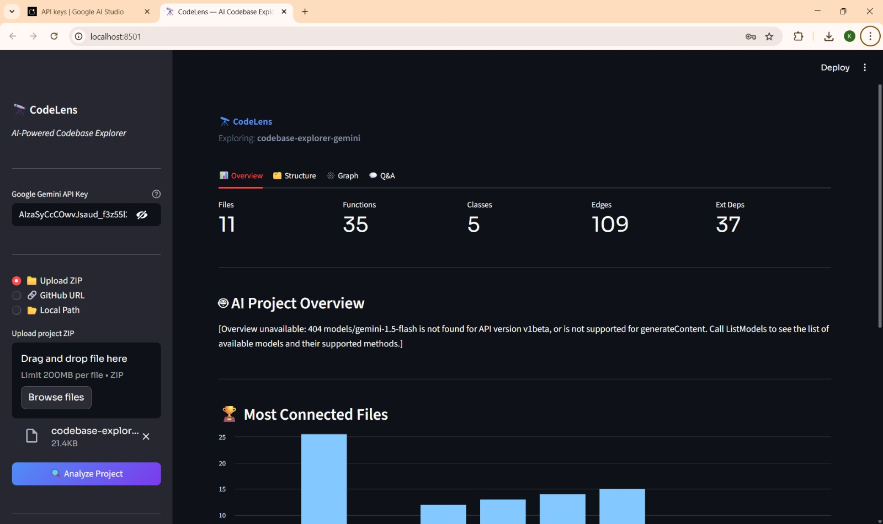
Proof of Concept (PoC) / Prototype Demo:
Notes:
Only stress on the 1st sentence – the definition
Come back to the 2nd sentence in the end as part of revision

Slide 12
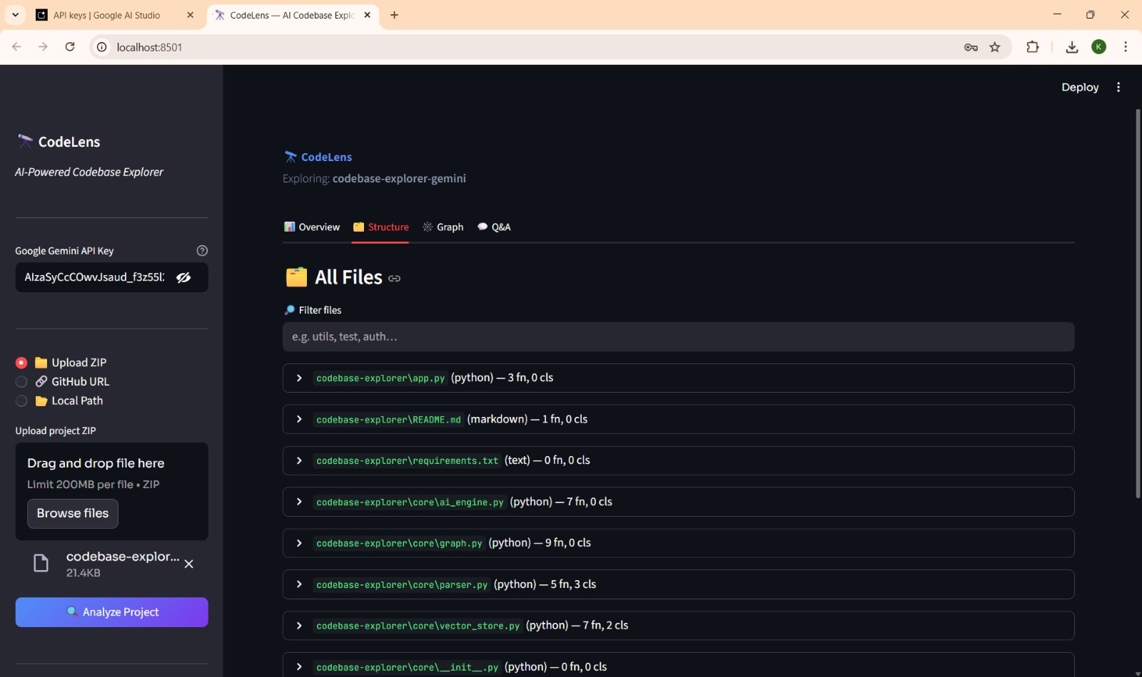
Proof of Concept (PoC) / Prototype Demo:
Notes:
Only stress on the 1st sentence – the definition
Come back to the 2nd sentence in the end as part of revision

Slide 13
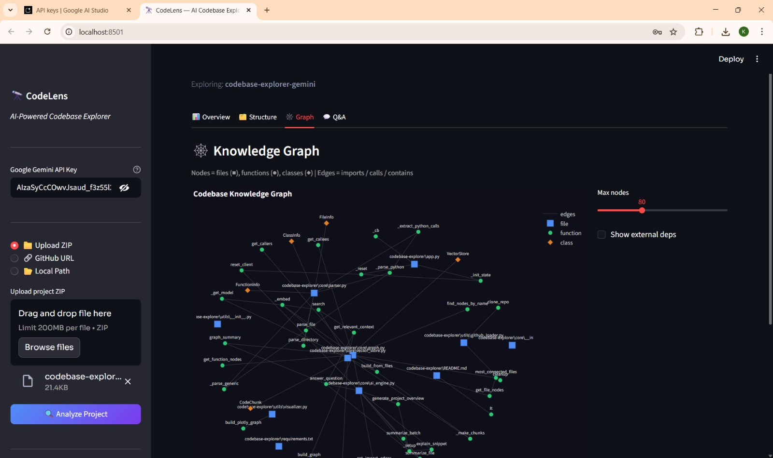
Proof of Concept (PoC) / Prototype Demo:
Notes:
Only stress on the 1st sentence – the definition
Come back to the 2nd sentence in the end as part of revision

Slide 14
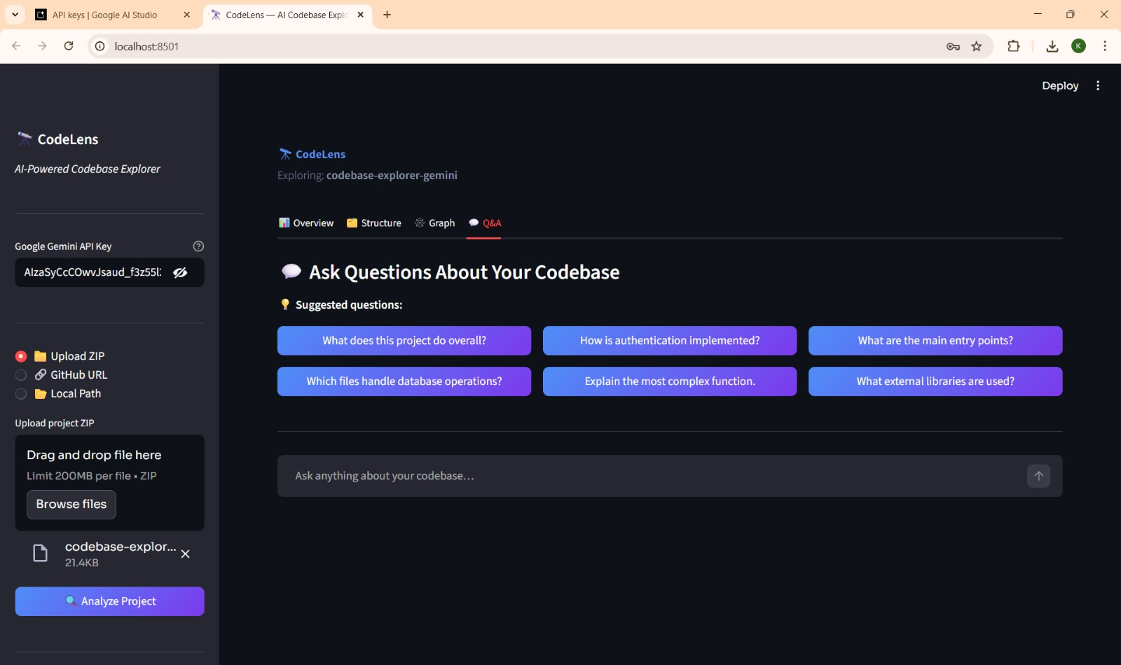
Proof of Concept (PoC) / Prototype Demo:
Notes:
Only stress on the 1st sentence – the definition
Come back to the 2nd sentence in the end as part of revision

Slide 15

Future Scope:
Integration with GitHub and IDEs
Support for multiple programming languages
Real-time collaboration features
Enhanced visualization of knowledge graphs
Improved AI accuracy with training

