Slide 1
Redistricting and Political Party Performance in Thailand:
2001 and 2005 comparison
By Sanittawan Nikki Tan
The Science of Elections and Campaigns | Final Project

Slide 2


Research Question
What is the effect of the redistricting of the house of representative constituencies on the performance of the TRT party and the (Thai) Democrat Party in the 2005 general election?
Context
3 elections under the 1997 constitution: 2001, 2005, 2006
Thai House of representative (lower house): Mixed-member system (MMS)
400 members from single-seat constituencies (ssc)
100 members from proportional representation (pr)
Redistricting occurred in 8 provinces before the 2005 election
Curious about the overall effect and how each party’s performance varies across provinces
Notes:
6 Jan 2001
6 Feb 2005
2 Apr 2006 (nullified by the constitutional court)
Application - if work in campaigns, want to know the lesson learn -> how to do campaign in the future when redistricting occurs (normally always occur before an election due to census change or coup d’etat)
Want to try experimental design (will be my first practice)

Slide 3

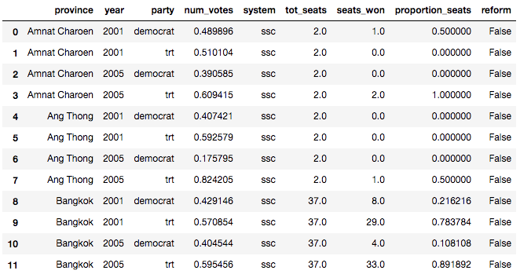
Data sources
2001 and 2005 election results at the provincial level (2-year party level panel)
Collected from the Office of the Election Commission
Include single-seat constituency and proportional representation results

Slide 4
Research Design - Observational Studies
Leverage the redistricting in 8 provinces as the shock
Use OLS to determine if there is an effect at all
Measure political party performance by two-party vote shares and the proportion of seats won in the single-seat constituency system by each party : only focus on TRT party and Democrat Party
Notes:
Hypothesis is no average effect? Or no effect?
Redistricted provinces: Chaiyaphum (-1), Nakhon Ratchasima (-1), Nonthaburi (+1), Pathum Thani (+1), Rayong (+1), Roi Et (-1), Samut Prakan (+1), Sing Buri (-1), Songkhla (+1), Trat (-1)
South -> 2 provinces
North -> 0
Northeast -> 3 Central -> 4
East -> 1

Slide 5
Hypothesis and Functional Forms
H₀: β₁ = 0
H_{a}: β₁ ≠ 0
Vote shares
Model 1
Proportion of seats won
Model 2
Model 3
Notes:
Model 4: Model 3 plus year fixed effects and province fixed effects

Slide 6
Preliminary results: vote shares vs reform
Model 1
areg voteshares reform i.year if system == "ssc", absorb(province_id)
Linear regression, absorbing indicators Number of obs = 304
Absorbed variable: province_id No. of categories = 76
F( 0, 226) = .
Prob > F = .
R-squared = 0.0000
Adj R-squared = -0.3407
Root MSE = 0.3185
------------------------------------------------------------------------------
voteshares | Coef. Std. Err. t P>|t| [95% Conf. Interval]
-------------+----------------------------------------------------------------
reform | 7.35e-13 .1190592 0.00 1.000 -.2346082 .2346082
|
year |
2005 | -7.35e-13 .0386279 -0.00 1.000 -.0761169 .0761169
|
_cons | .5 .0258365 19.35 0.000 .4490887 .5509113
------------------------------------------------------------------------------
F test of absorbed indicators: F(75, 226) = 0.000 Prob > F = 1.000

Slide 7
Preliminary results: seat proportions vs reform
Model 2
areg proportion_seats reform i.year, absorb(province_id)
Linear regression, absorbing indicators Number of obs = 304
Absorbed variable: province_id No. of categories = 76
F( 2, 226) = 1.79
Prob > F = 0.1693
R-squared = 0.0716
Adj R-squared = -0.2447
Root MSE = 0.4733
------------------------------------------------------------------------------
proportion~s | Coef. Std. Err. t P>|t| [95% Conf. Interval]
-------------+----------------------------------------------------------------
reform | -.0181607 .1769076 -0.10 0.918 -.36676 .3304387
|
year |
2005 | .1044913 .0573964 1.82 0.070 -.0086092 .2175919
|
_cons | .3719825 .0383899 9.69 0.000 .2963345 .4476305
------------------------------------------------------------------------------
F test of absorbed indicators: F(75, 226) = 0.185 Prob > F = 1.000

Slide 8
Preliminary results: interaction term
Model 3
reg proportion_seats democrat##reform if (year == 2005)
Source | SS df MS Number of obs = 152
-------------+---------------------------------- F(3, 148) = 15.48
Model | 7.78536303 3 2.59512101 Prob > F = 0.0000
Residual | 24.8138161 148 .16766092 R-squared = 0.2388
-------------+---------------------------------- Adj R-squared = 0.2234
Total | 32.5991791 151 .215888603 Root MSE = .40946
---------------------------------------------------------------------------------
proportion_se~s | Coef. Std. Err. t P>|t| [95% Conf. Interval]
----------------+----------------------------------------------------------------
1.democrat | -.4166584 .0702225 -5.93 0.000 -.5554268 -.2778901
1.reform | .1272703 .1530465 0.83 0.407 -.1751682 .4297089
|
democrat#reform |
1 1 | -.2692791 .2164404 -1.24 0.215 -.6969917 .1584336
|
_cons | .6836672 .0496548 13.77 0.000 .5855431 .7817912
---------------------------------------------------------------------------------

Slide 9
Results and Discussion
Fail to reject (sharp) null hypothesis: redistricting does not have effects on TRT and Democrat parties based on 2001 and 2005 comparison
Model 4?
Concerns
Design: redistricting is not randomly assigned
Confounders: politicians switching parties
Data: party-level data is not enough; need individual-level panel data; measure redistricting effects on individuals

Slide 11
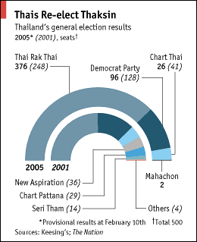
South -> 2 provinces out of 14 (0.14%)
North -> 0 provinces out of 17 (0)
Northeast -> 2 provinces out of 19 (0.11%)
Central -> 4 provinces out of 26 (0.15%)
Notes:
'Trat', 'Nakhon Ratchasima', 'Nonthaburi', 'Pathum Thani',\
'Roi Et', 'Rayong', 'Samut Prakan', 'Sing Buri'

Slide 12
Research Design (continued)
Compare performance of TRT and Democrat Party in the 2001 election and the 2005 election in the single-seat constituency (SSC), at the provincial level
Compare performance of TRT and Democrat Party in the 2001 and 2005 elections in the proportional representation (PR) system
Test if redistricting has any effects on the two parties
Look at the provincial level
Look at the regional level

Slide 13
Preliminary results
Democrat Party’s 2005 performance comparison in the SSC system
Vote shares
Mean of two party vote shares in the redistricted provinces = 0.2497525
Mean of two party vote shares in the non-redistricted provinces = 0.3195542
Difference = 0.2497525 - 0.3195542 = -.0698017
Proportion of seats won
Mean of proportion of seats won in the redistricted provinces = 0.125
Mean of proportion of seats won in the non-redistricted provinces = 0.2670087
Difference = 0.125 - .2670087 = -.1420087

