Slide 1
Final Presentation for Project Sponsors
EMC Education Services
Data Science & Big Data Analytics
Otto Group Product Classification
Zhakiyanova Meruyert
Kinzhitayeva Saniya
Shamgunova Gulnur
19.01.2017
Notes:
EMC Ed Services CA and DCA Launch Master V8

Slide 2
Project Goals
To build a predictive model to distinguish main product categories
Model’s predictive power should be at least as good as currently used techniques by the company
Model should be invariant to adding new product categories

Slide 3
Situation & Project Goals
Situation
In the Otto Group many identical products get classified differently
Recent analysis shows the loss of profit is caused by incorrect classification of similar products
Without model implementation the Otto Group risks having huge losses
Goals of the Otto Group Project
To build a predictive model to distinguish main product categories
Model’s predictive power should be at least as good as currently used techniques by the company
Model should be invariant to adding new product categories

Slide 4
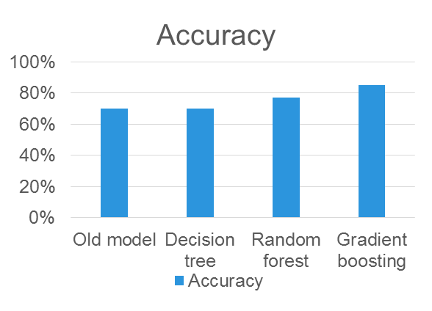
Executive Summary
Running the suggested model can help to rise e-commerce revenues
at least by 8.8% annually and to reach 6.5 billion euros
The suggested model has higher predictive power than previous used in the company
  Built 3 different models(gradient boosting, random forest, decision tree) and compared error rate among models with previous used in the company
Identified most influential features
Computational complexity of the model allows to run it daily

Slide 5
Approach
Given e-commerce product dataset with 93 features for more than 200,000 products. There are 9 categories for all products. Each target category represents one of most important product categories (like fashion, electronics, etc.)
Collaborated with IT to prepare datasets, implement classification
Developed models to obtain a predictive model with high accuracy for identifying future products categories
Fitting model with appropriate parameters
Worked with IT to simulate model performance within the Otto Group production environment

Slide 6
Model Description
Overview of Basic Methodology: define the model with high accuracy for identifying future product categories. Identify most influential features
Models: Gradient boosting, decision tree, random forest
Dependent variable: Categorical variable, 9 categories
Scope:
  More than 200,000 the Otto Group products with 93 features, each feature is categorical variable
Sampling
  Training sample: 61,878 observations
  Testing sample: 144,368 observations
Gradient boosting model has predictive power better than decision tree and random forest models
  We created models(gradient boosting, decision tree, random forest) and chose the best model, which can maximize the precision

Slide 7
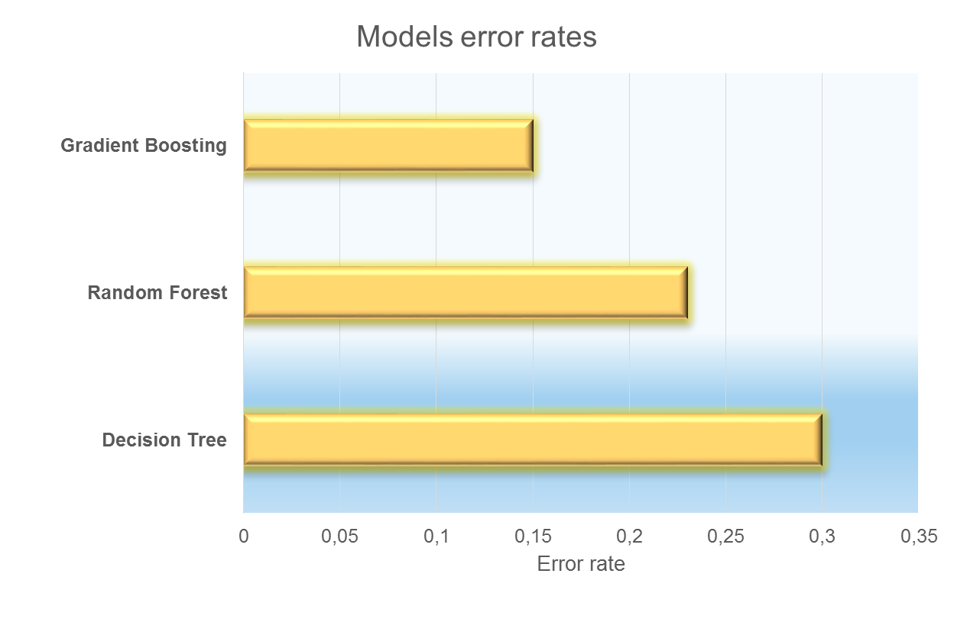
Key Points

Slide 8
Recommendations
Implement the model as a pilot, before more wide-scale rollout
  The Otto Group makes appropriate steps based on market trends: if predictions of online sales of some product category(for example, furniture, electronic devices, etc.) grow, the company is going to make investments in this field.
  Right product classification can decrease company losses and save high level of online sales
Run the predictive model according to appearance of new products
  Computational complexity of the model allows to run it daily

