Slide 1
Name-Abhinav Saini Class-x b Roll number-1003

Slide 2
agenda
Introduction
Types of real numbers
Real numbers on the number line
Properties of real numbers
Real life applications
Summary chart

Slide 3

What are real numbers?
Real numbers are all the numbers that can be found on the number line. They include both rational and irrational numbers, and they are used to represent quantities that can be measured or counted.

Slide 4
Types of real numbers
Natural Numbers: Counting numbers starting from 1. → 1, 2, 3, 4, …
Whole Numbers: Natural numbers plus 0. → 0, 1, 2, 3, …
Integers: Whole numbers and their negatives. → …, -3, -2, -1, 0, 1, 2, 3, …
Rational Numbers: Numbers that can be expressed as a fraction of two integers
→ Examples: 1/2, -3/4, 0.75, 5
Irrational Numbers: Numbers that cannot be expressed as a fraction. → Examples: √2, π, e

Slide 5
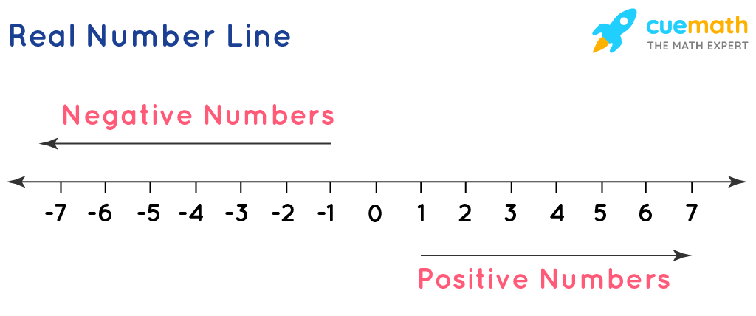
Real numbers on the number line

Slide 6
Properties of real numbers
1.Closure Property: The sum or product of any two real numbers is always a real number.
2.Commutative Property-We can change the order of numbers while adding or multiplying.
3.Associative Property-You can group numbers differently when adding or multiplying.
4.Distributive Property-Multiplication distributes over multiplication or subtraction.

Slide 7
Real life applications of real numbers
Banking & Finance – interest rates, account balances.
Measurements – lengths, weights, temperature.
Engineering – dimensions, tolerances, calculations.
Science & Research – formulas, data analysis.
Daily Life – shopping (prices), cooking (quantities).

Slide 8
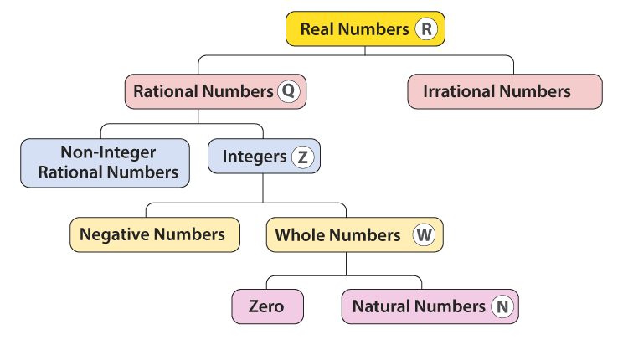
Summary chart

Slide 9
THANK YOU
Submitted to-
Ashima ma’am

