Slide 1

Supply Chain Shipment Prediction for Medical Records
2023
Data Science Engineering Methods & Tools INFO 6105
Saniya Athani - 002682245

Slide 2
Agenda:
Analysis of Supply Chain Shipment Pricing Data:
Business Problem
Introduction
Project Objectives
Pre-processing
Data Analysis, Training and Prediction
Impact
Future Directions
Recommendations/Conclusion

Slide 3
Business Problem
Over $10B in medical supplies shipped annually to 90+ countries
01
Delivery delays have severe public health consequences.
02
Unpredictable bottlenecks due to many complex variables.
03
Current prediction relies on expert manual evaluation, not scalable
04

Slide 4
Project Objective:
The primary objective of this project is to develop a machine learning model to predict whether a new global health commodity shipment would deliver on its scheduled date or not.
This information would be valuable to supply chain analysts who could use it to plan for potential delays and take proactive steps to mitigate them.

Slide 5
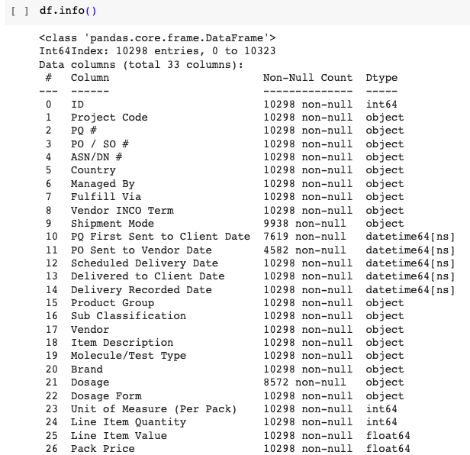
Data Source and Description:
The Supply Chain Shipment Pricing Dataset contains over 100,000 shipment records from various sources, including USAID's Project Procurement Request (PQR) system.
The dataset provides comprehensive information on shipment characteristics, including origin and destination countries, commodity types, transportation modes, and associated costs.
The dataset captures delay between expected and actual delivery

Slide 6
Project Approach:
Identified correlations between delayed shipments and factors like routes, volumes
Developed Random Forest model to predict on-time delivery with 99% accuracy
Developed a Logistic Regression model to predict the on-time delivery with 88% accuracy
Compared the models for our use case.

Slide 7
Metrics used:
Accuracy
Precision
Recall
F1 Score.

Slide 8

Scope of Analysis
Analyzing the dataset by its features
Selecting best fitting and highly relevant features
Training & Prediction
Data Insights
Feature Engineering
Training- testing split
Conclusion & Findings
Training with different Algorithms and Comparison
Data Training using different Algorithms
Data Processing

Slide 9
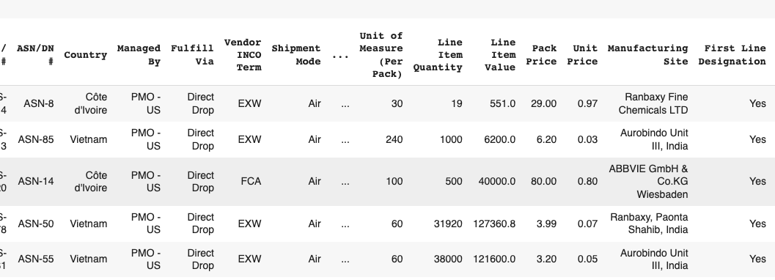
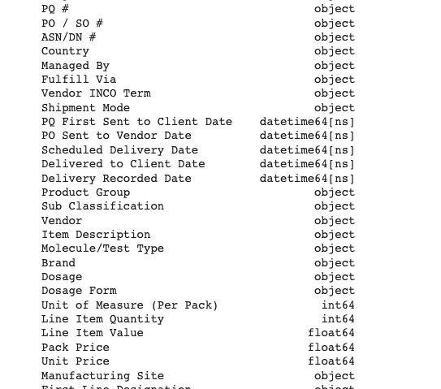
Data Exploration
Initial data exploration revealed intriguing patterns and correlations:
Larger order sizes were more susceptible to delays.
Certain product types, such as pharmaceuticals, exhibited higher delay rates.
Shipments routed through specific regions, such as Africa, were more prone to delays.

Slide 10
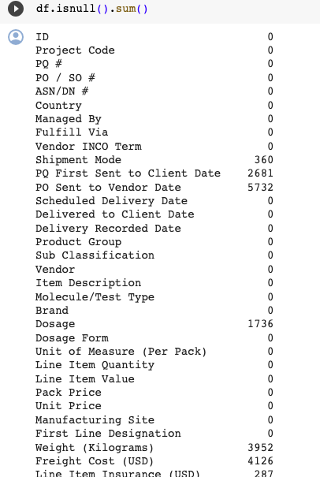
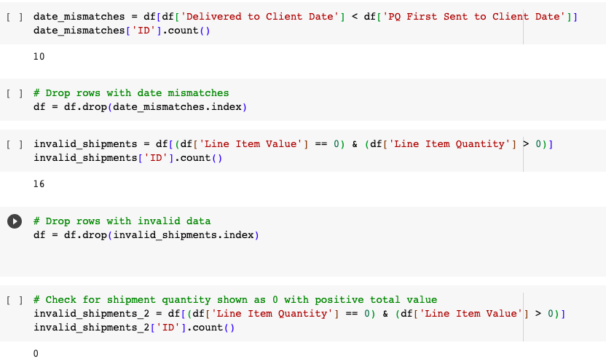
Data Preprocessing
Employed many techniques for data processing.
Missing values were imputed with mean values.
Mismatched data was dropped: Checked any date mismatches between the Shipment dates vs Delivery dates.
Invalid Data: The Item value is more than 0 and quanitity is more than 0. This could be invalid data as this could be error or pecial circumstances.

Slide 11
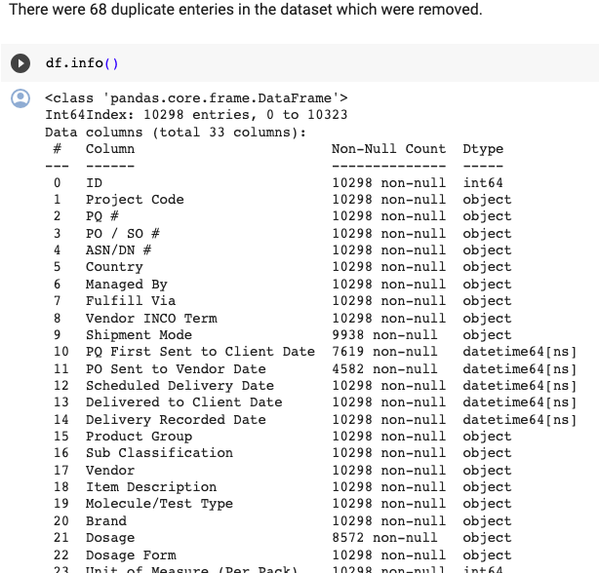
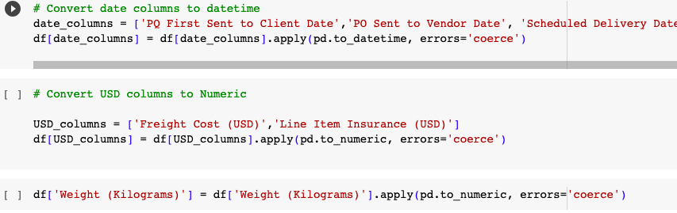
Data Preprocessing
Duplicates are removed
Categorical variables were converted to numerical representations using one-hot encoding or label encoding techniques.

Slide 12
Feature Engineering:
Feature engineering involves transforming raw data into features that are more meaningful for machine learning. We implemented various strategies here:
Temporary features were created from date and time information to capture temporary patterns and relationships
Features like shipping_delay, delivery_duration, order_to_delivery, and on_time_delivery were created from existing ones to capture additional information and enhance predictive power.

Slide 13
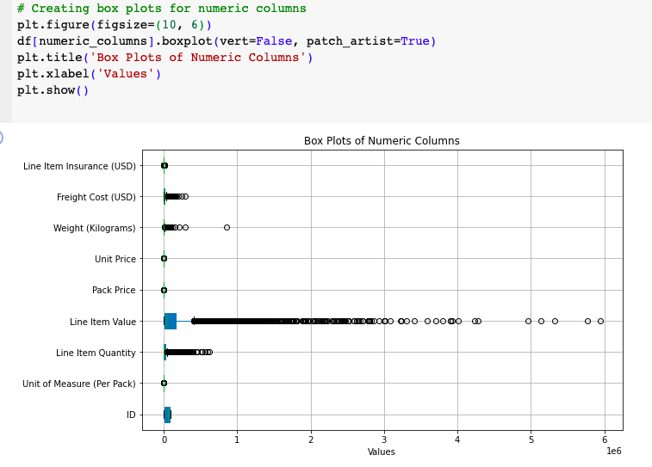
Data Preprocessing
Outliers were identified and analysed: There are potential outliers in various columns, especially in quantities, values, pack prices, unit prices, weights, freight costs, and insurance costs.

Slide 14
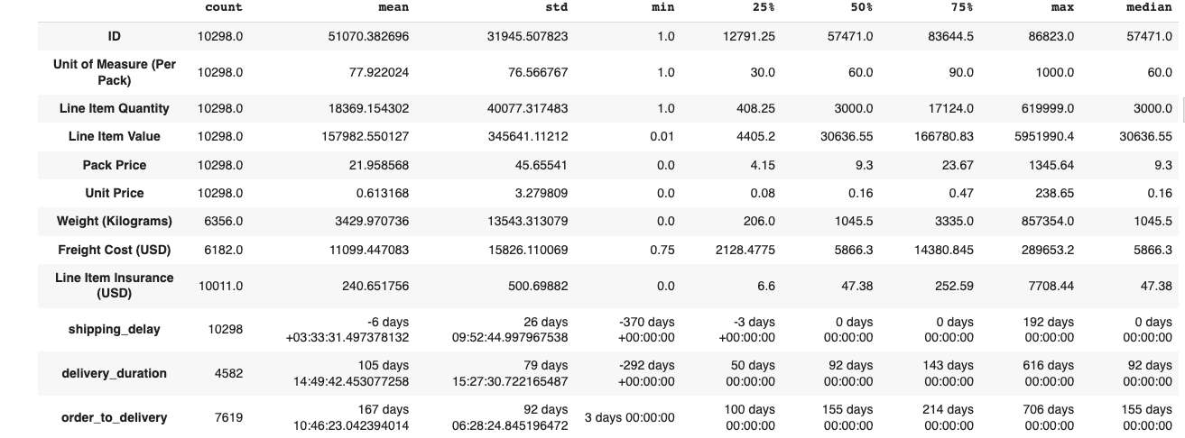
Data Analysis & Insight
Order Quantity Analysis:
The median order quantity is 3000 units. This shows most orders are for smaller quantities rather than bulk orders. However, we see some very large order quantities with max at 61,9999.0 units. Need to analyze what products had such bulk orders.
Pricing Analysis:
There is a large variation in product unit pricing looking at the standard deviation. Unit prices range from as low as 0.0𝑡𝑜 238. The median pack price is $9.3. So most products are lower priced, but we have some premium priced items driving average pack price higher.
Shipment Cost Analysis: The median freight cost is 5866 Max freight cost is 289653.2- this seems very high. Need to check which order/products had such high shipping bill. Similar for insurance cost - median is 47.345 but max is $7708.44, so we might have outliers.
Shipment Value:
The median value per line item is around $30600. The maximum value for a line item is significantly higher than the median, suggesting potential outliers.
Pack Price:
The average pack price is approximately $9. The maximum pack price is much higher than the average, indicating potential outliers. Unit Price:
The average unit price is around $0.16. The maximum unit price is considerably higher than the average, suggesting potential outliers.
Weight (Kilograms):
The average weight per shipment is approximately 238 kilograms. The maximum weight for a shipment is considerably higher than the average, indicating potential outliers. Freight Cost (USD):

Slide 15
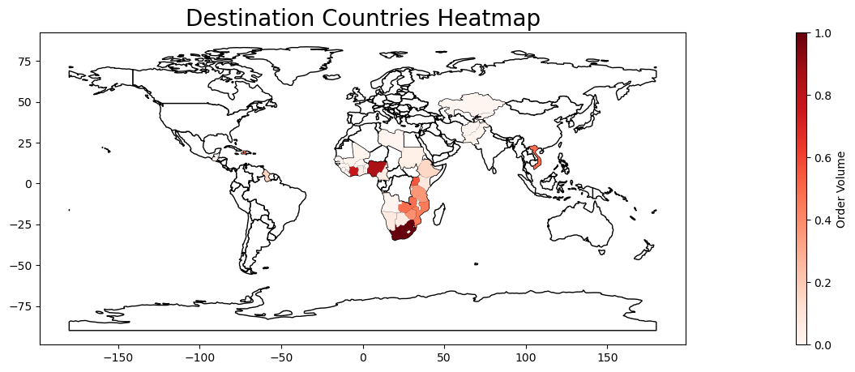
Country wise order data
The data is of 43 countries. There are mostly developing nations and majority are from African Continent.

Slide 16
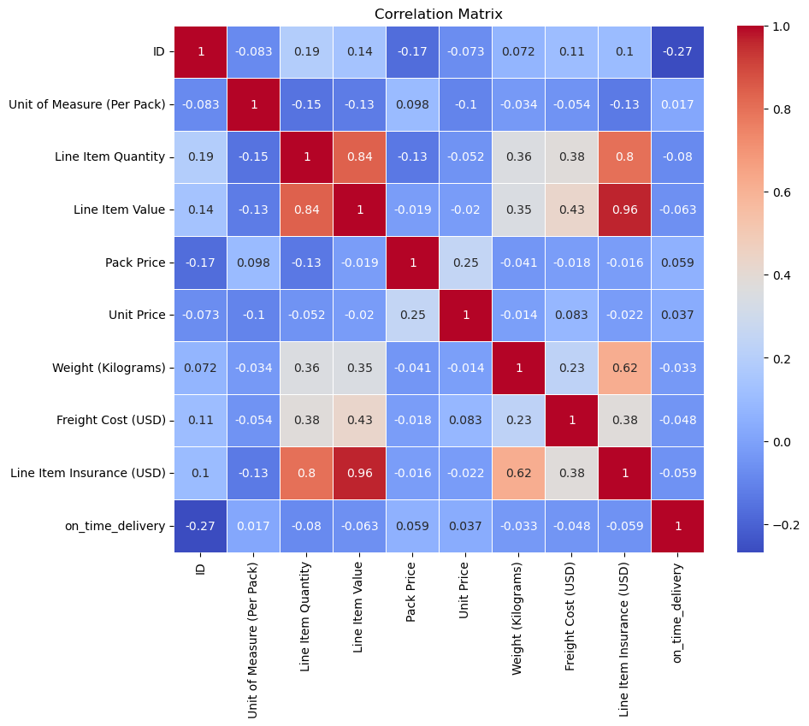
Correlation matrix heatmap
Correlation matrix which shows Correlation coefficient for the numerical variables
Line item Value and Line Item Insurance has high positive correlation with Insurance of 0.96
Line item quantity has a weak negative correlation with Pack price -0.13

Slide 17
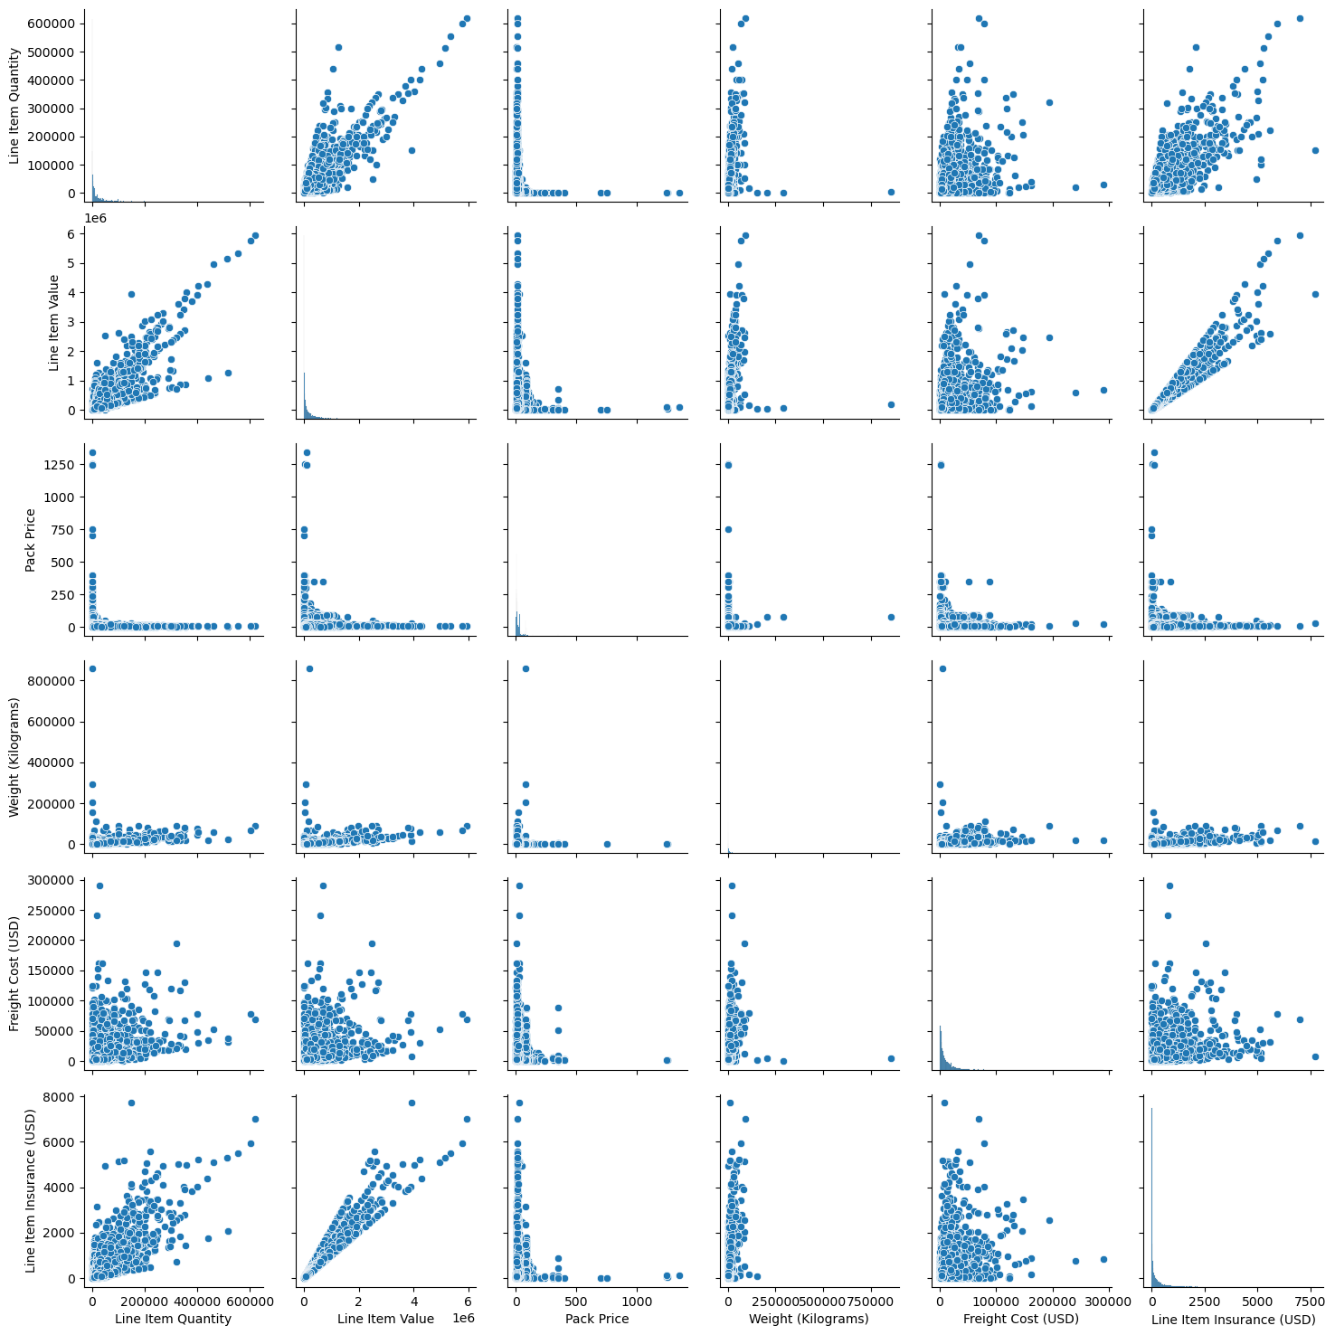
Correlation Pairplot
There is a high co-relation pair between Line Item Insurance and Value and quantiy of the items, which makes sense.
There is also positive high co-relation between Quantity and value.

Slide 18
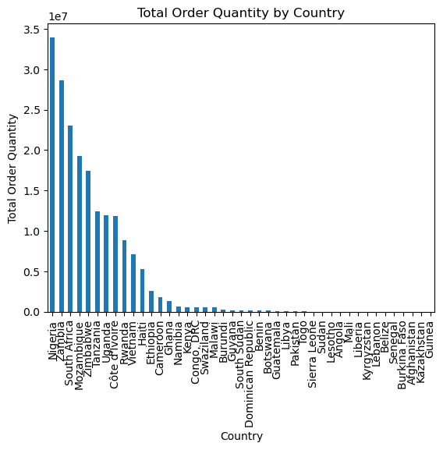
Order Analysis
Which countries has the most orders?
Nigeria ordered most medical supplies
Top 10 countries makes most of the orders

Slide 19
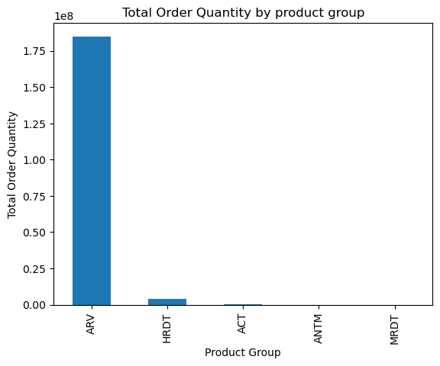
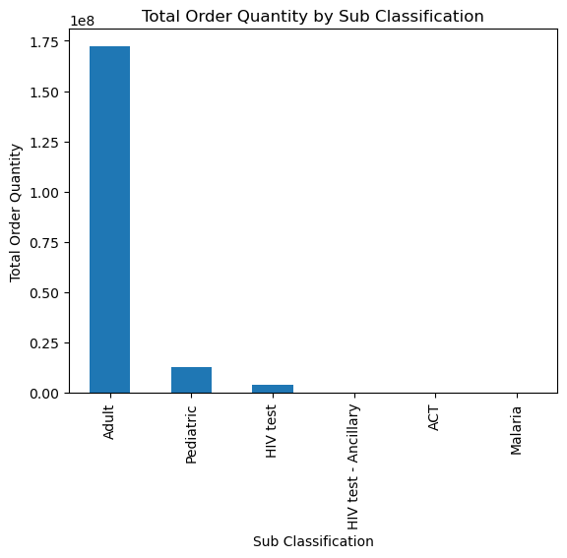
Order Analysis
What kind of medical supplies were shipped?
Majority of shipments consist of ARV Product type
Majority of shipments consist of Adult sub class of supplies

Slide 20
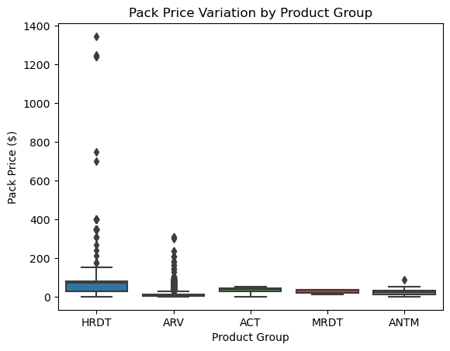
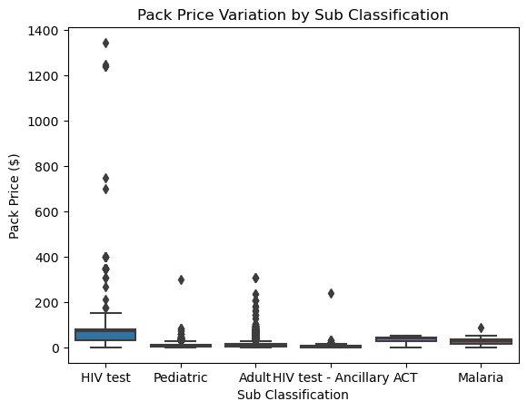
Cost Analysis
What are the costs of medical supplies?
HIV test has highest variability per pack price.
HRDT has high variability in pack price

Slide 21
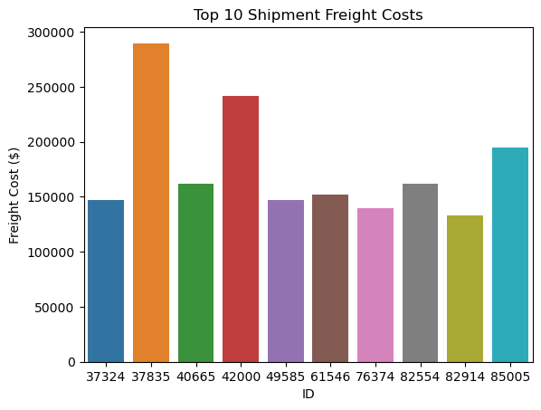
Cost Analysis
What are top 10 freight cost for the shipments?
Highest Freight cost is close to $300K

Slide 22
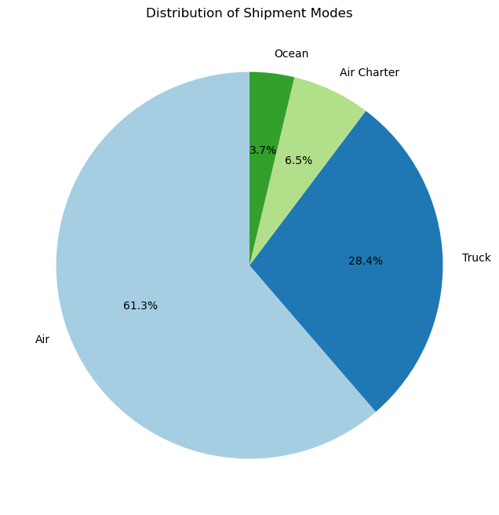
Delivery Analysis
How were the shipment delivered to customers?
Most of the shipments used Air as shipment mode ~ 61%
Next, 28.4% of the shipments were delivered by truck
6.5% and 3.7% were delivered by Air Charter and ocean, respectively.

Slide 23
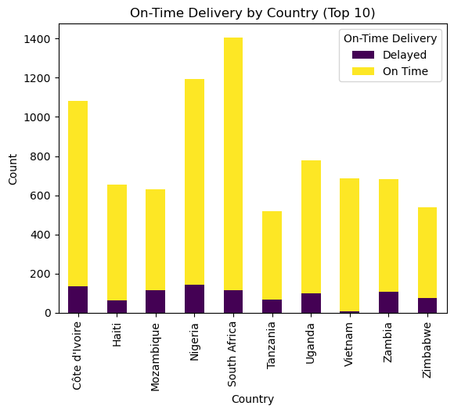
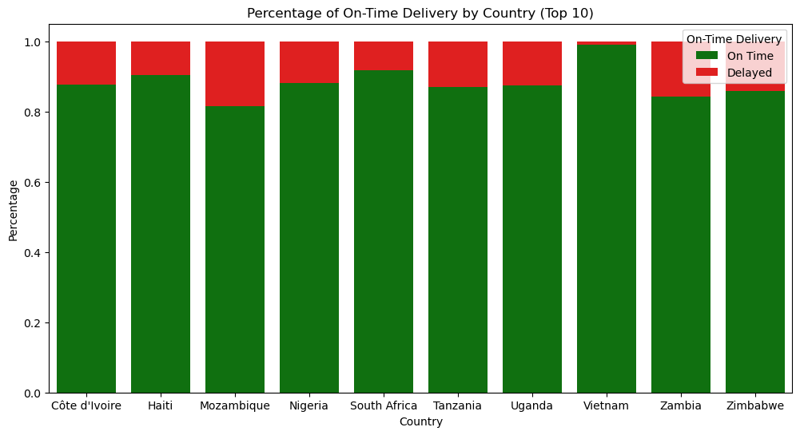
Delivery Analysis
Which countries received the greatest number of on-time shipments?
South Africa has the highest count of on time delivery. Most shipment delivered on-time SA.
Vietnam has the highest percentage of on time delivery. Aprox 98% shipment delivered to Vietnam were on-time.

Slide 24
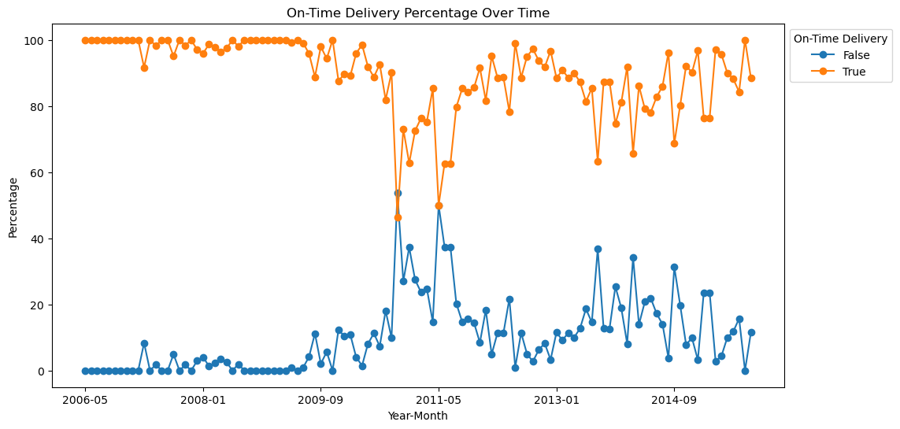
Delivery Analysis
Is there any pattern or trend in on-time delivery historically?
Looks like most shipment were delivered on time before 2010. There was sharp drop in 2010 and was close to 50% for 2 years. The trend after that is been inclining but did not reach to earlier levels.

Slide 25

On-Time delivery prediction model

Slide 26
Train-Test Split
Logistic Regression
Random Forest

Slide 27
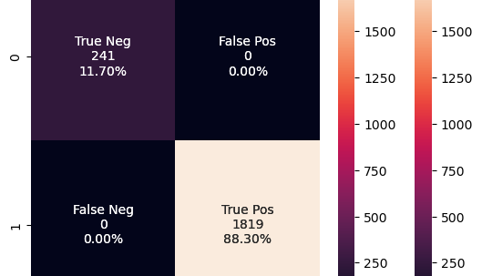
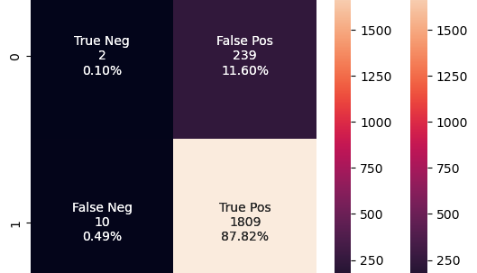
Confusion Matrix for Logistic Regression Model and Random Tree
Random Forest
Logistic Regression

Slide 28
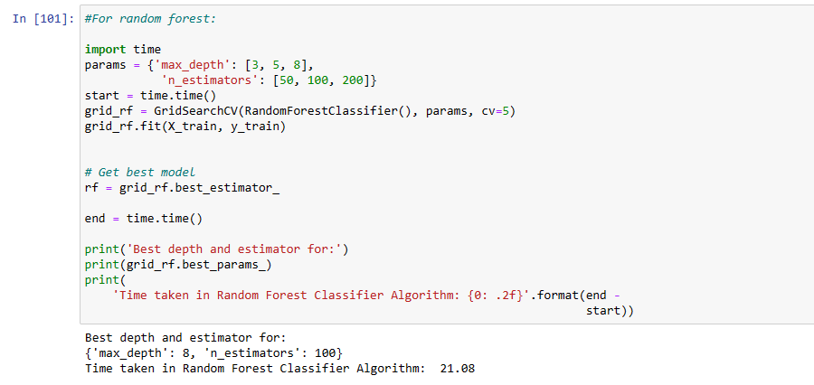
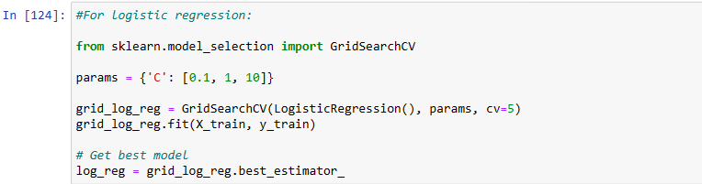
Model Tuning
Hypertuning using GridSearchCV

Slide 29

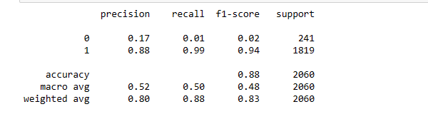
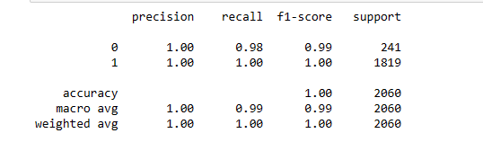
Findings & Conclusion
Amongst the two algorithms, Random Forest shows the highest accuracy of 99%
True Positive and True Negative are at 88.3% and 11.7% respectively
This concludes that Random Forest is the best Machine Learning Algorithm for this dataset

Slide 30
Data Scientist’s Conclusion
The Machine Learning approach have immense potential to transform global medical supply chains with data-driven decision-making.
Equipped with predictive models, supply chain analysts can take proactive actions to ensure smooth last-mile delivery.
Scheduling recipient site preparation
Proactive issue resolution to minimize completion delays
Identifying shipment routes prone to delays.
Notes:
With the insights and predictive models developed, supply chain analysts can now quantify shipment risks and take targeted actions to ensure essential medical commodities are delivered on time. Going further, we see opportunities to optimize global health supply chains across the pipeline - from order planning to routing logistics. We believe this project has demonstrated the immense potential of data-driven decision making to save lives by strengthening vulnerable medical supply chains.

Slide 31
References:
https://www.kaggle.com/datasets/apoorvwatsky/supply-chain-shipment-pricing-data
https://www.usaid.gov/data/dataset/0162a542-4f2e-4fe2-ad5d-8f6ed2344056
Supply Chain Shipment Pricing Dataset (opendatanetwork.com)

