Slide 1

Go, change the world
RV College of
Engineering
Department of Electronics and Instrumentation Engineering
INTERNSHIP PRESENTATION
(EI376SI)
SATELLISENSE: AN AI-DRIVEN DASHBOARD FOR SATELLITE IMAGE ANALYSIS USING LARGE LANGUAGE MODELS
Name: SANIYA U
USN: 1RV22EI046
Guide:Dr.Smrithi Srivastava
Date of Presentation: 9/2/2026

Slide 2
Introduction
Go, change the world
RV College of
Engineering
This internship was carried out at the Centre of Excellence in Cognitive Intelligent Systems for Sustainable Solutions (CISSS), RV College of Engineering, which focuses on AI-driven solutions for societal and environmental challenges
With the rapid growth of satellite missions, large volumes of geospatial data are generated daily, but extracting meaningful insights remains complex and skill-intensive
This internship focused on leveraging Large Language Models (LLMs) to simplify satellite image interpretation through natural language interaction
SatelliSense was developed as an AI-driven platform that integrates satellite image processing with LLMs to provide automated, interactive, and user-friendly geospatial analysis
The project demonstrates how AI can improve accessibility, interpretability, and real-world usability of satellite data for both technical and non-technical users.

Slide 3
About the Organization – HPCC
Go, change the world
RV College of
Engineering
RVCE–HPCC Systems Centre of Excellence follows a collaborative, low-hierarchy organizational structure that encourages open communication, cross-functional teamwork, and idea-driven decision making. This flexible approach supports rapid execution, iterative development, and scalable innovation in research-oriented internship projects.
The Centre develops high-quality, scalable software solutions with a strong focus on backend systems and clean architecture. All products are designed to be user-centric, configurable, and maintainable to meet real-world engineering needs.
RVCE–HPCC Systems CoE offers services in system architecture, backend development, API engineering and technical mentorship. These services emphasize scalability, performance, security, and industry-aligned development practices.
The Centre functions as an academic–industry collaborative initiative rather than a commercial enterprise.It engages with industry experts and institutions for mentorship, technical guidance, and real-world exposure.
The Centre follows structured development methodologies, clean architecture principles, and consistent documentation standards. Ethical engineering, secure implementation, and continuous testing are integral parts of its professional practices.

Slide 4
Go, change the world
RV College of
Engineering
SATELLISENSE: AN AI-DRIVEN DASHBOARD FOR SATELLITE IMAGE ANALYSIS USING LARGE LANGUAGE MODELS

Slide 5
Introduction
Go, change the world
RV College of
Engineering
Satellite imagery helps us understand the Earth by tracking environmental changes, natural resources, and disaster situations
It plays a key role in areas like disaster management, agriculture, water resource monitoring, urban planning, and sustainability
Traditional satellite image analysis depends on complex software, heavy preprocessing, and expert knowledge, which limits access for many users
Recent advances in Artificial Intelligence, especially Large Language Models with multimodal abilities, make satellite data easier to interpret
These models can analyze images, text, and spatial context together, enabling more natural interaction with geospatial data.
AI-driven dashboard helps combines satellite image processing with LLM-based reasoning.
Through a simple, interactive dashboard, users can upload satellite images and receive clear, meaningful insights without deep technical expertise

Slide 6
Satellite imagery provides valuable geospatial information, but analyzing it effectively requires
specialized tools and expert knowledge. Existing approaches involve complex preprocessing and
manual interpretation, making them inaccessible to many users. There is a need for an intelligent
and scalable system that can automate satellite image analysis, support spatial and temporal evaluation,
and present results in a simple, user-friendly manner. The system should deliver clear, actionable
insights through AI-driven reasoning and interactive visualizations.
Problem Statement
Go, change the world
RV College of
Engineering

Slide 7
Objectives of the Project
Go, change the world
RV College of
Engineering
To design an intelligent system that automates satellite image analysis using Artificial Intelligence.
To enhance image understanding and interpretation by integrating multimodal Large Language Models for explainable and human-readable insights.
To support multi-image, batch, and time-series analysis for detecting environmental changes.
To provide an interactive dashboard with location-based visualization and natural language querying.
To support disaster assessment, water resource analysis, and sustainable environmental monitoring through actionable insights.

Slide 8
Methodology
Go, change the world
RV College of
Engineering
Satellite images are uploaded through the dashboard with selected analysis categories such as disaster or water body analysis.
The uploaded images are preprocessed using normalization, resizing, and noise reduction to ensure consistent and reliable analysis
Preprocessed images are passed to the core AI layer, where a multimodal Large Language Model analyzes visual patterns and contextual information
A multimodal Large Language Model interprets the analysis results and generates natural language explanations.
Advanced intelligence modules apply time-series analysis, change detection, anomaly detection, and impact estimation on the processed data.
The analyzed results are visualized through interactive maps, dashboards, and image previews for better spatial understanding.
Natural language queries allow users to interact with the system and extract insights in a simple, conversational manner.
All analysis results, images, and metadata are stored for history tracking, comparison, and long-term monitoring.

Slide 9
System Overview
Go, change the world
RV College of
Engineering
SatelliSense is an AI-driven platform designed to analyze satellite images and generate meaningful geospatial insights
The system accepts satellite images as input and processes them using AI-based image analysis techniques
The platform supports spatial, temporal, and multi-image analysis for detecting environmental changes
An interactive dashboard presents visual analytics, maps, and AI-generated summaries for easy decision-making
Users can interact with the system using natural language queries to explore satellite data intuitively
Large Language Models are integrated to interpret the analysis results and convert them into clear, human-readable insights.

Slide 10
Software Implementation
Go, change the world
RV College of
Engineering
A set of modern programming tools and AI frameworks were used to ensure accuracy, scalability, and reproducibility
The project primarily uses Python-based technologies for AI development, data processing, and system integration.
VS Code supported structured development, debugging, and testing.
Google Colab enabled cloud-based execution with GPU acceleration
Pandas and NumPy were used for data cleaning and transformation
Matplotlib and Seaborn supported performance visualization , Streamlit were used for interactive dashboards and visual insights enabled natural language preprocessing.
Public datasets from Kaggle were used for experimentation data were used to store trained models and processed data Google Drive / Cloud storage was used for organized data management.
SatelliSense features an interactive web-based dashboard that allows users to upload satellite images and view results through maps, charts, and visual analytics.
Multimodal Large Language Models power the AI layer, enabling intelligent image interpretation, natural language querying, and explainable insights for decision support.

Slide 11
The experimental results demonstrate that SatelliSense successfully processes satellite images and generates meaningful geospatial insights in real time.
The system accurately identifies land-cover features, detects water bodies, and highlights disaster-affected regions.
Advanced features such as multi-image comparison, time-series analysis, and anomaly detection significantly improve situational awareness.
Interactive map-based visualization enhances spatial understanding, while AI-driven explanations make results easily interpretable.
Overall, these interfaces collectively demonstrate the novelty of SatelliSense as a complete AI-powered geospatial intelligence system with unique features.
The integration of interactive mapping, intelligent querying, water resource analytics, and anomaly detection transforms traditional satellite image analysis into a contextual, explainable, and decision-support driven platform.
Results
Go, change the world
RV College of
Engineering

Slide 12
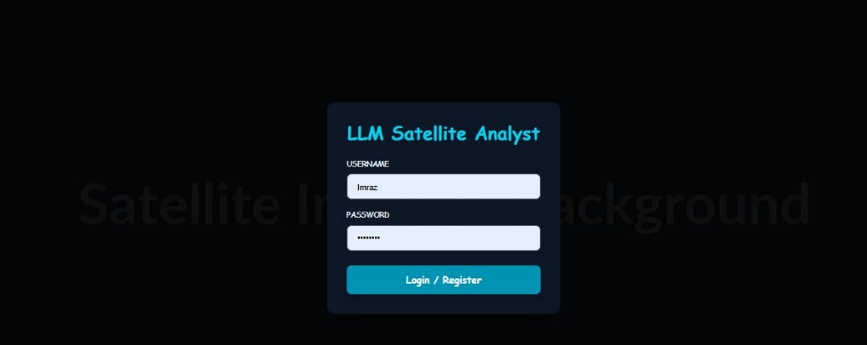
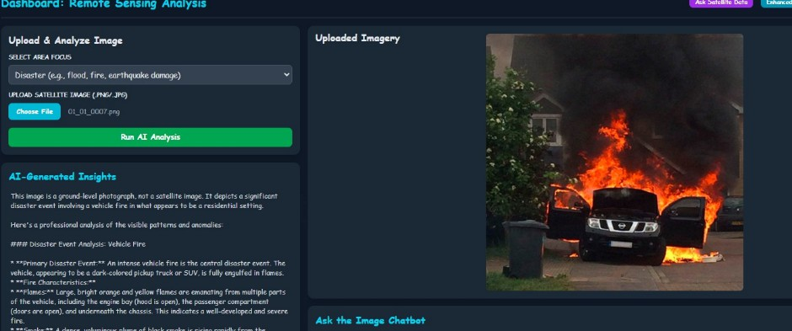
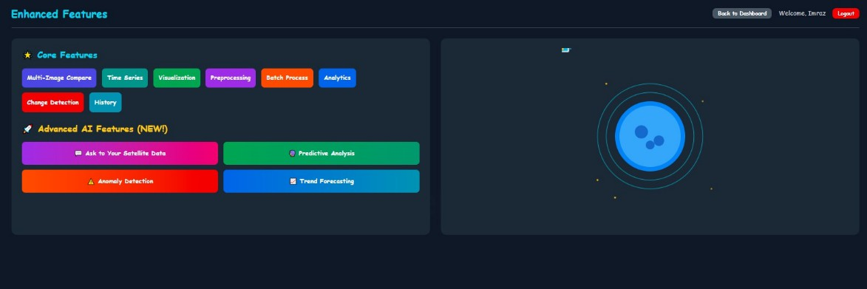
Project Results
Go, change the world
RV College of
Engineering
Login Interface of the LLM-Based Satellite Analysis System.
LLM-Based Interpretation of Disaster Image for Event Identification.
Modules Available in the LLM-Based Dashboard Enhanced Functional

Slide 13
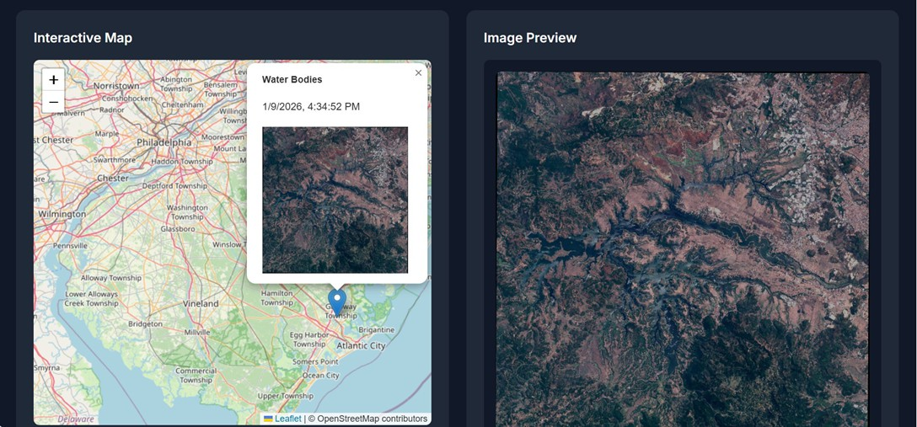
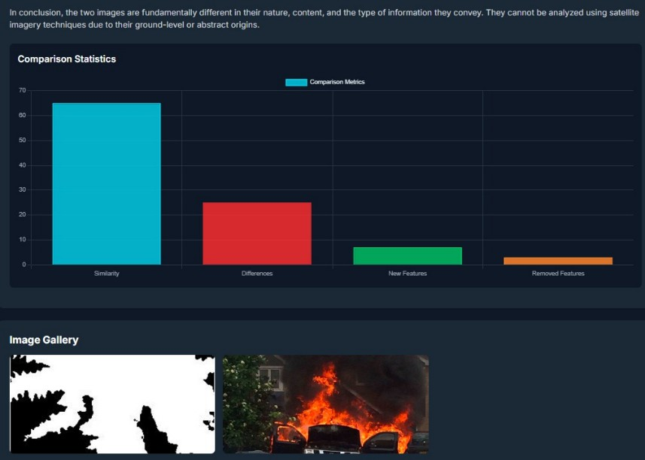
Project Results
Go, change the world
RV College of
Engineering
Interactive Map Visualization of Detected Water Body with
Geospatial Location.
Statistical Comparison of Features Across
Multiple Images

Slide 14
Conclusion
Go, change the world
RV College of
Engineering
SatelliSense successfully demonstrates an AI-driven geospatial intelligence platform that simplifies satellite image analysis
By integrating remote sensing with multimodal Large Language Models, the system converts complex satellite data into clear and actionable insights
Advanced features such as time-series analysis, change detection, anomaly detection, and intelligent querying enhance real-world usability
Interactive map-based visualization improves spatial understanding and decision support
The platform contributes to sustainable environmental monitoring, disaster management, and resource planning
With a modular and scalable architecture, SatelliSense lays the foundation for future AI-powered geospatial applications

Slide 15
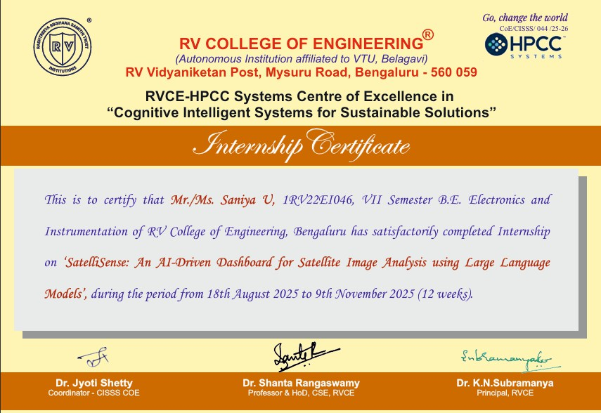
Internship Certificate
Go, change the world
RV College of
Engineering

Slide 16
Timeline
Go, change the world
RV College of
Engineering
Weeks | Summary of Activities Performed
Week 1 – 4 | Attended internship orientation and studied fundamentals of AI, machine learning, and satellite remote sensing Identified project domain, finalized problem statement, objectives, and scope Performed literature review, dataset study, and requirement specification
Week 5 – 8 | Designed system workflow, preprocessing pipeline, and solution architecture. Implemented CNN-based feature extraction and LLM-based inference modules. Integrated modules, optimized performance, and validated system functionality.
Week 9 – 12 | Conducted extensive testing and evaluated accuracy, explainability, and performance Refined prompts, analyzed limitations, and enhanced system reliability Prepared final internship report, presentation, and completed project submission.

Slide 17
Technical Knowledge Acquired
Go, change the world
RV College of
Engineering
The system combines machine learning, computer vision, and natural language processing to analyze satellite images and generate meaningful insights
Computer vision models extract features such as water bodies, floods, and vegetation changes from satellite imagery
Convolutional Neural Networks (CNNs) are trained on labeled satellite datasets to classify disasters and environmental patterns
A Large Language Model converts technical analysis results into clear, human-readable explanations
This enables users to understand results through natural language instead of complex maps or raw numerical data

Slide 18
Strong problem-solving and analytical thinking abilities were developed while addressing real-world challenges related to environmental monitoring and disaster management.
The project enhanced communication skills through technical documentation, report writing, and explanation of complex concepts in a clear manner.
Teamwork and collaboration skills were strengthened through coordinated planning and integration of multiple system components.
Effective time management and organizational skills were developed while balancing implementation, testing, and documentation tasks.
Exposure to sustainability-focused applications increased ethical awareness and social responsibility. Overall, the project fostered confidence, adaptability, and a professional research-oriented mindset.
Soft Skills Acquired
Go, change the world
RV College of
Engineering

Slide 19
Future Scope
Go, change the world
RV College of
Engineering
Enable near real-time analysis for floods, fires, droughts, and environmental changes
Adopt advanced AI models such as Vision Transformers, CLIP, and BLIP-2 for improved image–text understanding
Fine-tune Large Language Models using geospatial and environmental datasets for more accurate insights
Integrate real-time data from satellites, drones, and IoT sensors for faster disaster monitoring
Develop a cloud-based interactive dashboard for wider accessibility and real-world deployment
Extend usage for government agencies, NGOs, and environmental monitoring organizations.

Slide 20
Go, change the world
RV College of
Engineering
THANK YOU!

