Slide 1
A business case: Opening s restaurant in Toronto
Final Assignment for the Data Science Capstone Project

Slide 2

Introduction
Prior to opening a new business, it is crucial for novice and experienced entrepreneurs to make a smart decision in the matter of location, food type, logistics, concept, and more.
The goal of my final project is to explore a business idea of opening a new pizza restaurant in Toronto.

Slide 3
Questions of interest
Entrepreneurs want to know:
Which part of the city has the most and least restaurants at this moment?
How are the reviews of each restaurant that might be considered as a competitor?
Which type of restaurants is the most popular in each neighborhood?
Where can a new restaurant fit in perfectly? We assume that a neighborhood where there are no or comparatively less pizza restaurants located.

Slide 4
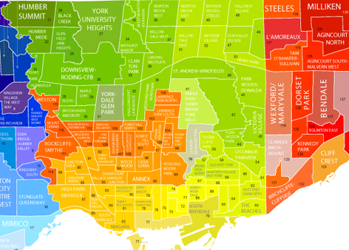
Data
The data used in this analysis is the scrapped data of Toronto neighborhoods.
It was crawled using Scrapy framework, it contains postal codes, borough names, and corresponding neighborhoods.
Issues within data collection:
1) A few scraped boroughs that were unidentified ("Not Assigned"), so these values had to be removed.
2) Duplicated values in the dataset was solved in the proccess.
3) Toronto neighborhood data with coordinates was provided by Coursera andI matched all the records with my scraped data.
4) Foursquare API was used to find and map all the restaurants in each neighborhood and further explore them in detail.

Slide 5
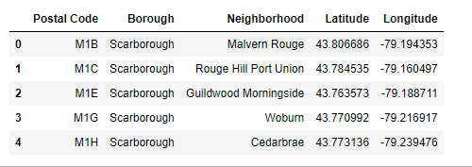
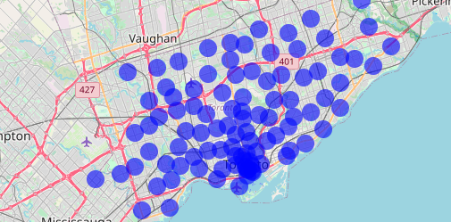
Data
The data on Toronto neighborhoods is presented below in the form of tables a alongside matched coordinates.
The data was used to locate all restaurants in Toronto accurately using Forsquare API for each neighborhood that is presented on the map below.

Slide 6
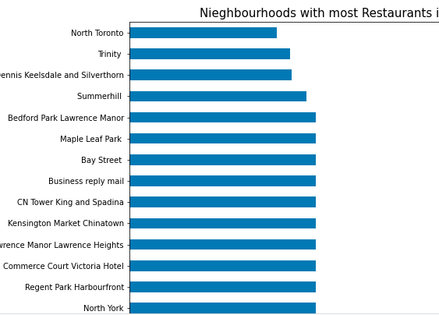
Methodology
K-Clustering ML technique will be used for this analysis.
Foresquare API is used in order to get relevant information on restaurants in each neighborhood in Toronto, such as reviews and the type of food they serve.

Slide 7
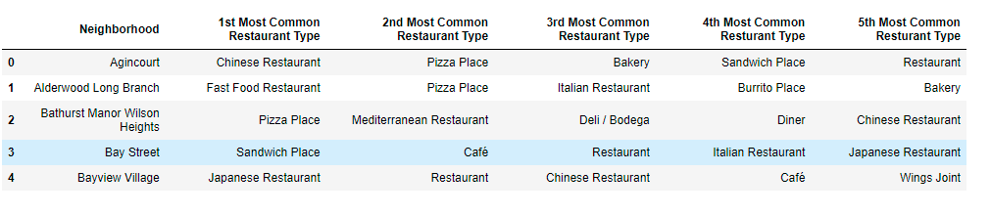
In the table below, we can clearly see what types of restaurants are most popular in each neighborhood (only a few presented as an expampe).
In order to avoid competition, a new pizza business should avoid areas such as Bathurst Manor Wilson Heights, Agincourt, Alderwood Long Branch, and others where pizzerias are in top 2 types of restaurants.¶

Slide 8
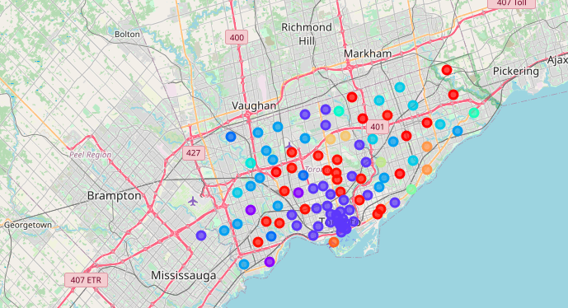
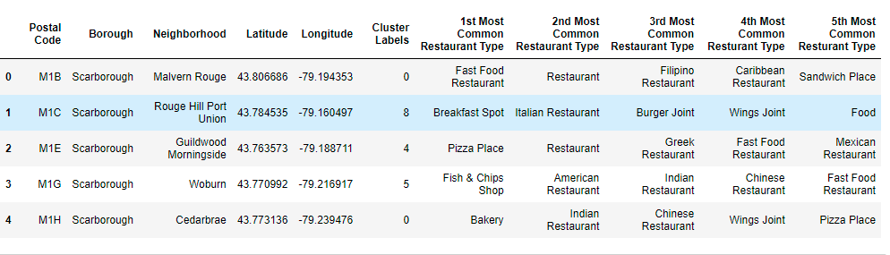
K-Clustering
I used unsupervised learning K-means algorithm to cluster the boroughs. K-Means algorithm is one of the most common cluster method of unsupervised learning.
The full analysis process is provided in the jupyter notebook.

