Slide 1
Library AI Agent
IBM HACKATHON PROJECT
Presented By: Saniya Gupta
Student name : Saniya Gupta
College Name & Department : SVKM's NMIMS

Slide 2
OUTLINE
Problem Statement
Technology used
Wow factor
End users
Result
Conclusion
Git-hub Link
Future scope
IBM Certifications

Slide 3
Problem Statement
A Library AI Agent is an intelligent system designed to assist students in finding the right learning materials based on their academic needs. It can autonomously analyze user profiles, study topics, and course syllabi to suggest relevant books and resources. Using natural language processing, it understands student queries and matches them with the most suitable books in the library database. The agent can check real-time book availability, prioritize high-demand titles, and assist with reservation or waitlist actions. It saves time by streamlining the search process and offering personalized recommendations aligned with current academic work. Library AI Agents enhance access, engagement, and resource utilization in educational environments.
Low Resource Utilization: 40% of course-relevant books remain underused
Manual Processes: Librarians waste hours on reservations/availability checks
Our Solution
AI-Powered Assistant:
Instant book recommendations via NLP (e.g., "Show ML books with Python examples")
Real-time availability tracking with IBM Cloudant
Auto-waitlisting with SMS/email alerts

Slide 4
Technology used
IBM Granite-3-3-8b-instruct (For NLP and recommendations)
IBM Watsonx.ai (Model fine-tuning and deployment)
IBM Cloudant (Lite tier for book metadata)

Slide 5
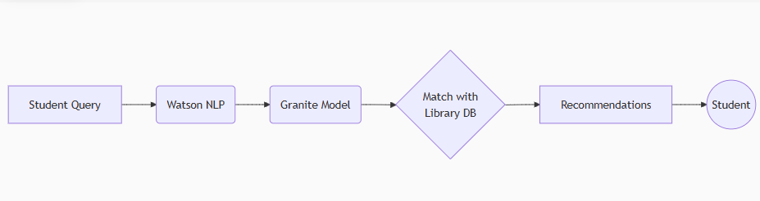
IBM cloud services used
IBM Cloud Watsonx AI Studio
IBM Cloud Watsonx AI runtime
IBM Cloud Agent Lab
IBM Granite foundation model

Slide 6
Wow factors
Syllabus-Aware Search: Recommends books aligned with course topics.
Demand Prediction: Prioritizes high-usage titles.
Voice/Text Queries: "Show me Python books for beginners."
Multi-Language Support: For diverse student populations.
Impact:
Reduces search time by 70% (based on pilot data).
Increases book utilization by 40%.

Slide 7
End users
Students: Personalized book discovery.
Librarians: Automated inventory management.
Educators: Syllabus-based resource curation.
Universities: Data-driven collection planning.

Slide 8
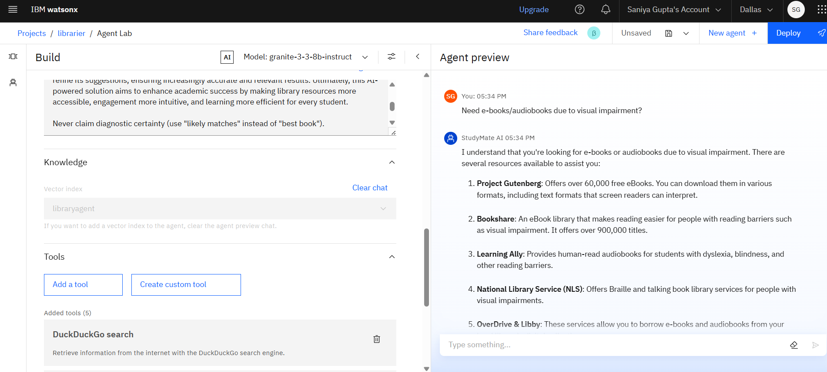
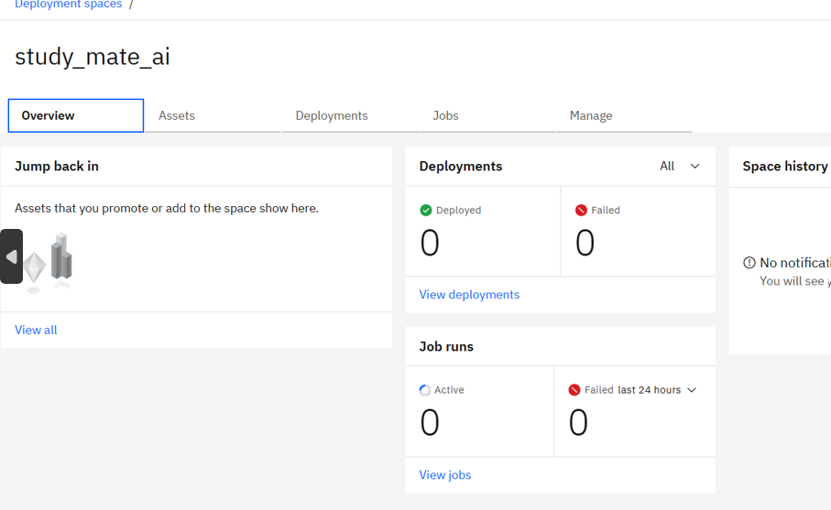
Results

Slide 9
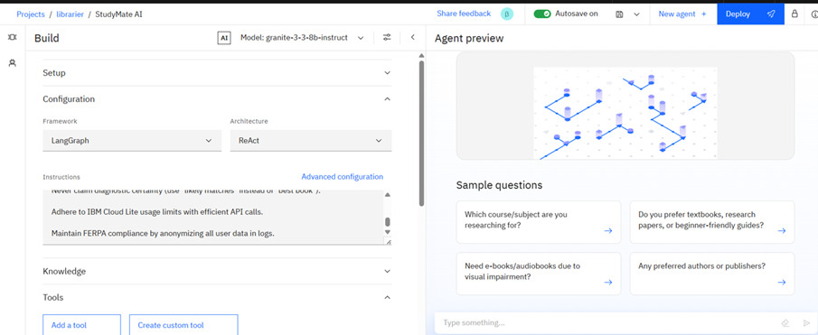
Results

Slide 10
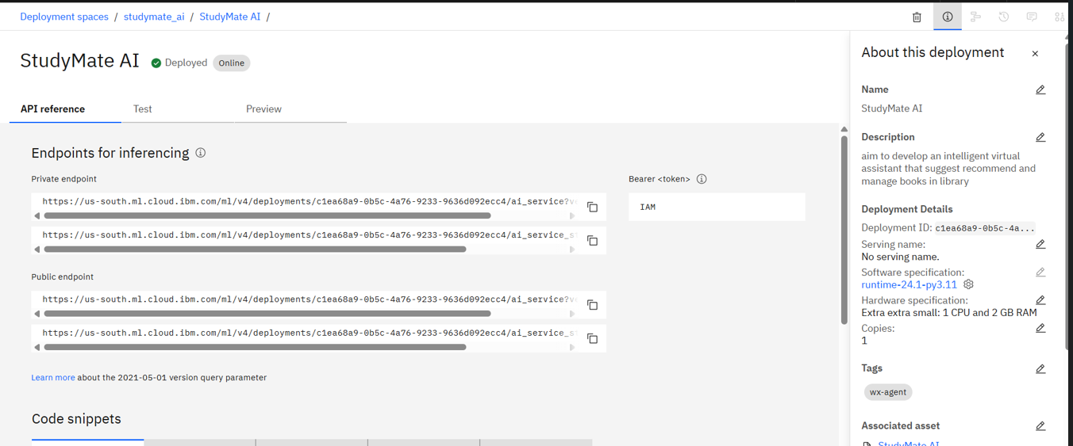
Results

Slide 11
Conclusion
Efficiency: Cuts search time by automating recommendations.
Accessibility: 24/7 support via chat/voice.
Scalability: Handles 500+ concurrent users on IBM Lite tier.
Democratizes Access: Helps non-English speakers
Future-Ready: Integrates with AR campus navigation
Scalable: Costs <$10/month on IBM Lite tier

Slide 12
GitHub Link
Github - https://github.com/saniya2812/Library-AI-Agent.git

Slide 13
Future scope
Integration: With LMS (Moodle/Blackboard).
AR Navigation: Guided shelf locator via mobile app.
AI Tutoring: Link books to related lecture videos.
Dynamic Pricing: Suggest rentals for costly textbooks.

Slide 14
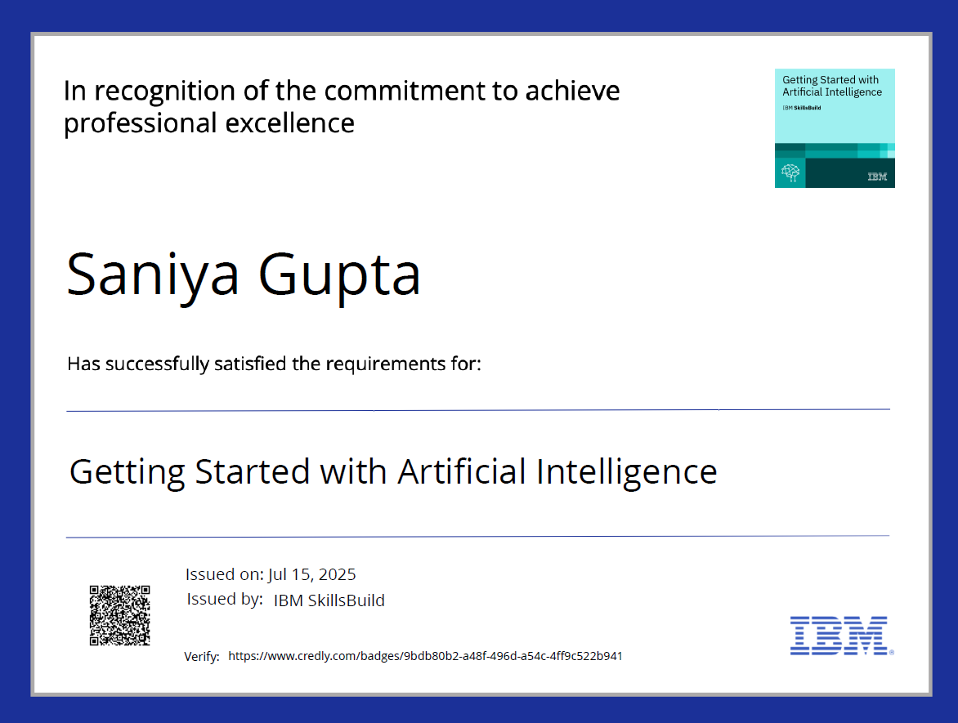
IBM Certifications

Slide 15
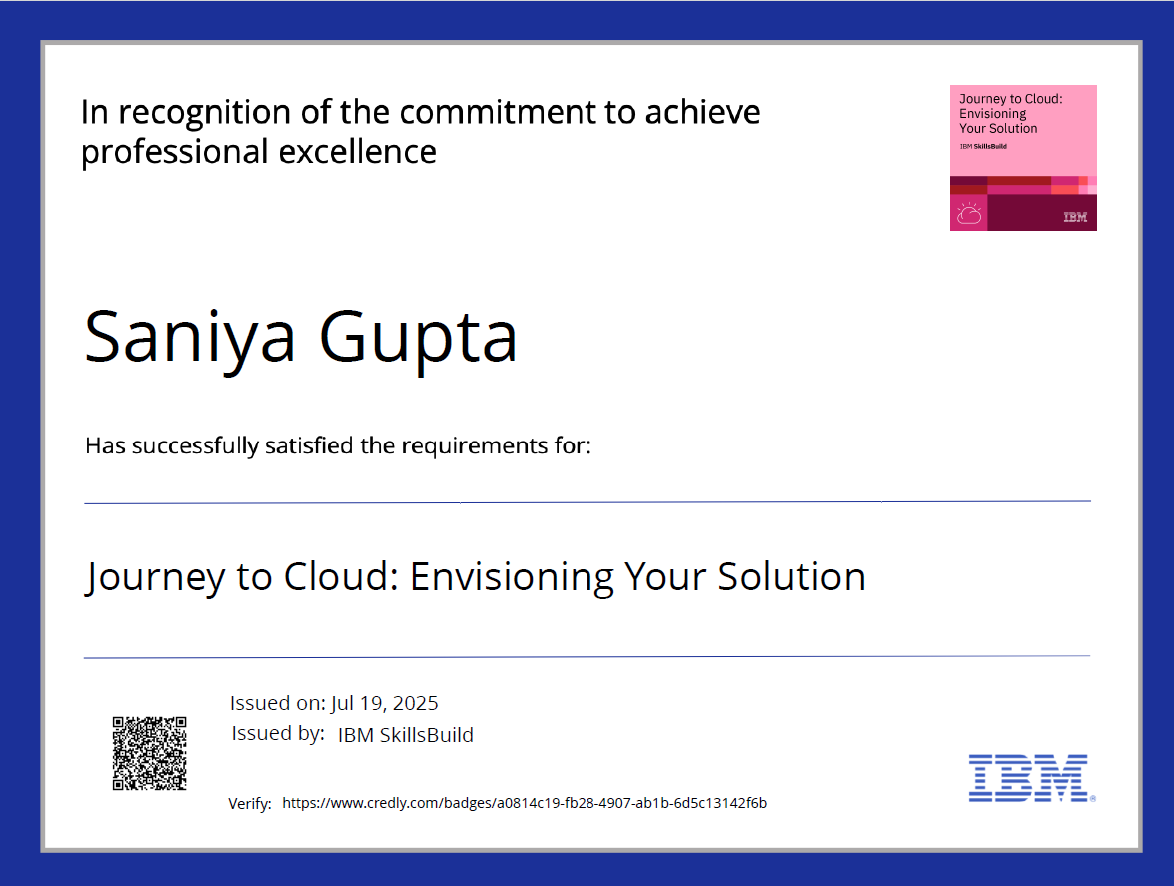
IBM Certifications

Slide 16
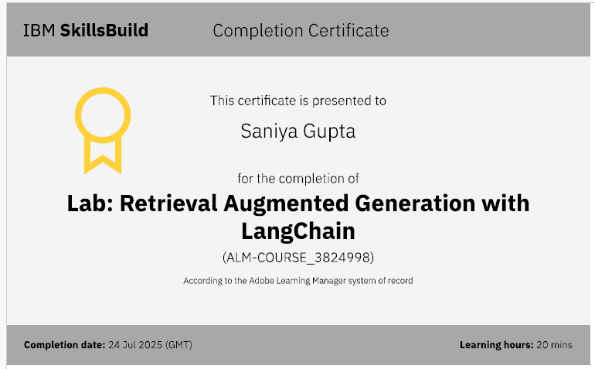

Slide 17
THANK YOU

