Slide 1
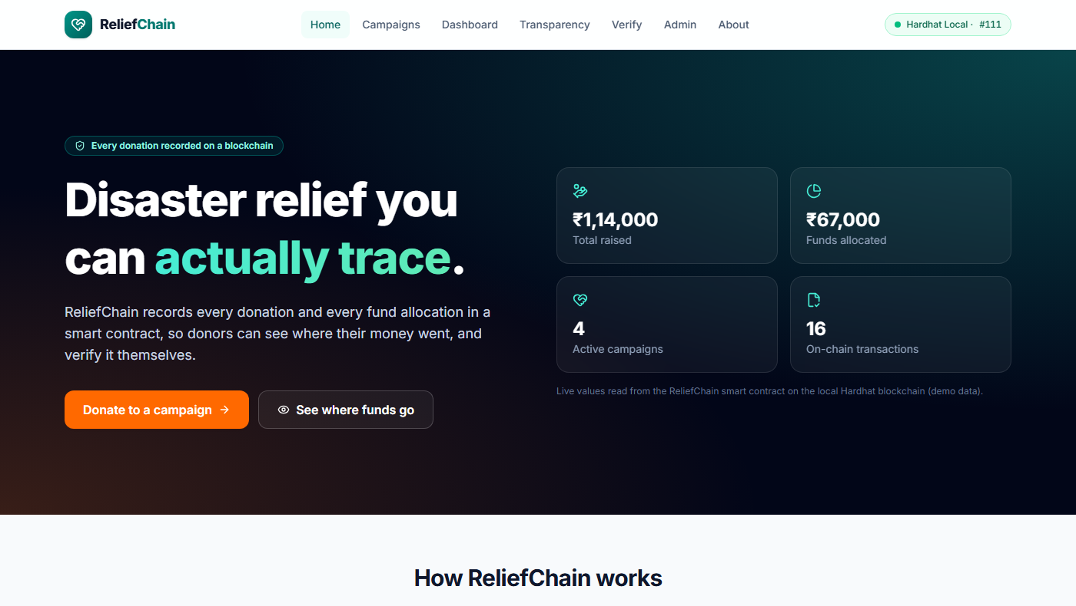
ReliefChain
COLLEGE MINI-PROJECT · BLOCKCHAIN TECHNOLOGY
Blockchain-Based Disaster Relief Fund Tracker for transparent and genuine charity
Presented by: __________________
Guided by: __________________
Live app running on a local Ethereum blockchain
Notes:
Good morning ma'am. Our project is ReliefChain, a blockchain-based disaster relief fund tracker. It addresses the syllabus topic: develop a blockchain based application for transparent and genuine charity. On the right is our working application.

Slide 2

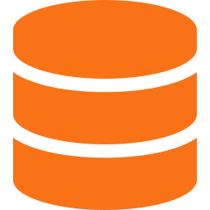


The problem: donors can't see where relief money goes
No proof your donation was counted
Receipts are emails or PDFs that cannot be independently checked.
THE TRUST GAP
Donor gives ₹500
Records sit in a private database
The organization can edit or delete entries and nobody would know.
?
Spending shown only as totals, months later
Donors rarely see how much went to food, medicine or shelter.
Flood victims
Fake fundraisers appear after disasters
Without a public trail, genuine and fake appeals look the same.
Lack of transparency reduces trust and discourages donations.
Notes:
When people donate after a flood, they can't see whether their donation was counted or how it was spent. Records are in a private database that can be changed. That gap between donor and victim is the trust problem we solve.

Slide 3


Existing system vs ReliefChain
Existing system
Proposed: ReliefChain
Charity keeps records in its own database
Every donation stored in a smart contract
Records can be changed silently
Records are permanent and tamper-evident
Annual report published months later
Dashboard updates in real time
Donor receipt cannot be verified
Every receipt is a verifiable transaction hash
Only total spending is shown
Spending shown category-wise: food, medicine, shelter
Notes:
Compare the two. In the existing system the charity controls the records. In ReliefChain every donation and every allocation is written to a smart contract, so it is permanent, public and verifiable with a transaction hash.

Slide 4





How a donation flows through ReliefChain
1
2
3
4
5
Donor
React website
FastAPI backend
Smart contract
Blockchain
Enters name and ₹ amount, clicks Donate
Sends the request to the backend API
Validates input, signs the transaction
Checks the rules and stores the donation
Mines it in a block, returns a tx hash
EXAMPLE RECORD STORED ON THE BLOCKCHAIN
Rahul → ₹500 → Chennai Flood Relief 2026
tx hash 0xb34ea59d7d2f…61283498 · block #290 · status: Confirmed
Notes:
Walk through the five steps. The donor never needs a crypto wallet: the backend holds the organization's wallet, which is the contract owner, and signs the transaction. The blockchain returns a transaction hash, which becomes the donor's receipt.

Slide 5


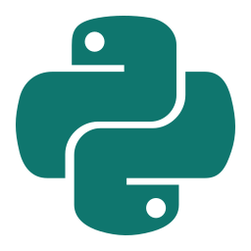

System architecture
Donor / Admin
What is stored where
Web browser
ON THE BLOCKCHAIN
React website
Campaigns, targets and status
Donations: name, ₹ amount, time
Allocations: category, ₹, note
Transaction hashes (event logs)
Vite · Tailwind CSS · Recharts
FastAPI backend
Python · web3.py · owner wallet
OFF-CHAIN (LOCAL)
ReliefChain smart contract
Campaign images (too costly on-chain)
Admin key and wallet private key
Solidity · OpenZeppelin Ownable
Ethereum blockchain
No separate database: the smart contract is the single source of truth.
Hardhat local network
Notes:
Five layers. Users interact with the React website, which calls the FastAPI backend. The backend uses web3.py to talk to the smart contract on a local Ethereum blockchain run by Hardhat. All financial data is on-chain; only images and secrets are kept locally.

Slide 6


Smart contract: functions and security rules
ReliefChain.sol (Solidity 0.8.24)
Rules enforced by code
createCampaign()
Admin opens a new relief campaign
onlyOwner
only the organization's wallet can write, so no fake donations
donate()
Records a donation; auto-COMPLETED at target
Valid campaign ID
no records for campaigns that don't exist
allocateFunds()
Records spending by category
No over-allocation
spending can never exceed money donated
closeCampaign()
Active + before deadline
closed or expired campaigns can't collect
Stops new donations
get…() view functions
Amount > 0, name required
no empty or meaningless records
getCampaign, getDonations, getAllocations: free public reads
Notes:
The contract has four write functions, all protected by onlyOwner, and free read functions. The most important rule: allocateFunds rejects any amount larger than raised minus already-allocated, so the organization can't claim to spend money it never received. Events are emitted for every action.

Slide 7




Technology stack
Solidity + OpenZeppelin
Hardhat
FastAPI + web3.py
Smart contract language and the Ownable access-control library
Local Ethereum blockchain, compiling, testing and deployment
Python REST API that signs and sends blockchain transactions
React + Vite
Tailwind CSS
Recharts
Fast, component-based single-page web application
Modern, responsive styling for desktop and mobile
Donut chart showing how funds are allocated
Notes:
Solidity for the contract, Hardhat to run a local Ethereum network, FastAPI with web3.py for the backend, React with Vite and Tailwind for the website, and Recharts for the allocation chart.

Slide 8
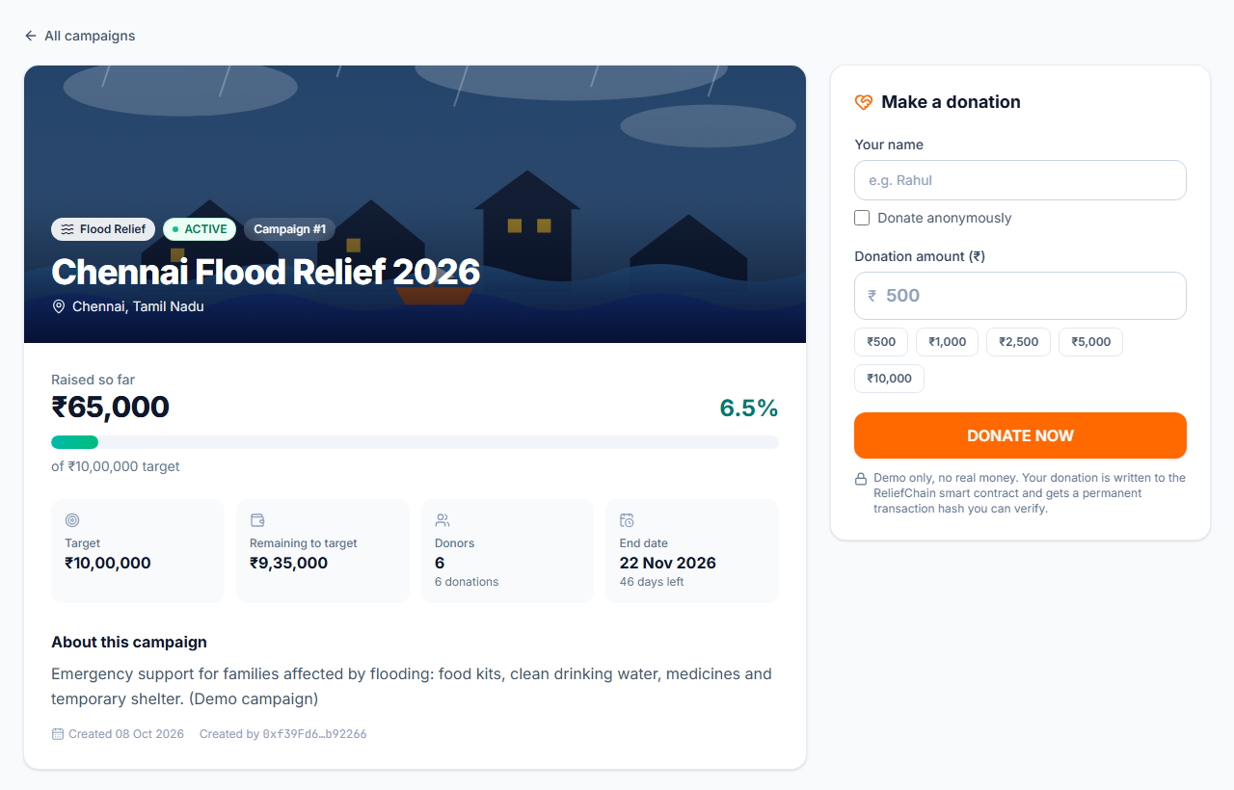
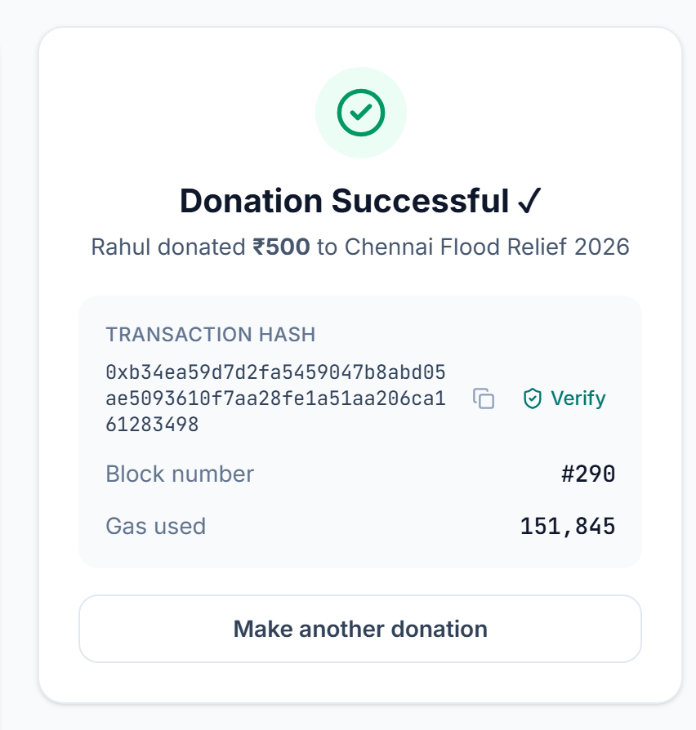
Live app: donate and get a blockchain receipt
Campaign page: target, raised, progress, donors, status
Receipt with real transaction hash and block
Notes:
This is the campaign page for Chennai Flood Relief. The donor types a name and amount and clicks Donate Now. Within a second the transaction is mined and the donor sees Donation Successful with the transaction hash and block number. That hash is permanent proof.

Slide 9
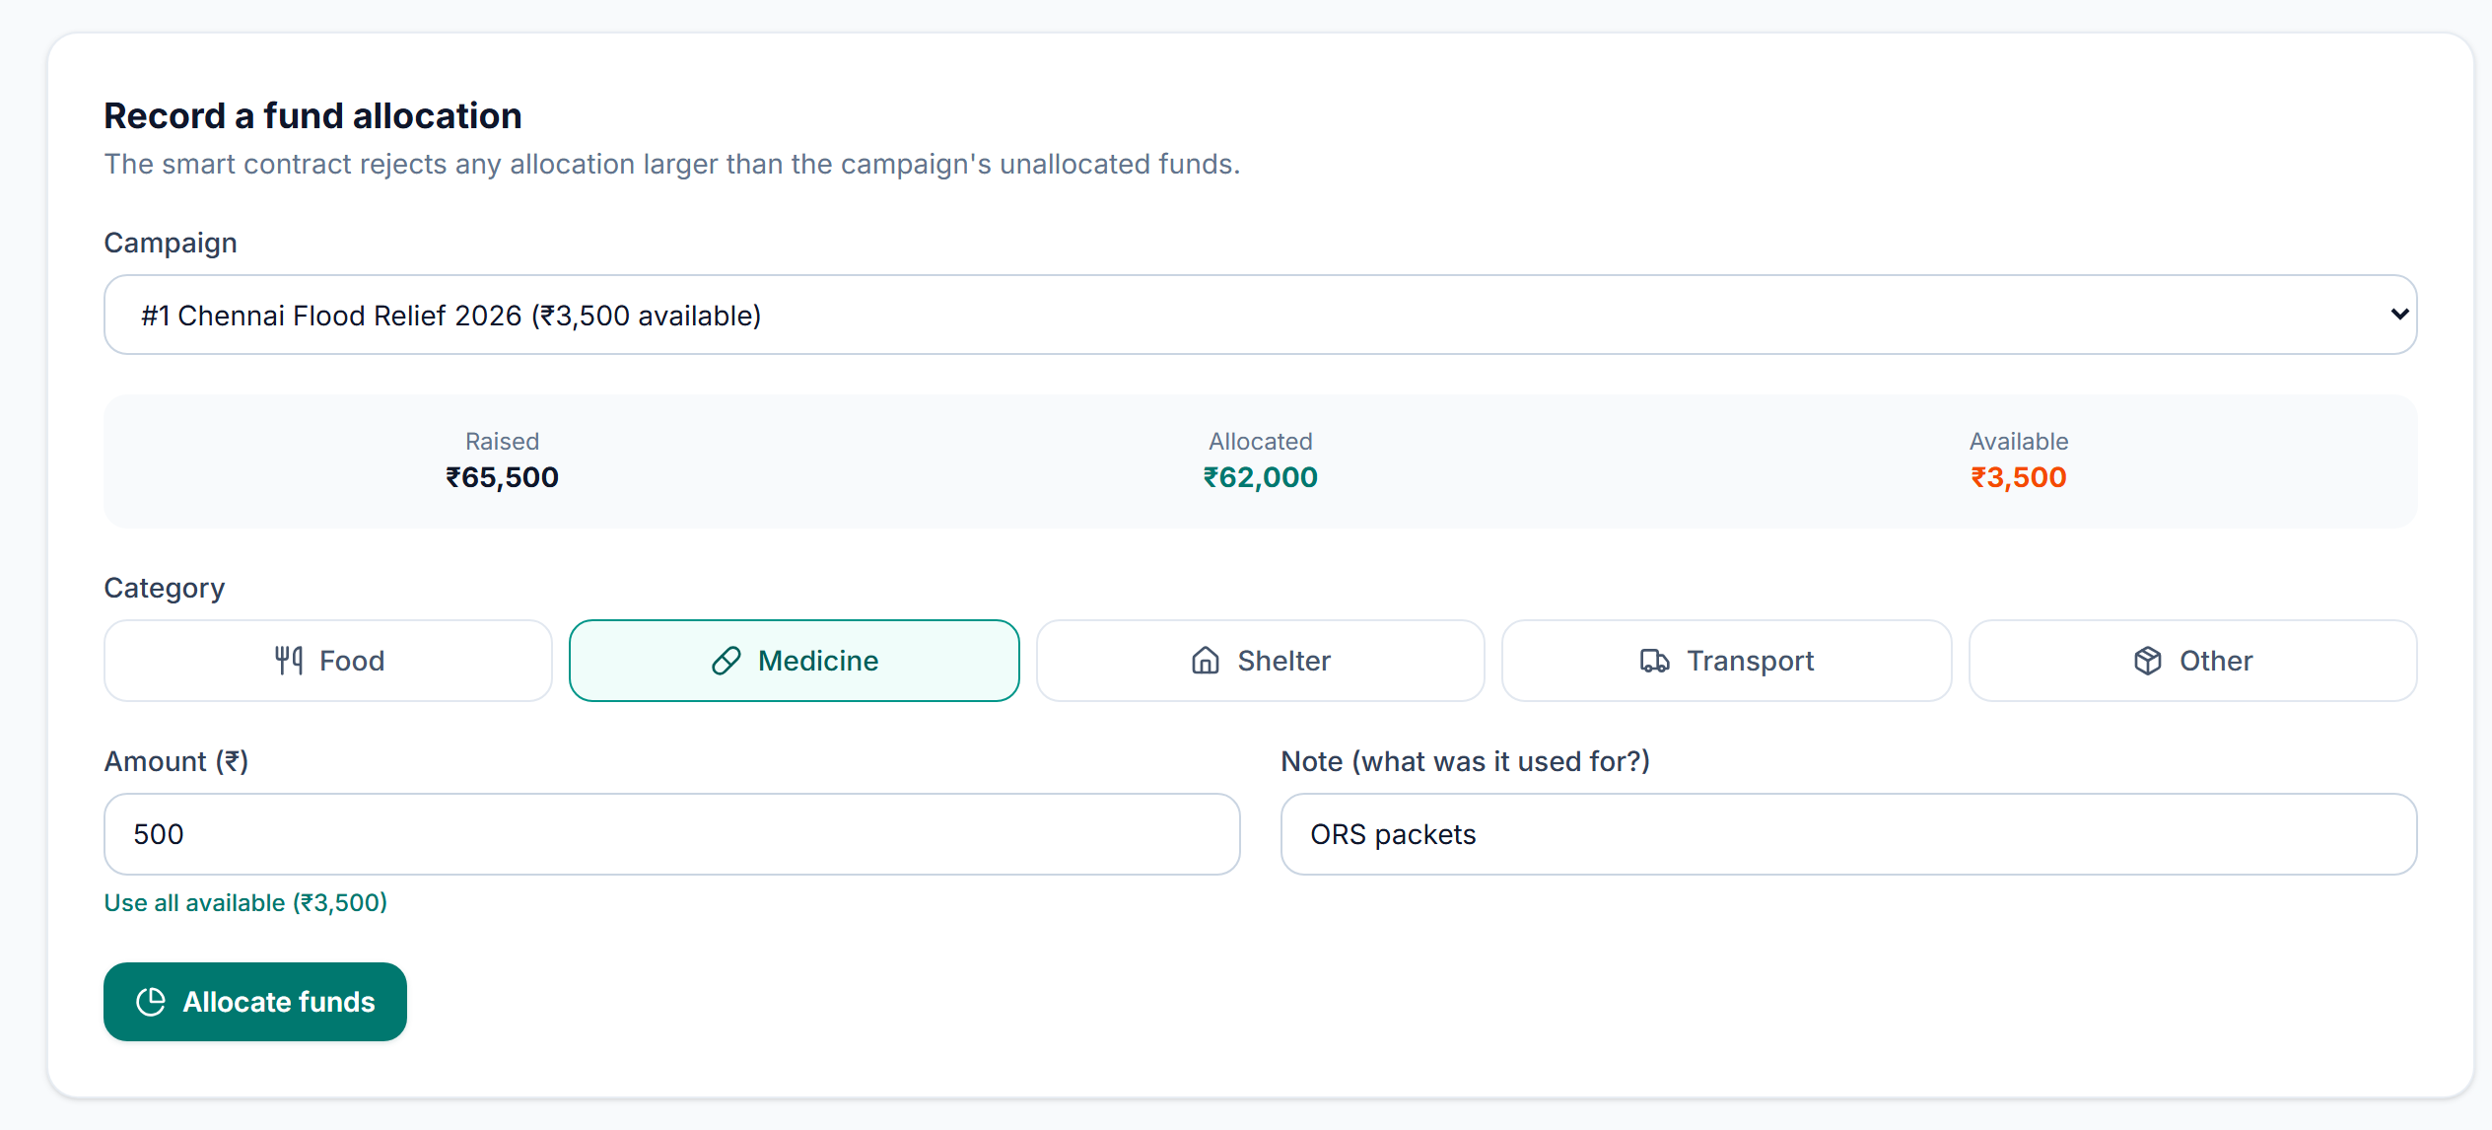
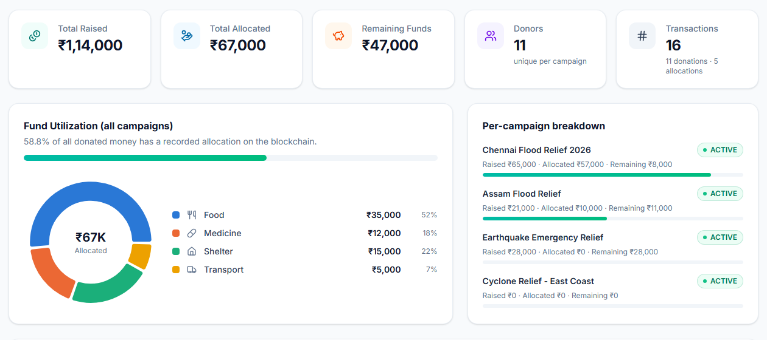





Live app: track how every rupee is used
Admin records an allocation
Category + amount + note. Over-allocation is rejected by the smart contract.
Public transparency dashboard
Raised vs allocated, category donut chart and a public ledger of transactions.
Food
Medicine
Shelter
Transport
Other
Notes:
The relief organization logs in to the admin panel and records how funds were used: category, amount and a note. If it tries to record more than was donated, the smart contract rejects it. The transparency dashboard shows everything publicly.

Slide 10
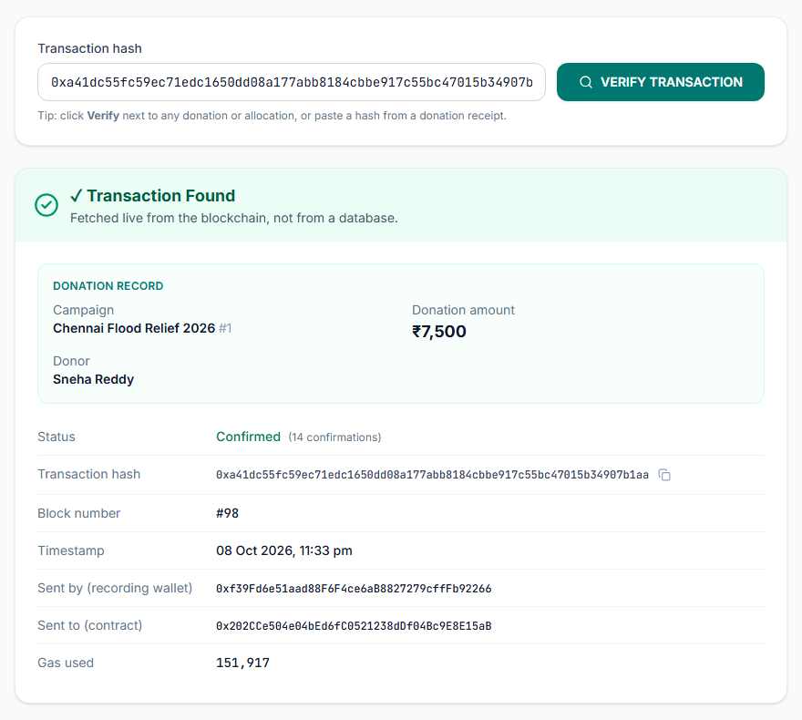




Anyone can verify a transaction
Copy the transaction hash
From the donation receipt or any history row
Paste it on the Verify page
The backend looks it up directly on the blockchain, not in a database
See the decoded record
Campaign, donor, amount, block number and status: Confirmed
Fake hash? Not found
Edited or invented hashes simply don't exist on the chain
Notes:
Verification is what makes it trustworthy. Anyone can paste a transaction hash and we fetch it straight from the blockchain and decode it. A tampered hash returns not found.

Slide 11

Real-life applications
Where blockchain transparency is already used in charity, and where a system like ReliefChain fits
Notes:
Now the real-life side: how organizations already use blockchain for aid, and where our system can be applied.

Slide 12



Blockchain in real-world aid and charity
UN World Food Programme
UNICEF
BitGive Foundation
Building Blocks (2017 onward)
CryptoFund (2019)
GiveTrack
First field-tested in January 2017 in Pakistan. Now a shared blockchain network where aid agencies coordinate help and avoid duplicate aid; WFP reports 4.8 million households supported.
A fund that can receive, hold and disburse donations in cryptocurrency, so money sent to projects can be publicly traced on the blockchain.
A donation platform that uses blockchain to show donors how their contribution moves and how the charity spends it.
Common idea: a shared, tamper-evident record of who gave, who received and how much. ReliefChain applies it to disaster relief.
Summaries of publicly reported initiatives. ReliefChain is a simplified academic model of the same idea.
Notes:
This idea is not just academic. The UN World Food Programme's Building Blocks, first tested in Pakistan in 2017, is now a shared blockchain network for coordinating aid, used in Jordan, Bangladesh and Ukraine. UNICEF created a CryptoFund in 2019. BitGive's GiveTrack lets donors trace donations. Our project is a simplified model of the same concept.

Slide 13






Where ReliefChain can be used in real life
Disaster relief NGOs
Government relief funds
Flood, cyclone and earthquake funds publish every donation and every rupee spent.
State relief funds can show citizens how disaster money is distributed.
Corporate CSR
Medical crowdfunding
Companies spending CSR funds can prove where the money went.
Families raising money for treatment show hospital-bill usage to donors.
Temple and trust donations
Scholarships and alumni funds
Large trusts can make offerings and their usage publicly auditable.
Colleges show alumni exactly which students and needs their money supported.
Notes:
The same system works anywhere people donate and want proof: disaster NGOs, government relief funds, corporate CSR spending, medical crowdfunding, temple trusts, and college scholarship or alumni funds.

Slide 14
Real-life scenario: cyclone relief in a coastal district
Day 1
Days 1-7
Day 8
Day 10
Audit
Campaign created
Citizens donate
Funds allocated
Public checks
Bills matched
An NGO opens “Cyclone Relief” on-chain with a target of ₹5,00,000.
Each donor gets a transaction hash as a permanent receipt.
₹2,00,000 food kits and ₹1,00,000 medicine recorded with notes.
Donors and journalists view the Transparency page and verify hashes.
Auditors compare bills and receipts against on-chain allocations.
Result: every rupee in and out is public, permanent and checkable by anyone, without trusting a private spreadsheet.
Illustrative scenario; real-money collection assumes a payment-gateway integration (future scope).
Notes:
A realistic scenario. After a cyclone, an NGO creates a campaign. Citizens donate and each gets a hash. The NGO records allocations for food kits and medicine. Donors and journalists check the dashboard, and auditors match bills against the on-chain records.

Slide 15
Testing and results
15/15
5/5
51/51
Smart-contract tests passed
Backend integration tests passed
Browser checks passed
Hardhat + Chai
pytest against the live chain
Real Chrome, clicking like a user
What was tested
Campaign creation and deployment
Single and multiple donations, unique donors
Fund allocation and over-allocation rejection
Unauthorized admin actions blocked
Invalid campaign IDs and invalid input
Campaign closing and automatic COMPLETED status
Verification of real vs fake transaction hashes
Mobile layout and error handling in the UI
Notes:
We tested at three levels. 15 smart contract tests, 5 backend integration tests on the live chain, and 51 automated checks in a real browser covering donation, verification, admin actions, errors and mobile layout. All passed.

Slide 16


Advantages and limitations
Advantages
Limitations
Records are public and tamper-evident
Anyone can verify any transaction
Rules enforced by code: no over-allocation
Donors need no crypto wallet
Category-wise trail of fund usage
Cannot prove the charity itself is genuine
Allocations are self-reported by the organization
Donors trust the backend to record their donation
No real payment gateway yet (demo amounts)
Local test chain resets when restarted
“Blockchain does not automatically prove that a charity is genuine. It provides a transparent and tamper-evident record of donations and fund allocations.”
Notes:
Be honest about limits. Blockchain makes records transparent and tamper-evident, but verifying that an organization is genuine is still an off-chain process, and allocations are self-reported.

Slide 17






Future scope
UPI / payment gateway
Optional MetaMask donations
Collect real money and store the payment reference on-chain
Let donors with wallets sign their own transactions
Bills on IPFS
Multi-signature approval
Upload receipts and store their hash with each allocation
Two of three trustees must approve each allocation
Public network deployment
SMS / email receipts
Deploy on a testnet or Polygon with block-explorer links
Send donors their transaction hash automatically
Notes:
Next steps: a UPI payment gateway, optional MetaMask for donors with wallets, bills on IPFS, multi-signature approvals, deployment on a public network, and SMS receipts.

Slide 18

Thank you
CONCLUSION
Recorded on blockchain
Rules in code
Verifiable by anyone
Every donation and allocation is stored permanently in a smart contract
Only the owner can write, and spending can never exceed donations
Any transaction can be checked by its hash, straight from the chain
Questions?
Notes:
To conclude: ReliefChain records every donation and allocation on a blockchain, enforces rules in code, and lets anyone verify transactions. It makes charity finances transparent, while being honest that organization verification remains off-chain. Thank you, we are happy to take questions.

