Slide 1


NATURAL LANGUAGE PROCESSING
Ganesh Namagiri

Slide 2
Agenda
Evolution of Human Language
What is Text Mining?
Text Mining and Natural Language Processing?
Applications of NLP
NLP Components

Slide 3



THE HUMAN LANGUAGE
Language
Alphabets
Words of Sentences

Slide 4






THE 21ST CENTURY

Slide 5

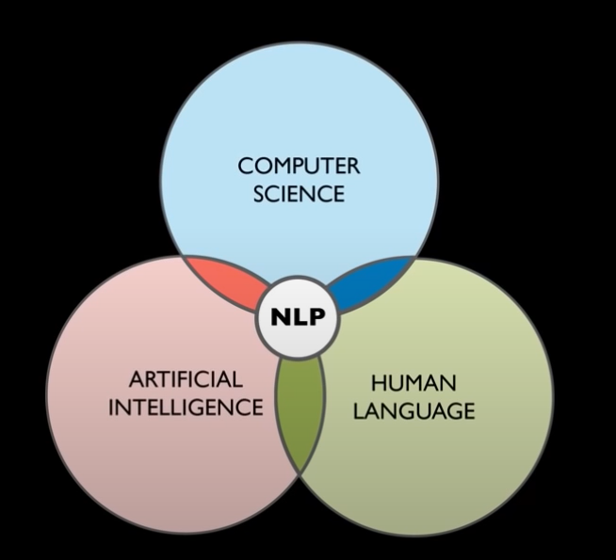
TEXT MINING AND NLP
Text mining / Text analytics: the process of deriving meaningful information from the natural language text.
NLP : Natural Language Processing is artificial intelligence method of communicating with an intelligent system using the natural language (human language)

Slide 6



OVERALL GOAL
NLP

Slide 7
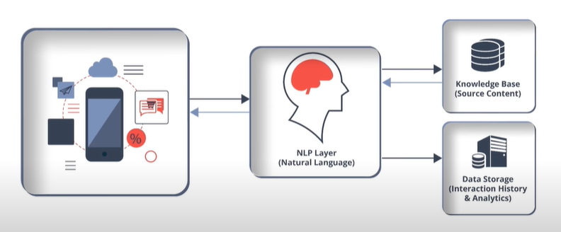
BASIC STRUCTURE OF A NLP APPLICATION

Slide 8
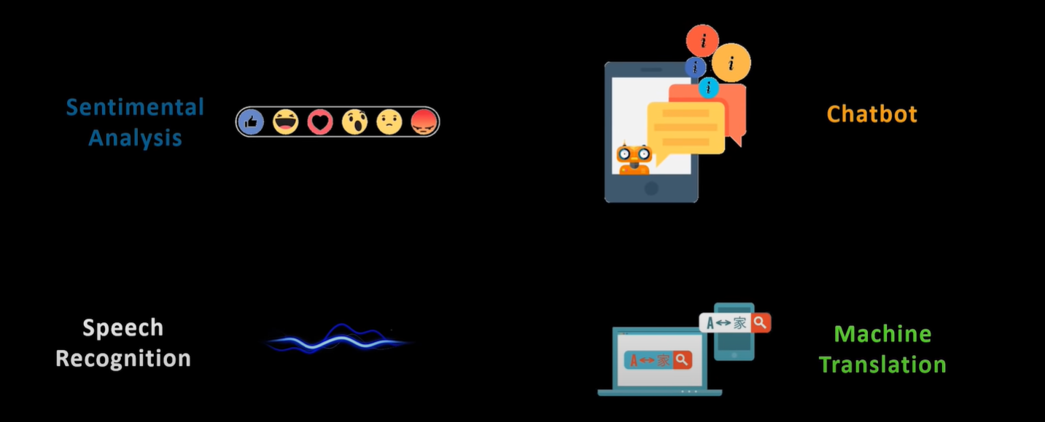
APPLICATIONS

Slide 9
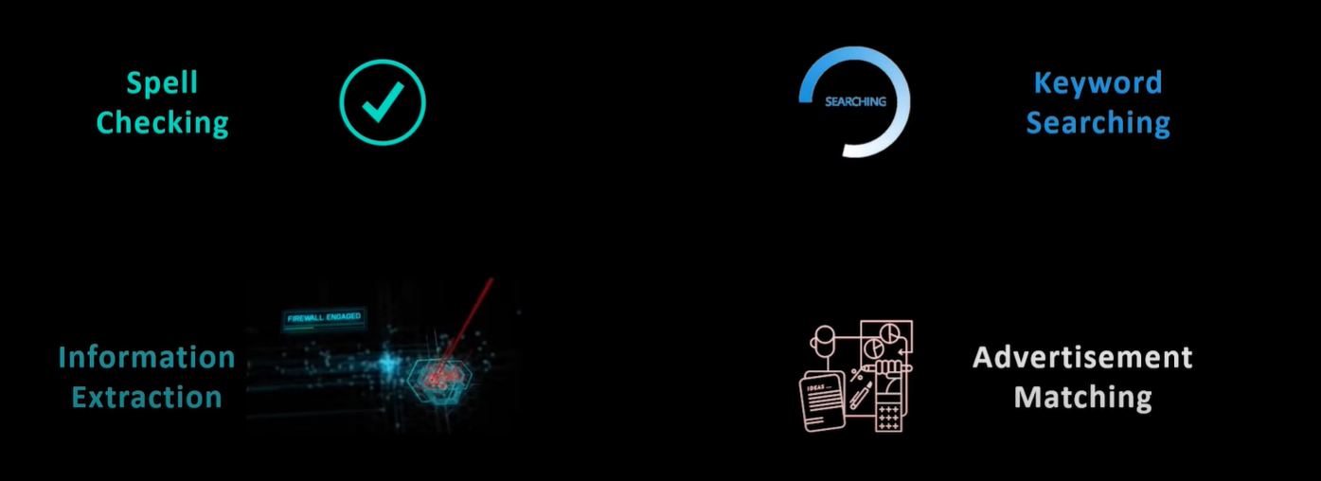
APPLICATIONS

Slide 10

COMPONENTS OF NLP
Natural Language Understanding
Natural Language Generation

Slide 11

NLU : AMBIGUITY
Lexical Ambiguity
She is looking for a match
The fisherman went to the bank
Syntactic Ambiguity
The chicken is ready to eat
I saw the man with binoculars
Referential Ambiguity
The boy told his father the theft. He was very upset

Slide 12


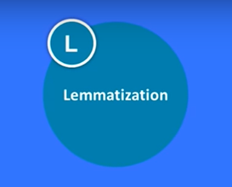



STEPS IN NLP
Tokenization
Stemming
Lemmatization
POS Tags
Named Entity Recognition
Chunking

Slide 13

Tokenization
Breaking strings into words/tokens.

Slide 14
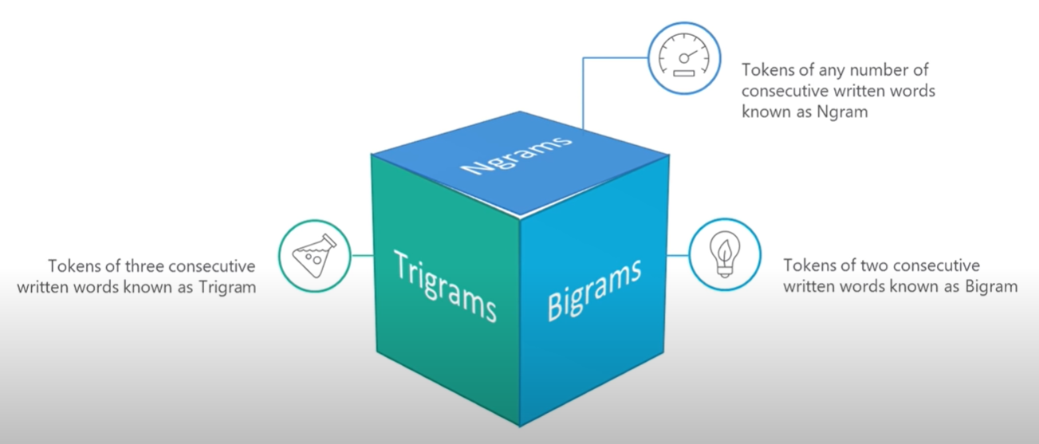
Tokenization

Slide 15
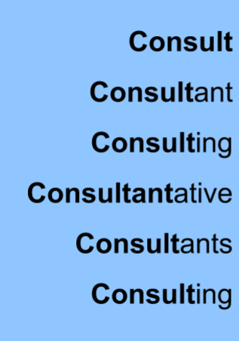

Stemming
Normalizing the words into its base or the root form.
Prefixes and suffixes to change the infected word.
Result may not be the root form always

Slide 16
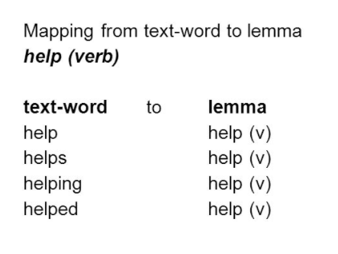
Lemmatization
Morphological analysis of the word to bring the given word to its original word or root word form (also know as ‘lemma’).
Output of this is a proper word

Slide 17
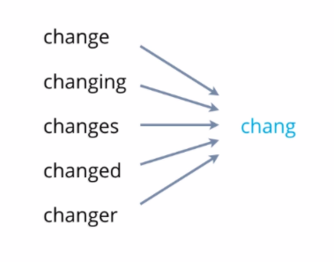
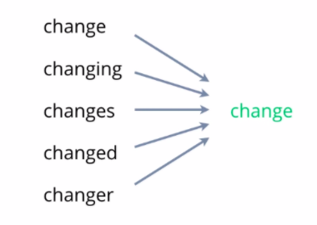
Stemming vs Lemmatization

Slide 18
POS Tags
POS : Parts of Speech it indicates how a word functions in meaning as well as grammatically with the sentence.
A word can have more than one POS based on the context in which it is used.
Google something on the internet
VERB
Although Google is a Proper Noun

Slide 19
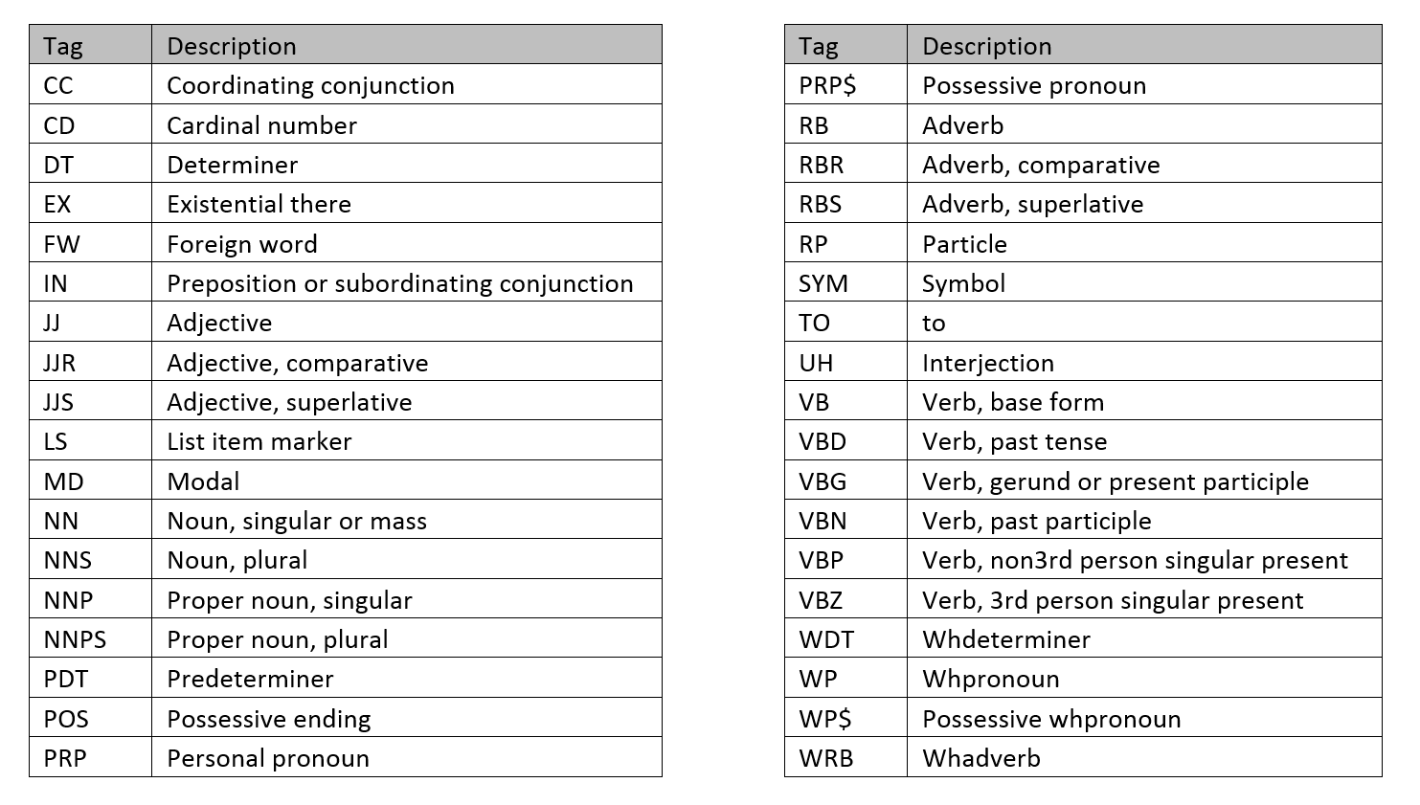
POS : Tags and Descriptions

Slide 20
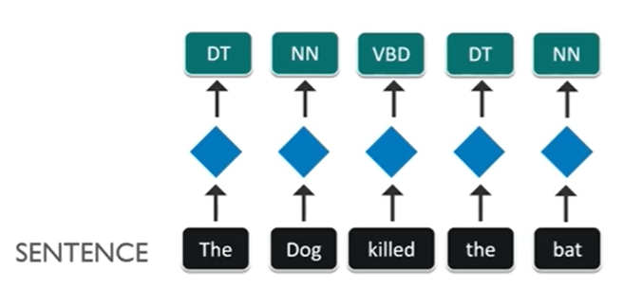
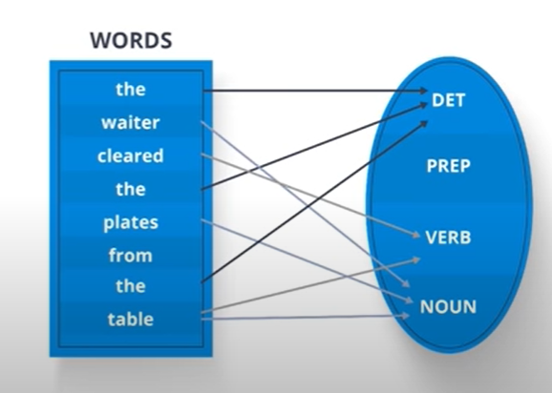
POS Example

Slide 21
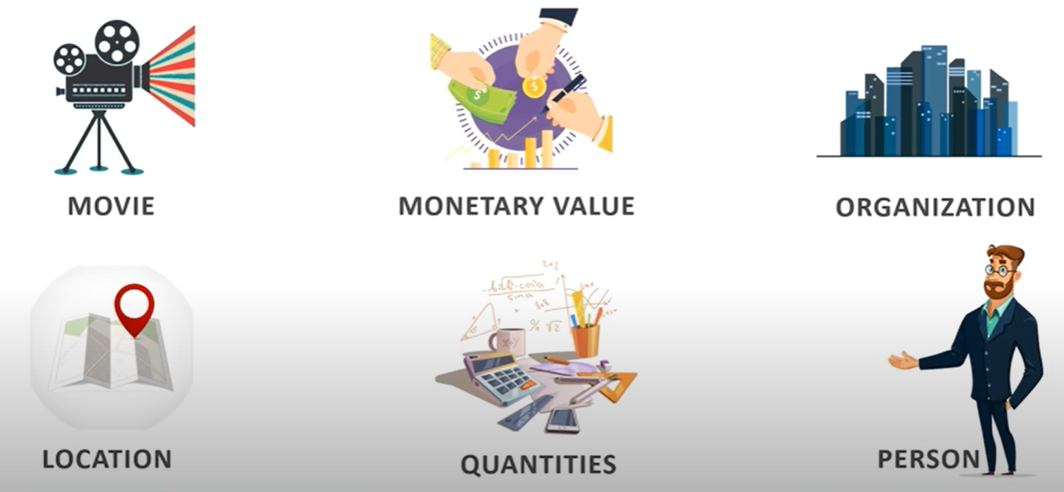
Named Entity Recognition
NER: It is the process of detecting named entities.

Slide 22
NER : Example
Google’s CEO Sundar Pichai introduced the new pixel at Minnesota Roi Centre Event
Organization
Person
Location
Organization

Slide 23
Chunking
Picking up the individual pieces of information and Grouping them into bigger pieces
We Caught the Black Panther
PRP
VBD
DT
JJ
NN
NP
NP
CHUNKS

