Slide 1

Arts and culture
+++

Slide 2
INTRODUCTION OF CULTURE
Culture refers to the shared beliefs, values, traditions, and practices of a group of people, passed down through generations.
Shared:
Cultural elements are not individual creations, but rather are shared by a group.
Learned:
Individuals acquire culture through observation, education, and social interaction.
Symbolic:
Culture relies on symbols, including language, to communicate meanings and values.
Integrated:
Cultural elements are interconnected and interdependent, influencing one another.
Dynamic:
Culture is not static; it evolves and changes over time as societies adapt to new circumstances.

Slide 3
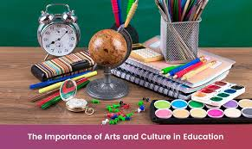
WHAT IS ART?
Art mean various branches of creative activities, such as painting, music, literature, and dance.

Slide 4
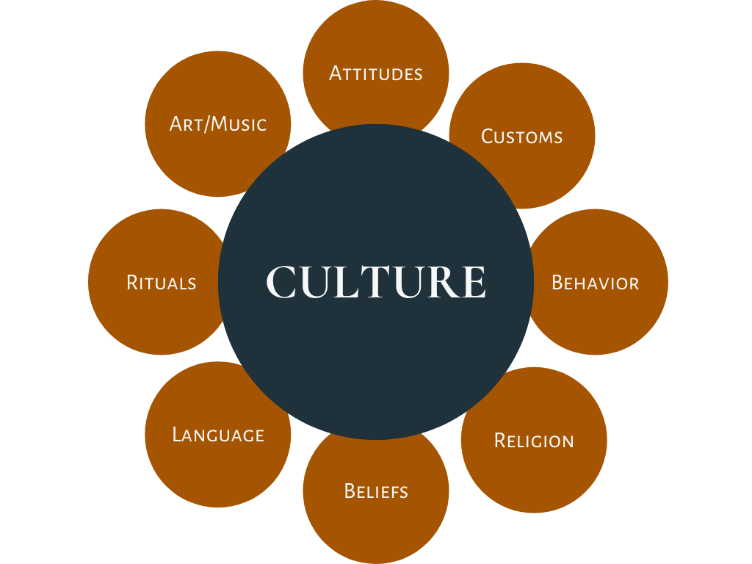
What is culture?
Culture is a shared way of life that includes beliefs, values, practices, and behaviors. It can also refer to the arts and material objects that represent a group of people. Culture is dynamic and can change over time.

Slide 5
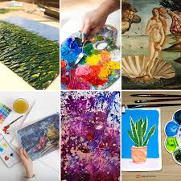
Types of arts
High Culture:

Slide 6
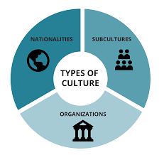
Types of culture
High Culture:
Low culture:
Folk Culture:
Popular Culture:
Organizational Culture:

Slide 7
Similarites between of arts and culture
Art is a subtype of cultur
Every culturepromotes and art
Every culture has a specific type of art in different forms like craft, dance, calligraphy etc.

Slide 8
Countries with rich art and cuture
Pakistan
India
Iran
UAE
Sri Lanka
Bangladesh
Turkey
Thailand

Slide 9
importants
Most simple terms is communication
Medium to express ideas and to share information
Art highlights the beauty of culture

Slide 10


