Slide 1

SMART INDIA HACKATHON 2026
TITLE PAGE
Problem Statement ID –26212
Problem Statement Title-Student Innovation-Solutions could be in the form of waste segregation, disposal, and improve sanitization system.
Theme- Clean & Green Technology
PS Category- Hardware
Team ID-179046
Team Name-BioBreath

Slide 2
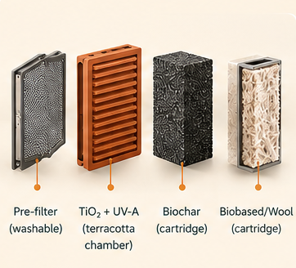
VayuJeeva
BioBreath
VayuJeeva BioWall – Smart Source-Capture System for Sustainable Indoor Environmental Sanitization
Proposed Solution:
Source Capture: Captures pollutants at the point of generation before they disperse indoors.
Multi-Stage Treatment: Combines washable pre-filtration, TiO₂ + UV-A, biochar and a biobased/wool cartridge.
Smart Control: ESP32-based PM/VOC/T-RH/pressure sensing enables adaptive airflow and IoT monitoring.
Sustainable Design: Uses a terracotta housing with replaceable cartridges, supporting modular maintenance and resource-efficient operation.
Innovation & Uniqueness:
Hybrid Source Treatment: Source capture with TiO₂ + UV-A, biochar and biobased filtration.
Smart Sustainability: ESP32 sensing, adaptive airflow and replaceable cartridges.
How it addresses the problem:
Prevents pollutant spread: Captures pollution at the source before it disperses across the indoor environment.
Improves sanitization: Uses multi-stage filtration and treatment to reduce particulate and suitable organic pollutants.
Enables intelligent operation: Real-time sensors detect pollution levels and automatically adjust system operation.
Reduces resource and maintenance burden: Modular terracotta housing and replaceable treatment cartridges support reusable, serviceable operation

Slide 3
TECHNICAL APPROACH
BioBreath
SOURCE-LEVEL CAPTURE
Smart inlet + Variable-Speed Blower
PHOTOCATALYTIC TREATMENT
TiO₂-Coated Terracotta + Shielded UV-A
ADSORPTION
Coconut-Shell Biochar Cartridge
BIOBASED TREATMENT
Wool / Biobased Cartridge
PRE-FILTRATION
Washable PM & Grease Filter
PERFORMANCE VALIDATION
PM/VOC reduction + airflow + power + pressure drop
SENSING & CONTROL
PM2.5 + VOC + T/RH + Pressure Sensors
CONTROLLED AIR OUTLET
IoT MONITORING & MAINTENANCE ALERT
ADAPTIVE AIRFLOW CONTROL
ESP32 PROCESSING
TECHNOLOGIES USED:
ESP32 & IoT
PM2.5 & VOC Sensing
TiO₂ Photocatalysis + UV-A
Biochar Adsorption
Adaptive Airflow Control
Terracotta-Based Filtration
Biobased/Wool Filtration
IoT Dashboard
ITERATE & OPTIMIZE
Youtube link: https://youtu.be/Gjkb1LPXgA8
Github link: https://github.com/saniyabeig789-cyber/VayuJeeva-SIH2026

Slide 4
FEASIBILITY AND VIABILITY
BioBreath
ANALYSIS OF FEASIBILITY OF IDEA:
Technical Feasibility: Uses readily available ESP32, sensors, blower, TiO₂, UV-A and biochar components.
Economic & Environmental Feasibility: Low-cost terracotta and bio-based materials enable affordable, resource-conscious construction.
Operational Feasibility: Source capture, modular cartridges and sensor-controlled airflow simplify operation and maintenance.
Scalability & Validation:Modular design enables diverse indoor deployment with measurable PM/VOC, airflow, and power performance.
Strategies to Overcome Challenges:
Smart & Affordable: Low-cost sensors with ESP32-based monitoring.
Energy Efficient: Adaptive fan control reduces power consumption.
Easy Maintenance: Replaceable, low-cost cartridges.
Sustainable: Terracotta and biochar reduce material and energy costs.
Safe & Reliable: Shielded UV with automatic shut-off.
Simple Validation: Repeated PM/VOC and airflow testing.
Potential Challenges & Risks:
Sensor Accuracy & Calibration
Airflow, Pressure Drop & Power Consumption
Filter/Cartridge Maintenance
UV & Bio-Cartridge Safety
Long-Term Performance Validation

Slide 5
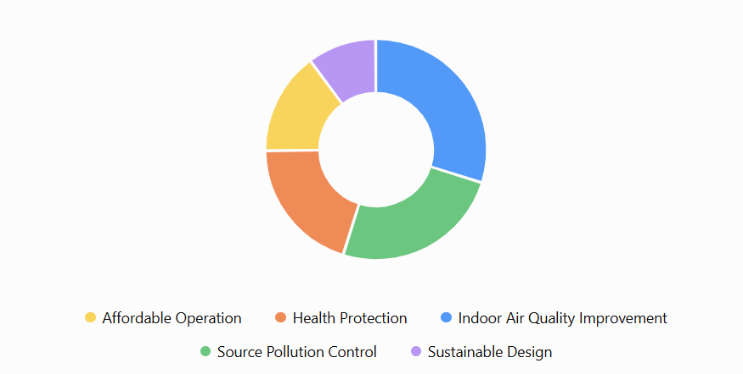
IMPACT AND BENEFITS
BioBreath
Target Audiences:
Households & Kitchens
Schools & Classrooms
Clinics & Small Healthcare Facilities
Small Shops & Workspaces
Restaurants & Food Businesses
Institutions & Community Spaces
Benefits of the Solution:
Healthier Indoor Air – Reduces PM and suitable VOC exposure.
Source-Level Capture – Controls pollution before it spreads.
Affordable & Sustainable – Low-cost, low-power, eco-friendly design.
Smart & Modular – Automated monitoring with easy cartridge replacement.
Potential Impact on Target Audience:
Health Protection: Reduces exposure to indoor PM and VOC pollution.
Cleaner Spaces: Improves indoor environmental quality at pollution sources.
Affordable Access: Low-cost, modular design suits homes, classrooms and small businesses.
Smart Awareness: Real-time monitoring helps users understand and manage pollution.
Sustainable Use: Low-power operation and replaceable components reduce resource consumption.
10%
15%
30%
20%
25%
Potential Benefit Distribution of VayuJeeva BioWall

Slide 6
RESEARCH AND REFERENCES
BioBreath
WHO – Household Air Pollution & Health
Covers global exposure, health impacts and household pollution sources. World Health Organization
WHO Household Air Pollution
WHO – Exposure to Health-Damaging Air Pollutants
Provides evidence on health risks associated with PM and other air pollutants. World Health Organization
WHO Air Pollution Exposure Report
Haghighat et al. – TiO₂ Photocatalytic Oxidation for Indoor VOC Removal
Reviews TiO₂-based photocatalytic oxidation for indoor VOC treatment and discusses its limitations. ScienceDirect
Research Paper – TiO₂-Based PCO
Haghighat et al. – Photocatalytic Oxidation for Indoor Air Purification
Reviews the use of TiO₂ photocatalysis for VOC removal in indoor environments. ScienceDirect
Research Paper – Indoor Air PCO

