Slide 1


Page Replacement Algorithm
(LRU)
This presentation explores the Least Recently Used (LRU) page replacement algorithm, a fundamental concept in operating systems memory management. We'll delve into its definition, implementation, advantages, disadvantages, and practical applications.
by Saniya Momin
Roll.No:2405030
Sub: CSF
College:GMFC

Slide 2
Introduction to Page Replacement
What is a Page Replacement Algorithm?
Why is it Important?
A page replacement algorithm determines which page in memory should be replaced when a new page needs to be loaded. This is crucial for efficient memory management in operating systems.
Page replacement algorithms ensure that frequently used pages remain in memory, minimizing the number of page faults and improving system performance.

Slide 3

What is LRU?
The Least Recently Used (LRU) algorithm replaces the page that has not been used for the longest period of time. This strategy aims to keep frequently accessed pages in memory, reducing the likelihood of page faults.
LRU is commonly implemented in memory management systems to optimize memory utilization and improve overall system performance.

Slide 4
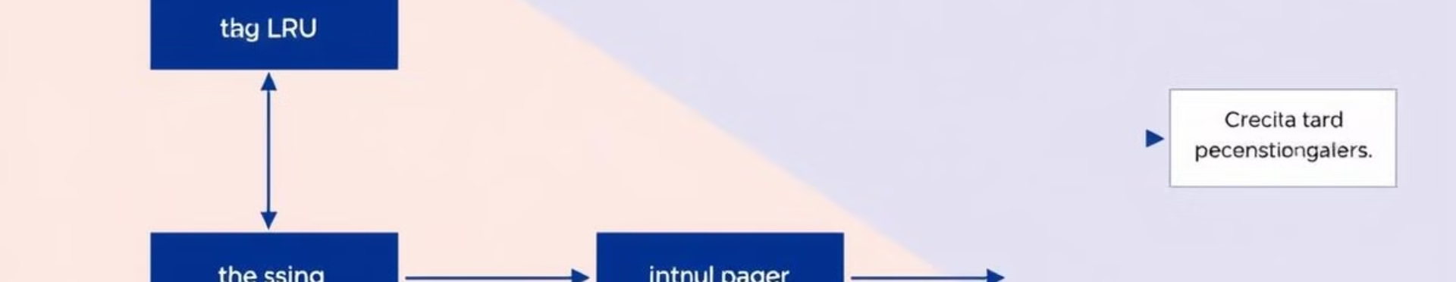
How LRU Works
1
Track Page Usage
2
Replace Least Recently Used
3
Methods for Tracking Usage
The LRU algorithm keeps track of the last access time for each page in memory.
When memory is full and a new page needs to be loaded, the page with the oldest access time is replaced.
LRU implementation can use counter-based or stack-based approaches to efficiently track page usage.

Slide 5
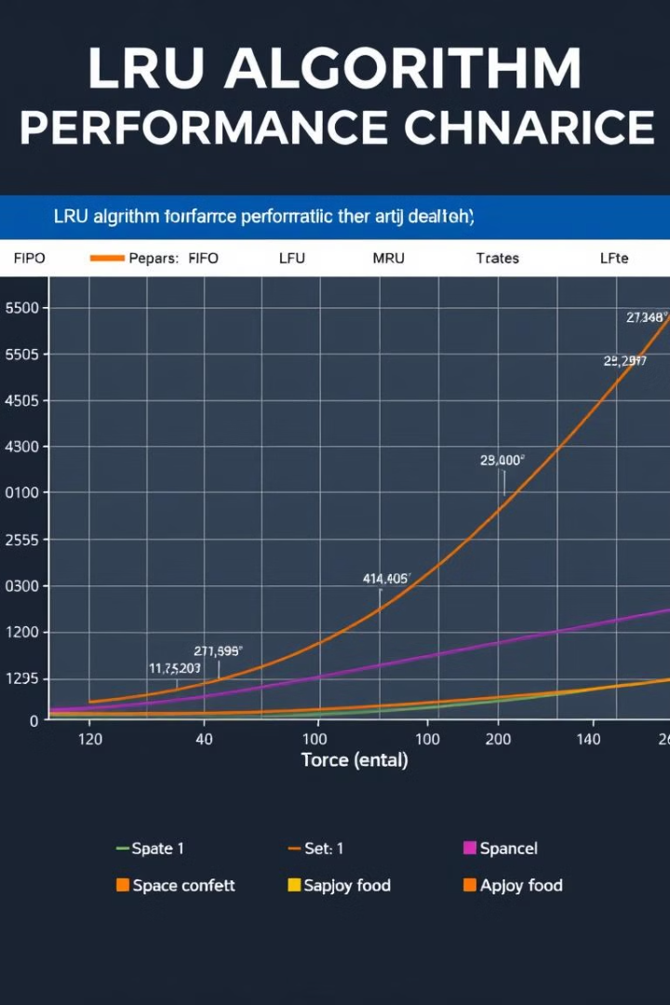
Advantages of LRU
Adapts to Program Behavior
Minimizes Page Faults
LRU minimizes page faults in many practical scenarios, leading to improved system performance.
LRU adapts to the actual access patterns of programs, making it effective for a wide range of applications.
Simple Implementation
LRU is relatively simple to implement using modern data structures, making it practical for real-world systems.

Slide 6
Disadvantages of LRU
Overhead
Not Suitable for All Access Patterns
LRU requires tracking page usage history, which can introduce overhead and potentially impact performance.
LRU may not be the most efficient algorithm for all access patterns, especially those with unpredictable or cyclical behavior.

Slide 7
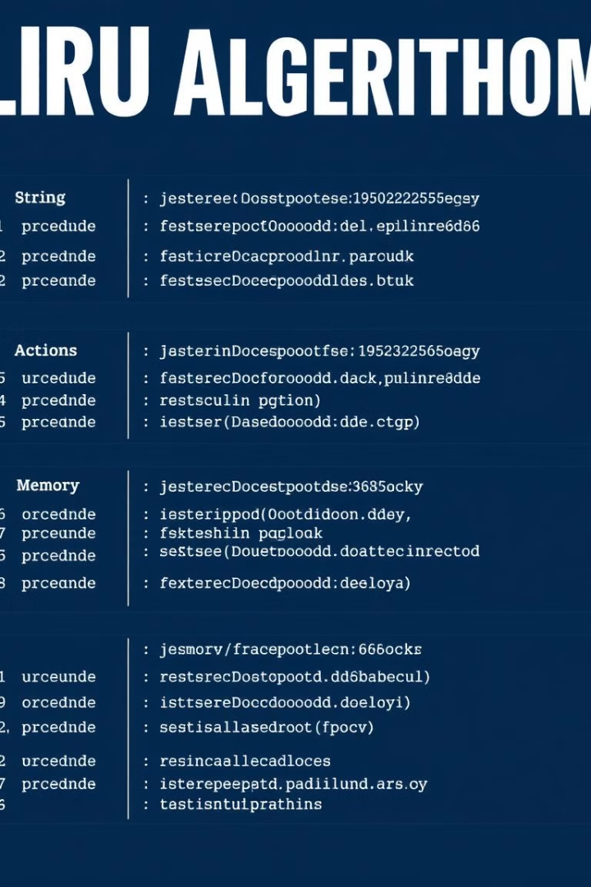
LRU Example (Step-by-Step)
Time Step
Reference String
Memory Frames
Page Fault?
1
7
[7]
Yes
2
0
[7, 0]
Yes
3
1
[7, 0, 1]
Yes
4
2
[0, 1, 2]
Yes
5
0
[1, 2, 0]
No
6
3
[2, 0, 3]
Yes
7
0
[0, 3, 0]
No
8
4
[3, 0, 4]
Yes

Slide 8




Applications of LRU
Operating System Memory Management
Cache Replacement Policies
Database Management Systems
LRU is applied in cache management to determine which cache entries to replace when the cache is full.
LRU is widely used in operating systems to manage virtual memory and optimize page replacement.
LRU is used in database systems to manage buffer pools and optimize data access.

Slide 9



Conclusion
1
Efficient for Predictable Access
2
Trade-offs Between Simplicity and Performance
3
Widely Used in Operating Systems and Other Applications

Slide 10


