Slide 1


PROGRAMME
«Zhasyl Damu» («Green development») for the years 2010-2014
Ministry of Environment Protection of the Republic of Kazakhstan

Slide 2
The Reason for adopting the Program
The Program was developed according to the Commissions of the President of the Republic of Kazakhstan, the Prime-Minister and the Head of Administration of the President on creating the conditions on preservation and natural ecosystem restoration
The Strategic Development Plan of the Republic of Kazakhstan till 2020
Necessity of development of economic tools and scientific maintenance of wildlife management, expansion of international cooperation by working out of a complex of measures on low carbon emission development in Kazakhstan
  The Program is developed by the Ministry of Environment Protection of RK and accepted at the Government session on September, 2nd, 2010

Slide 3
Main Tasks
Task 1: Development of the "green economy» by means of introduction of clean technologies, saving natural resources, increasing energy efficiency
Task 2: Decrease in anthropogenous influence on components of environment and human health by improving the quality of atmospheric air, decreasing the pollution of water resources, liquidations of "historical" wastes
Task 3: Preservation and restoration of natural ecosystems for creating the conditions for transition to sustainable development by preventing desertification and land degradation, planting forests and increasing the areas of protected natural territories
Task 4: Rehabilitation of ecological disaster zones and territories affected by radiation, chemical and biological pollution (Semipalatinsk region, the Aral Sea region, etc.)
Task 5: Development and perfection of a control system by the quality of environment

Slide 4
The Programme also provides:
Decrease of negative motor transport impact
Introduction of automated continuous emission control on sources and in sanitary-protective zones of the large industrial enterprises
Realisation of the projects on building, reconstruction and modernisations of systems of water consumption, water removal and sewer treatment facilities in large cities and human settlements
Working out the stimulation mechanisms for enterprises for waste recycling and processing

Slide 5
Terms of the Program Implementation
1 stage (2010 - 2012) - organizational actions for decrease in level of pollution and rational use of environment
2 stage (2013 - 2014) - improvement of the quality of environment management

Slide 6
Budget of the Program and its funding sources
The general budget of the Program will make 163,5 billion tenge (1,112 billion $)
Financing sources:
  The republican budget
  Local budgets
  Loans
  The international grants
Own funds of enterprises

Slide 7
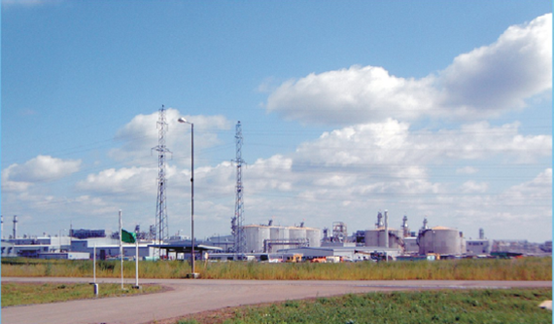
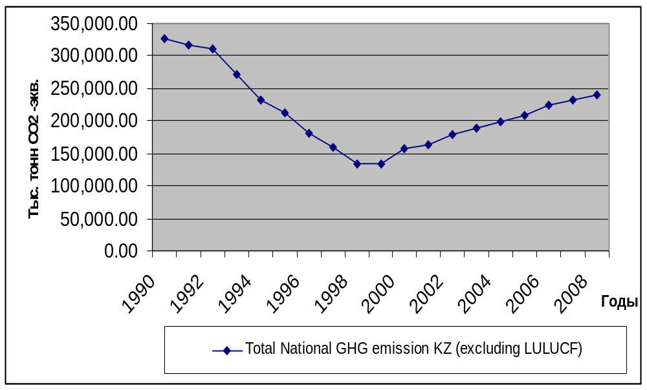
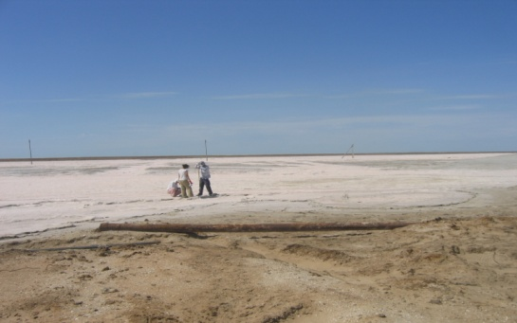
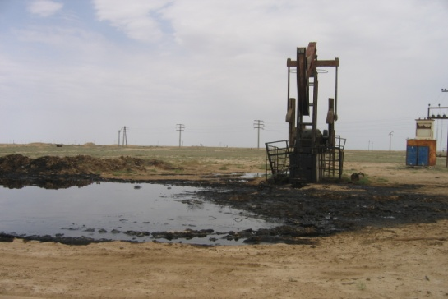
Main environmental problems of Kazakhstan
Climate change and greenhouse gas emissions

Slide 8
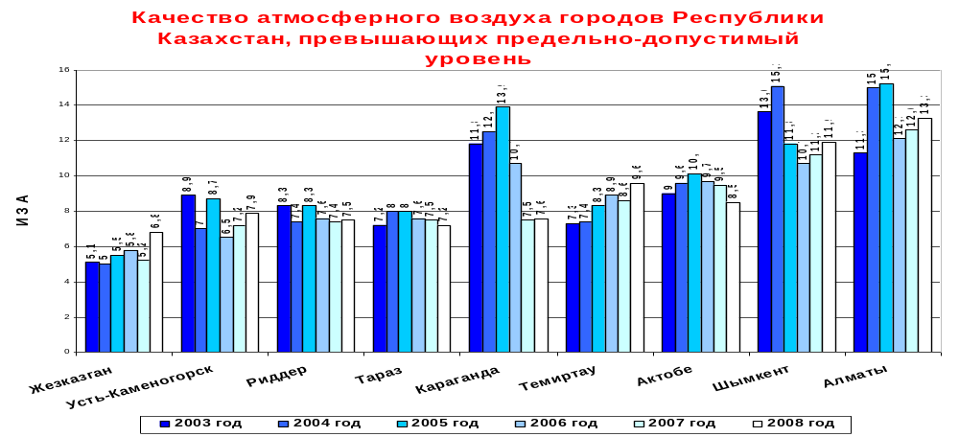
Main environmental problems of Kazakhstan
Atmospheric air pollution
Emissions of industrial enterprises of Kazakhstan into the atmosphere make now about three million tons a year from which 85 % produce by 43 large enterprises. The contribution of motor transport to air pollution reaches 60 %.
Admissible level

Slide 9
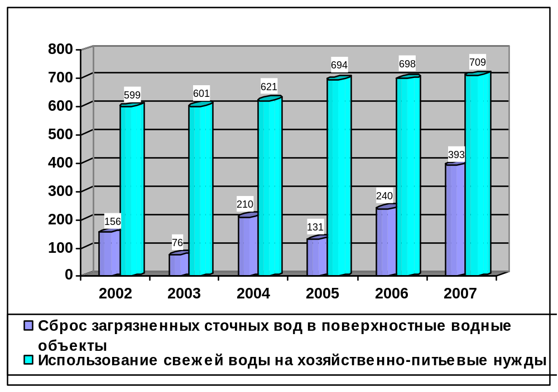
Main environmental problems of Kazakhstan
        Irrational use and pollution of water resources
Intensive pollution of water objects by enterprises of mining, metallurgical and chemical industry, municipal services by copper, sulphates, iron, nitrites, phenols, mineral oil
95,2% of city and 57,2% of rural population have access to drinking water
Dynamics of fresh water use for domestic needs and discharge of polluted waste waters into the surface water objects of the Republic of Kazakhstan

Slide 10
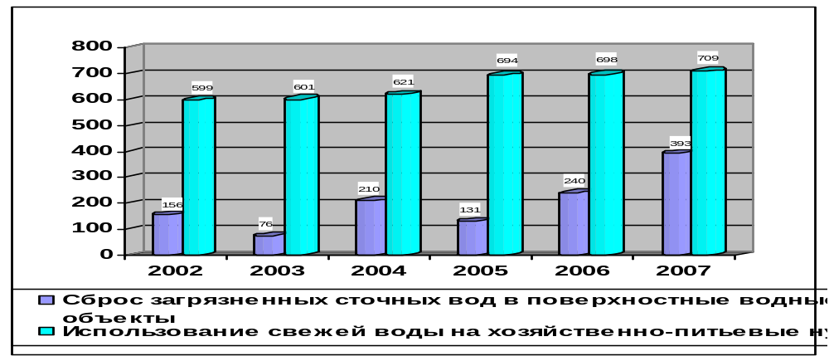
Main environmental problems of Kazakhstan
        Irrational use and pollution of water resources
Intensive pollution of water objects by the enterprises of the mining, metallurgical and chemical industry, municipal services copper, sulphates, iron, nitrites, phenols, mineral oil
To potable water 95,2 % of city and 57,2 % of agricultural population have access

Slide 11
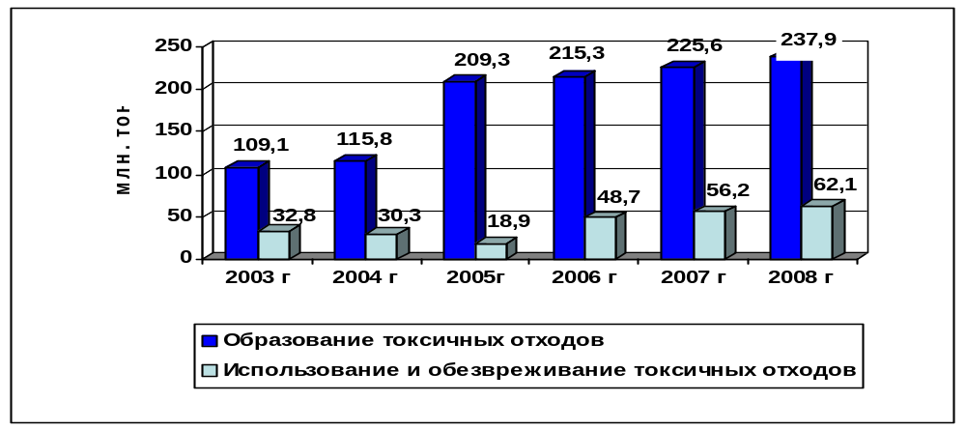
Main environmental problems of Kazakhstan
Industrial waste accumulation
To date 34 billion tons of Industrial waste have been accumulated, and the tendency of their annual growth is now observed. About 250 million tons of toxic wastes are produced by the enterprises of Kazakhstan annually, from them only 18.5 % is used by enterprises and neutralized. In developed countries this indicator exceeds 30 %.
The great bulk of municipal waste in Kazakhstan (more than 97 %) is taken out and stored on the open dumps without sorting,

Slide 12
The expected results will be as follows
considerable improvements of many ecological indicators in Kazakhstan by the year 2014
In particular:
  the average index of air pollution in cities will not exceed the permissible levels
  the share of treated wastes will reach 21.9 %
  the area of forests will be increased by 38 %;
  the funding for scientific research from the total amount of budget expenses for nature protection will increase from 1.5 % to 5 %

Slide 13
THANK YOU FOR ATTENTION!
Irina Yesserkepova, Expert
of Kazakh Scientific Research Institute
for Ecology and Climate
of The Ministry of Environmental Protection of Kazakhstan

