Slide 1

Introduction to Generative AI & Architectures

Slide 2
What makes GenAI different from ML pipelines
Traditional ML pipelines
Designed and trained for a single, specific task
Identifying spam
Predicting house prices
GenAI models
Large Language Models (LLMs)
Act as programmable reasoning components
Adapted to many different tasks through natural language

Slide 3
Discriminative AI ( The Critic)
Its job is to classify or predict a label.
Input
An image of a dog
Output
Label "Dog"
Math
It models the Conditional Probability P(y|x) (Probability of label y given input x )
It draws a line (boundary) between classes.

Slide 4
Generative AI (The Artist)
Its job is to create new data instances that look like the training data.
Input
Random noise or a text prompt.
Output
A brand-new image of a dog that has never existed before.
Math
It models the Joint Probability or just the distribution of the data.
It tries to understand how the data was created so it can make more of it.

Slide 5
Text Generation (The Foundation)
Mechanism
It treats text as a sequence of tokens
Objective
Predict the next token based on probability
Key Innovation
Attention Mechanism, which allows the model to maintain context over long sequences

Slide 6
Image Generation Architectures
How do we teach a computer to dream an image?
We have developed three major architectures over time
Variational Autoencoders (VAEs) to Generative Adversarial Networks (GANs) to Diffusion Models (The Modern Standard)

Slide 7
Variational Autoencoders (VAEs)
The Probabilistic Compressor
Concept
You take an image, compress it into a tiny vector of numbers (Latent Space), and then try to uncompress it back to the original.
The Trick
We force that tiny vector to follow a Gaussian (Bell Curve) distribution.
Generation
To create a new image, we just sample a random point from that Bell Curve and ask the Decoder to uncompress it.
Result
Blurry but coherent images.

Slide 8
Generative Adversarial Networks (GANs)
The Forger vs. The Detective
Introduced by Ian Goodfellow in 2014, this uses two neural networks fighting each other.
The Generator (G)
Tries to create fake images to fool the detective.
The Discriminator (D)
Tries to catch the fakes.

Slide 9
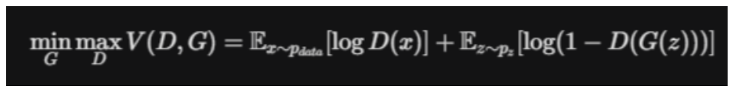
Generative Adversarial Networks (GANs)
The Math (Minimax Game)
They play a zero-sum game. The Generator wants to minimize the value function V(D,G) , while the Discriminator wants to maximize it.
Result
Sharp, realistic images, but very hard to train (unstable).

Slide 10
Diffusion Models (The Modern Standard)
The Fog Strategy.
Used by Stable Diffusion, DALL-E 3, and Midjourney.
Diffusion models win because they are stable and mathematically robust. They work in two steps:
Forward Diffusion (Destroying Data)
Reverse Diffusion (Creating Data)

Slide 11
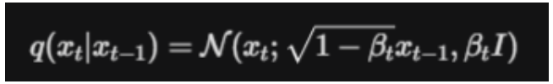
Diffusion Models (The Modern Standard)
Forward Diffusion (Destroying Data)
Take a clear image and slowly add Gaussian noise to it over 1,000 steps until it is pure static (random noise).
Reverse Diffusion (Creating Data)
Train a neural network (usually a U-Net) to predict the noise and subtract it.
If you start with pure static and subtract the predicted noise 1,000 times, you reveal a crisp, new image.

Slide 12
Video Generation (Space-Time)
Video is just a stack of images that change over time.
To generate video, we combine Transformers with Diffusion.

Slide 13
The Architecture - Spatiotemporal Transformers
Models like Sora use a Diffusion Transformer (DiT) architecture.
Patches (The Tokens)
Instead of breaking an image into 2D squares (patches), we break a video into 3D cubes (Spatiotemporal Patches)
A cube contains pixels (x,y) over a brief duration (t).
3D Attention
The Transformer pays attention to these cubes
It learns that if a ball cube is at location(10,10) at time t=1, it should be at at (10,12) at time t=2 due to gravity.
Generation
It diffuses (removes noise from) these 3D cubes simultaneously, ensuring the video is consistent in space (looks good) and time (moves smoothly).

Slide 14
Multimodal Models (Connecting Text & Images)
How do we control these image generators with text?
We need a model that understands both modalities.
The industry standard is CLIP (Contrastive Language-Image Pre-training).
CLIP Architecture
CLIP trains two Encoders simultaneously:
Text Encoder: Turns text into a vector.
Image Encoder: Turns images into a vector.

Slide 15
The Training Game (Contrastive Learning)
We feed the model millions of Image-Text pairs
e.g.,: a photo of a dog and the caption "A cute dog"
The model must move the vector for the image of the dog and the text "A cute dog" closer together in mathematical space.
It must move the vector for "A cute dog" and a photo of a banana farther apart.

Slide 16
Multimodal (CLIP)
The Math (Dot Product maximization):
We want to maximize the dot product similarity between correct pairs () and minimize it for incorrect pairs.
Why this matters
When you type "A futuristic city" into Midjourney, the AI uses CLIP to find the mathematical vector for that phrase, then uses Diffusion to generate an image that matches that vector.

Slide 17
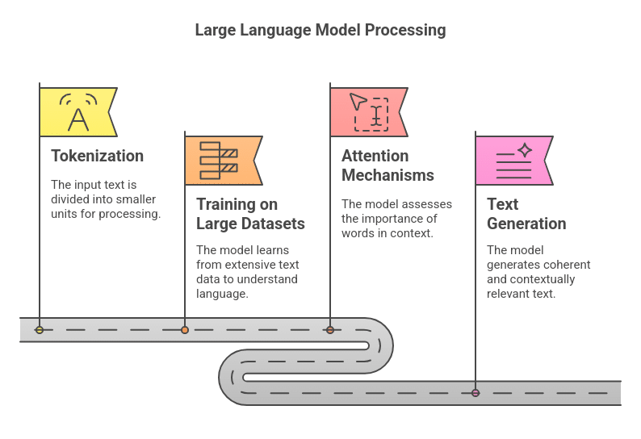

Slide 18
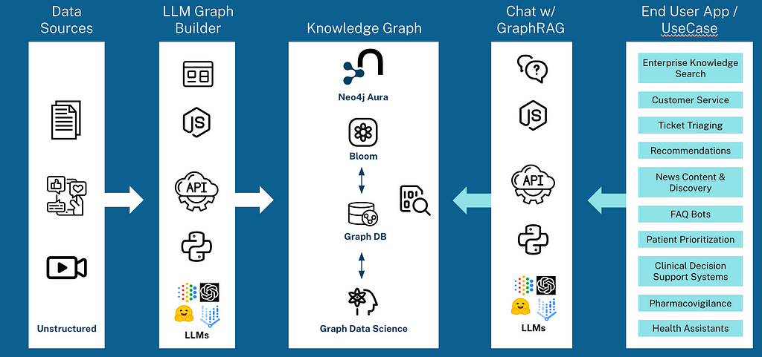

Slide 19
What makes GenAI different from ML pipelines
Feature | Traditional ML Pipelines | GenAI / Agentic Systems
Primary Goal | Task-specific prediction (e.g.: classification, regression). | General-purpose reasoning and content generation.
Core Component | Specialized algorithms/pipelines for a single task. | LLMs used as programmable reasoning components.
Logic Layer | Hard-coded logic and feature engineering. | Natural language prompts acting as the interface.
Model Usage | Often requires custom training or fine-tuning. | Focus on black-box inference using pre-trained models.
Input Handling | Structured data or specific feature vectors. | Tokens, context windows and unstructured text.
Control Levers | Hyperparameter tuning during training. | Prompt engineering and sampling (Temperature, Top-k/p).
Output Type | Deterministic values or labels. | Probabilistic text, JSON, or tool-calling actions.

Slide 20
The GenAI Pipeline
Stage 1
Pre-Training (The Foundation)
What happens
The model reads the entire internet to learn "World Knowledge."
Cost
Millions of dollars.
Outcome
A "Foundation Model" (Base GPT-4, Llama 3) that can speak fluently but has no specific instructions.

Slide 21
The GenAI Pipeline
Stage 2
SFT (Supervised Fine-Tuning)
The Shift
We move from "predicting the next word" to "following instructions."
Action
We feed the model Q&A pairs (Instruction Response).
Result
The model learns to act like an assistant rather than just a document completer.

Slide 22
The GenAI Pipeline
Stage 3
RLHF (Reinforcement Learning from Human Feedback)
The Alignment
This step does not exist in traditional ML.
Problem
The model might be toxic or hallucinations.
Solution
Humans rank the AI's answers (A is better than B).
A Reward Model is trained to guide the AI toward "helpful and harmless" outputs.

Slide 23
The GenAI Pipeline
Stage 4
RAG (Retrieval-Augmented Generation)
The Context Bridge
Traditional ML retrains to learn new data.
GenAI uses RAG.
Mechanism
Instead of retraining the model on your company PDF, you:
Search your PDF for relevant text.
Paste that text into the prompt.
Ask the GenAI to answer based only on that text.

Slide 24
LLM Training vs. Inference
Training
The massive, resource-intensive process
A model learns from a dataset to predict the next token
Inference
The act of using a pre-trained model
To generate a response based on an input
The Shift
In Agentic AI, we treat the LLM as a Black-Box Component
We don't modify its internal weights
We focus on how to call it effectively.

Slide 25
LLM Training vs. Inference
Feature | Training (Development Phase) | Inference (Usage Phase)
Goal | Create the model's knowledge base. | Apply knowledge to solve a specific task.
Compute | High (Thousands of GPUs for months). | Low (Can run on CPU/Local hardware).
Data | Trillions of tokens from the web. | A single user prompt and specific context.
Cost | Millions of dollars in capital. | Fractions of a cent per request.

Slide 26
Why the Black-Box Model Matters
LLM as a Reasoning Component
We treat the model as a programmable part of our software
similar to an API or a database
Input vs. Output
The box is black (hidden internals)
Our primary control is the Prompt

Slide 27
Why the Black-Box Model Matters
Execution Realities
We must manage the trade-offs that occur during this usage phase
Latency
How long the black box takes to process the request
Cost
Managing token usage for every API call
Determinism
Ensuring the box gives consistent answers for the same input

Slide 28
Analogy
Training - Going to University
Inference - Performing a Job
As developers in this program, we are the Managers hiring the graduate (the LLM)
We don't need to re-teach them everything
We just need to give them the right instructions (Prompts)

Slide 29
The Currency of LLMs - Tokens & Context Windows
Tokens
The atomic units of text processed by the model
These aren't always full words
They can be characters or sub-words
e.g.: learning might be learn + ing
Context Window
The specific memory limit for a single interaction
It represents the maximum number of tokens the model can process at once
The Constraint
If a prompt and its response exceed the context window, the model will forget the earliest parts of the conversation

Slide 30
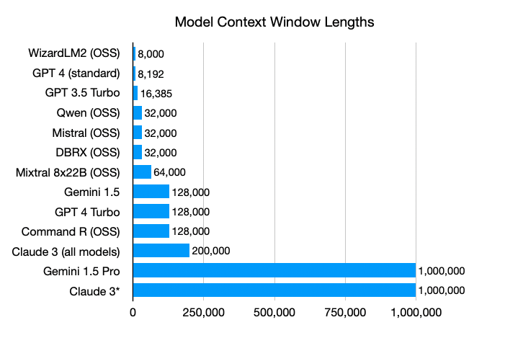

Slide 31
Tokens and Context Window
Think of tokens as the model's vocabulary
We pay for what we use
Understanding tokens is key to managing cost and latency
The context window is like a desk
Once it's full, you have to move old papers off to make room for new ones

Slide 32
Controlling Creativity - Temperature
A parameter that controls the randomness of the model's output
Low Temperature (0.0 - 0.3)
Deterministic and focused
Coding, factual retrieval, and data extraction where accuracy is critical
High Temperature (0.7 - 1.0+)
Diverse and creative
Brainstorming, creative writing, or roleplay

Slide 33
Temperature
Find the Balance Between Logic and Imagination
For our Agentic systems, we will often keep temperature low to ensure determinism—we want our tools to behave the same way every time we run them

Slide 34
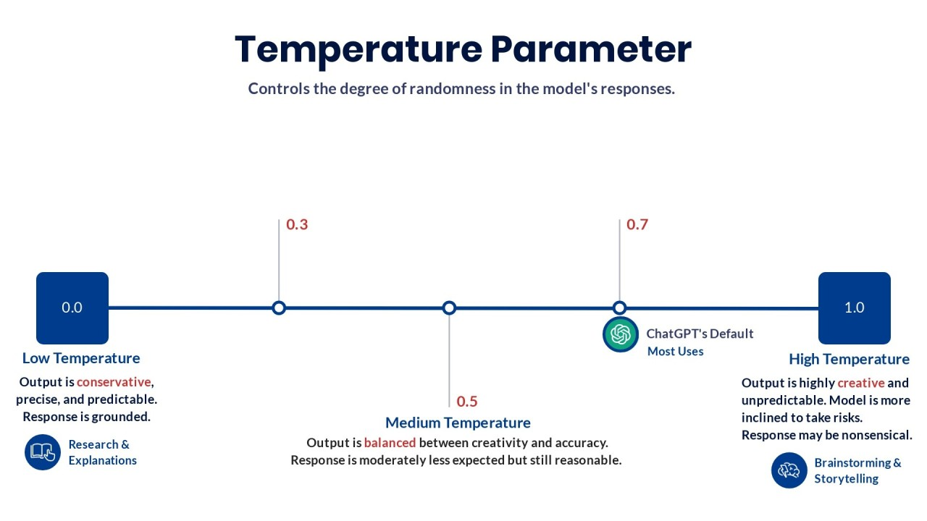

Slide 35
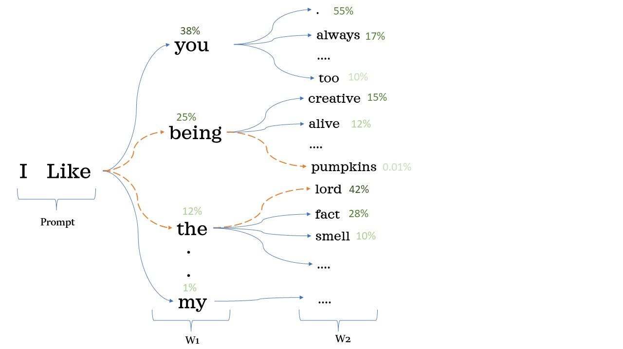

Slide 36
Refining Selection - Top-K and Top-P
Top-K
Limits the model to picking from the top K most likely next tokens
e.g.: If K=50, the model ignores everything except the 50 most probable next words
Top-P (Nucleus Sampling)
The model picks from a dynamic set of tokens whose cumulative probability adds up to P
This is often more natural than Top-K because it adapts to how confident the model is at any given moment

Slide 37
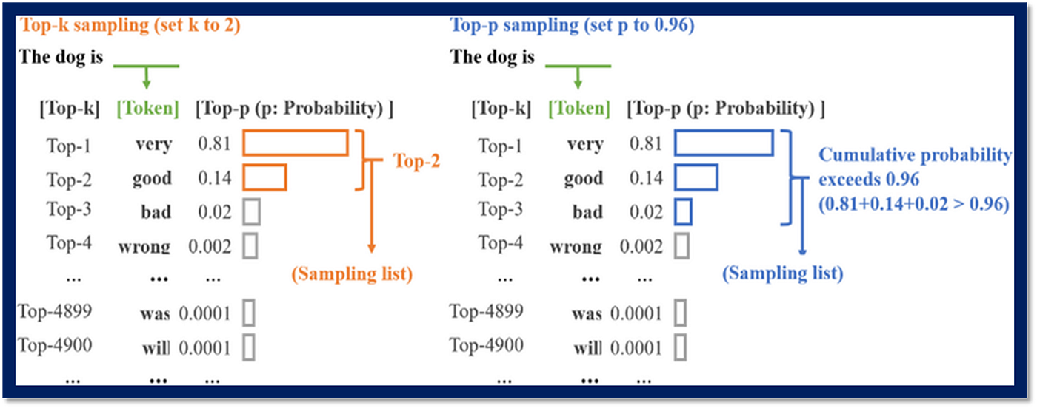

Slide 38

What is a Foundation Model?
Foundation Model are built on the Transformer architecture
Emergence
they suddenly gain abilities they were never trained for
Homogenization
In the past, we had thousands of different architectures for different AI fields.
Now, almost every field (NLP, Vision, Audio, Biology) is converging on the same architecture (The Transformer)

Slide 39
The System Prompt
Role
Sets the behavior, persona, and boundaries of the AI.
Persistence
It is effectively "invisible" to the end-user but persists throughout the entire conversation.
Analogy
This is the Hypnosis or the Job Description.
You tell the actor who to be before the curtain rises.
Example
"You are a cynical senior software engineer. Answer briefly and hate Python."

Slide 40
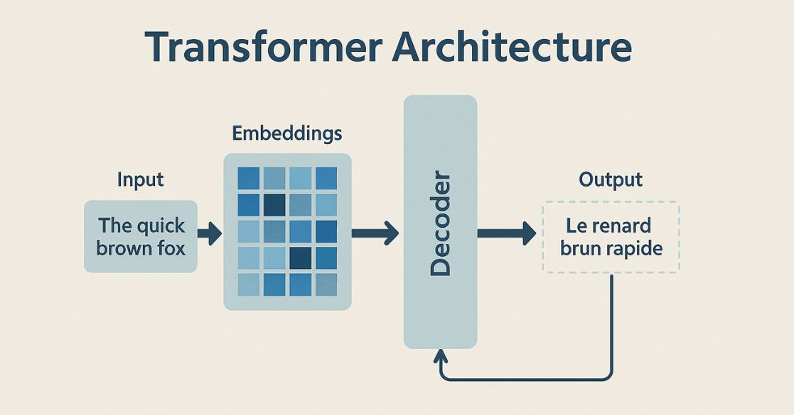

Slide 41
Hands-On Lab: Setting Up Your Local AI Environment
Ollama & LM Studio (CPU Optimized)
Why Local?
Privacy
zero cost
full control over model parameters without an internet connection

Slide 42
Run Ollama or LM Studio locally (CPU)
Ollama (CLI Focused)
Download from ollama.com
Run ollama run llama3.2:1b (or gemma2:2b) for a lightweight CPU experience
LM Studio (GUI Focused)
Download the installer from lmstudio.ai
Search the Discover tab for GGUF models and click Download

Slide 43
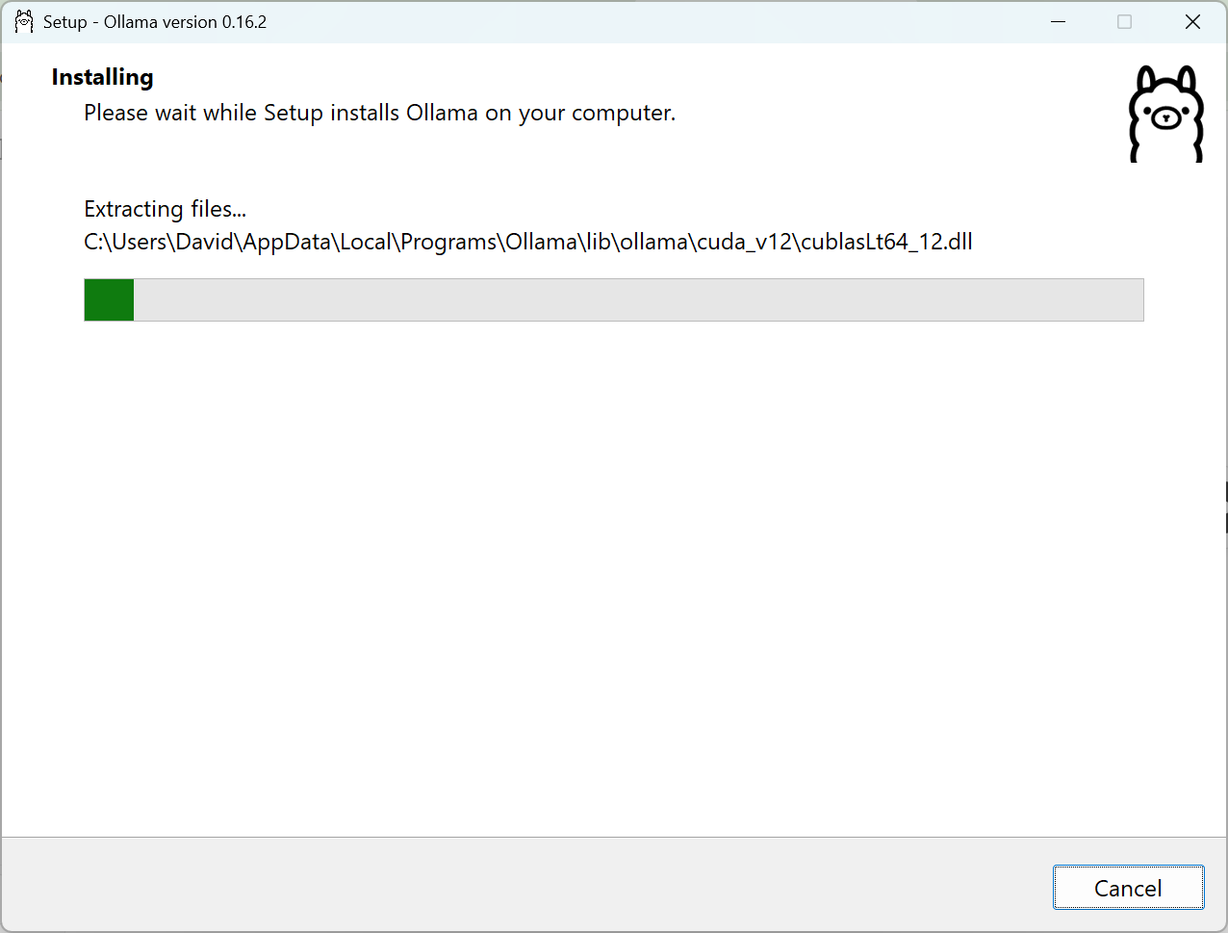

Slide 44
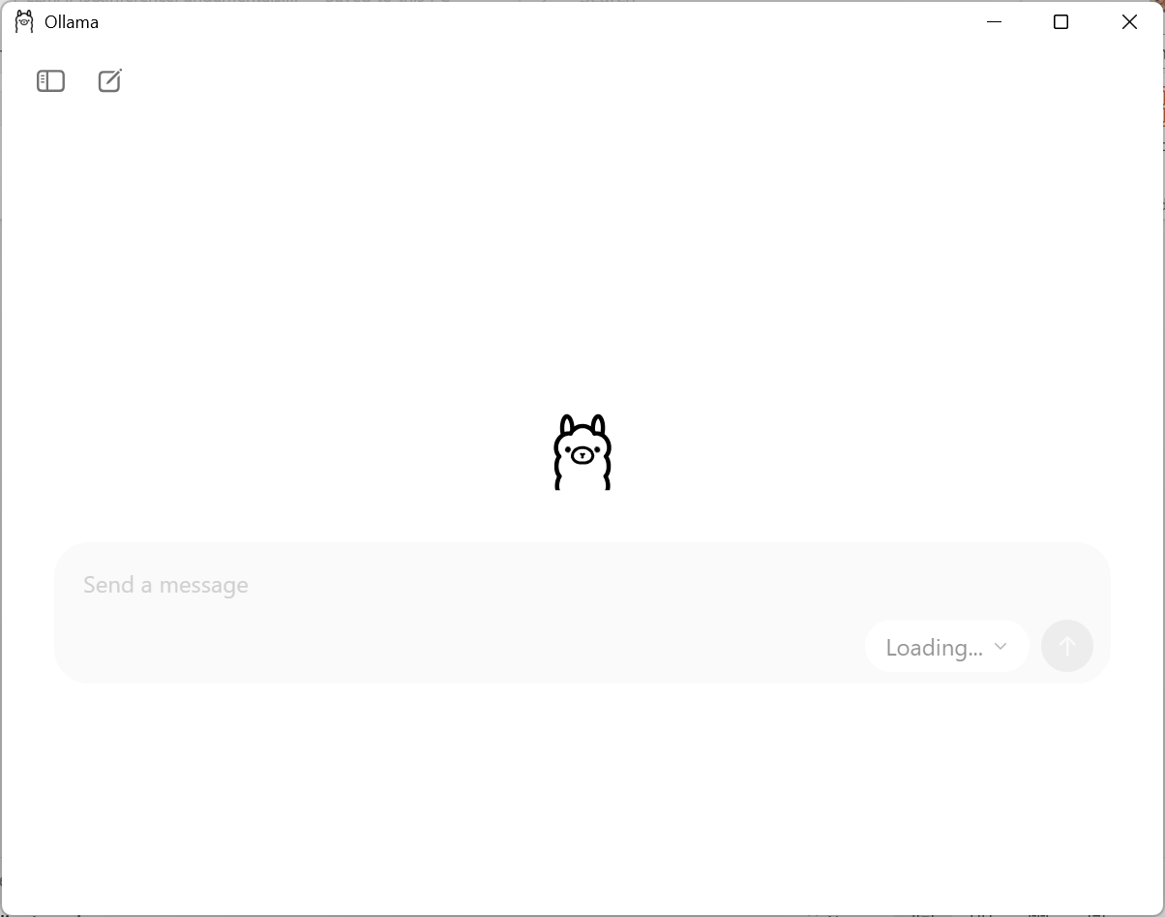

Slide 45
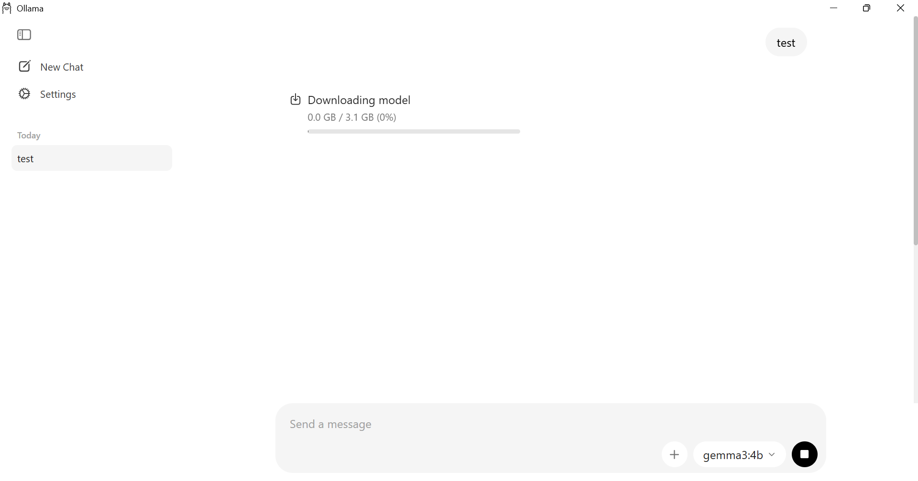

Slide 46
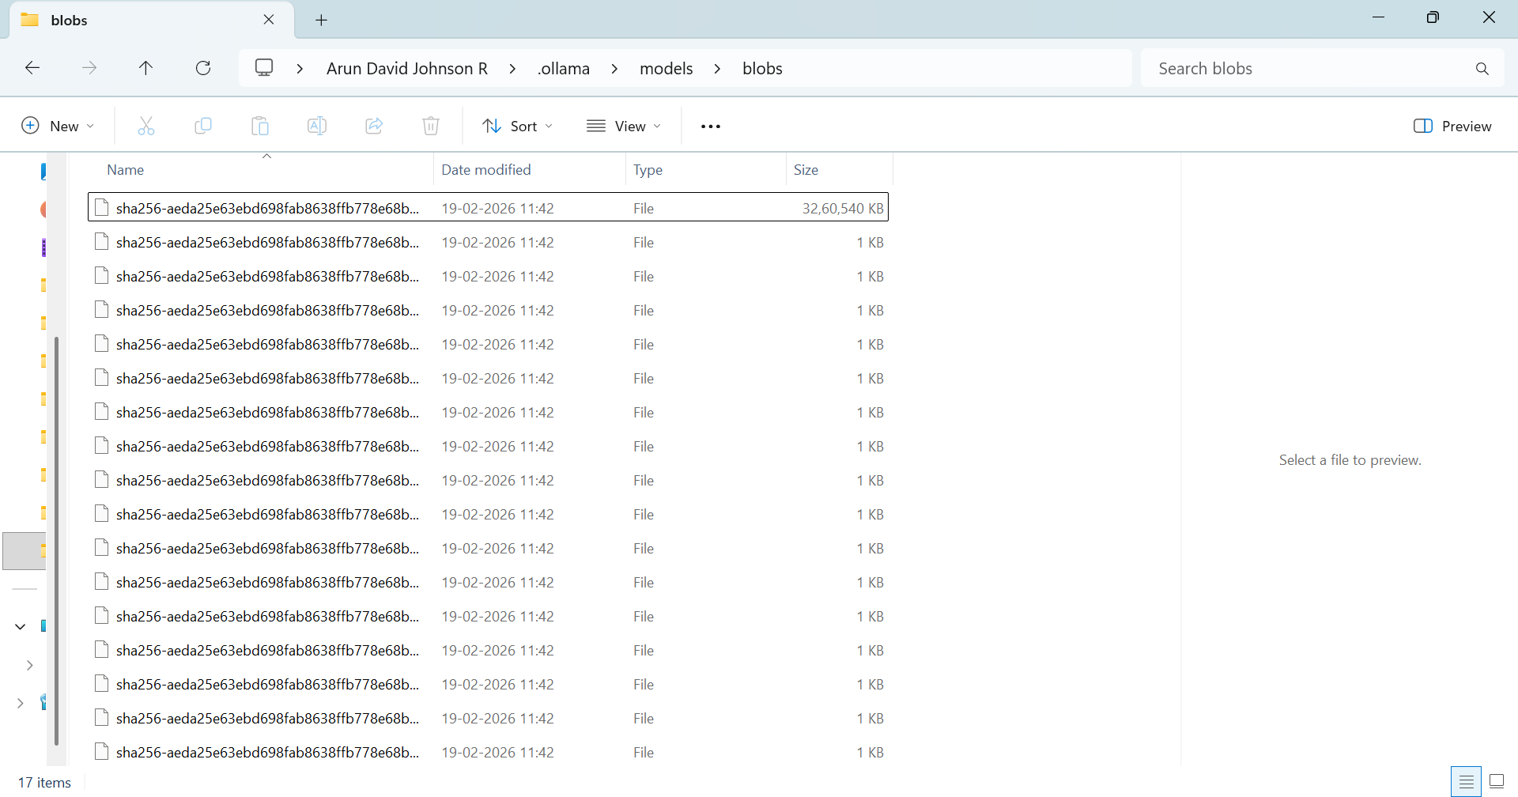

Slide 47
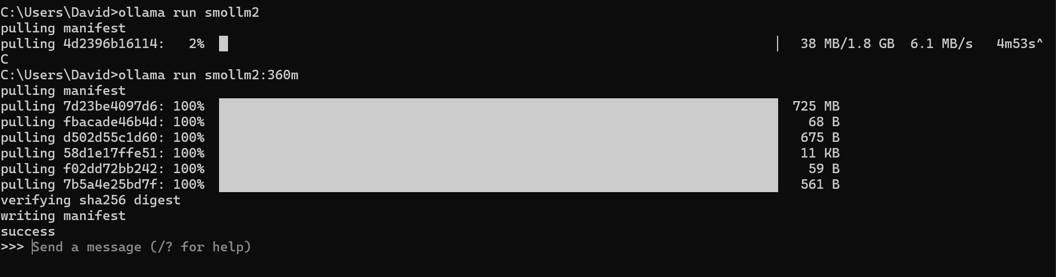

Slide 48
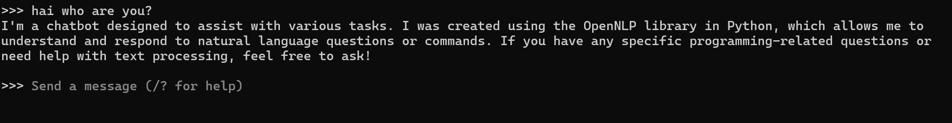

Slide 49
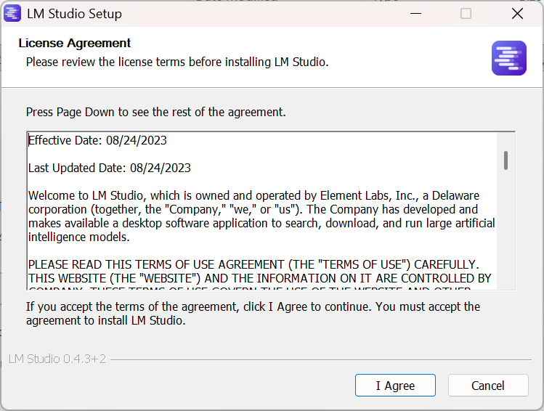

Slide 50
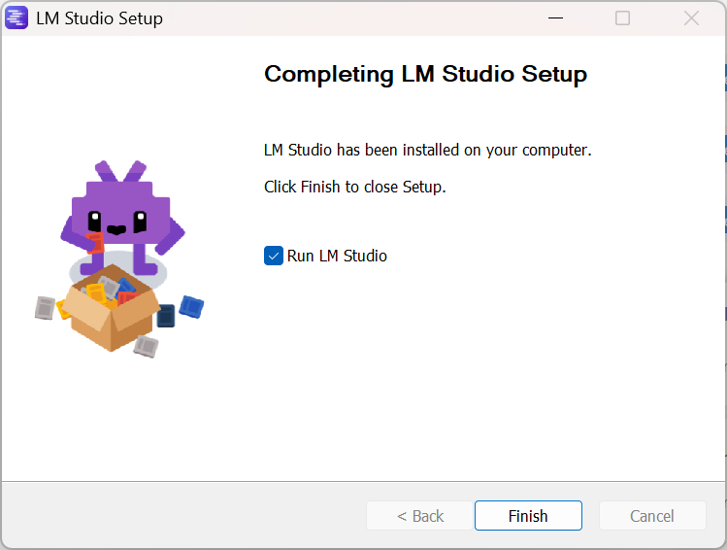

Slide 51
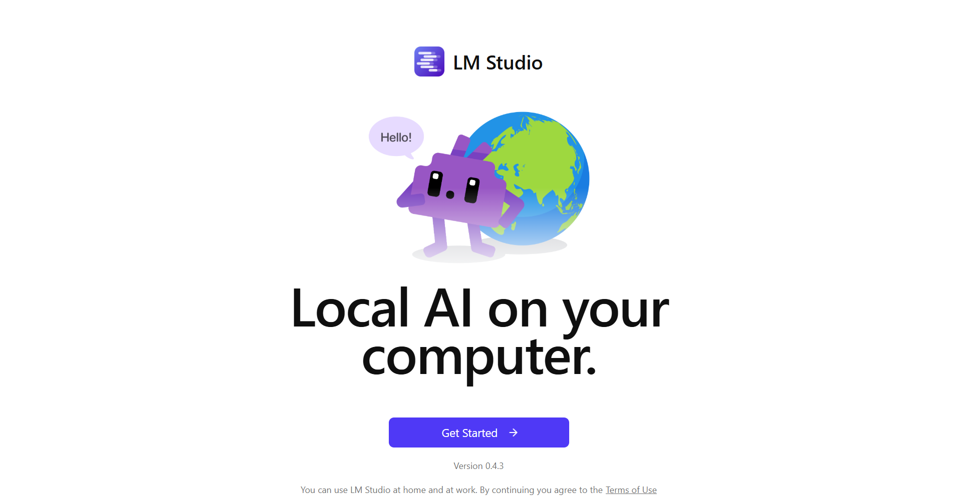

Slide 52
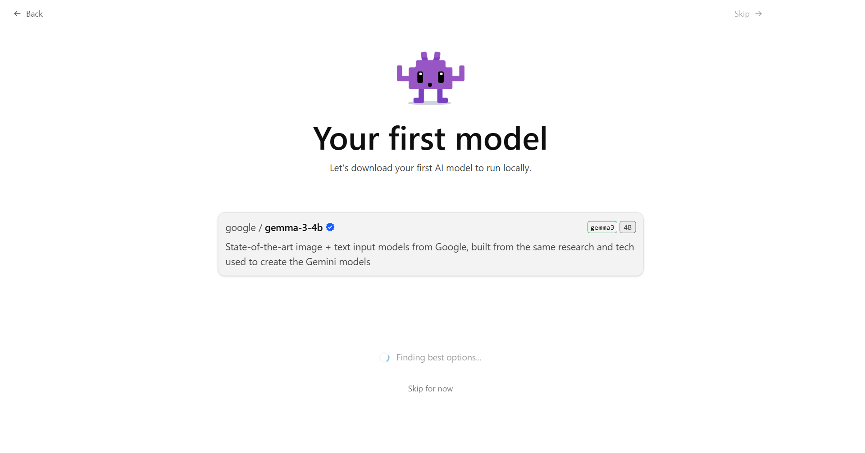

Slide 53
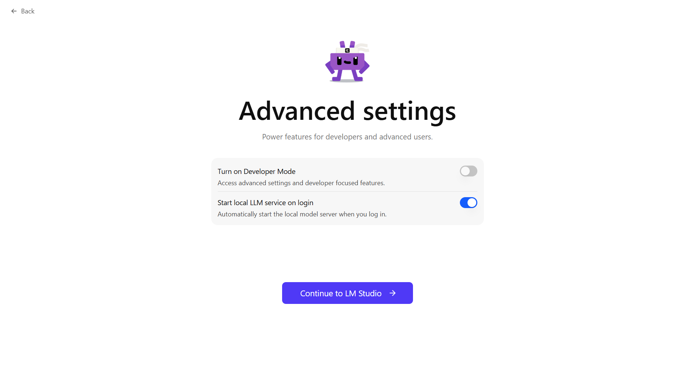

Slide 54
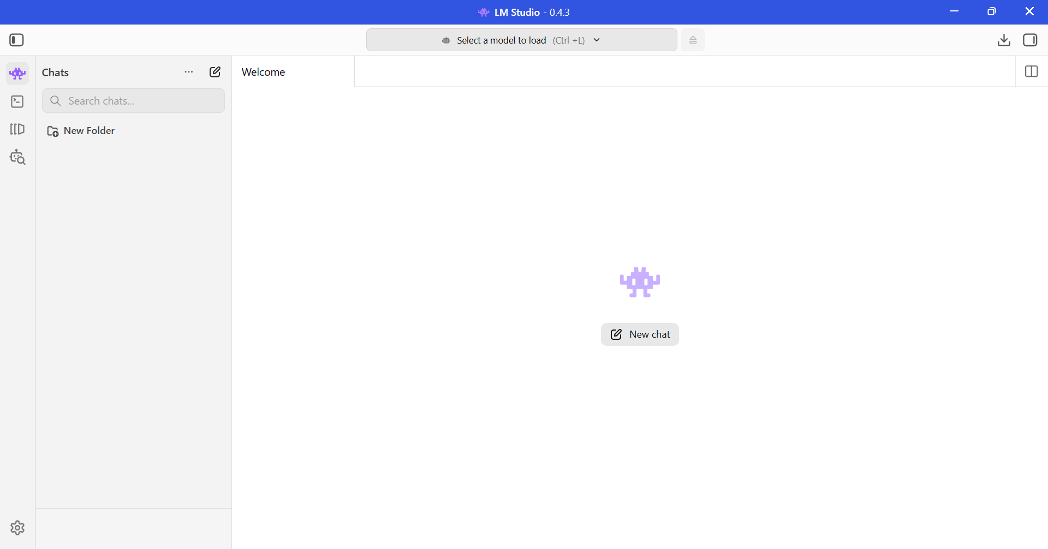

Slide 55
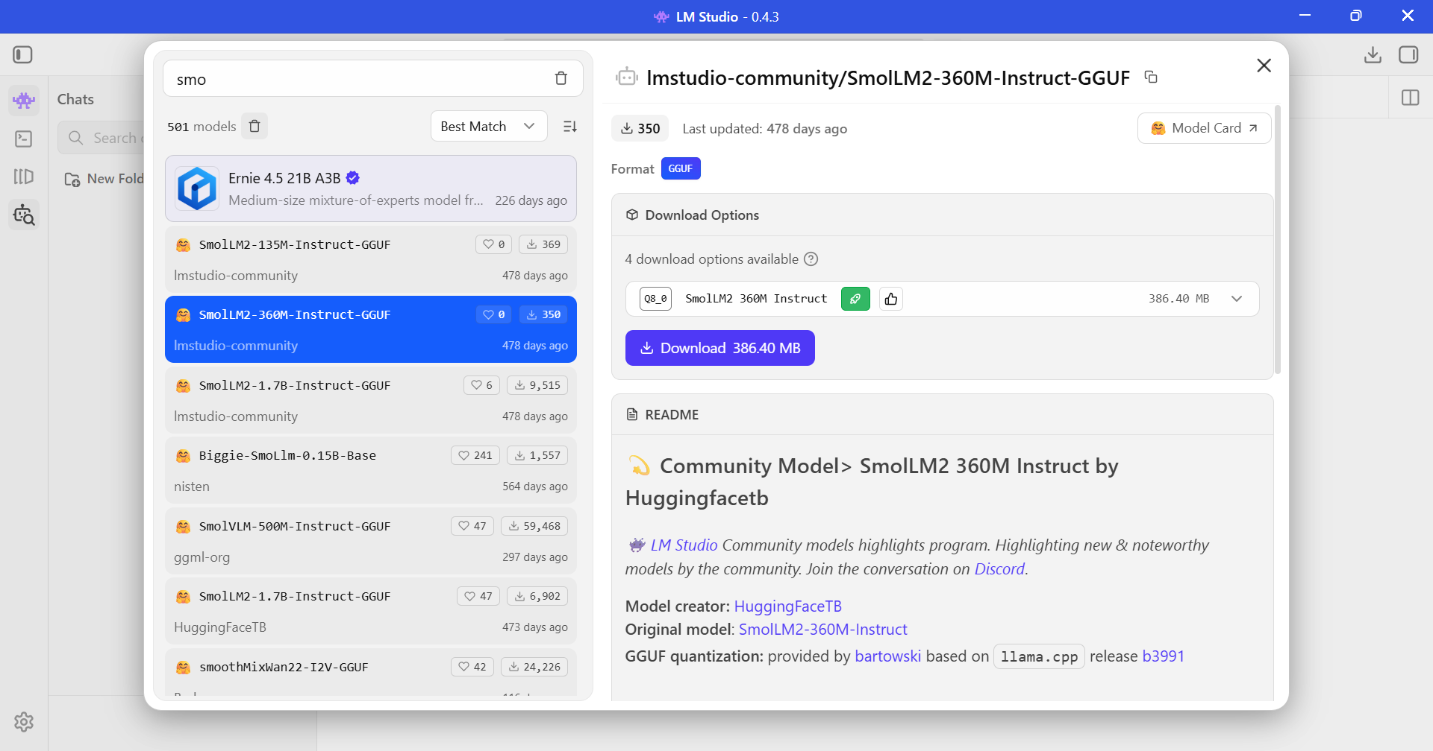

Slide 56
