Slide 1

K means Clustering
Talib Sir
AI/ML

Slide 2
K means Clustering – Introduction
K-Means Clustering is an Unsupervised Machine Learning algorithm, which groups the unlabeled dataset into different clusters. The article aims to explore the fundamentals and working of k mean clustering along with the implementation.

Slide 3
What is K-means Clustering?
Unsupervised Machine Learning is the process of teaching a computer to use unlabeled, unclassified data and enabling the algorithm to operate on that data without supervision. Without any previous data training, the machine’s job in this case is to organize unsorted data according to parallels, patterns, and variations.
K means clustering, assigns data points to one of the K clusters depending on their distance from the center of the clusters. It starts by randomly assigning the clusters centroid in the space. Then each data point assign to one of the cluster based on its distance from centroid of the cluster. After assigning each point to one of the cluster, new cluster centroids are assigned. This process runs iteratively until it finds good cluster. In the analysis we assume that number of cluster is given in advanced and we have to put points in one of the group.

Slide 4
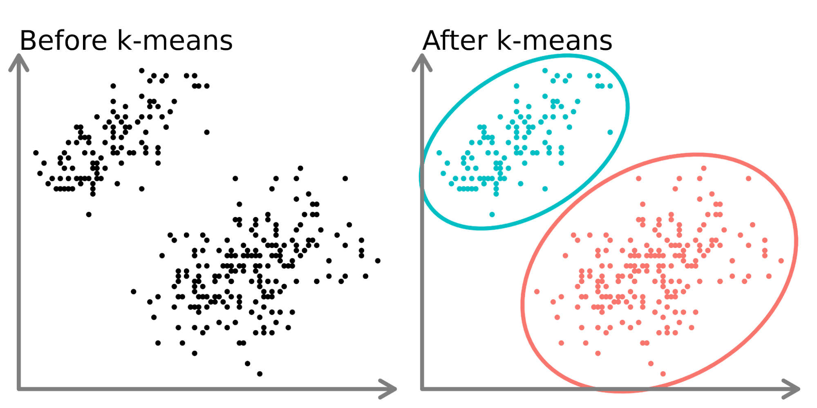
What is the objective of k-means clustering?
The goal of clustering is to divide the population or set of data points into a number of groups so that the data points within each group are more comparable to one another and different from the data points within the other groups. It is essentially a grouping of things based on how similar and different they are to one another.

Slide 5
How k-means clustering works?
We are given a data set of items, with certain features, and values for these features (like a vector). The task is to categorize those items into groups. To achieve this, we will use the K-means algorithm, an unsupervised learning algorithm. ‘K’ in the name of the algorithm represents the number of groups/clusters we want to classify our items into.
The algorithm works as follows:
First, we randomly initialize k points, called means or cluster centroids.
We categorize each item to its closest mean, and we update the mean’s coordinates, which are the averages of the items categorized in that cluster so far.
We repeat the process for a given number of iterations and at the end, we have our clusters.

Slide 6
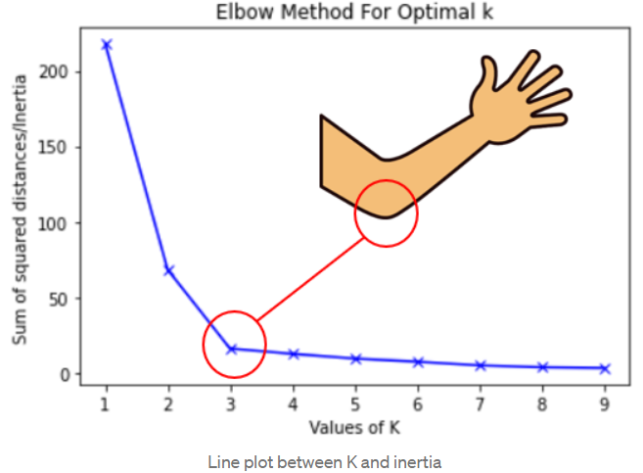
Elbow Method
The elbow method is a graphical method for finding the optimal K value in a k-means clustering algorithm. The elbow graph shows the within-cluster-sum-of-square (WCSS) values on the y-axis corresponding to the different values of K (on the x-axis)

Slide 7
Conclusion
In conclusion, K-means clustering is a powerful unsupervised machine learning algorithm for grouping unlabeled datasets. Its objective is to divide data into clusters, making similar data points part of the same group. The algorithm initializes cluster centroids and iteratively assigns data points to the nearest centroid, updating centroids based on the mean of points in each cluster.

Slide 8
Frequently Asked Questions (FAQs)
Q1. What is k-means clustering for data analysis?
Ans -K-means is a partitioning method that divides a dataset into ‘k’ distinct, non-overlapping subsets (clusters) based on similarity, aiming to minimize the variance within each cluster.
Q2.What is an example of k-means in real life?
Ans.Customer segmentation in marketing, where k-means groups customers based on purchasing behavior, allowing businesses to tailor marketing strategies for different segments.
Q3. What type of data is k-means clustering model?
Ans.K-means works well with numerical data, where the concept of distance between data points is meaningful. It’s commonly applied to continuous variables.
Q4.Is K-means used for prediction?
Ans.K-means is primarily used for clustering and grouping similar data points. It does not predict labels for new data; it assigns them to existing clusters based on similarity.
Q5.What is the objective of k-means clustering?
Ans.The objective is to partition data into ‘k’ clusters, minimizing the intra-cluster variance. It seeks to form groups where data points within each cluster are more similar to each other than to those in other clusters.

